Slide 1
EIS ANALYZER
EIS Analyzer
Emulator
STM32F303CCT6 Simulation Platform
for Electrochemical Impedance Spectroscopy
10 Hz – 100 kHz
Sweep range
Python / PyQt5 / NumPy / Matplotlib · KiCad PCB5 · Master's Thesis

Slide 2
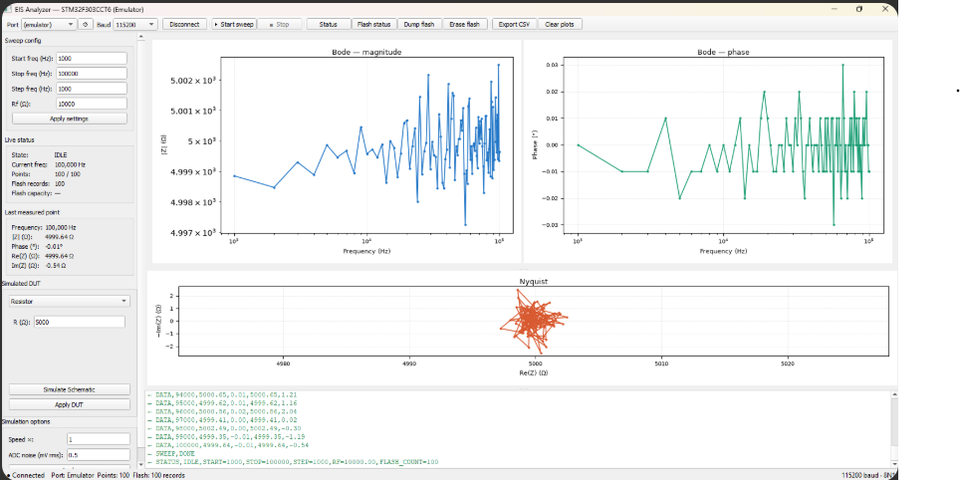

Slide 3
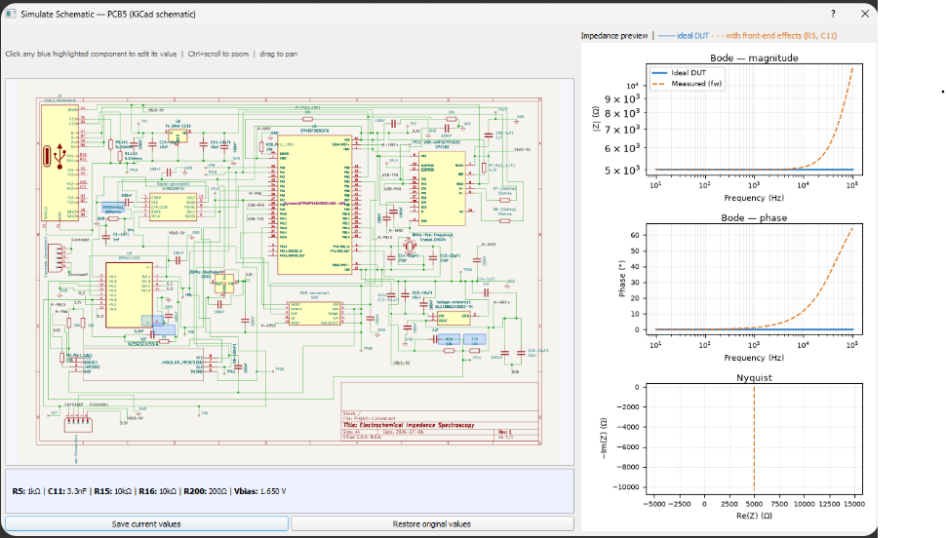

Slide 4
Simulated DUT Models
Resistor
RC Parallel
R
RC
Pure resistive element Z(f) = R (frequency-independent) Used for baseline calibration.
Resistor parallel with capacitor Z = R / (1 + jωRC) Models simple electrode response.
Randles Cell
Custom CSV
Zw
CSV
Rs + (Rct ∥ Cdl) + Warburg σ Full electrochemical interface model Parameterise Rs, Rct, Cdl, σ.
Load freq / Re(Z) / Im(Z) table Log-frequency interpolation Any measured or simulated data.

Slide 5
Toolbar Controls & UART Protocol
Button | UART Command | Description
Connect / Disconnect | (internal) | Opens the in-process SimWorker link
▶ Start sweep | START | Begins frequency sweep, clears data
■ Stop | STOP | Halts sweep; no deadlock via queue
Status | STATUS | Returns IDLE/RUNNING + config + flash count
Flash status | FLASH_STATUS | Reports flash record count vs. capacity (576 max)
Dump flash | DUMP_FLASH | Streams all stored sweep records (FLASH_DATA,...)
Erase flash | ERASE_FLASH | Clears W25Q32 flash log (confirmation required)
Export CSV | (local) | Saves current sweep to a .csv file
Clear plots | (local) | Resets all plot data and the point counter

Slide 6
PCB5 Analog Front-End — Editable Components
Ref | Value | Role in circuit | Effect of changing
R5 | 1 kΩ (Rf) | TIA feedback resistor — converts current to V | Scales |Z|; must match GUI Rf field
C11 | 3.3 nF | Feedback cap in parallel with R5 | Limits bandwidth; phase error at high f
R15 | 10 kΩ | Bias divider — VREF side (3.3 V → Vbias) | Adjusts TIA virtual ground voltage
R16 | 10 kΩ | Bias divider — GND side (Vbias → 0 V) | Vbias = 3.3×R16/(R15+R16) = 1.65 V
R200 | 200 Ω | AD9833 output series resistor (current limit) | Small impact on excitation amplitude
All values are session-only — reset to PCB5 hardware defaults when the emulator closes.

Slide 7
Summary & Distribution
Key Features
EIS_Emulator.exe
Identical PyQt5 GUI to the real STM32 hardware application
65 MB · Self-contained, no install
✓ No Python or KiCad required
5 DUT models: Resistor · RC Parallel · Randles Cell · Custom CSV
✓ Double-click to launch on any Windows PC
Full UART ASCII protocol faithfully reproduced
✓ Bundled: PyQt5 + NumPy + Matplotlib + KiCad SVG
Simulate Schematic: real KiCad PCB5 view with clickable components
Technology Stack
Live Bode magnitude, Bode phase, and Nyquist preview plots
Python 3.14 + PyInstaller 6.21
Configurable sweep speed multiplier and ADC noise level
PyQt5 (GUI + SVG rendering via QtSvg)
NumPy · Matplotlib (Qt5Agg backend)
Flash log simulation (576 records · Dump · Erase)
KiCad 8 schematic exported as A4 SVG
Queue-based threading — Stop button never causes GUI freeze
sim/selftest.py — headless validation suite

