Slide 1

Introduction to
Part 2
Notes:
Had a nice break and enjoyed yourselves so far.
moving to more complicated datatypes and concepts in programming.
Let us begin with higher level structures/containers
CC-BY Digital Skills Team at the University of Edinburgh www.ed.ac.uk/is/skills

Slide 2
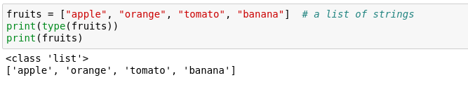
Lists
One of the most useful concepts
Group multiple variables together (a kind of container!)
Notes:
lots of data of the same type?
example, various fruits.
Can be grouped in a list
Allows us to process data as a group. Write a manipulation once, do it many times.
I.e. to find the sugar content of each fruit.

Slide 3


Indexing a list
Indexing – accessing items within a data structure
Indexing a list is not very intuitive...
The first element of a list has an index 0
Notes:
How to access?
called indexing - not very intuitive.
get a particular item using square brackets

Slide 4

Data structure sizes
Make sure you are always aware of the sizes of each variable!
This can easily be done using the len() function.
It returns the length/size of any data structure

Slide 5

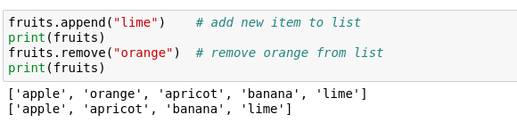
Is a tomato really a fruit?
Furthermore, we can modify lists in various ways
Notes:
serious questions! Is a tomato really a fruit?
Change it
Index item and change its values
we can also add/remove
Done using methods

Slide 6
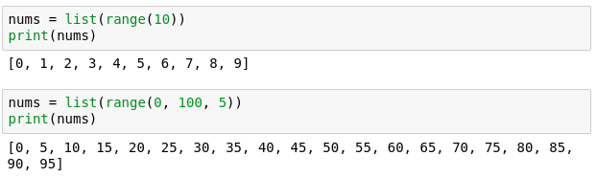
Lists with integers
range() - a function that generates a sequence of numbers as a list
Notes:
something more useful
Can we generate a list of numbers easily?
Yes, using the built in func. Range()
This is useful for generating plots for example.
Let us look at how we can make something with it

Slide 7
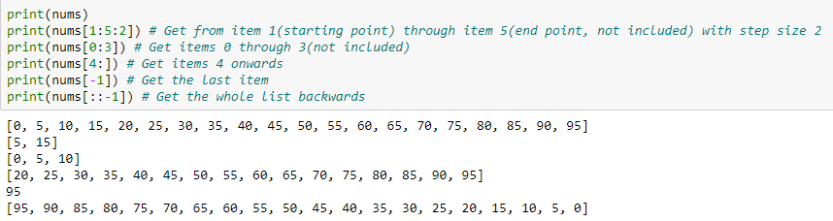
Slicing lists
Slicing – obtain a particular set of sub-elements from a data structure.
Very useful and flexible.
Notes:
Accessing lists in different ways is CRUICIAL to using arrays!
Many possibilities
Some examples

Slide 8

Lists can be of different types
Not very useful, but possible

Slide 9
Mutability
Mutable object – can be changed after creation.
Immutable object - can NOT be changed after creation.

Slide 10
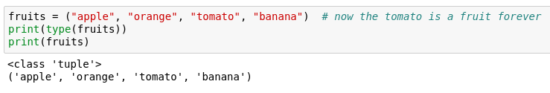
Tuples
Effectively lists that are immutable (I.e. can't be changed)
Notes:
tuple – an immutable list
look at initial example – tomato always a fruit now
try changing it; example in your notebooks.

Slide 11
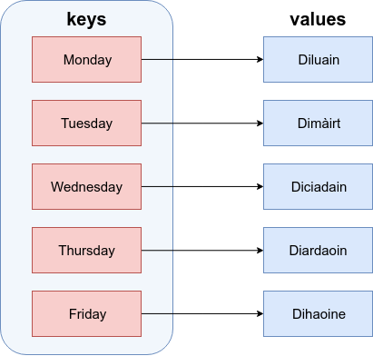
Dictionaries
Language Dictionary:
Similar to actual dictionaries
They are effectively 2 lists combined – keys and values
We use the keys to access the values instead of indexing them like a list
Each value is mapped to a unique key
Days of the week in English
Days of the week in Scottish Gaelic
Notes:
similar to actual dictionaries.
effectively 2 lists combined - keys and values
Example - days of the week in Gaelic mapped to their English translations

Slide 12

Dictionary definition
Defined as comma separated key : value pairs:
Comma separated
Curly brackets
Notes:
Note curly brackets and colons

Slide 13
Dictionary properties
Values are mapped to a key
Values are accessed by their key
Key are unique and are immutable
Values cannot exist without a key

Slide 14
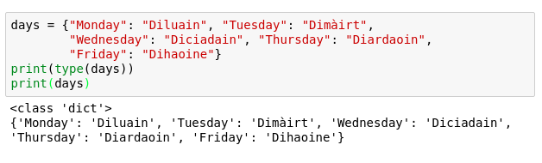
Dictionaries
Let us define the one from the previous image

Slide 15

Accessing a dictionary
Values are accessed by their keys (just like a dictionary)
Note that they can't be indexed like a list
Notes:
Give example of how you access a dictionary in real life.
Say we want to look up the Gaelic translation of Friday?

Slide 16
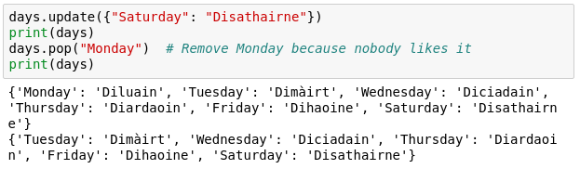
Altering a dictionary
Can be done via the dictionary methods
Notes:
Note that they are not the same as for lists for obvious reasons
We are not going to go over all methods for dicts
You can find them using the dir('dict')
Or simply by googling afterwards

Slide 17
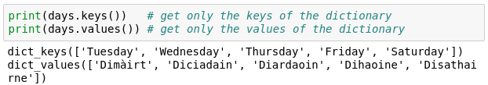
Keys and Values
It is possible to obtain only the keys or values of a dictionary.
This is useful for iteration.

Slide 18
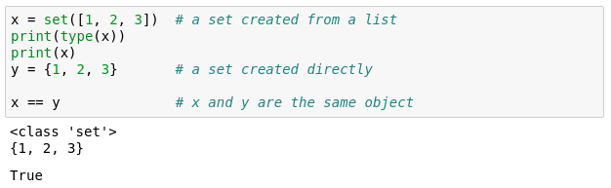
Sets
Effectively lists that can't contain duplicate items
Similar functionality to lists
Can't be indexed or sliced
Can be created with {} or you can convert a list to a set
Notes:
Essentially a list of unique items

Slide 19

If Else
Fundamental building block of software
Conditional statement
Executed if answer is True
Executed if answer is False
Notes:
ask very politely "Do you really want to close me", answers Yes and No that is essentially a if-else block.
press Yes the program closes else, you press no and the program continues.
All programs build on if-else blocks, a lot of if-else blocks
The expression in the brackets after the if is the boolean evaluation expression.
If True, execute the code between if and else, if False execute code after else.

Slide 20
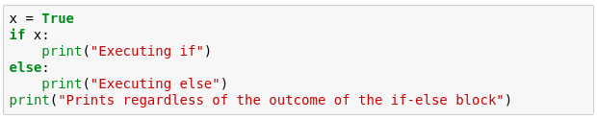
If Else example
Try running the example below.
What do you get?
Notes:
Here is an example that is also included in your notebooks
Go through the example
noticed that the first 2 print statements don't have the same indentation level

Slide 21
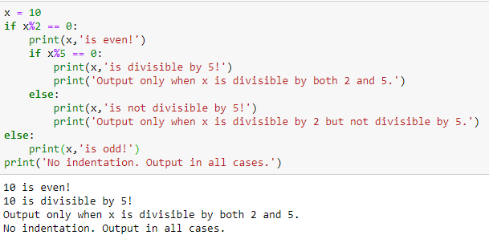
Indentation matters!
Code is grouped by its indentation
Indentation is the number of whitespace or tab characters before the code.
If you put code in the wrong block then you will get unexpected behaviour
Notes:
What is indentation? amount of whitespace or tab characters in front of your code.
important in Python because it groups blocks of code together

Slide 22
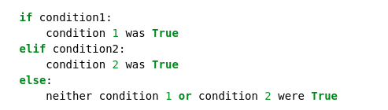
Extending if-else blocks
We can add infinitely more if statements using elif
elif = else + if which means that the previous statements must be false for the current one to evaluate to true
Notes:
extend if block to many different conditions.
done with the elif
previous statements have been false and the current condition is true then execute the current elif block.
Relevant bitcoin example in your code.

Slide 23

For loop
Allows us to iterate over a set amount of variables within a data structure. During that we can manipulate each item however we want
Again, indentation is important here!
Notes:
lists and others are useful when loops
Loops allow us to iterate over containers
For loops are the more controllable
Code explanation
Item is a subset of itemList

Slide 24
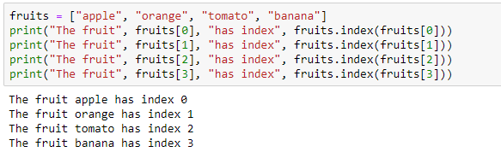
Example
Say we want to go over a list and print each item along with its index
What if we have much more than 4 items in the list, say, 1000?
Notes:
We have 4 copy pasted lines
What if we have more items?
Can we use for?

Slide 25
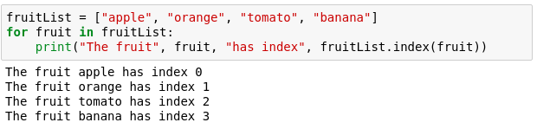
For example
Now with a for loop
Saves us writing more lines
Doesn't limit us in term of size
Notes:
Saves us a few lines of writing
Allows us to not care about size of the list

Slide 26
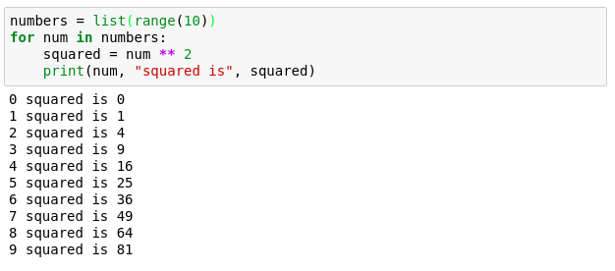
Numerical for loop
Notes:
more useful usage of the for loop.
iterate over 0 to 9 and find the squares

Slide 27
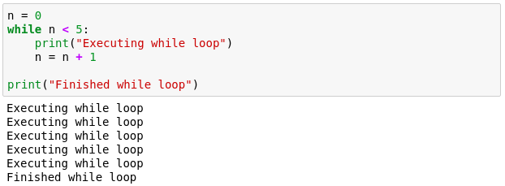
While loop
Another useful loop. Similar to the for loop.
A while loop doesn't run for a predefined number of iterations, like a for loop. Instead, it stops as soon as a given condition becomes true/false.
Notes:
While less controllable than for
Manual control inside.
We must tell it when to stop
While loop that executes 5 times

Slide 28
Break statement
Allows us to go(break) out of a loop preliminary.
Adds a bit of controllability to a while loop.
Usually used with an if.
Can also be used in a for loop.
Notes:
We can also get out of a while whenever we want with break.
Usually used with an if statement
Redo last example
Can also be used in for loops

Slide 29
Functions
Allow us to package functionality in a nice and readable way
reuse it without writing it again
Make code modular and readable
Rule of thumb - if you are planning on using very similar code more than once, it may be worthwhile writing it as a reusable function.
Notes:
Print() is actually a function that we have been using

Slide 30
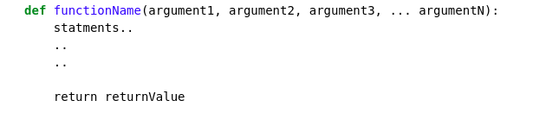
Function declaration
keyword
Any number of arguments
Indent the body of the function!!!
[Optional] Exits the function and returns some value
Functions accept arguments and execute a piece of code
Often they also return values (the result of their code)
Notes:
Go through the declaration

Slide 31
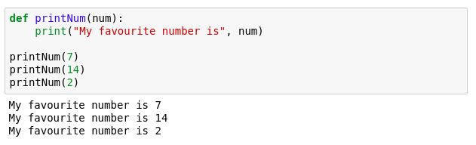
Function example
Notes:
Quick print statement

Slide 32
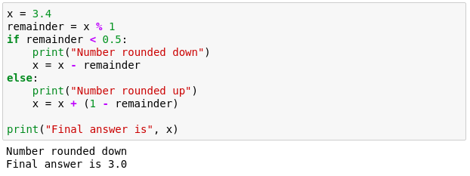
Function example 2
We want to make a program that rounds numbers up or down.
Try to pack the following into a function.
Notes:
more complex problem - rounding a number.
nice an desirable functionality
How can we bundle it and reuse it?

Slide 33
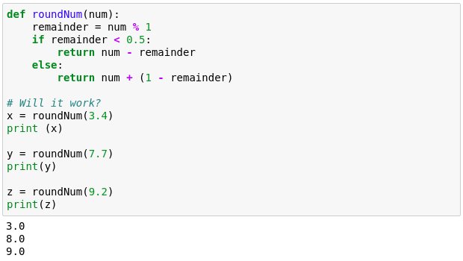
Function example 2
Notes:
Multiline indentation

Slide 34
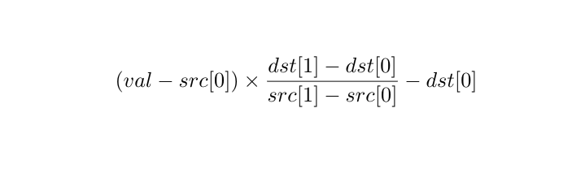
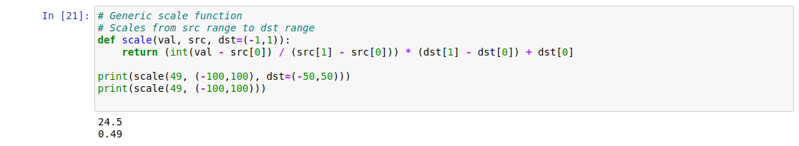
Function example 3
Notes:
Default argument value

Slide 35

Functions: 2 types of arguments
Position Arguments:
Mandatory to supply values when calling the function
Keyword Arguments:
Optional to supply values when calling the function
If not supplied, then default value is taken
Always supplied at the end
Notes:
Default argument value

Slide 36
Python’s Modules

Slide 37
What are modules?
Definitions of functions and variables are not saved when interpreter is exited
Modules allow definitions to be saved for later access
Modules also allow statements to be run as executable scripts
Modules are files with .py extension

Slide 38
Importing modules
Modules are imported by using built-in import command, without the .py extension
import example
To make access easier, individual definitions within a module may be imported
from function import func1, func2
When modules are imported, all statements and definitions will be executed

Slide 39
Accessing module components
To use functions defined in module, type module name followed by dot
example.func(3)
If function in module was imported individually with from, the module name and the dot may be excluded
func(3)

Slide 40
Module search path
Interpreter looks for all imported modules in certain designated places, in the following order, until the module is found:
Current directory
The list of directories in PYTHONPATH environment variable
Installation-dependent default path

Slide 41
Standard modules
There is a standard library of Python modules
These modules contain built-in operations that are not actually a part of Python at its core
Some modules are only imported if a certain operating system is being used
One important library module is called the “math module”
Python has a built-in math module

Slide 42
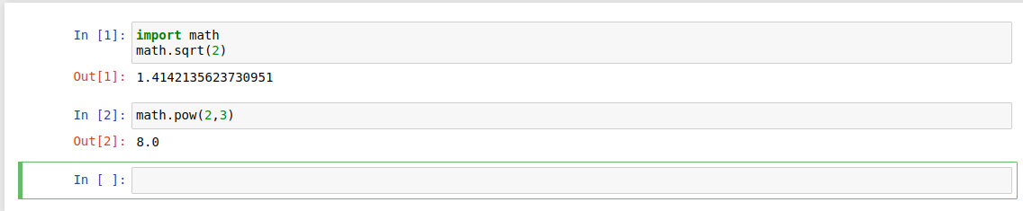
Example: The math module
Two functions contained in math, sqrt and pow, allow for the calculation of square roots and powers

Slide 43
Example: The math module
To check out all the functions and variables in the math module, run
>>> import math
>>> dir(math)
['__doc__', '__file__', '__loader__', '__name__', '__package__', '__spec__', 'acos', 'acosh', 'asin', 'asinh', 'atan', 'atan2', 'atanh', 'cbrt', 'ceil', 'comb', 'copysign', 'cos', 'cosh', 'degrees', 'dist', 'e', 'erf', 'erfc', 'exp', 'exp2', 'expm1', 'fabs', 'factorial', 'floor', 'fmod', 'frexp', 'fsum', 'gamma', 'gcd', 'hypot', 'inf', 'isclose', 'isfinite', 'isinf', 'isnan', 'isqrt', 'lcm', 'ldexp', 'lgamma', 'log', 'log10', 'log1p', 'log2', 'modf', 'nan', 'nextafter', 'perm', 'pi', 'pow', 'prod', 'radians', 'remainder', 'sin', 'sinh', 'sqrt', 'tan', 'tanh', 'tau', 'trunc', 'ulp']
>>> math.pi # Print value of pi
3.141592653589793

Slide 44
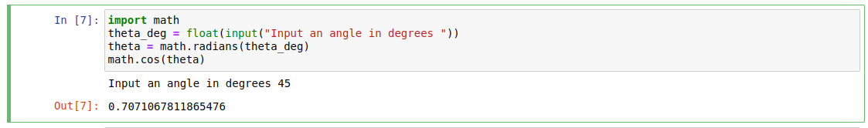
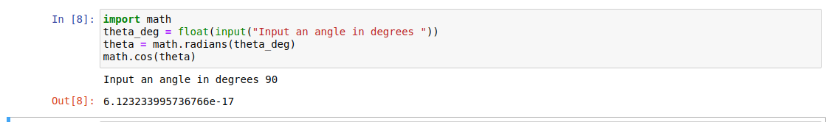
Example: The math module

Slide 45
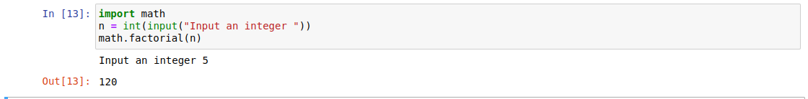
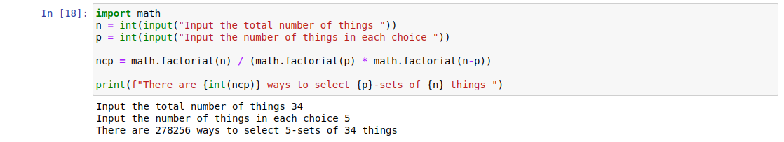
Example: The math module

