Slide 1
1. Studied Dataset for the color classification

Slide 2
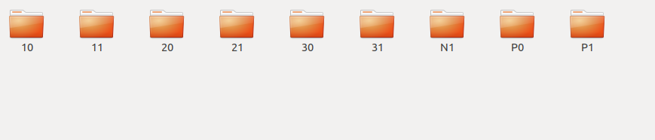
Sorting of dataset

Slide 3
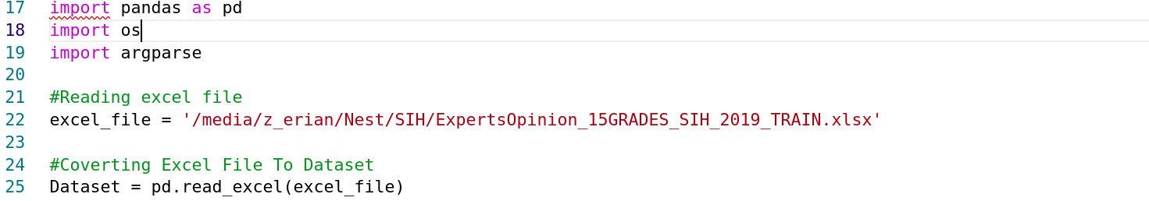
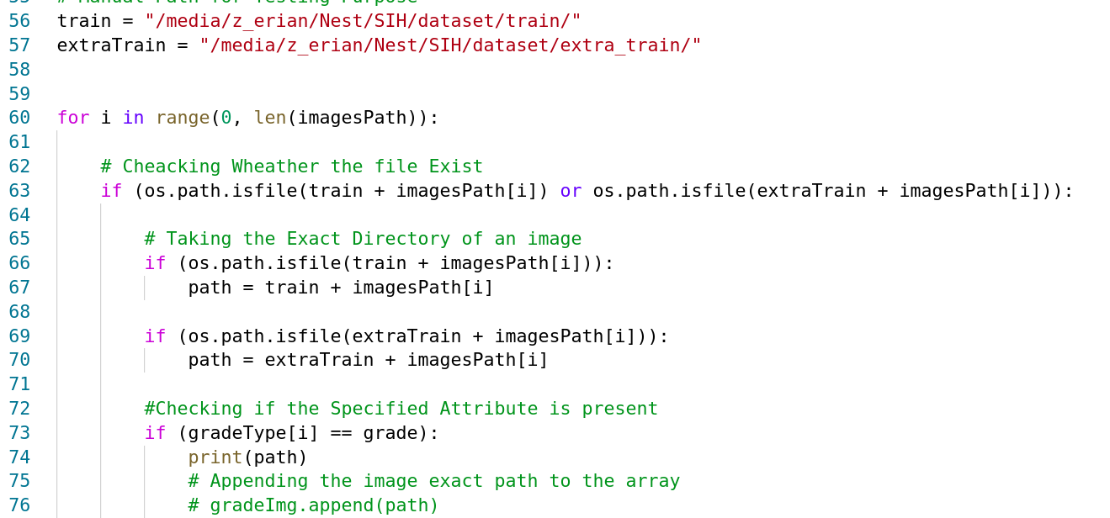
Data filtering and Automation

Slide 4
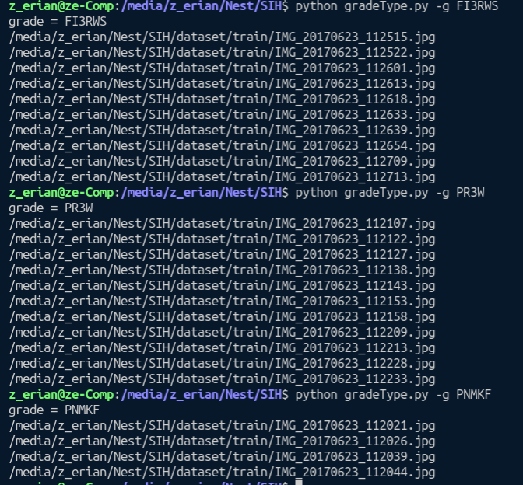

Slide 5
2. Color feature extraction:
Mean of all channels
Intensity
Mode
Standard Deviation
Variance
Skewness
Kurtosis
Histogram comparison
Color Segmentation

Slide 6
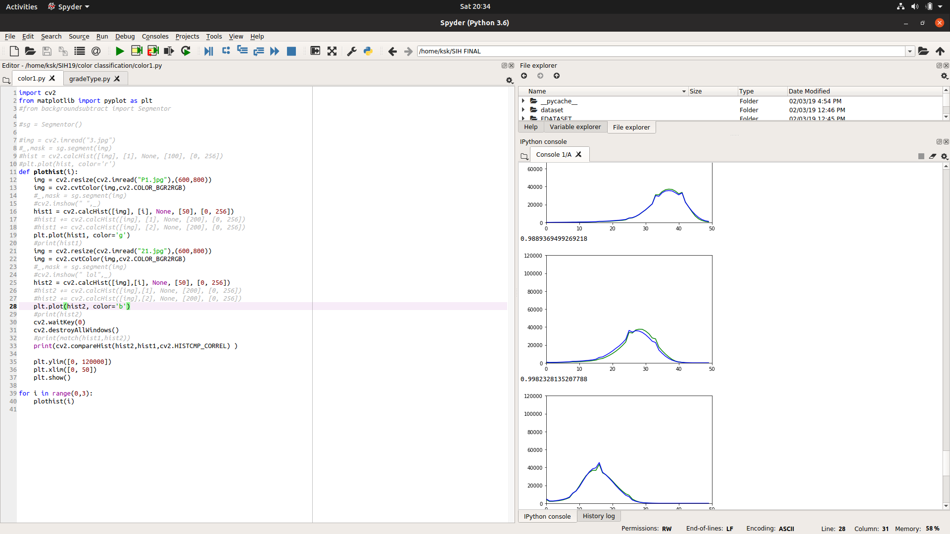
Histograms

Slide 7
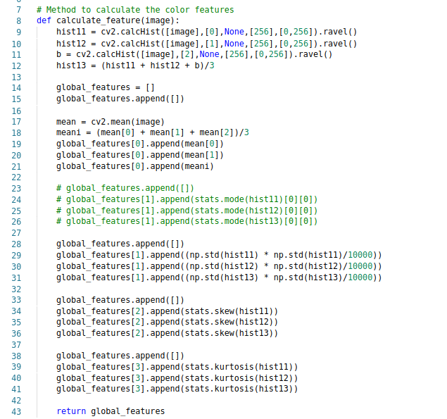
7 features

Slide 8
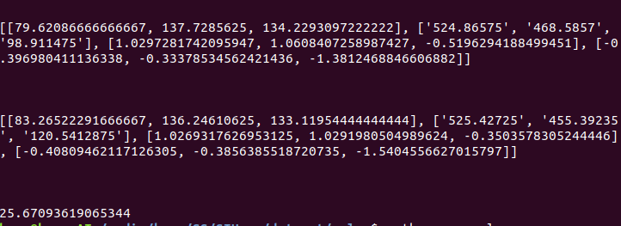
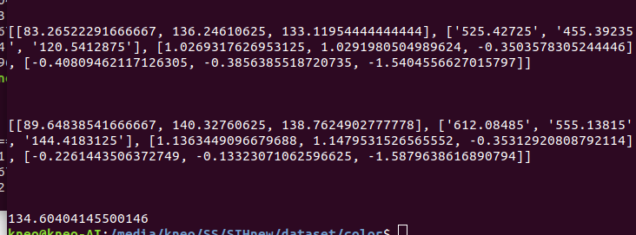
Different classes
Same classes

Slide 9
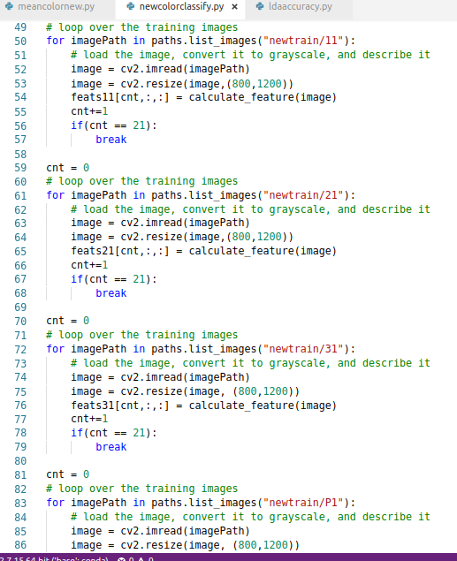
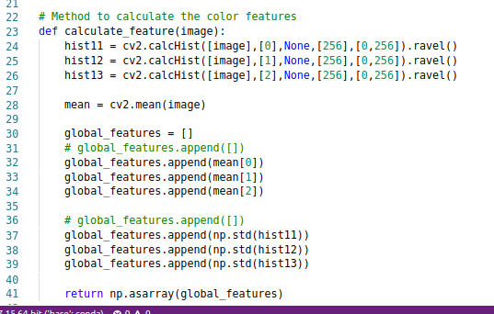
Mean And Standard Deviation with Euclidean distance

Slide 10
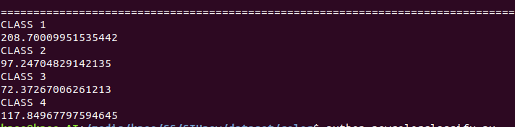

Slide 11
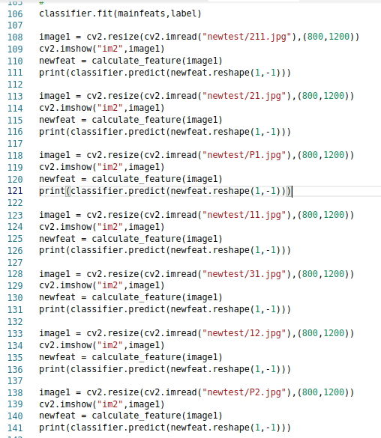
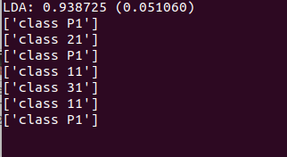
LDA classifier

Slide 12
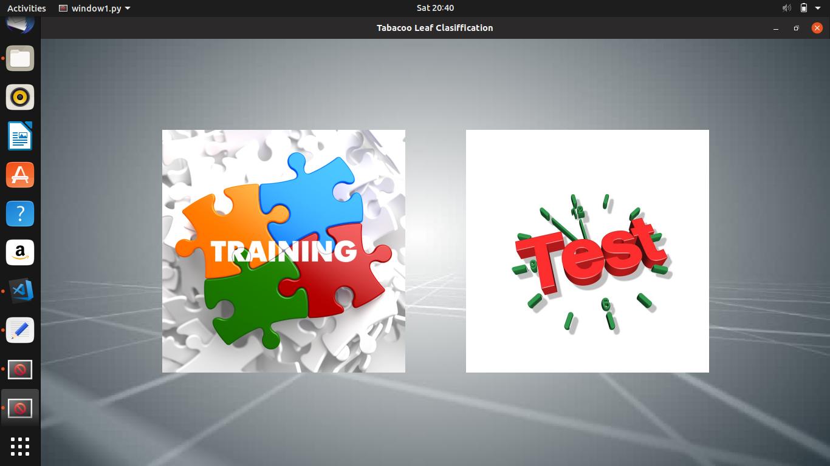
4. User Interface

Slide 13
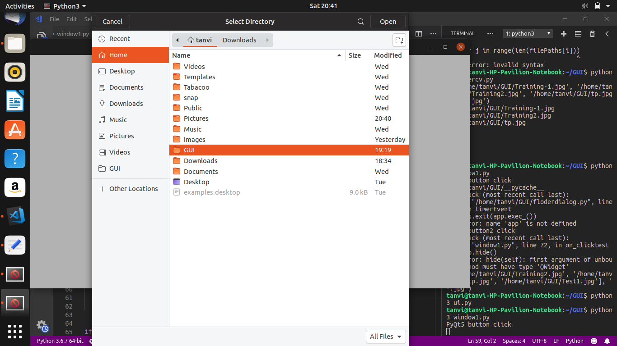
4. User Interface

Slide 14
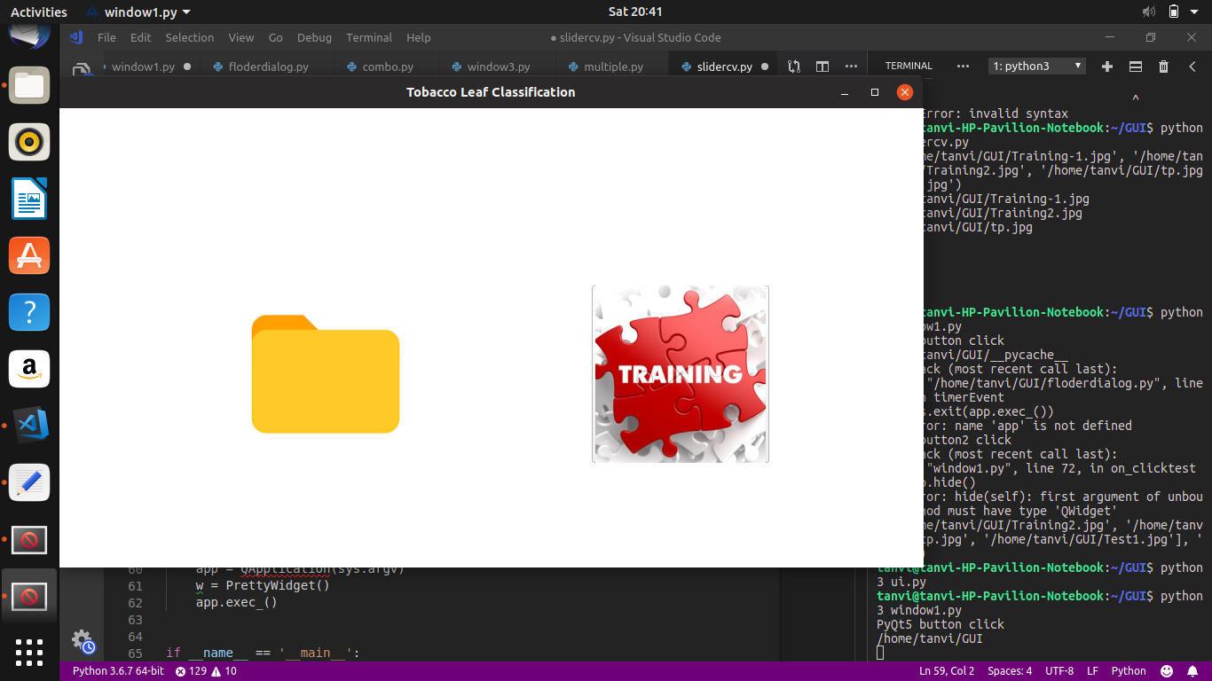
4. User Interface

Slide 15
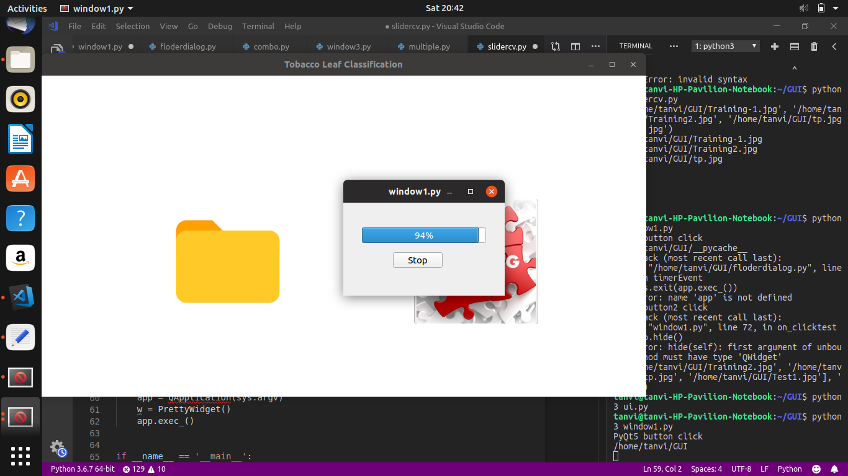
4. User Interface

Slide 16
4. User Interface

Slide 17
FURTHER STRATEGIES – TEXTURE CLASSIFICSTION USING LBP AND GABOR FILTERS

