Slide 1


Slide 2

Community Skill Exchange Platform

Slide 3
Group Members Introduction
Name: Muhammadullah
VU ID: BC210408700
This is me Muhammadullah, I’m student of Virtual University of Pakistan. I belong to district Swat.

Slide 4

INTRODUCTION OF PROJECT
Community Skills Exchange Platform, a web-based system that enables individuals
to exchange skills through a time/skill bartering model.
Many people have valuable skills but can't afford paid services they need
No structured platform exists for direct skill-for-skill bartering
Traditional learning platforms require money, creating access barriers

Slide 5
Our Solution
A web-based bartering platform where skills are the currency
Users teach what they know and learn what they want — no money involved
Trust built through transparent ratings and reviews

Slide 6
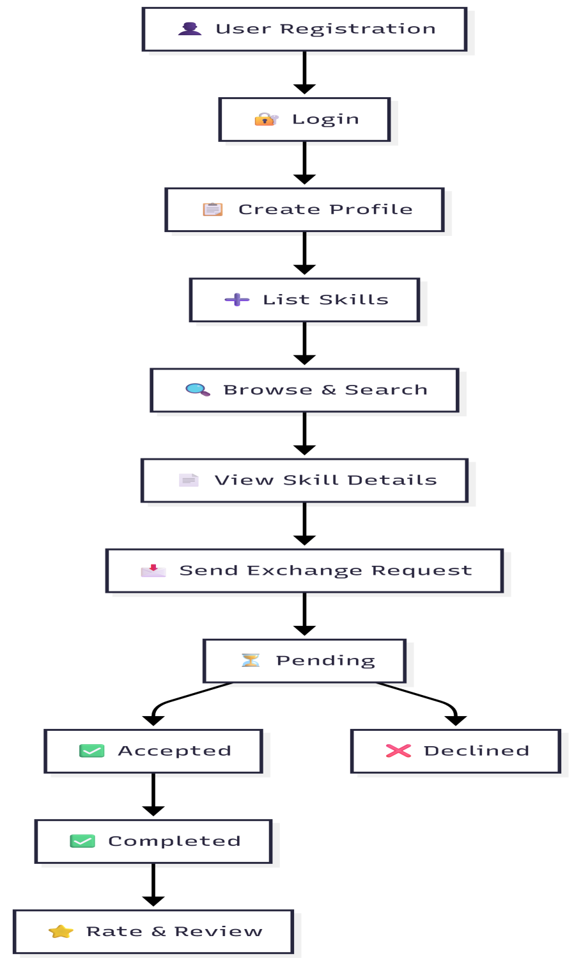
Diagram of Process Model
Complete Flow

Slide 7
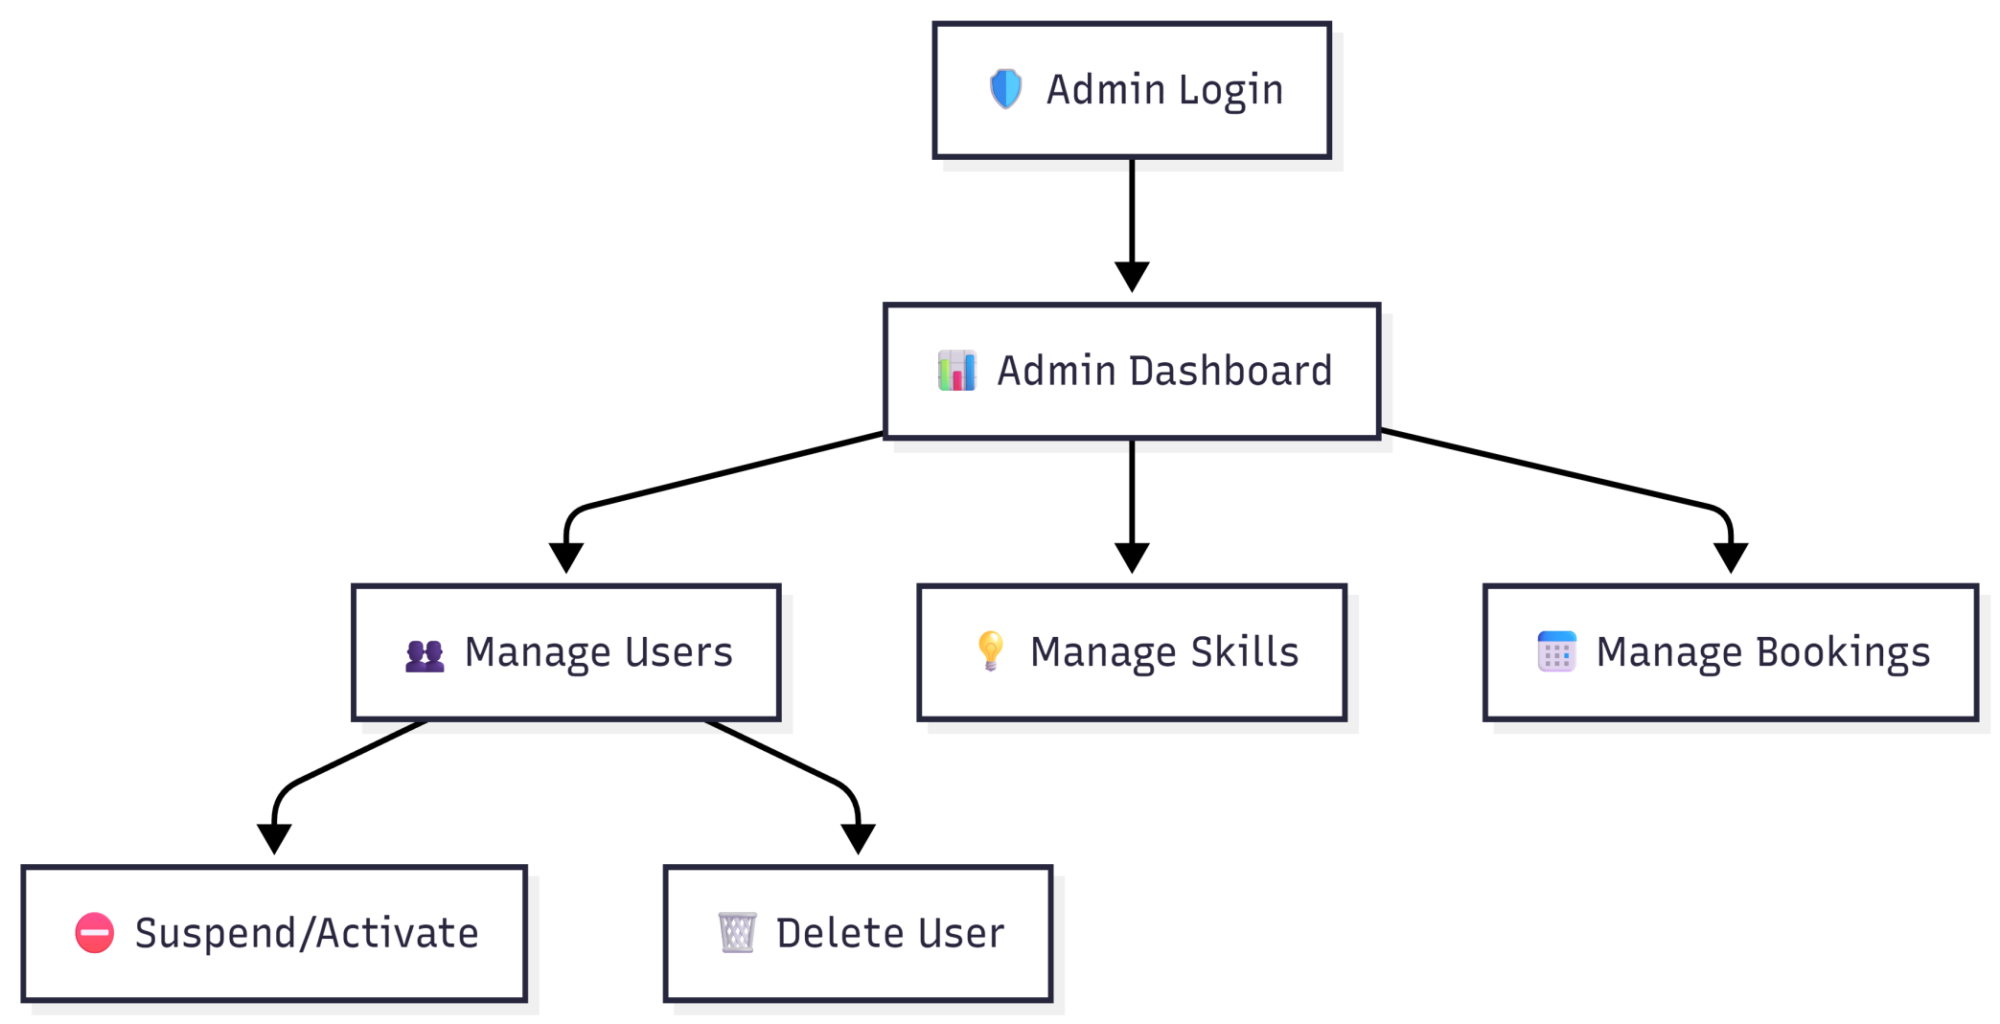
Diagram of Process Model
Admin Flow

Slide 8
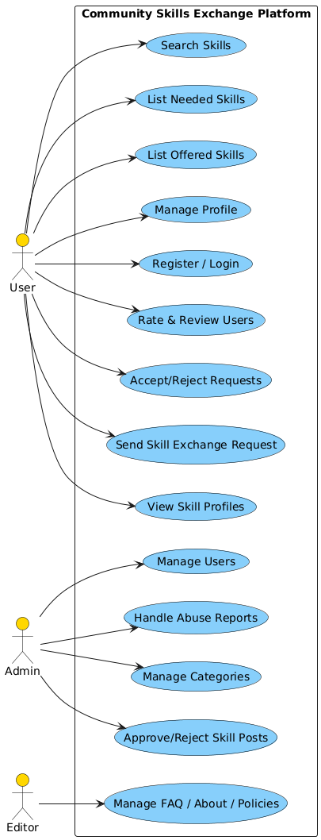
Use Case Diagram

Slide 9
Business Rules Catalog
User & Profile
Unique email and username required for registration
Minimum 8-character password
Email cannot be changed after registration
Avatar max 5MB, must be appropriate
One account per email address
Skill Listing
Skills must have title, category, and description
Must be classified as "Offering" or "Requesting"
Cannot list illegal or licensed professional services
Exchange & Booking
One request per skill per user (prevents spam)
Users cannot request their own skills
Status flow: Pending → Accepted/Declined → Completed
No monetary transactions allowed
Only skill owner can accept, decline, or mark complete

Slide 10
Business Rules Catalog
Account Status
Suspended users cannot login or accept requests
Only admins can suspend/activate accounts
Admin Controls
Only Admin role can access admin panel
Admins can delete skills, bookings, reviews
Admins can change user roles and manage suspensions
At least one admin must exist at all times
Notifications
Emails sent for: New Request, Accepted, Completed
Transactional emails cannot be opted out
Platform Rules
Harassment = immediate suspension
Spam and commercial ads prohibited
Minimum age: 13 years

Slide 11
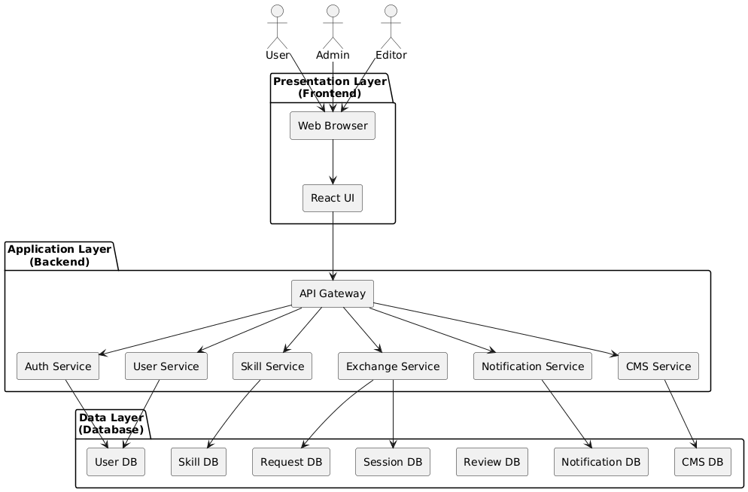
Architectural Design

Slide 12
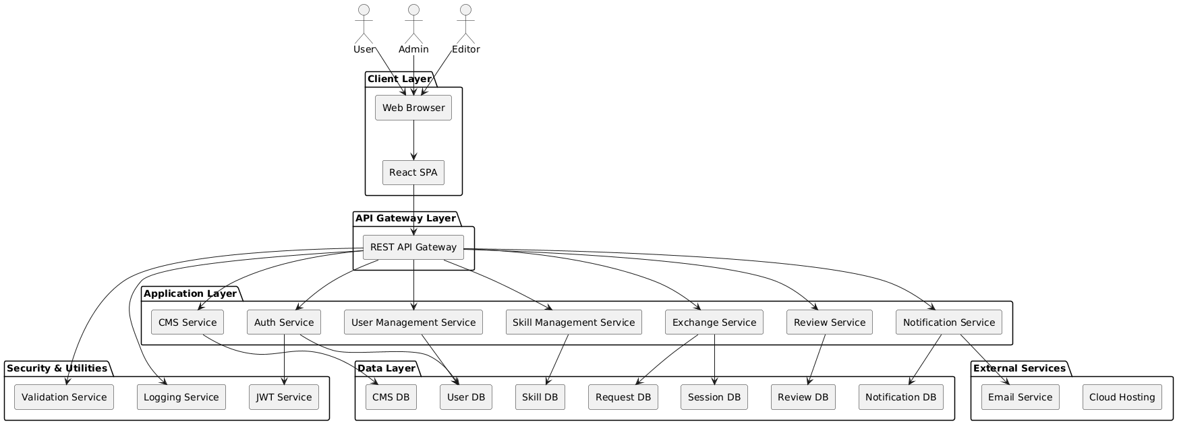
Architectural Design

Slide 13
Team Structure
Dear sir, there is no team involved in making this web application.
This web application is built only by me having
VU ID: BC210408700 and name is Muhammadullah.
There is no team/group involved at all.

Slide 14
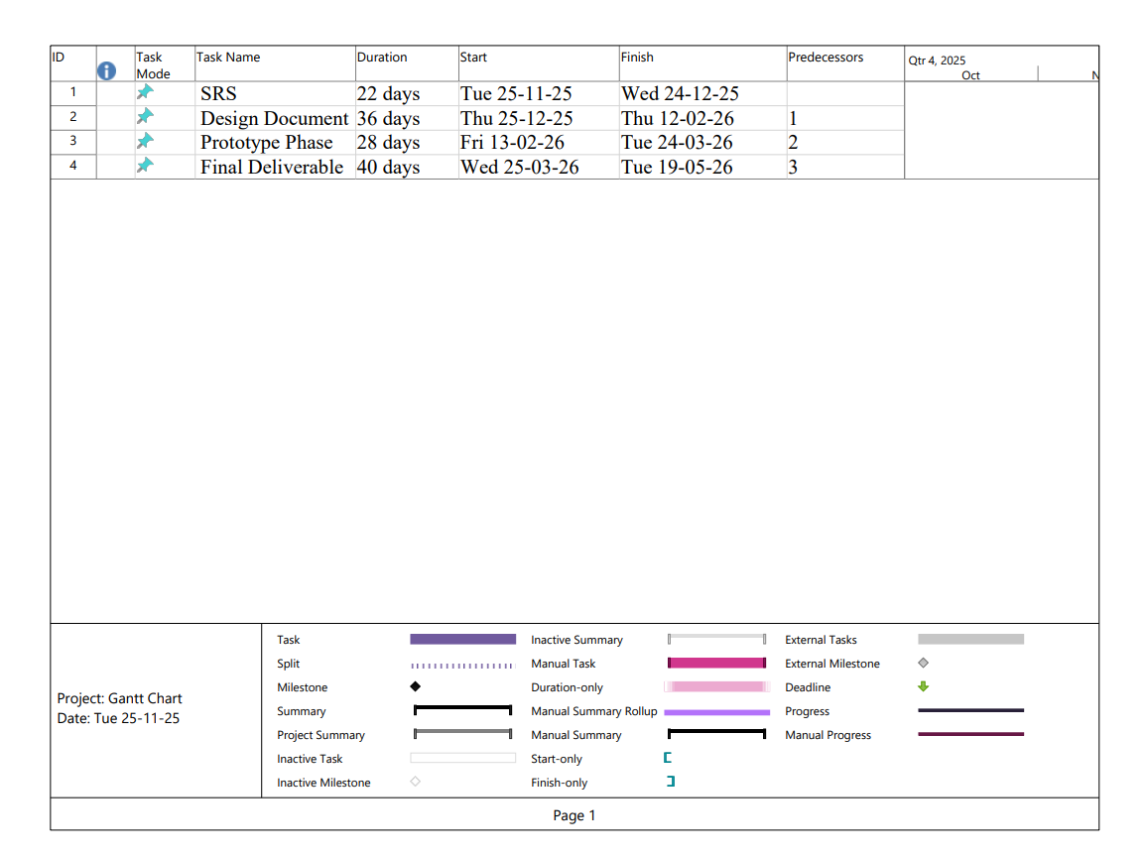
Project Schedule

Slide 15
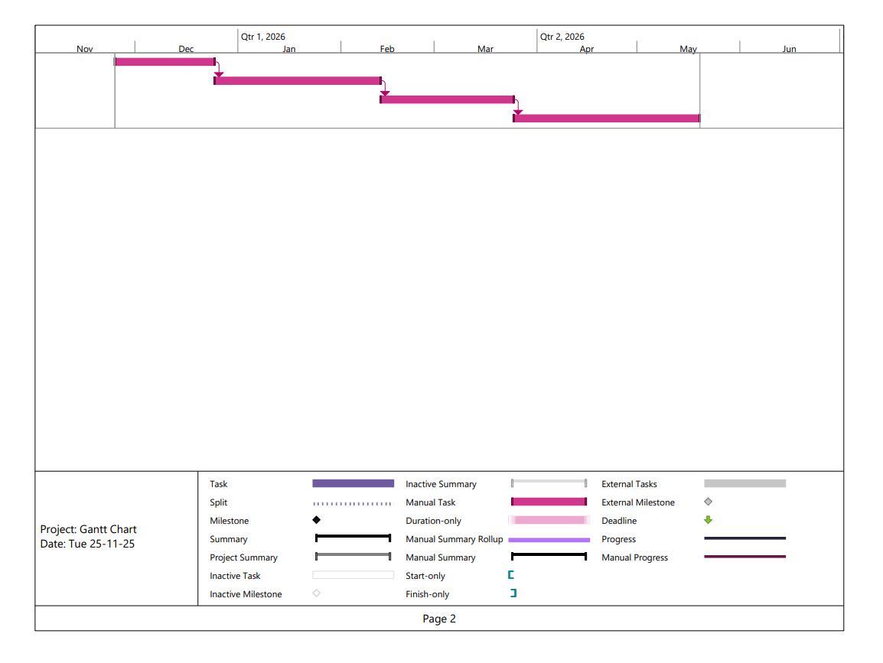
Project Schedule

Slide 16
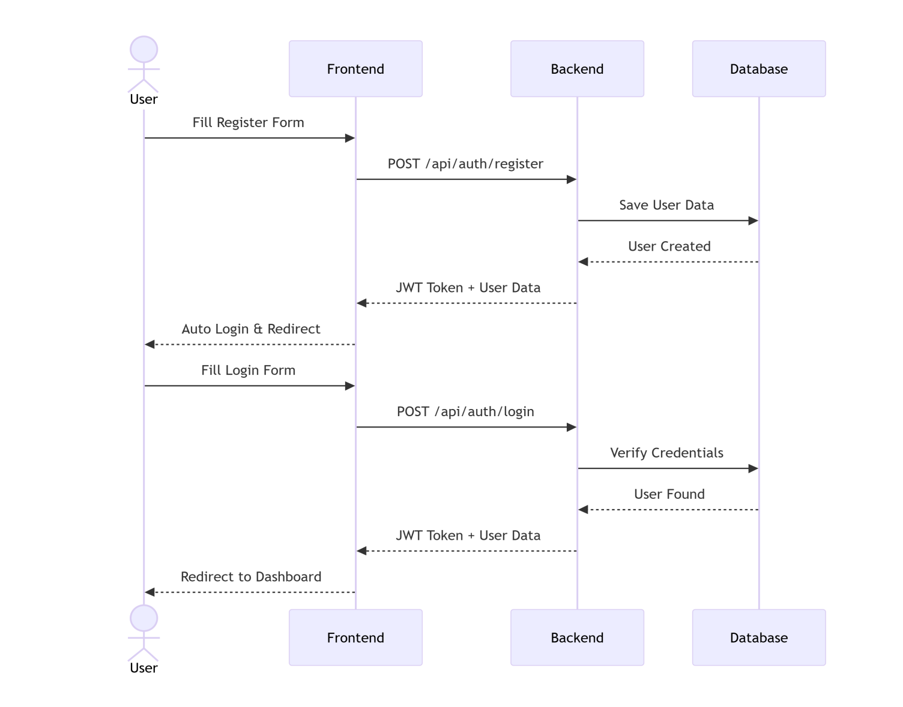
Sequence Diagrams
User Registration & Login

Slide 17
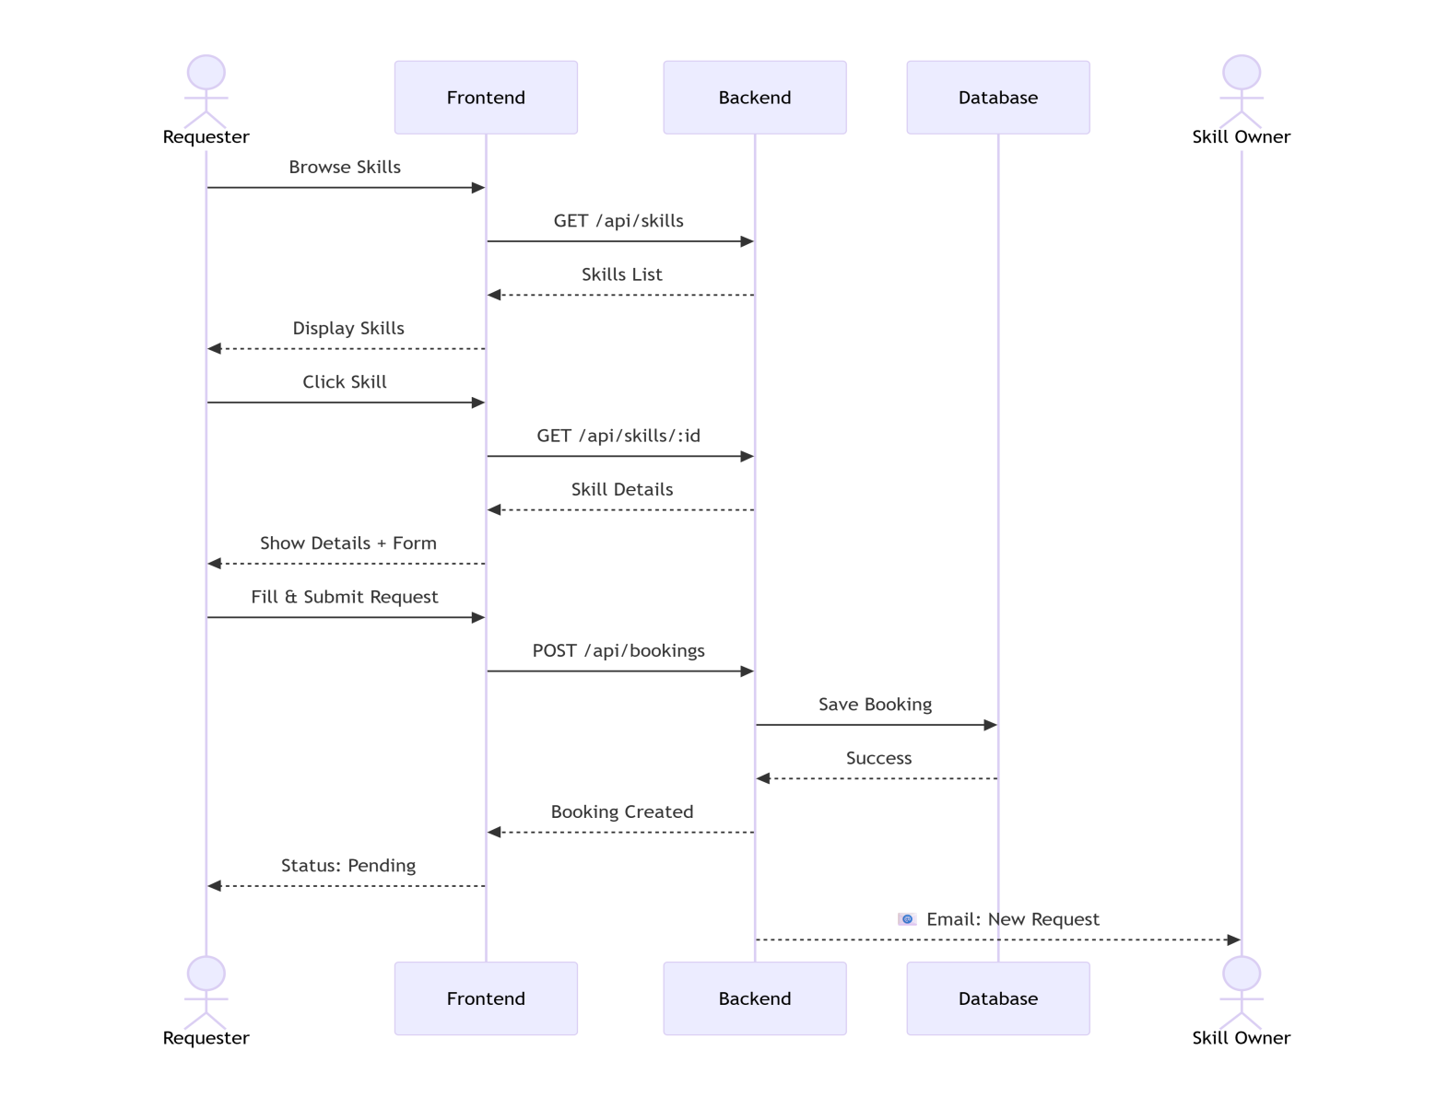
Sequence Diagrams
Skill Exchange Request

Slide 18
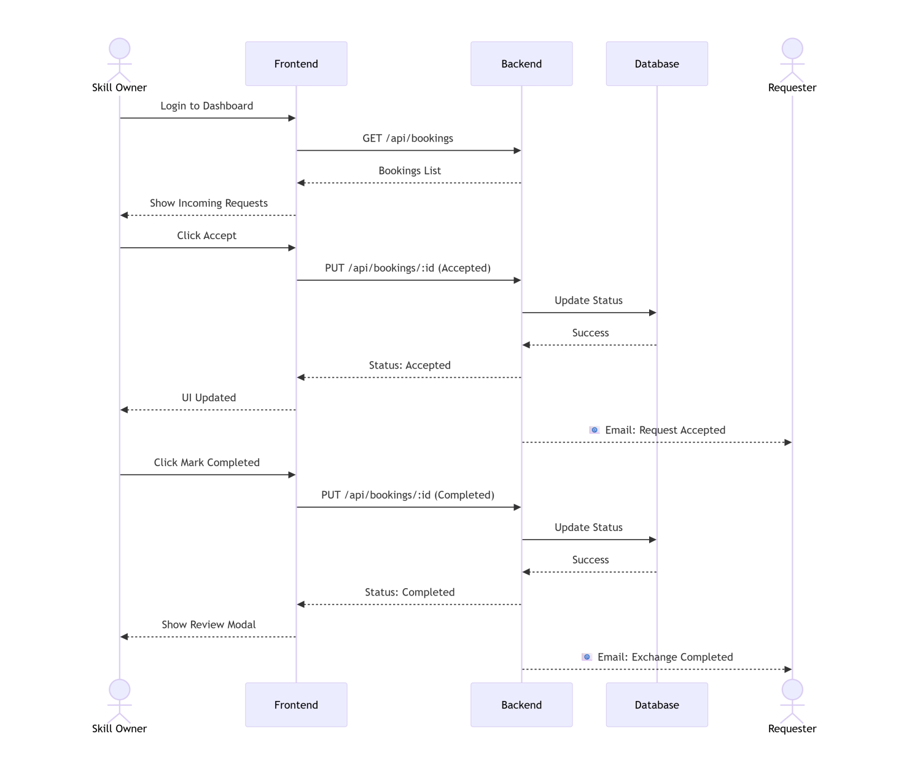
Sequence Diagrams
Accept & Complete Exchange

Slide 19
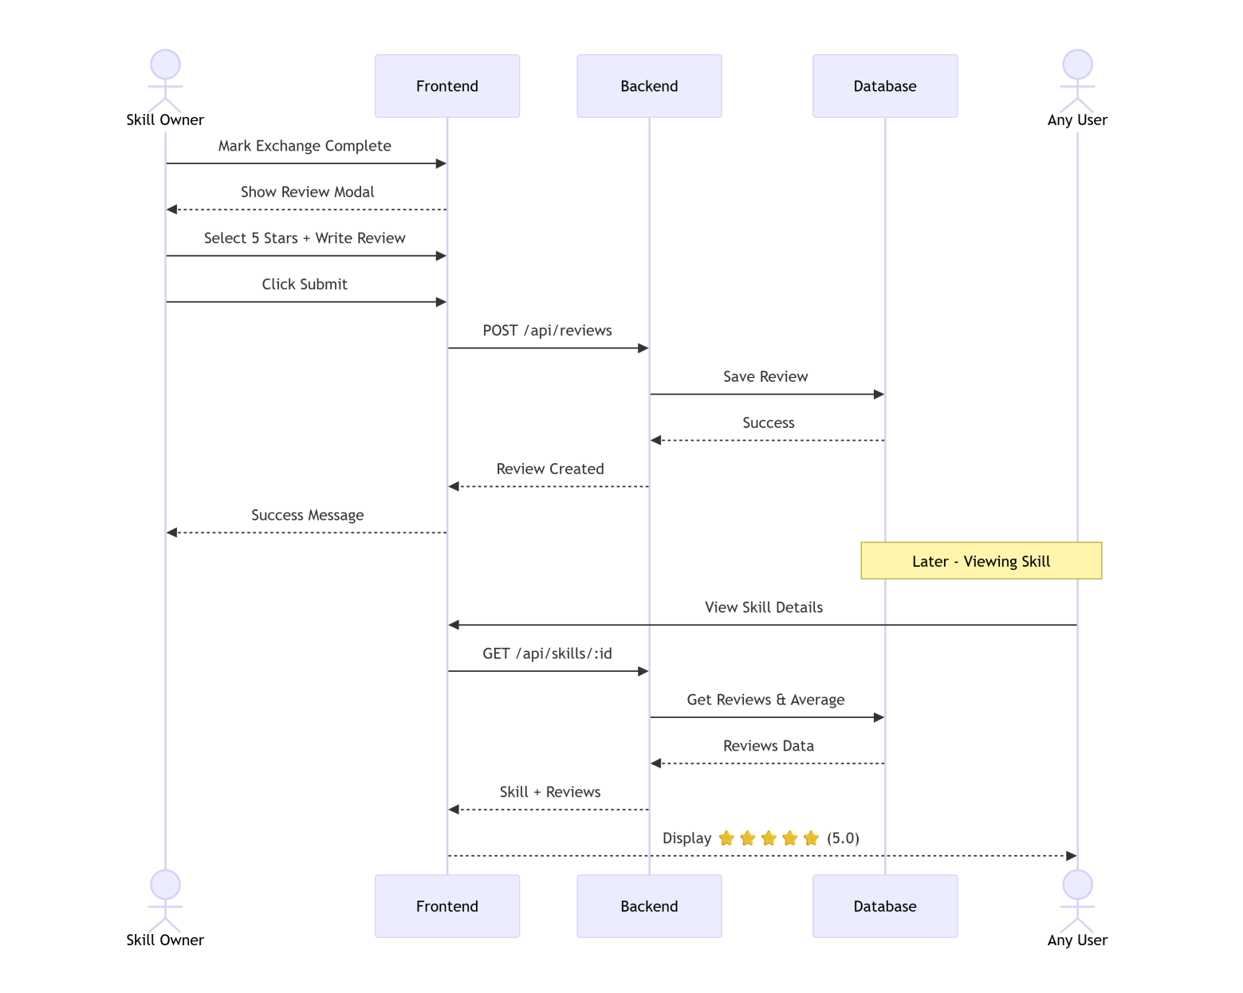
Sequence Diagrams
Rating & Review Submission

Slide 20
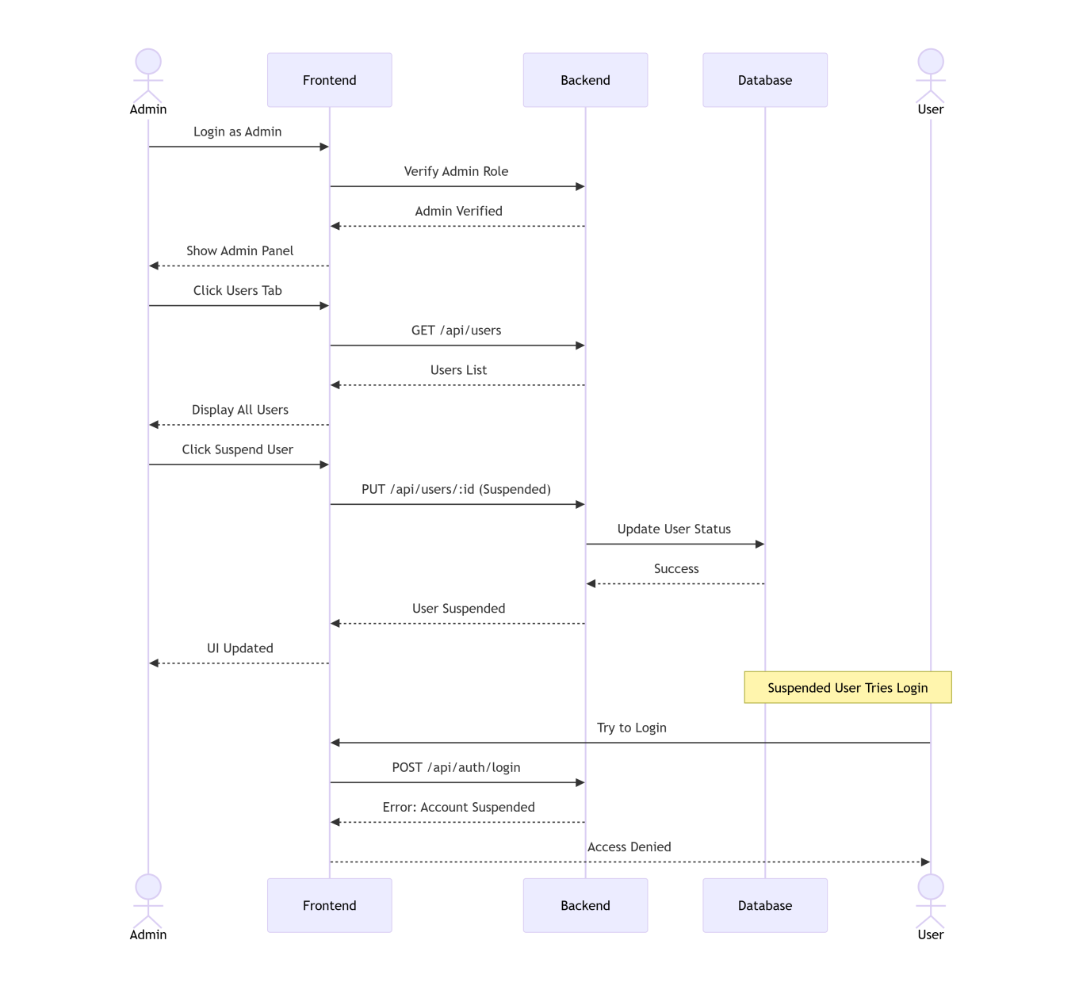
Sequence Diagrams
Admin User Management

Slide 21
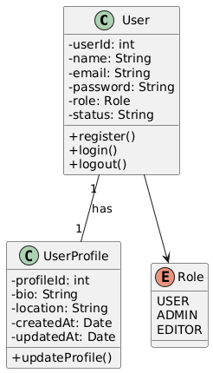
Class Diagram
Core User and Authentication Class

Slide 22
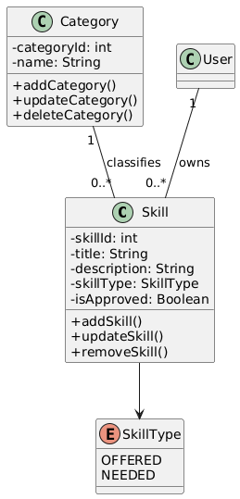
Class Diagram
Skills and Categories

Slide 23
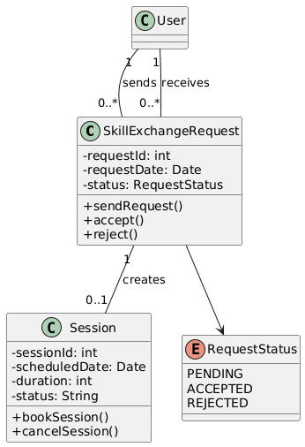
Class Diagram
Skill Exchange Request

Slide 24
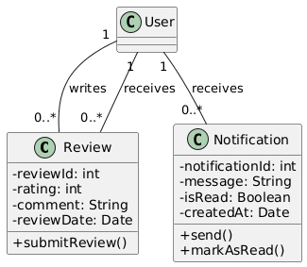
Class Diagram
Ratings and Reviews

Slide 25
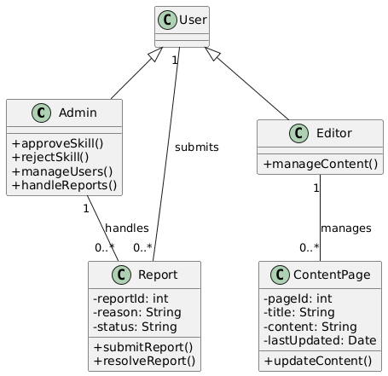
Class Diagram
Admin, Reports and CMS

Slide 26
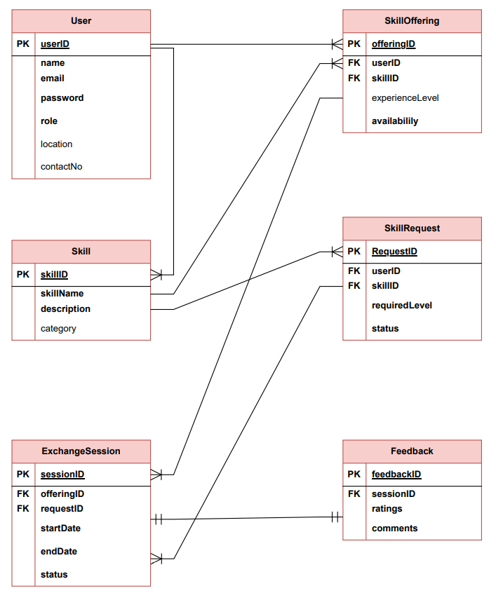
Entity Relationship Diagram

Slide 27
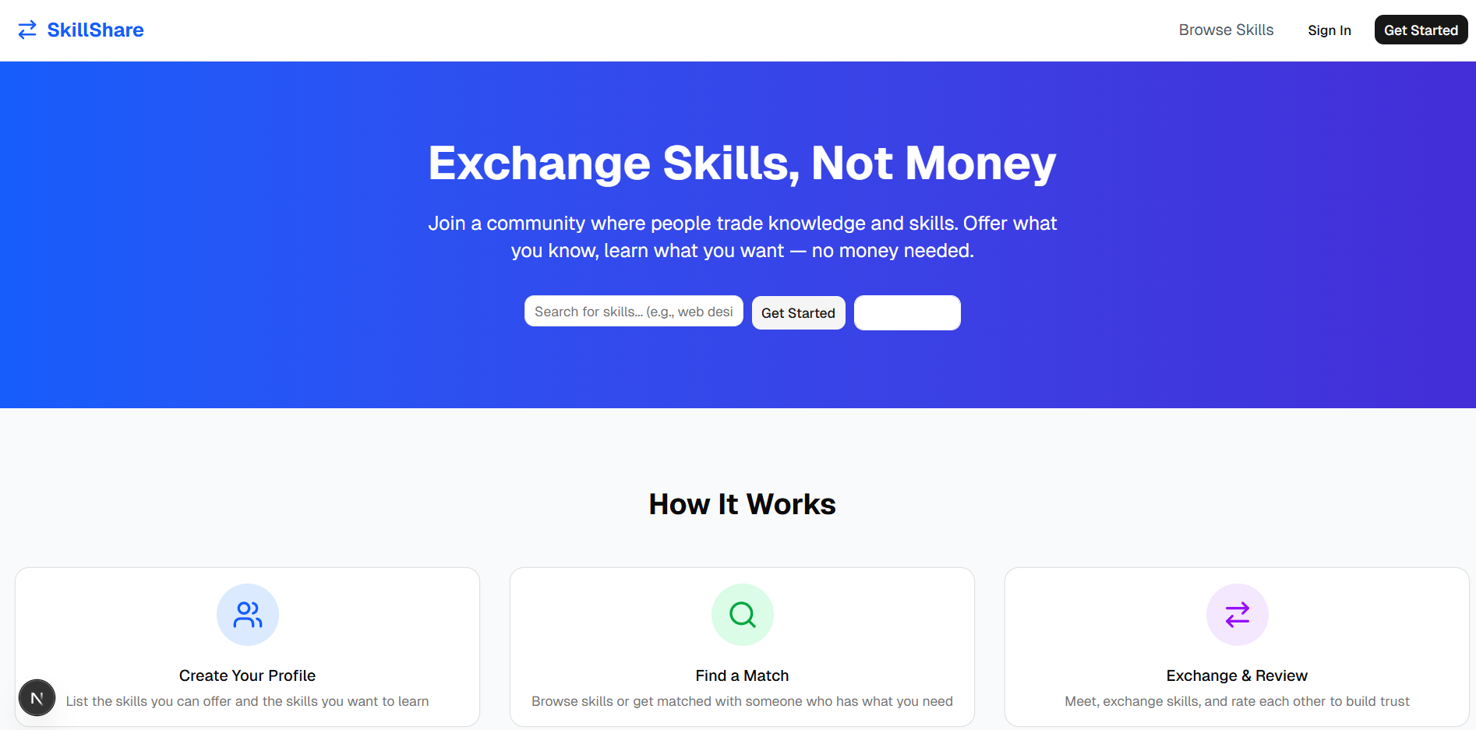
User Interfaces

Slide 28
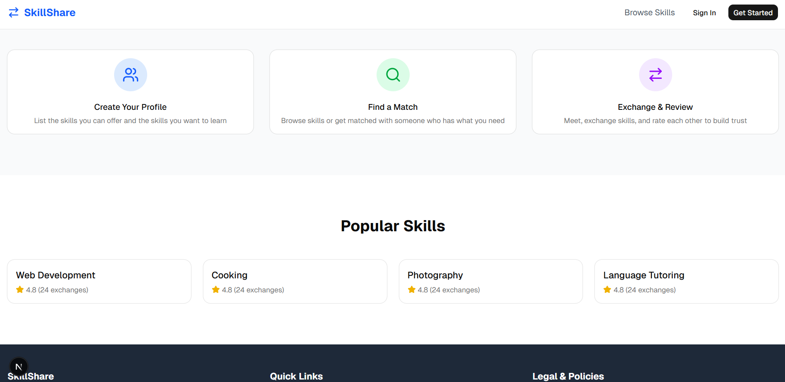
User Interfaces

Slide 29
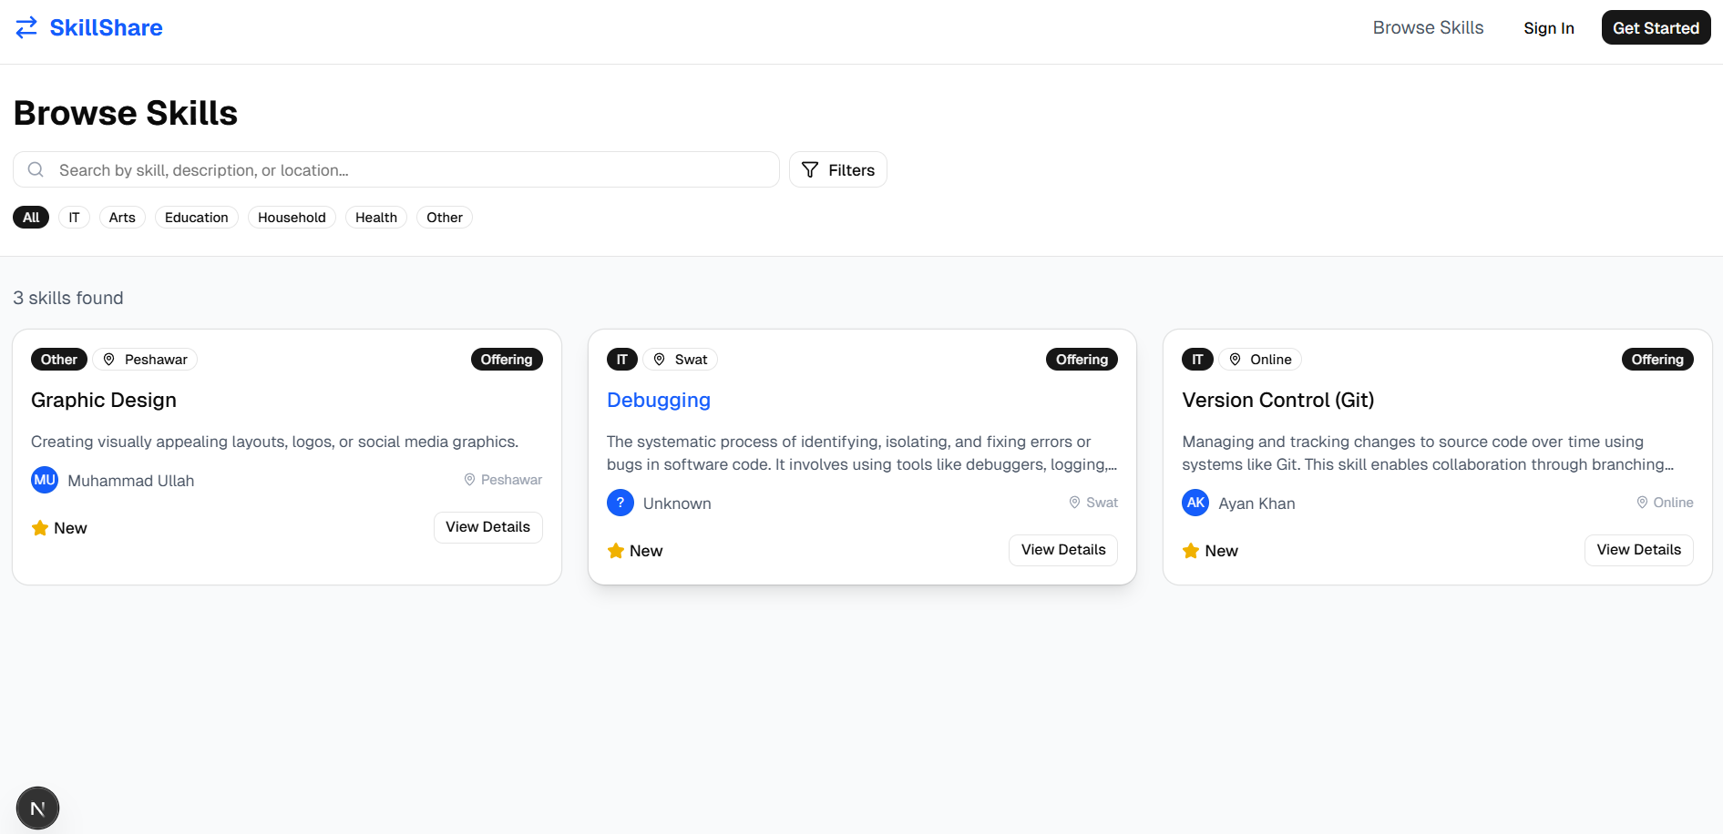
User Interfaces

Slide 30
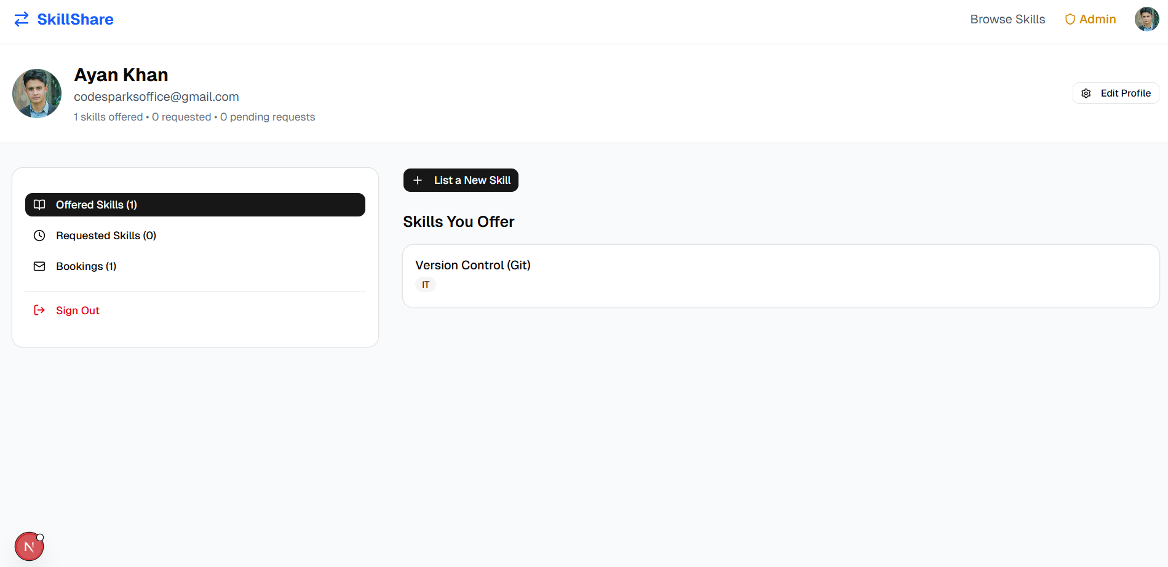
User Interfaces

Slide 31
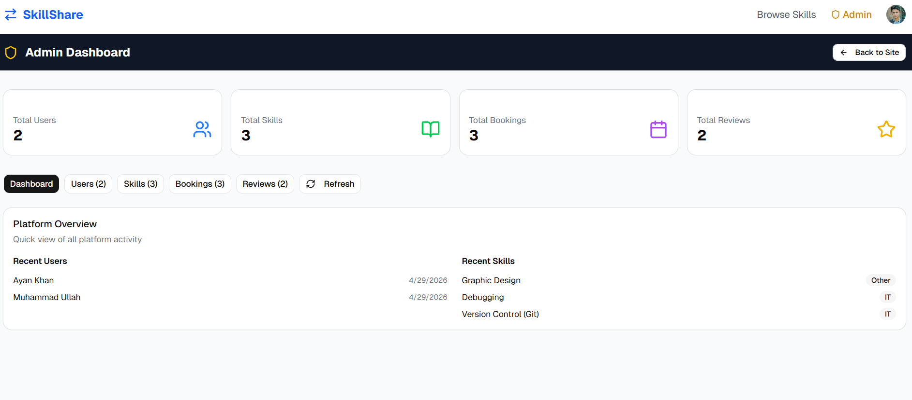
User Interfaces

Slide 32
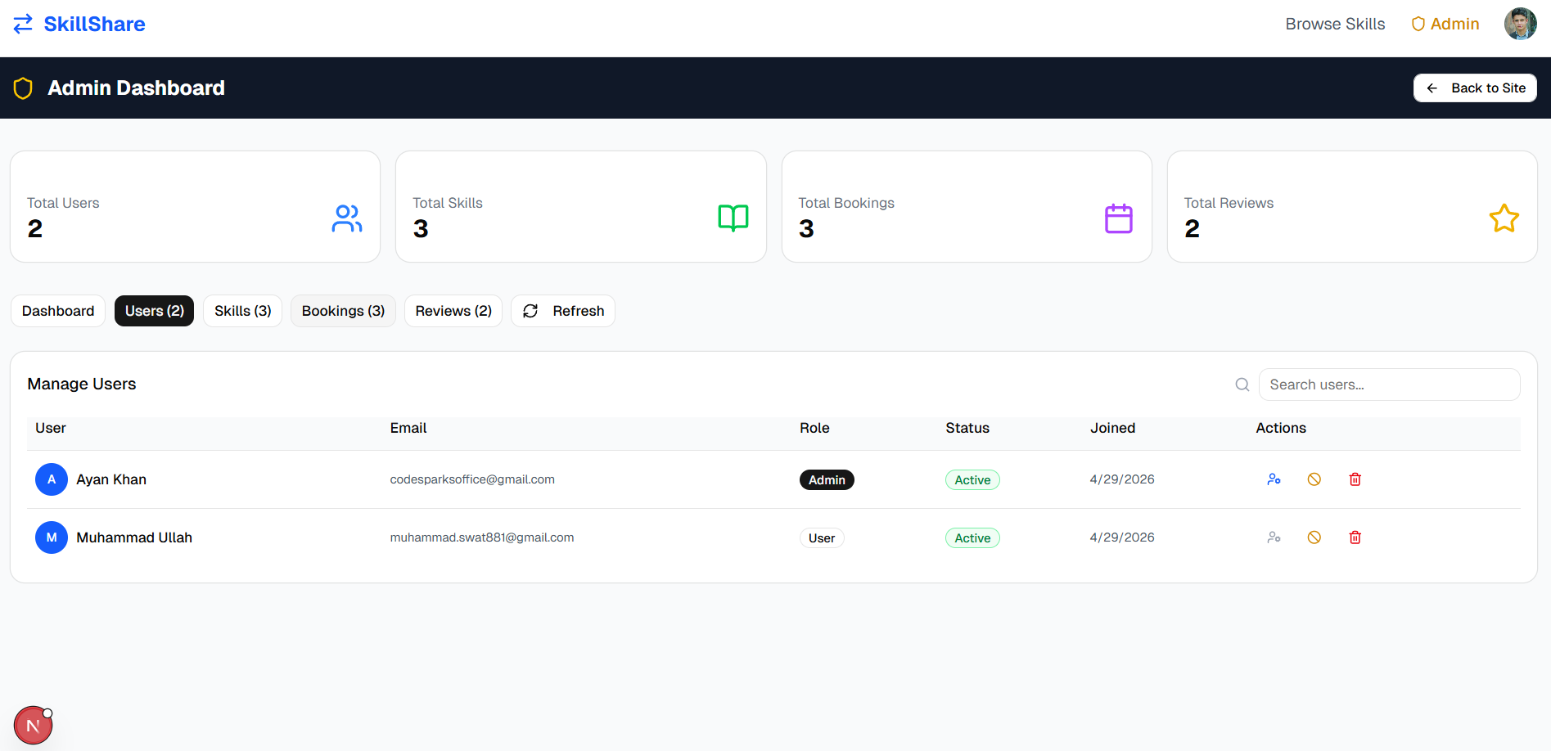
User Interfaces

Slide 33
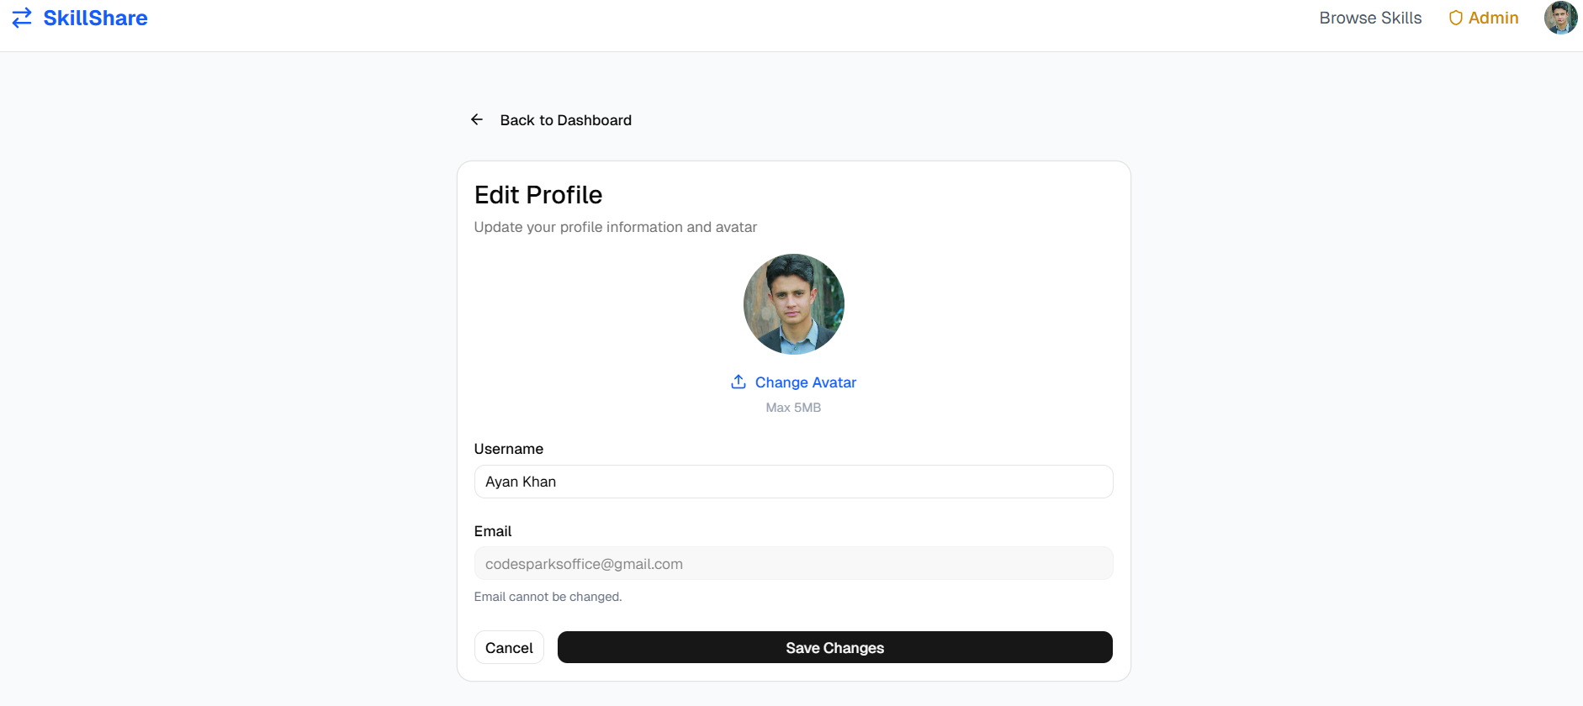
User Interfaces

Slide 34
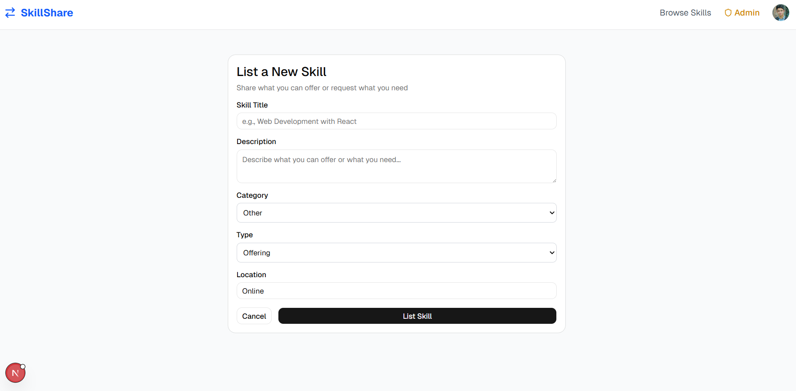
User Interfaces

Slide 35
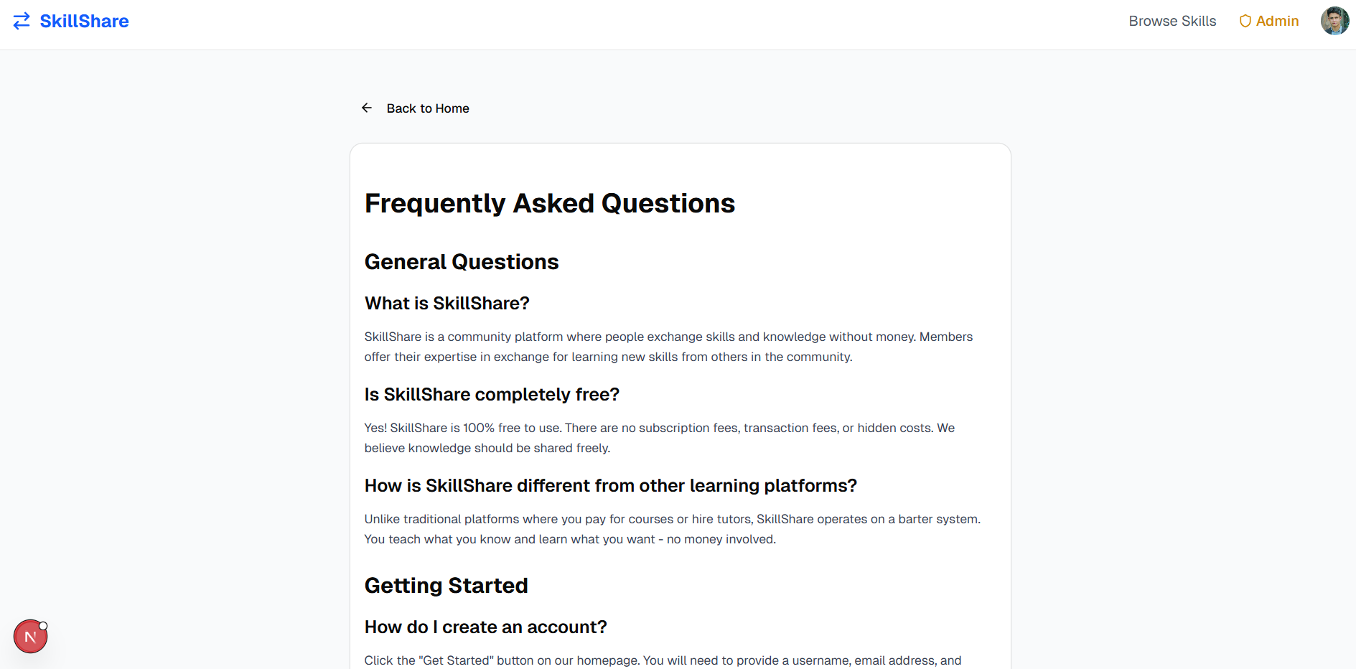
User Interfaces

Slide 36
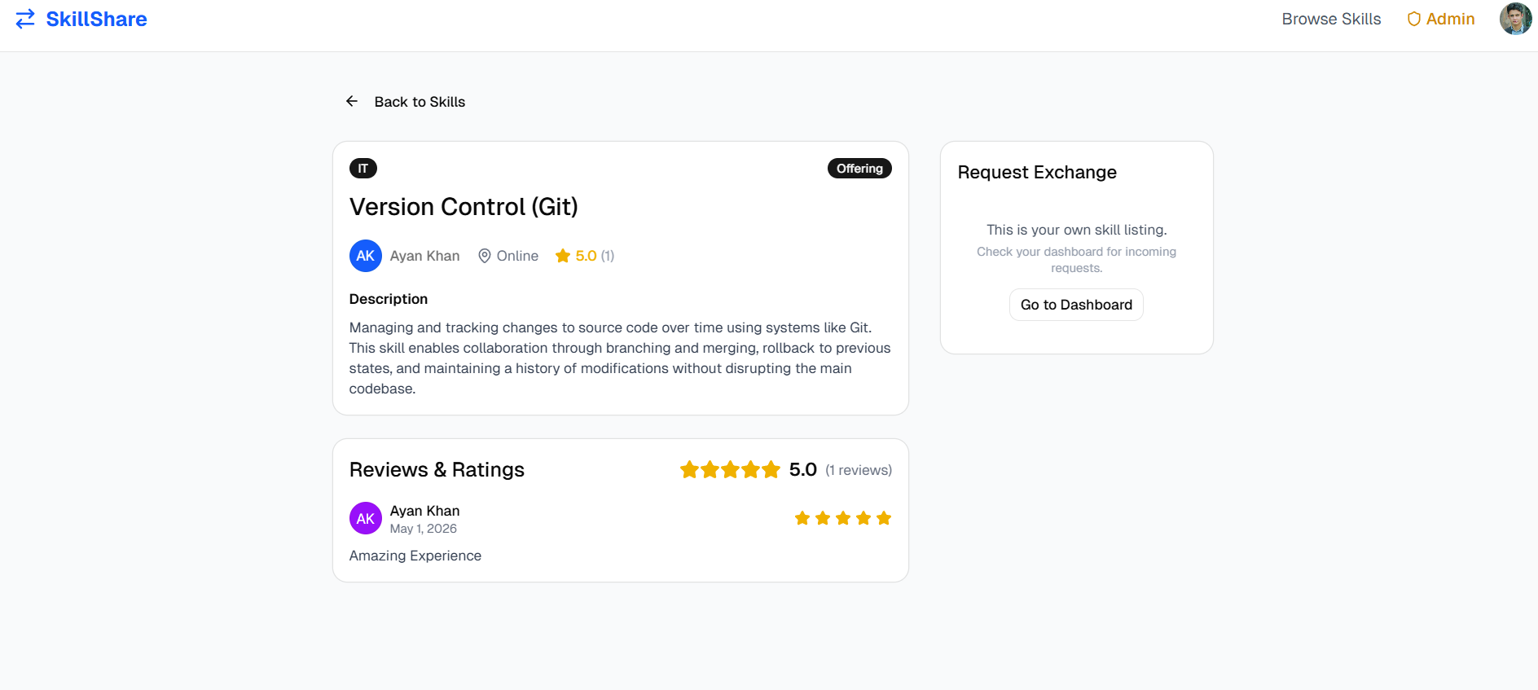
User Interfaces

Slide 37
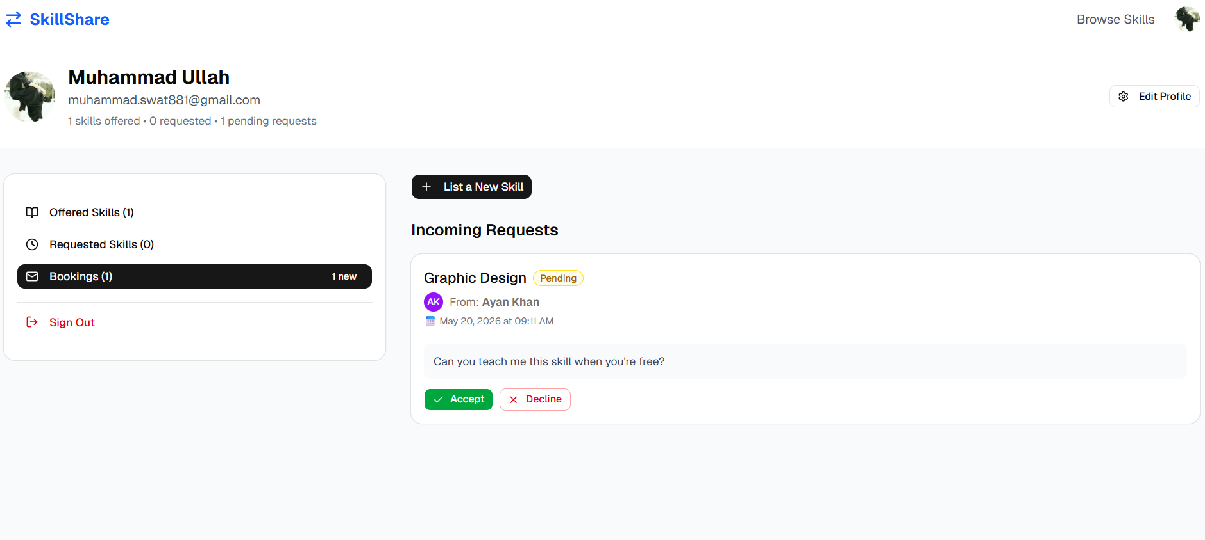
User Interfaces

Slide 38
Tools
Frontend: Next.js + React + TailwindCSS + shadcn/ui
Backend: Strapi CMS + Node.js
Database: SQLite
Auth: JWT
Email: Gmail
Tools: VS Code, Postman, Chrome

