Slide 1
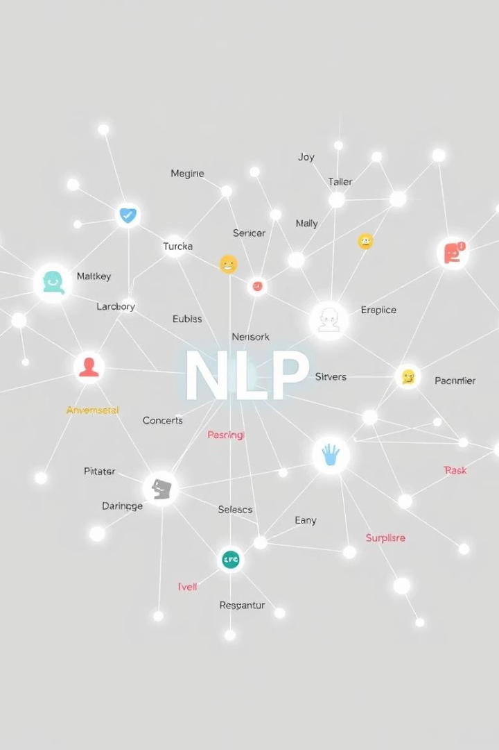
Emotion Detection from Text
Developing an ML model to classify emotions such as joy, anger, sadness, and fear.
Name: Ayan Kumar Dey
College: JIS College Of Engineering
Roll: 123211003040
Stream: B.Tech CSE

Slide 2

Dataset and Preprocessing
Dataset
Preprocessing
Format
Emotions Dataset from Kaggle with six classes: joy, sadness, anger, fear, love, surprise.
Stopwords, punctuation, and user handles removed using neattext.
Data consists of raw text paired with emotion labels for training.
TF-IDF used to convert text into numerical vectors.

Slide 3
Modeling Approach
Text Cleanup
Clean raw text and prepare for vectorization.
Vectorization
Convert text to TF-IDF vectors.
Model Training
Train logistic regression on training data.
Evaluation
Assess accuracy and generate classification report.
Persistence
Save the trained model with joblib.

Slide 4
Results and Insights
Performance
Example
Model achieves over 95% accuracy with strong F1-scores across classes.
Input: "I'm feeling amazing today!"
Predicted emotion: joy
The model is reliable, interpretable, and ready for integration.

