Slide 1
Entity-Relationship Model
Extended Features

Slide 2
Outline
Non-binary Relationships
Extended E-R Features
Design of the Bank Database
Reduction to Relation Schemas
Database Design
UML

Slide 3

Non-binary Relationship Sets
Most relationship sets are binary
There are occasions when it is more convenient to represent relationships as non-binary.
E-R Diagram with a Ternary Relationship

Slide 4
Cardinality Constraints on Ternary Relationship
We allow at most one arrow out of a ternary (or greater degree) relationship to indicate a cardinality constraint
For example, an arrow from proj_guide to instructor indicates each student has at most one guide for a project
More than one arrow is ambiguous.

Slide 5
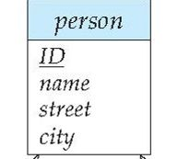
IS-A: Specialization
Consider a Person entity set
Now suppose we want to model an Employee entity set and a Student entity set. However,
We want to say that an “Employee is-a Person” and a “Student is-a Person”.
That is, in addition to Person attributes, an Employee entity has an extra salary field.
We depict this as follows.

Slide 6
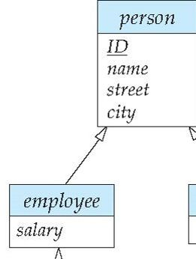
IS-A: representation
This depicts that employee entity set is a specialization of the person entity set.
An employee entity has all the attributes of person and in addition has a salary attribute.
This is similar to superclass-subclass hierarchy in object-oriented langauges.
Note the arrow from the specialized entity set to the general entity set.

Slide 7
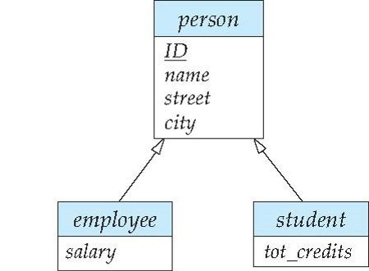
IS-A: specialization
Suppose we add another specialization called student.
Student has an extra attribute tot_credits.
Student is-a person. But a student may be or may not be an employee.
Represented in the E-R diagram as:
Arrow indicates that employee “IS-A” person and student “IS-A” person.

Slide 8
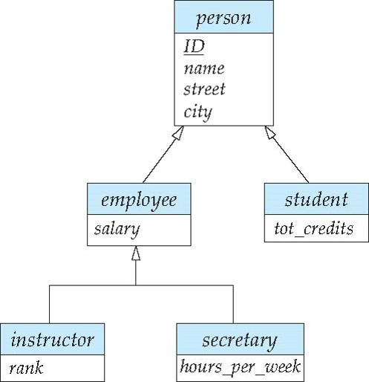
Further specialization
Consider E-R diagram:
Instructor “IS-A” employee, secretary “IS-A” employee,
Instructor and secretary are disjoint entities.
(overlapping
specialization)
(disjoint
specialization)

Slide 9

Specialization Example
Overlapping – employee and student
Disjoint – instructor and secretary
Total and partial

Slide 10
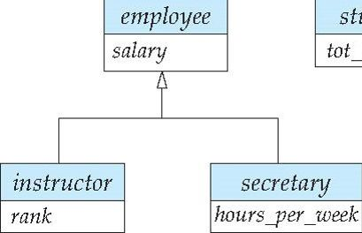
Generalization
Specialization is useful in top-down design approach.
Generalization is the opposite of specialization.
It merges together the common attributes of closely related entity sets into a higher-level entity set.
A bottom-up design strategy.

Slide 11
Representing Specialization via Relation Schemas
Method 1:
  Form a schema for the higher-level entity
  Form a schema for each lower-level entity set, include primary key of higher-level entity set and local attributes
  Drawback: getting information about an employee requires accessing two relations:
    the one corresponding to the low-level schema (employee) and the one corresponding to the high-level schema
schema attributes
person ID, name, street, city
student ID, tot_cred
employee ID, salary

Slide 12
Representing Specialization as Schemas (Cont.)
Method 2:
  Form a schema for each entity set with all local and inherited attributes
  Drawback: name, street and city may be stored redundantly for people who are both students and employees
schema attributes
person ID, name, street, city
student ID, name, street, city, tot_cred
employee ID, name, street, city, salary

Slide 13
Generalization
A bottom-up design process – combine a number of entity sets that share the same features into a higher-level entity set.
Specialization and generalization are simple inversions of each other; they are represented in an E-R diagram in the same way.
The terms specialization and generalization are used interchangeably.

Slide 14
Design Constraints on a Specialization/Generalization
Completeness constraint for specialization/generalization:
  total: higher entity must belong to one of the lower-level entity sets.
  E.g., an employee must be either an instructor or a secretary.
  partial: higher level entity need not belong to one of the lower-level entity sets.
  E.g., there can be employees that are neither instructor nor secretary.
Partial generalization is the default.
Specify total generalization in ER diagram by adding the keyword total in the diagram.

Slide 15

Aggregating a relationship:
  Consider the ternary relationship proj_guide.
  Suppose we want to record evaluations of a student by a guide on a project

Slide 16
Aggregation (Cont.)
Relationship sets eval_for and proj_guide represent overlapping information
  Every eval_for relationship corresponds to a proj_guide relationship
  However, some proj_guide relationships may not correspond to any eval_for relationships
    So we can’t discard the proj_guide relationship
Eliminate this redundancy via aggregation
  Treat relationship as an abstract entity
  Allows relationships between relationships
  Abstraction of relationship into new entity

Slide 17

Aggregation (Cont.)
Eliminate this redundancy via aggregation without introducing redundancy, the following diagram represents:
  A student is guided by a particular instructor on a particular project
  A student, instructor, project combination may have an associated evaluation

Slide 18
Representing Aggregation via Schemas
To represent aggregation, create a schema containing
  Primary key of the aggregated relationship,
  The primary key of the associated entity set
  Any descriptive attributes
E.g.
  The schema eval_for is:
  eval_for (s_ID, project_id, i_ID, evaluation_id)
  The schema proj_guide is redundant.

Slide 19
Design Issues

Slide 20

Entities vs. Attributes
Use of entity sets vs. attributes
Use of phone as an entity allows extra information about phone numbers (whether, office, residence, mobile etc.) and multiple phone numbers.

Slide 21

Entities vs. Relationship sets
Use of entity sets vs. relationship sets
Possible guideline is to designate a relationship set to describe an action that occurs between entities
Placement of relationship attributes
For example, attribute date as attribute of advisor or as attribute of student

Slide 22
Binary Vs. Non-Binary Relationships
It is possible to replace any non-binary (n-ary, for n > 2) relationship set by a number of distinct binary relationship sets.
However: an n-ary relationship set shows more clearly that several entities participate in a single relationship.
Some relationships that appear to be non-binary may be better represented using binary relationships
  For example, a ternary relationship parents, relating a child to his/her father and mother, is best replaced by two binary relationships, father and mother
    Using two binary relationships allows partial information (e.g., only mother being known)
  But there are some relationships that are naturally non-binary
    Example: proj_guide

Slide 23

Converting Non-Binary Relationships to Binary Form
In general, any non-binary relationship can be represented using binary relationships by creating an artificial entity set.
  Replace R between entity sets A, B and C by an entity set E, and three relationship sets:
1. R_{A}, relating E and A 2. R_{B}, relating E and B
3. R_{C}, relating E and C
  Create an identifying attribute for E and add any attributes of R to E
  For each relationship (a_{i} , b_{i} , c_{i}) in R, create
1. a new entity e_{i} in the entity set E 2. add (e_{i} , a_{i} ) to R_{A}
3. add (e_{i} , b_{i} ) to R_{B} 4. add (e_{i} , c_{i} ) to R_{C}

Slide 24
Converting Non-Binary Relationships (Cont.)
Also need to translate constraints
  Translating all constraints may not be possible
  There may be instances in the translated schema that
  cannot correspond to any instance of R
    Exercise: add constraints to the relationships R_{A}, R_{B} and R_{C} to ensure that a newly created entity corresponds to exactly one entity in each of entity sets A, B and C
  We can avoid creating an identifying attribute by making E a weak entity set (described shortly) identified by the three relationship sets

Slide 25
E-R Design Decisions
The use of an attribute or entity set to represent an object.
Whether a real-world concept is best expressed by an entity set or a relationship set.
The use of a ternary relationship versus a pair of binary relationships.
The use of a strong or weak entity set.
The use of specialization/generalization – contributes to modularity in the design.
The use of aggregation – can treat the aggregate entity set as a single unit without concern for the details of its internal structure.

Slide 26

Summary of Symbols Used in E-R Notation

Slide 27
Symbols Used in E-R Notation (Cont.)

Slide 28

Alternative ER Notations
Chen, IDE1FX, …

Slide 29
Alternative ER Notations
Chen IDE1FX (Crows feet notation)

Slide 30
UML
UML: Unified Modeling Language
UML has many components to graphically model different aspects of an entire software system
UML Class Diagrams correspond to E-R Diagram, but several differences.

Slide 31

ER vs. UML Class Diagrams
*Note reversal of position in cardinality constraint depiction

Slide 32
ER vs. UML Class Diagrams
ER Diagram Notation
Equivalent in UML
*Generalization can use merged or separate arrows independent
of disjoint/overlapping

Slide 33
UML Class Diagrams (Cont.)
Binary relationship sets are represented in UML by just drawing a line connecting the entity sets. The relationship set name is written adjacent to the line.
The role played by an entity set in a relationship set may also be specified by writing the role name on the line, adjacent to the entity set.
The relationship set name may alternatively be written in a box, along with attributes of the relationship set, and the box is connected, using a dotted line, to the line depicting the relationship set.

Slide 34
End of Module 7

Slide 35

Multivalued Attributes (Cont.)
Special case:entity time_slot has only one attribute other than the primary-key attribute, and that attribute is multivalued
  Optimization: Don’t create the relation corresponding to the entity, just create the one corresponding to the multivalued attribute
  time_slot(time_slot_id, day, start_time, end_time)
  Caveat: time_slot attribute of section (from sec_time_slot) cannot be a foreign key due to this optimization

Slide 36
Representing Aggregation via Schemas (Cont.)
For example, to represent aggregation manages between relationship works_on and entity set manager, create a schema
eval_for (s_ID, project_id, i_ID, evaluation_id)
Schema proj_guide is redundant provided we are willing to store null values for attribute manager_name in relation on schema manages

