Slide 1
HIRESHPERE

Slide 2

Presented by
Guided by
Ayan Mansuri( 202212102020 )
Shubham Pipala( 202212102075)
Yash Prajapati(202212102083)
Trupti Mam

Slide 3

Index
Project Profile ________________________________________________________________ .3
Porject Description ____________________________________________________________ .3
User Screen Layout ____________________________________________________________ .3
Company Screen Layout ________________________________________________________ .3
Company Screen Layout ________________________________________________________ .3
Admin Screen Layout __________________________________________________________ .3
Sampaling Coding _____________________________________________________________ .3
Future Enhancement ___________________________________________________________ .3
Conclusion ___________________________________________________________________ .3
Bibliography __________________________________________________________________ .3

Slide 4
Project Profile
Project Name | HireSphere(Job Portal)
Project Name
Objectives

Slide 5

Project Description
  blank

Slide 6
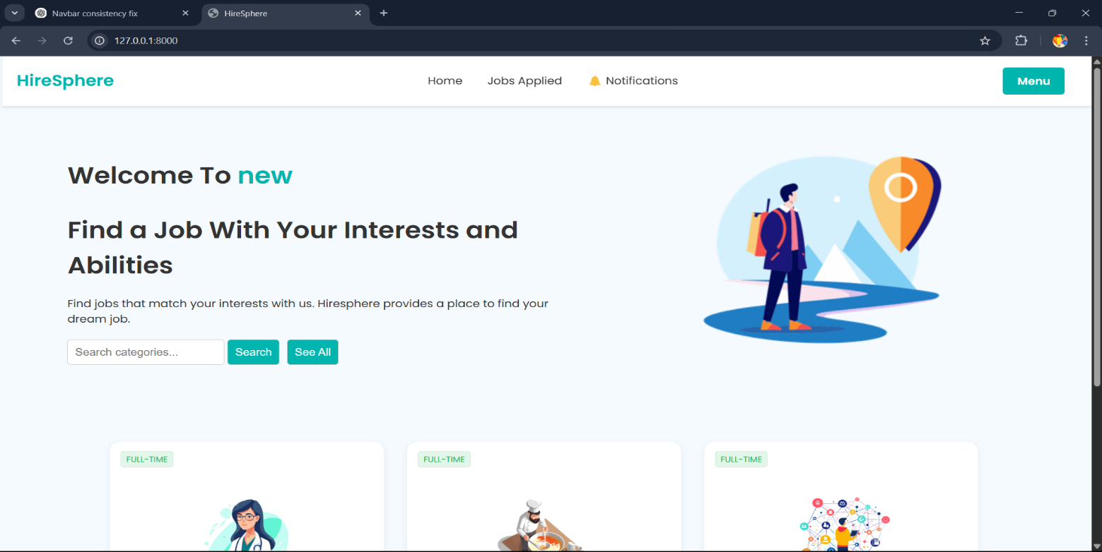
User Screen Layout
User Home Page

Slide 7
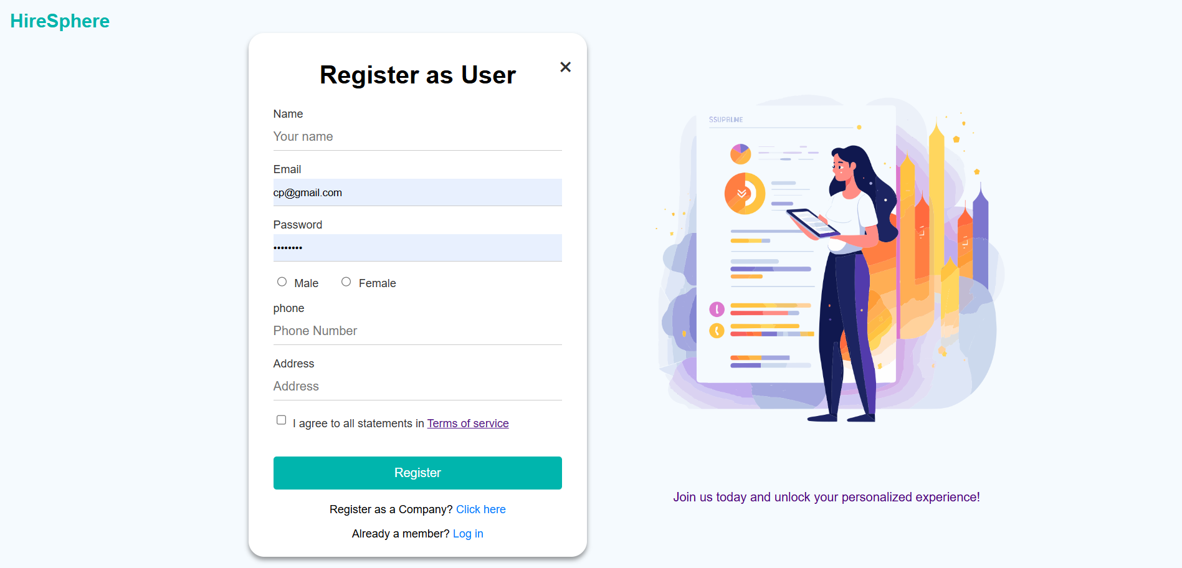
User Registration Page

Slide 8
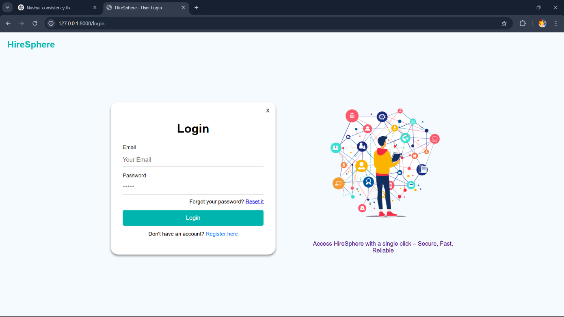
LoginPage

Slide 9
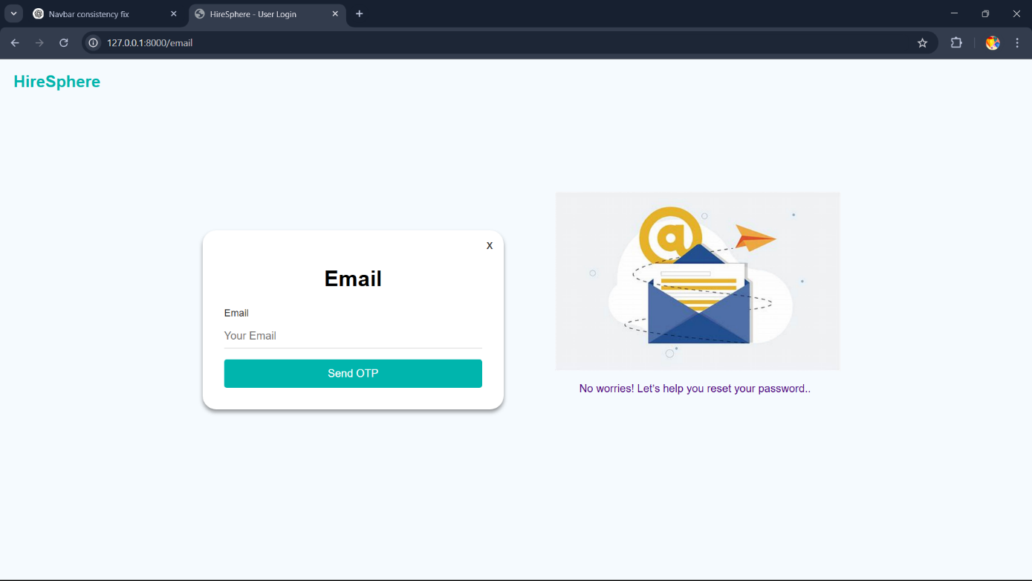
Forgot Password

Slide 10
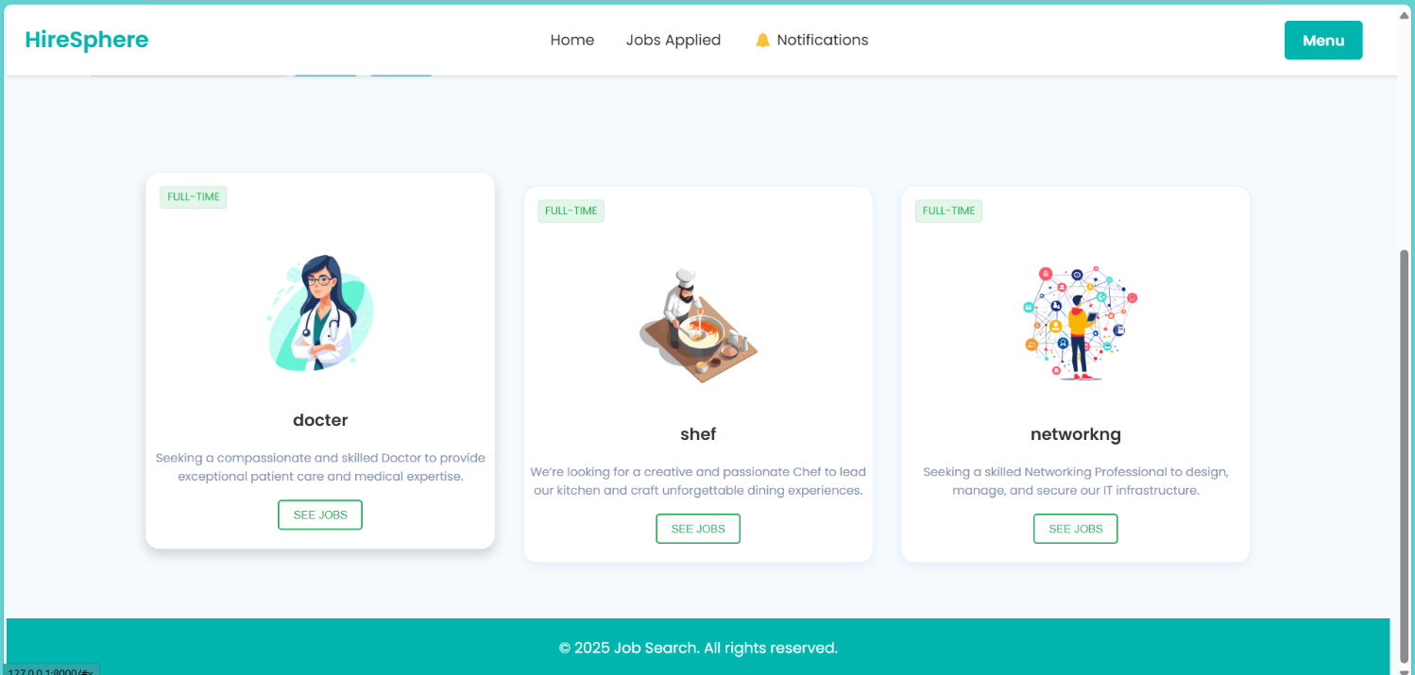
Jobs according to category

Slide 11
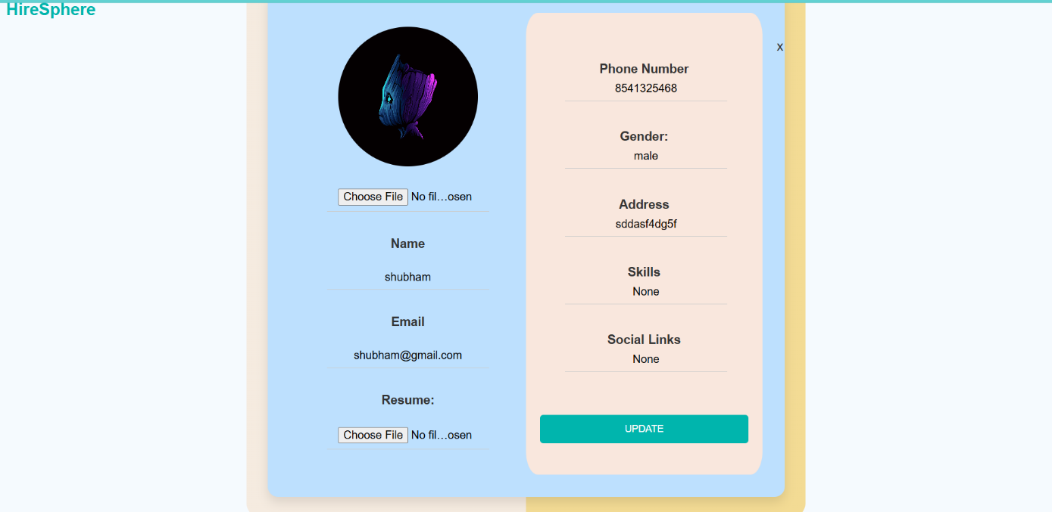
Profile Page

Slide 12
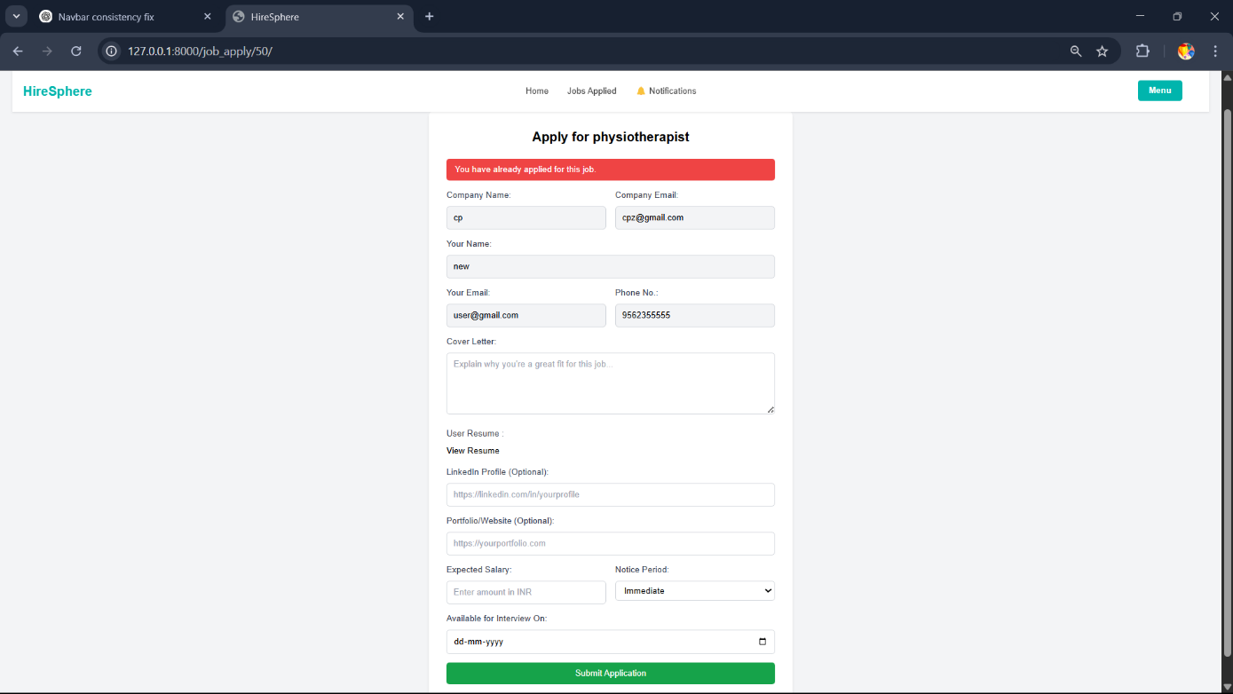
Job Application Form

Slide 13
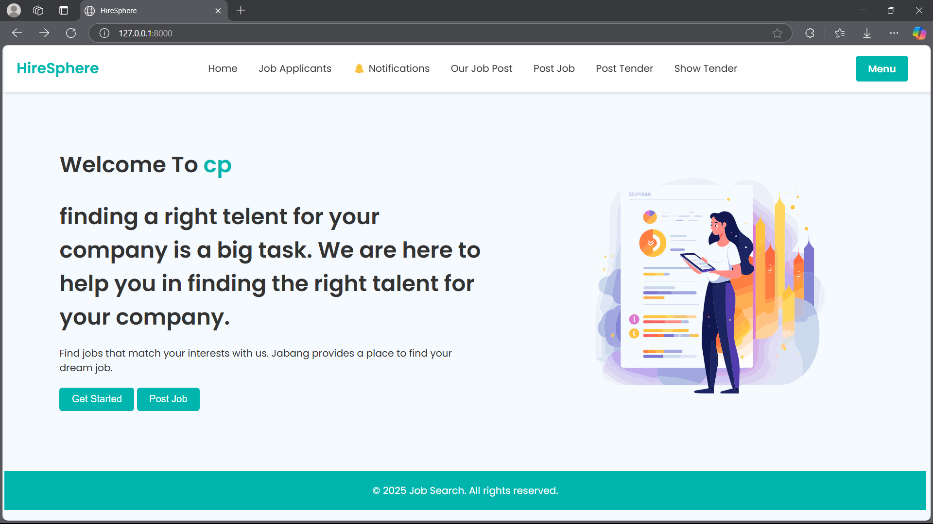
Company Screen Layout
Company Home Page

Slide 14
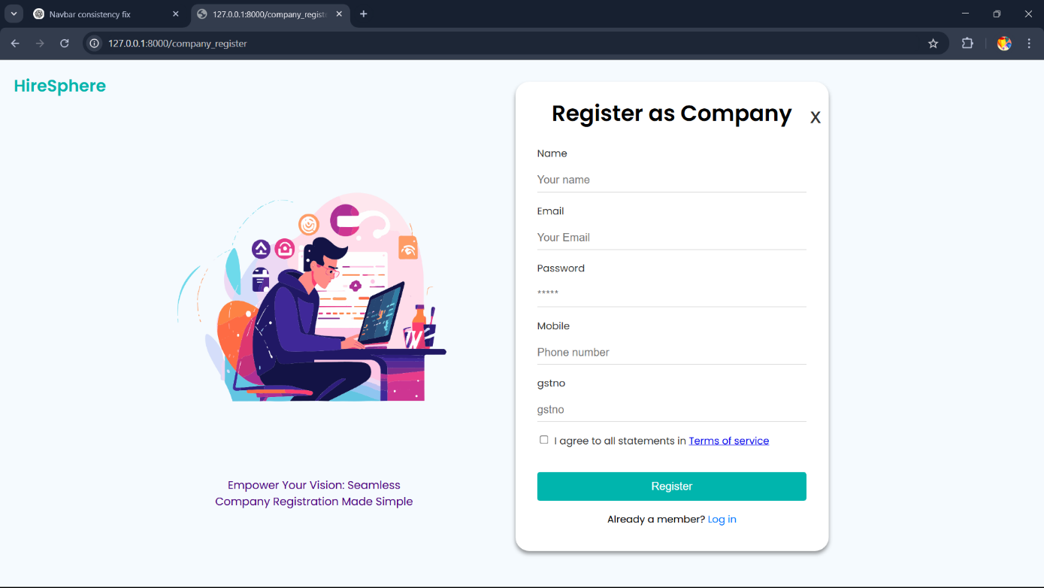
Company Registration Page

Slide 15
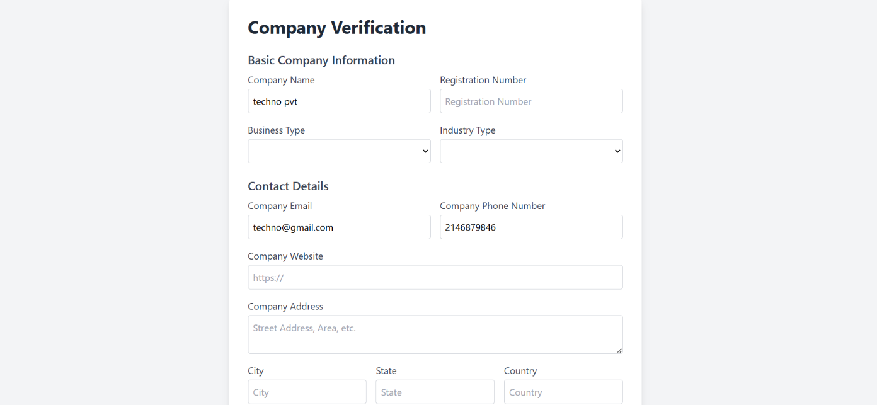
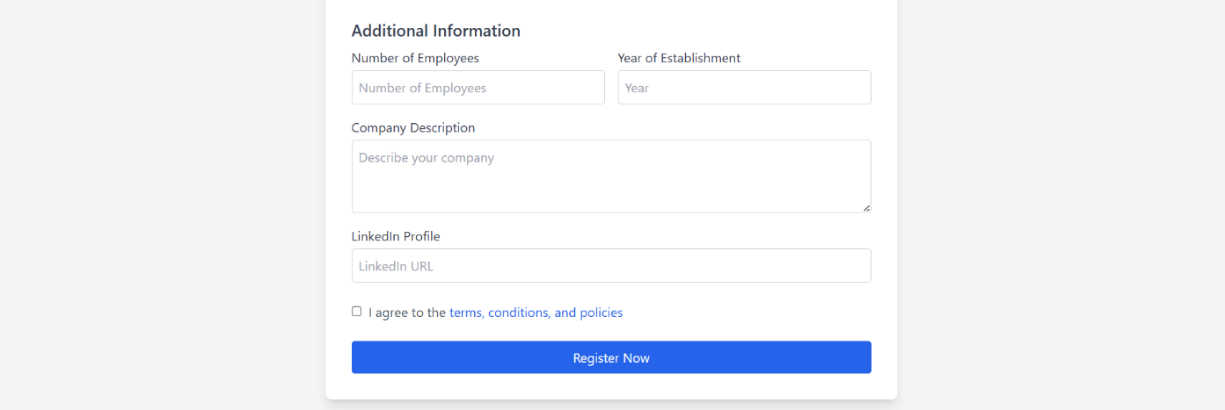
Company Verification Form

Slide 16
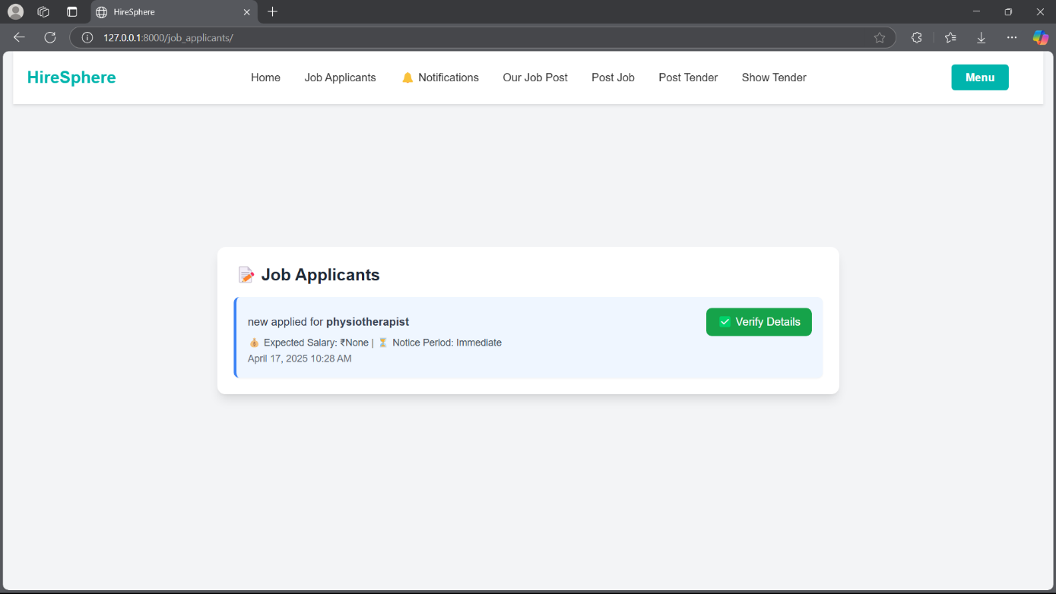
Job Applicant

Slide 17
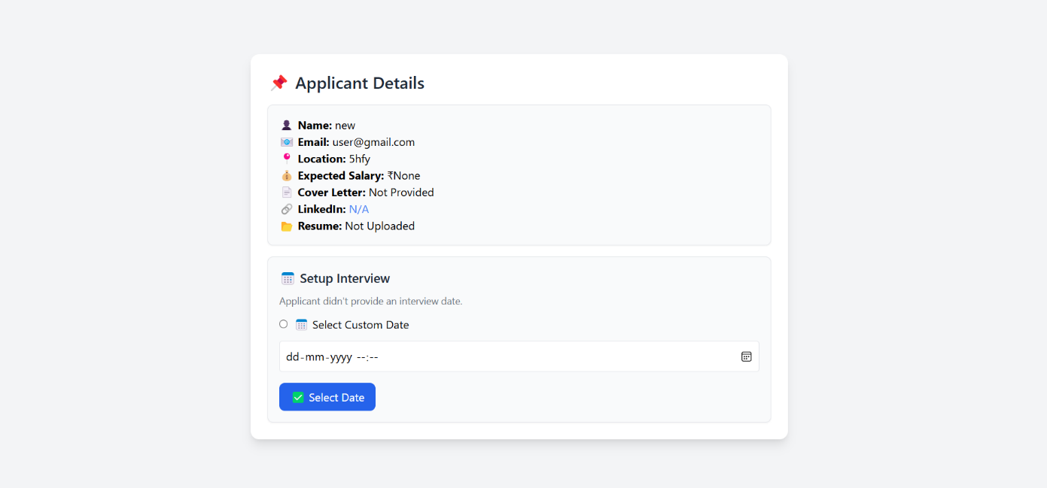
Verify Application

Slide 18
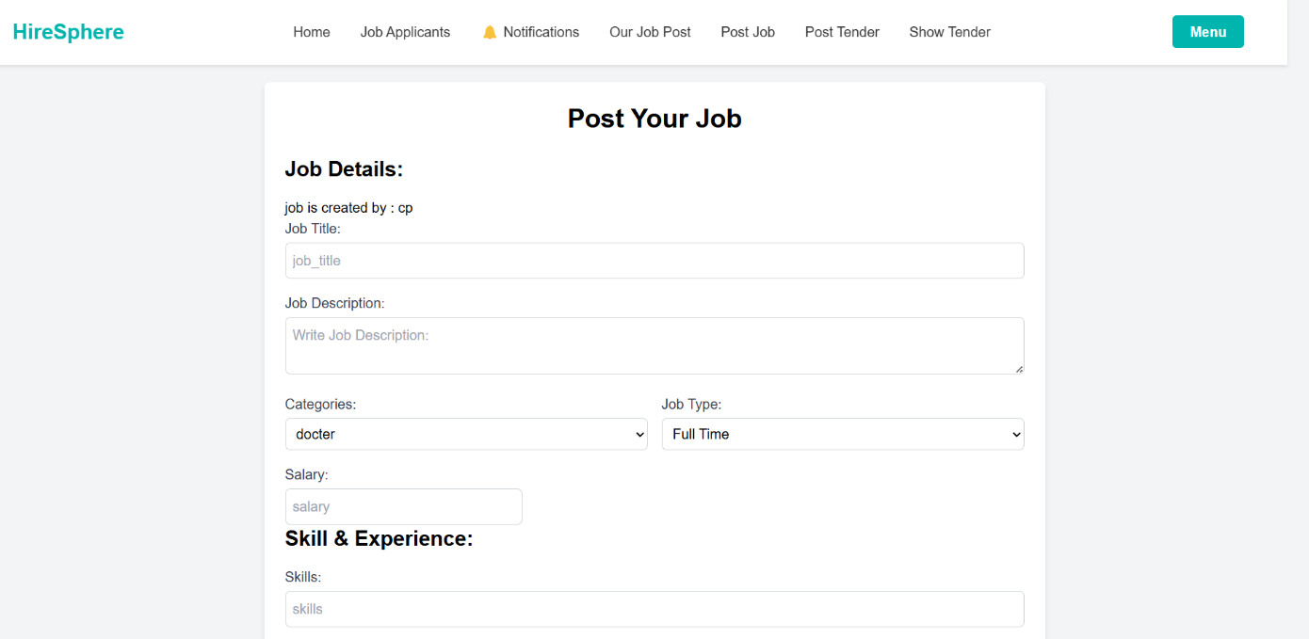
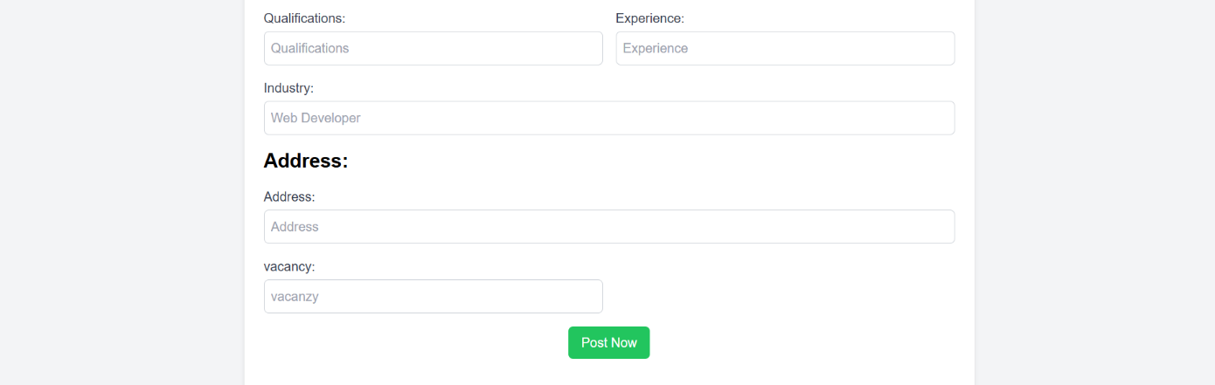
Post Jobs

Slide 19
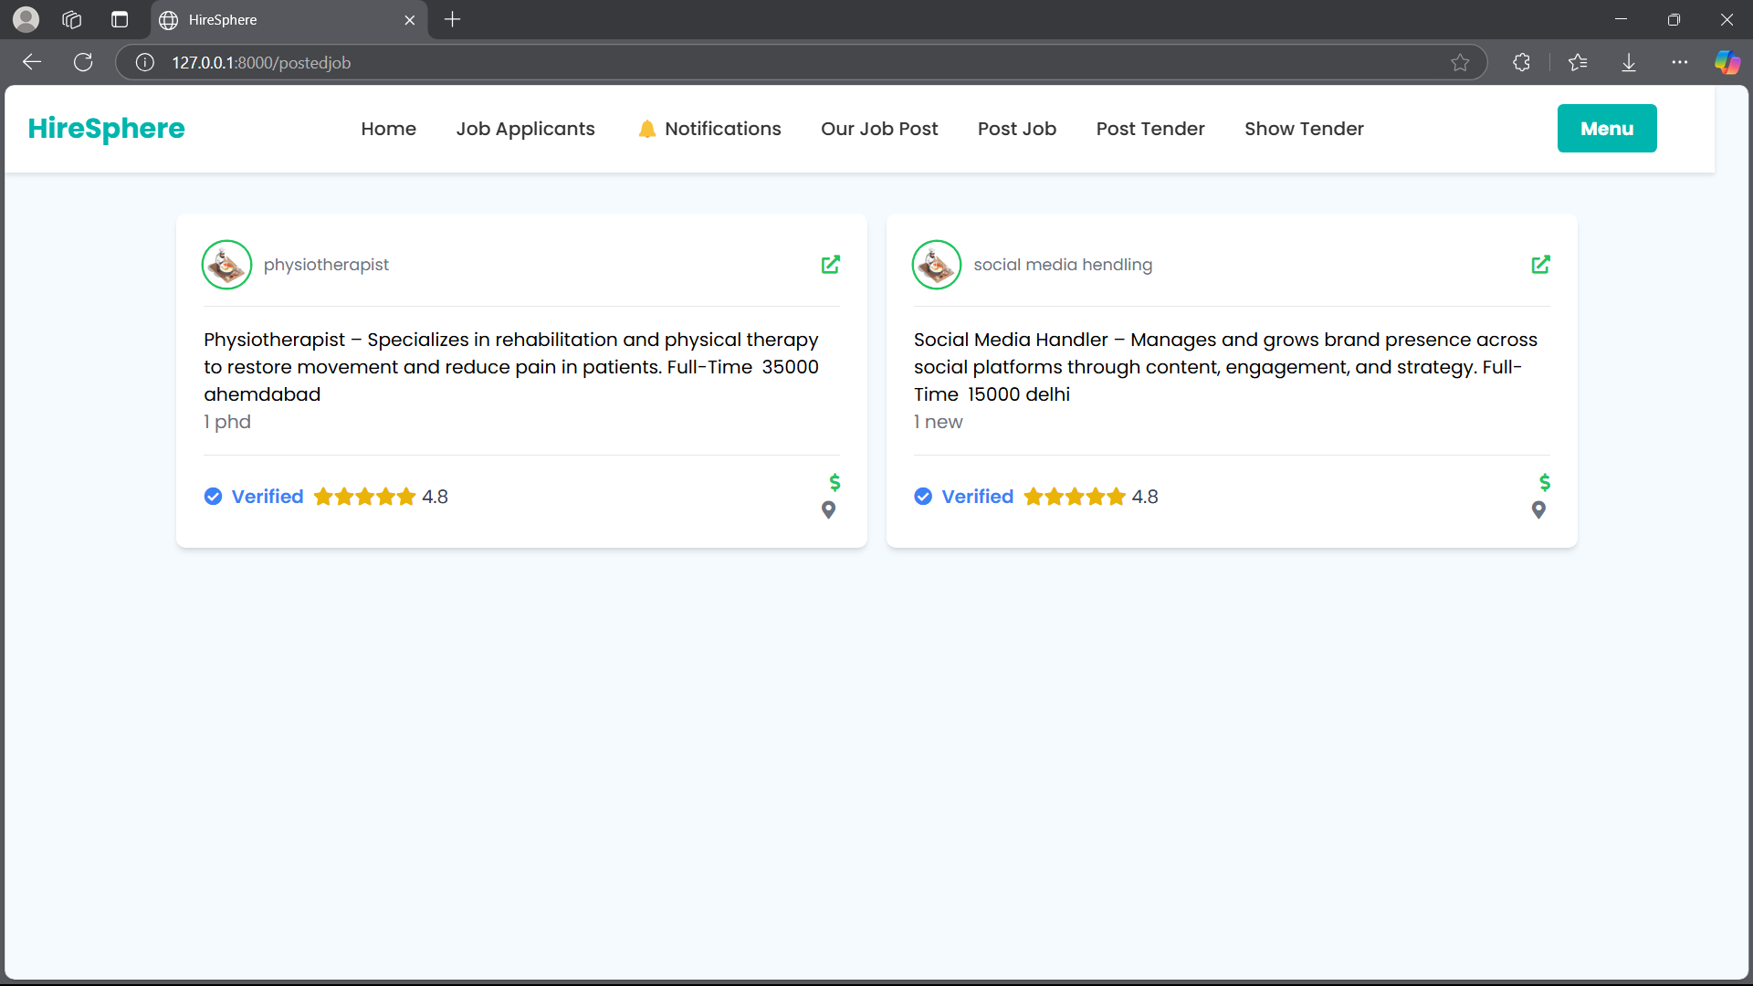
Posted Jobs by company

Slide 20
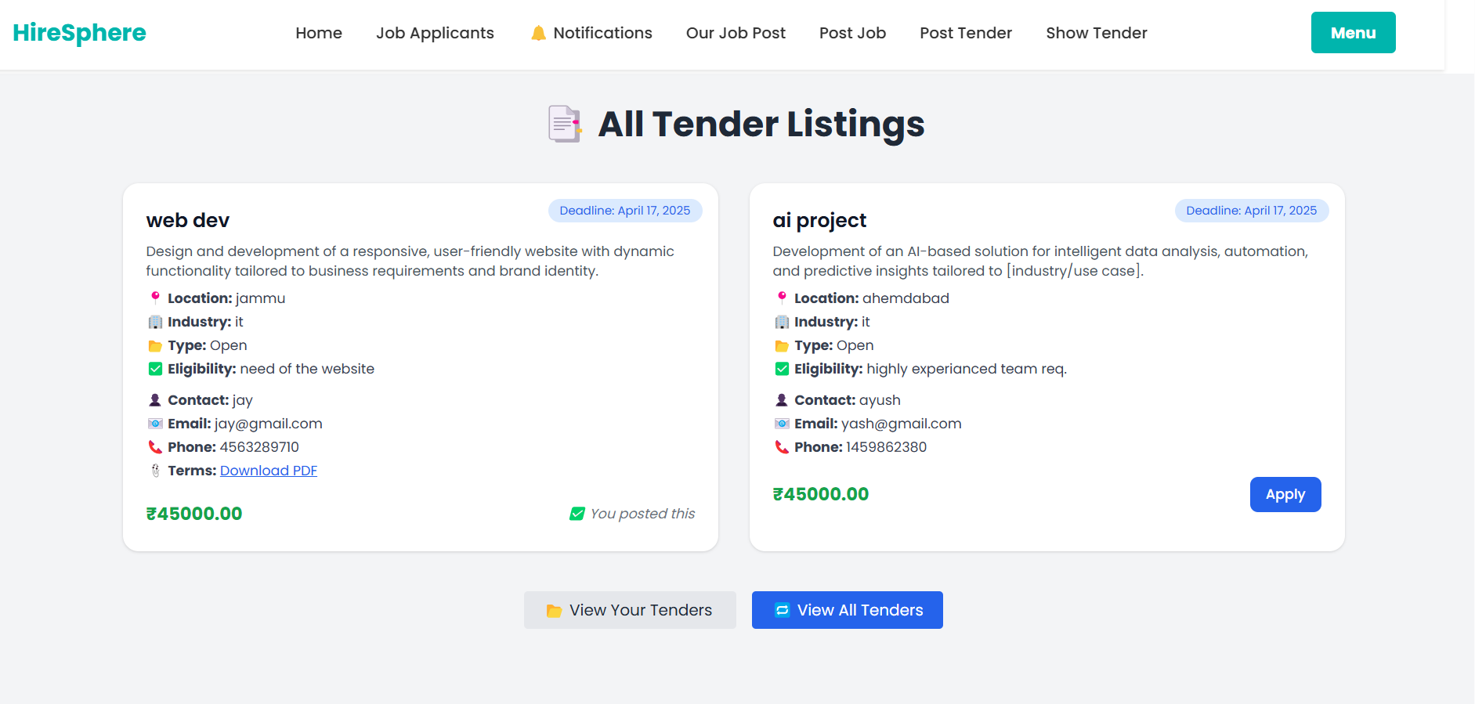
Tender List

Slide 21
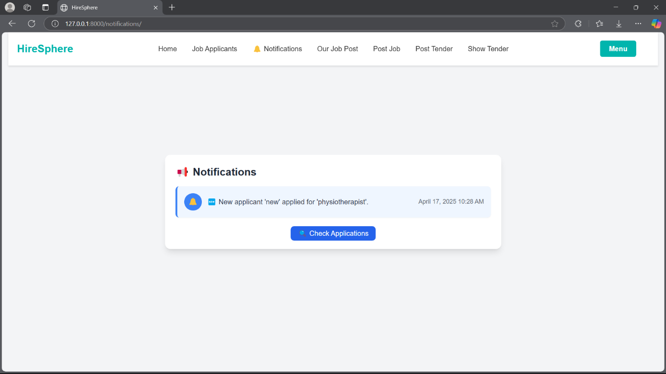
Company Notification

Slide 22
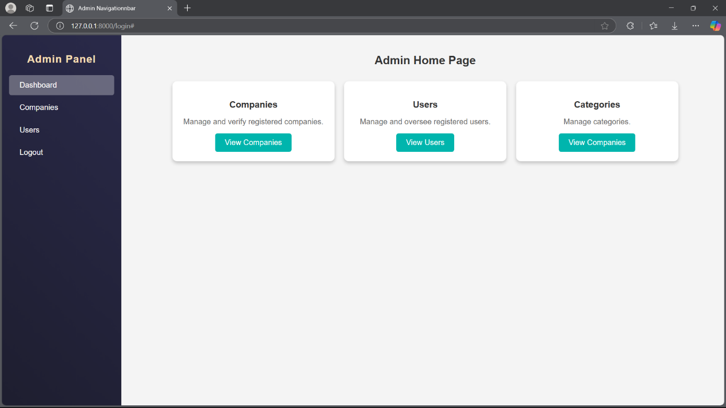
Admin Screen Layout
Admin Home Page

Slide 23
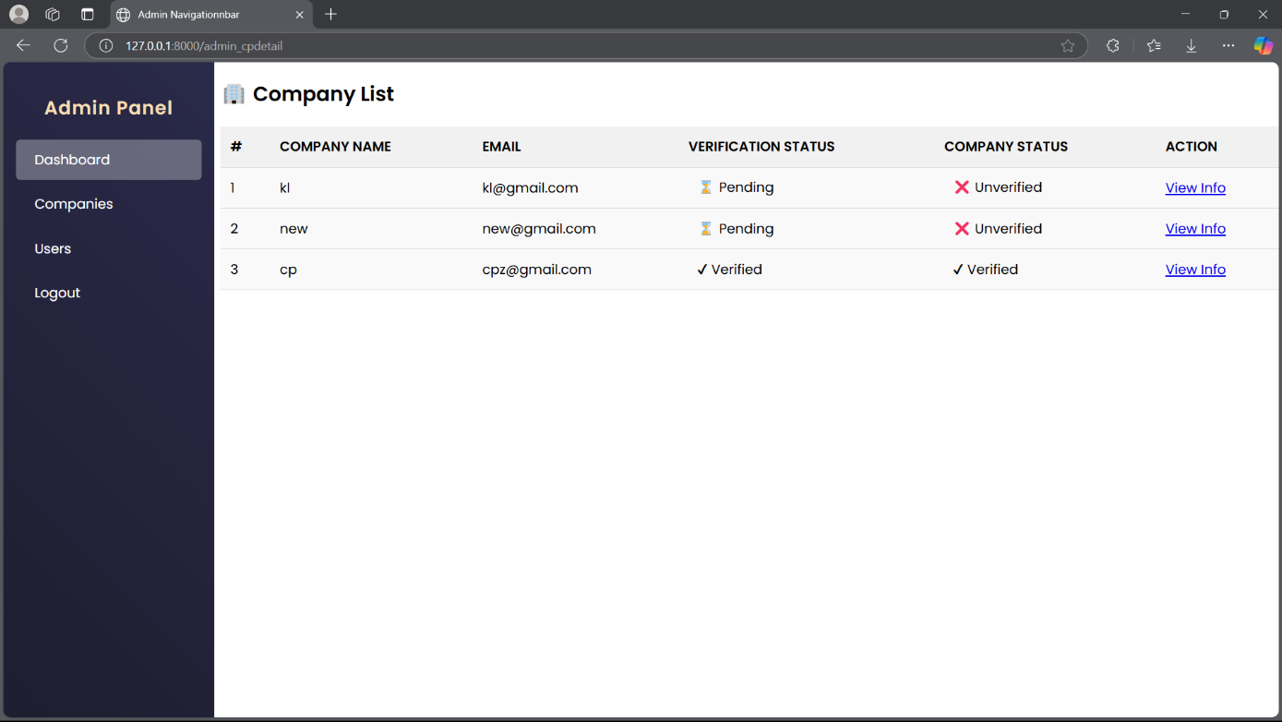
Company list

Slide 24
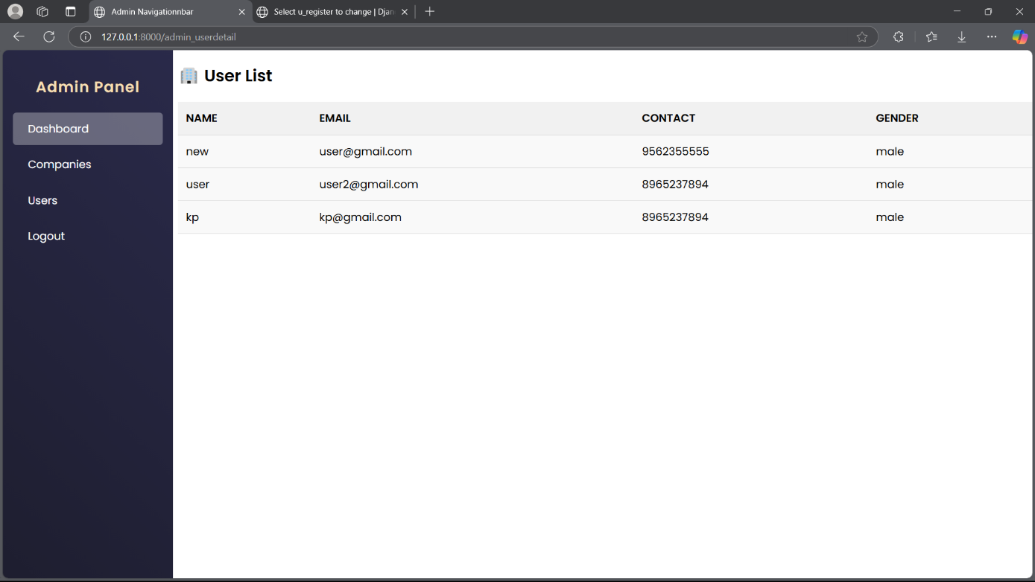
User List

Slide 25
Category List

Slide 26
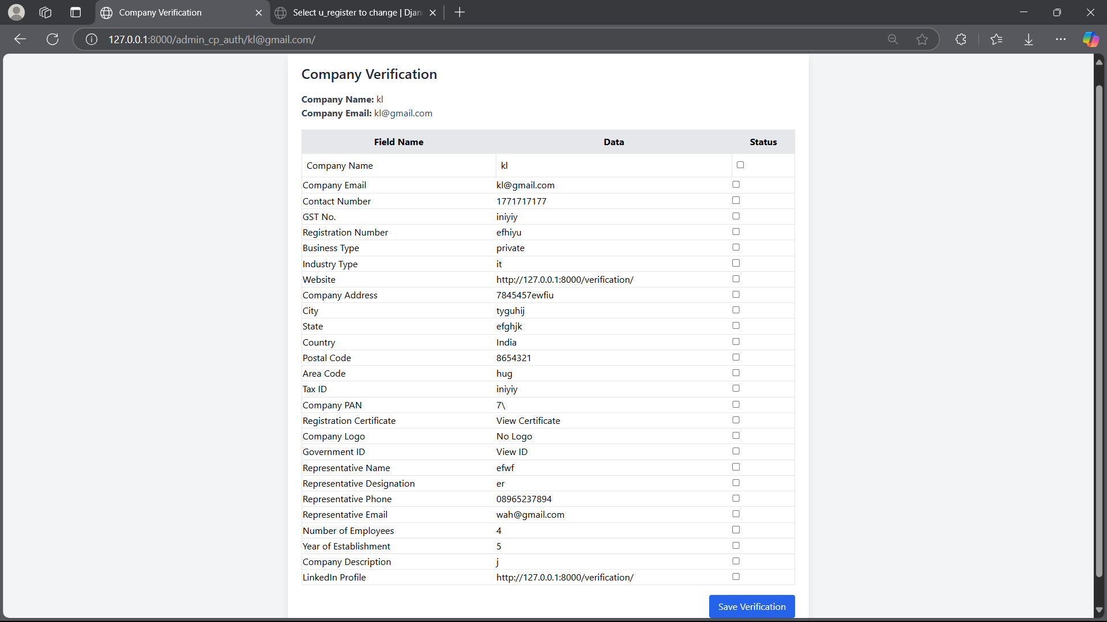
Company Verification page by admin

Slide 27
Future Enhancement
🔮What’s Coming Next – The Future of Your Career, Simplified
We're building more than just a job portal — we're creating your personalized career companion. Here's a sneak peek into features we're rolling out soon to empower every candidate to grow, learn, and get hired smarter:
📄 Smart Resume Highlighting
Stand out to top recruiters effortlessly. Our AI-enhanced resume builder will auto-optimize your profile based on job roles, trending skills, and recruiter preferences.
🧠 Skill Tests & Verified Certifications
Boost your credibility with built-in assessments. Whether you're into coding, design, marketing, or medicine — earn skill badges that recruiters trust.
✅ Personal To-Do & Smart Notes
Manage your applications, follow-ups, learning goals, and interview prep in one place. Stay focused and organized with personalized reminders.

Slide 28
📚 Integrated Learning & Research Hub
Books, courses, Wikipedia, YouTube explainers — all curated and categorized for your career path. Whether you're studying for an exam or brushing up before an interview, your digital study buddy is ready.
📅 Interview Scheduler & Calendar Sync
Never miss an opportunity. With automatic calendar integration, you'll receive alerts, prep tips, and reminders for every interview, test, or deadline.
🧩 Personal Study & Progress Dashboard
Visualize your goals, track your learning curve, and see how your skills stack up in your chosen field — whether you're a student or a

Slide 29
Conclusion
Online job portals make it easy for job seekers to find jobs and for employers to find candidates quickly. They save time and money by offering a centralized platform for job postings and applications. With features like job matching, they help connect the right candidates with the right roles. These portals also allow access to opportunities globally, breaking location barriers. As technology improves, they continue to add new features like video interviews and skill assessments, making the job search process more efficient.

Slide 30
Bibliography
https://www.w3schools.com/
https://www.google.com/
https://app.diagrams.net

