Slide 1
HEALTH INSURANCE PREDICTION
USING MACHINE LEARNING

Slide 2
LINKS
Dataset Link
Google Colab Link

Slide 3
OBJECTIVE
The objective is to predict whether or not a person has health insurance using various machine learning models and see which one gives the best result. The “Response” is the target variable.

Slide 4
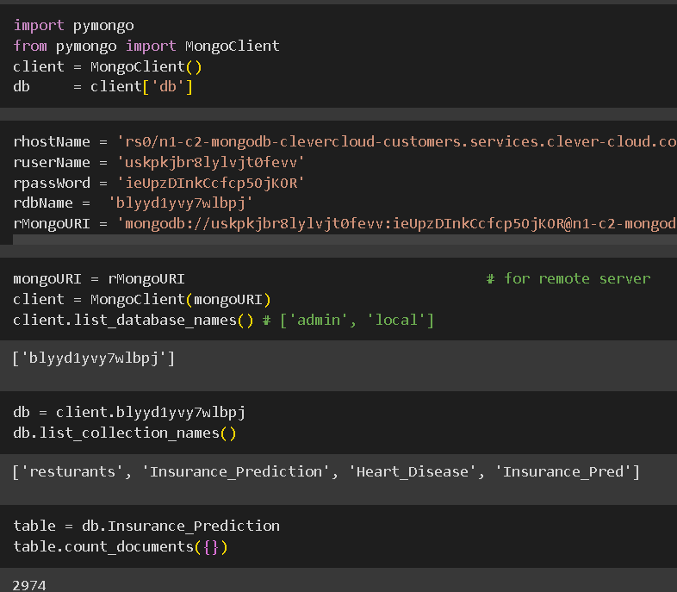
MONGO DB
Data stored in Mongo DB remote server.
Clever Cloud used to host the data.
Data fetched from the cloud using Clever Cloud credentials and proceeded with EDA.

Slide 5
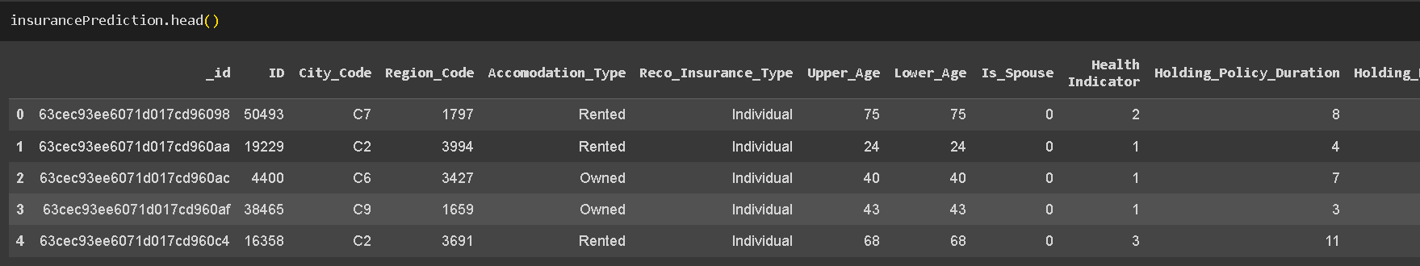
DATASET
Health Insurance dataset downloaded from Kaggle.
There are 11 columns.
The “Response” column is the target variable.
There are no null values in the dataset.
There are 2974 records.

Slide 6
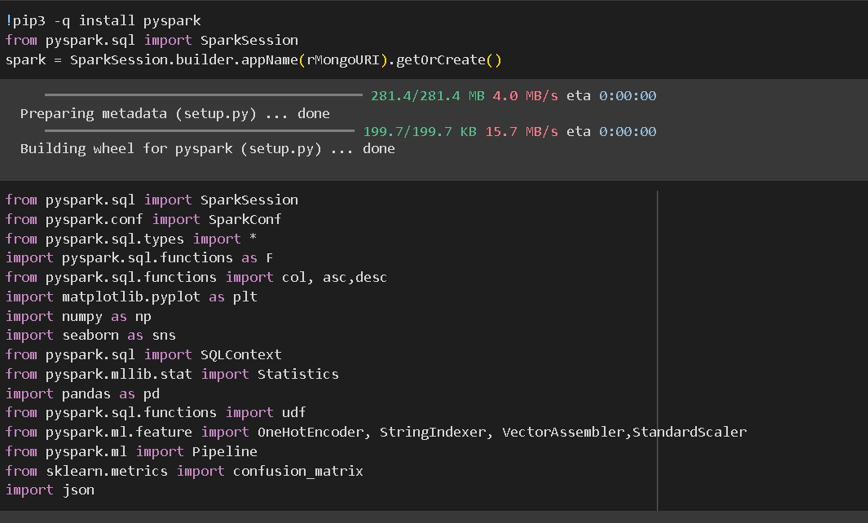
INITIALISING SPARK
Installed Pyspark in google colab.
Imported all the necessary libraries.

Slide 7
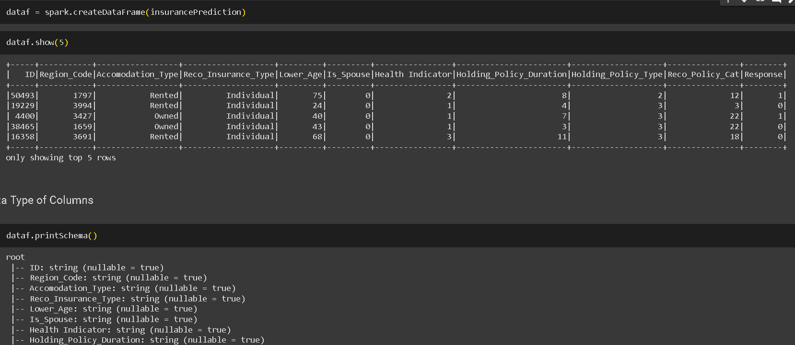
SPARK DATAFRAME & COLUMN DATATYPE
Created Spark Dataframe.
Checked and converted the column data types as required.

Slide 8
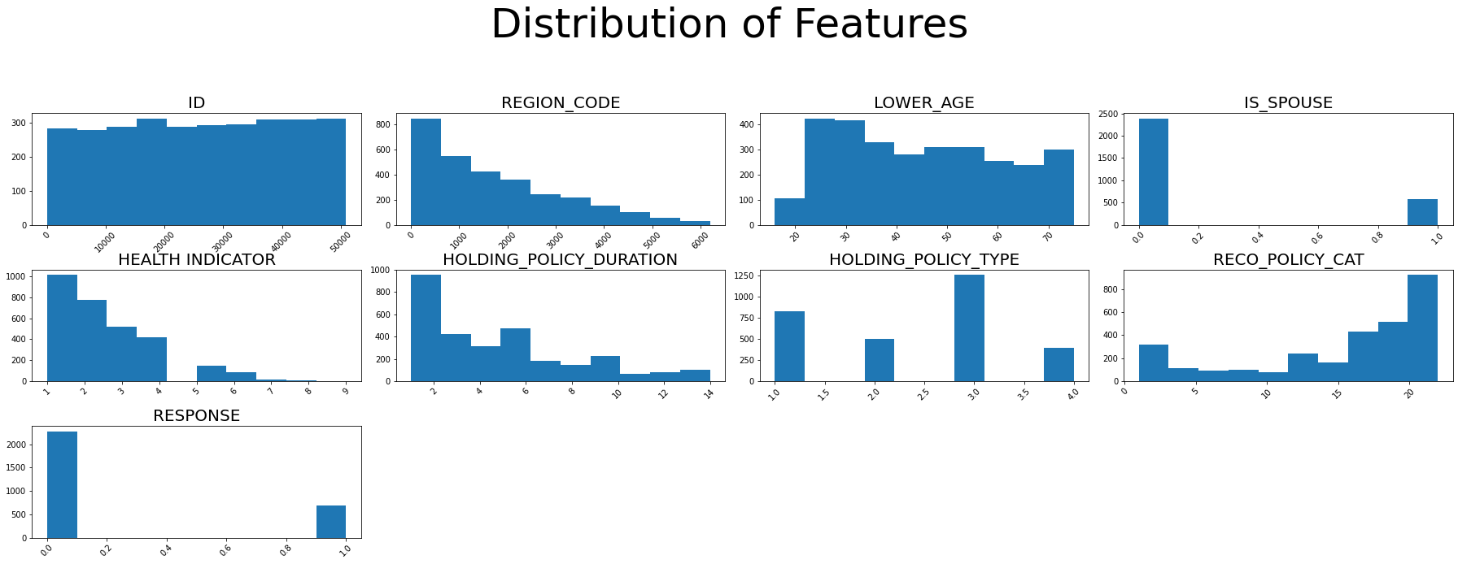
FEATURE DISTRIBUTION

Slide 9
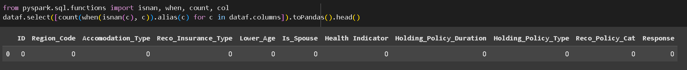
CHECKING FOR NULL VALUES

Slide 10
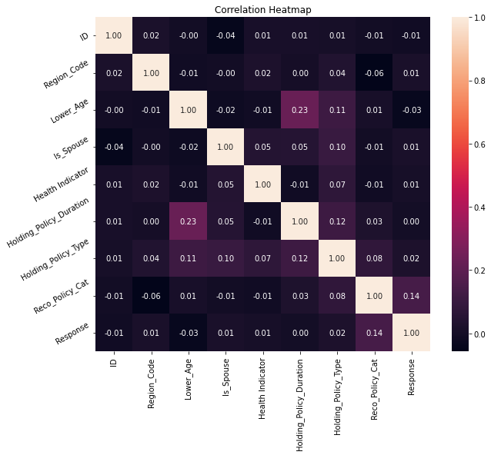
CORRELATION HEAT MAP
None of the variables have values more than 0.5.
Thus there is minimal chance of multicollinearity.

Slide 11
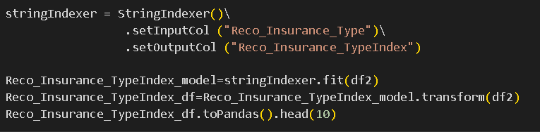
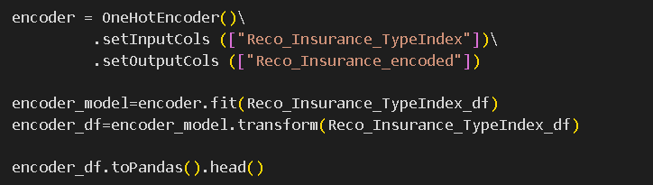
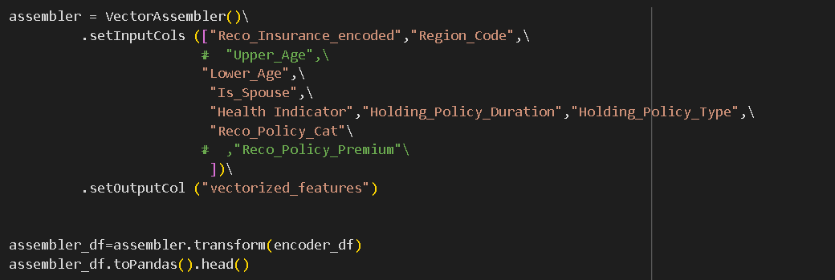
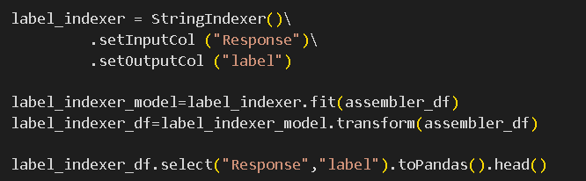
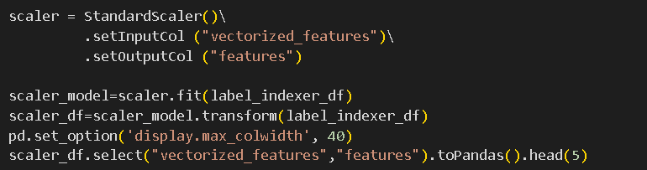
DATA PRE-PROCESSING
String Indexer
One Hot Encoder
Vector Assembler
Label Indexer
Standard Scaler

Slide 12
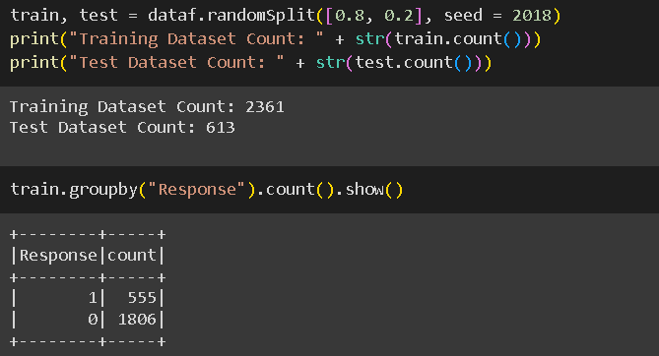
TRAIN TEST SPLIT
We split the data into two datasets – Train & Test.
80% of the data for training.
20% of data for testing.

Slide 13
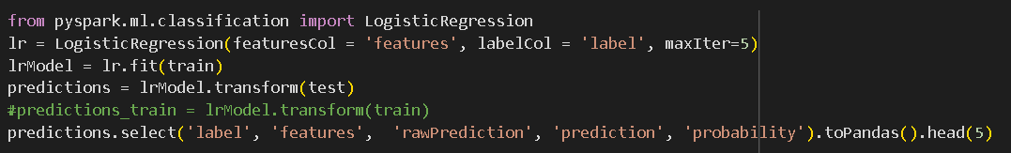
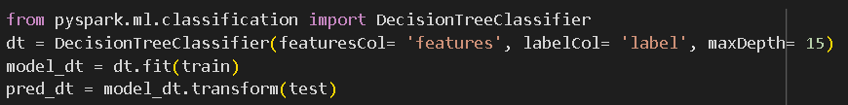
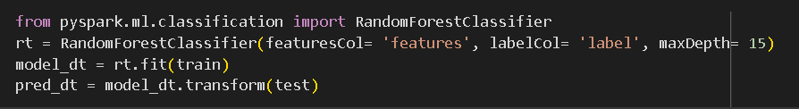
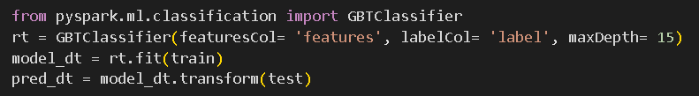
MODEL TRAINING
Logistic Regression
Decision Tree
Random Forest
GBT Classifier
4 different models used for training the data and the outputs were evaluated.

Slide 14
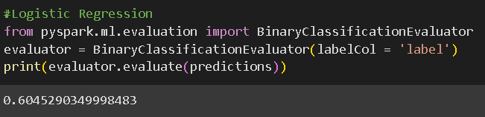
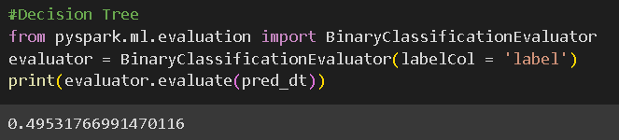
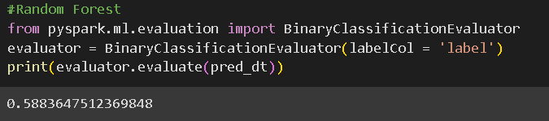
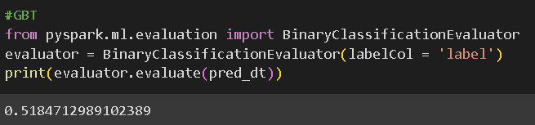
MODEL EVALUATION

Slide 15
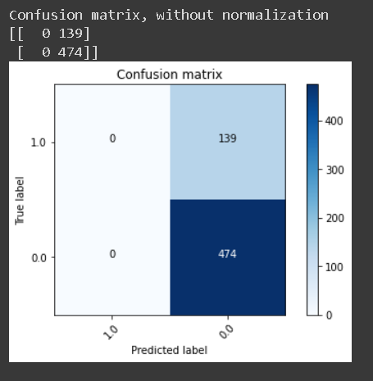
CONFUSION MATRIX

Slide 16
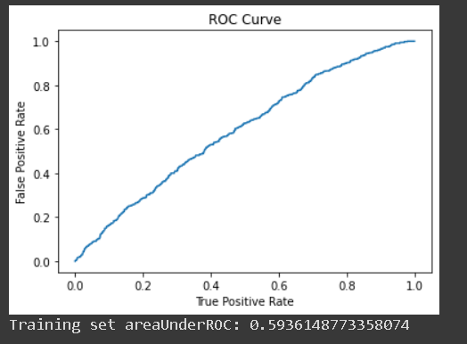
ROC CURVE

Slide 17
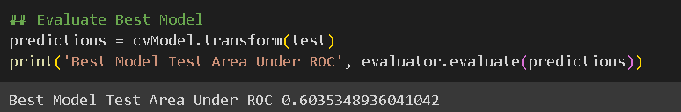
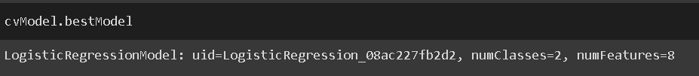
CONCLUSION - BEST MODEL

