Slide 1
Docker

Slide 2
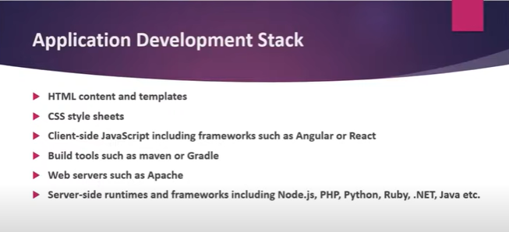

Slide 3
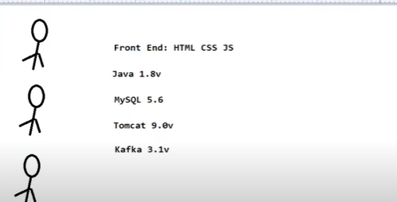
Lets take one example for development team

Slide 4
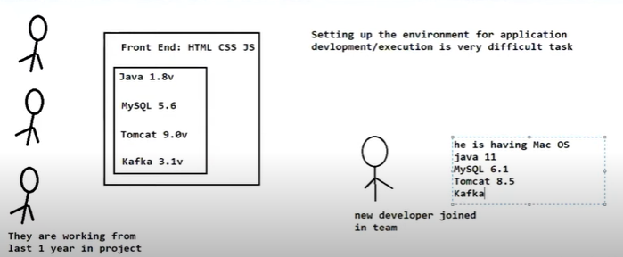

Slide 5
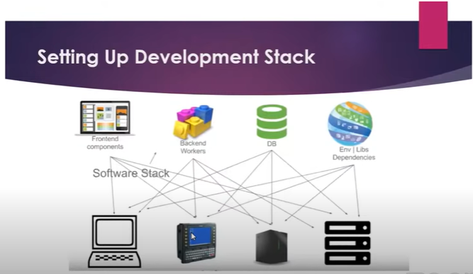

Slide 6
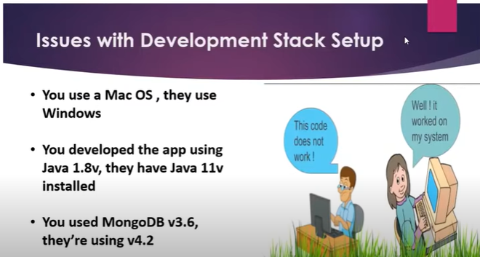

Slide 7
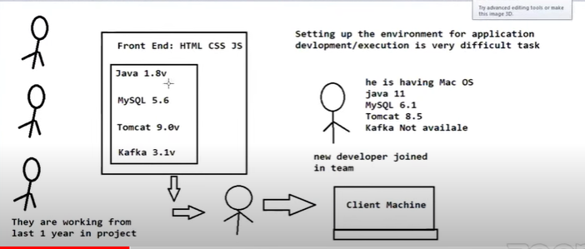

Slide 8
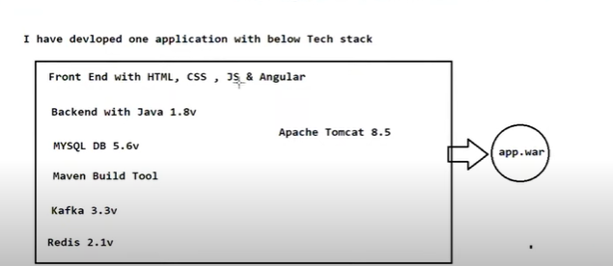

Slide 9
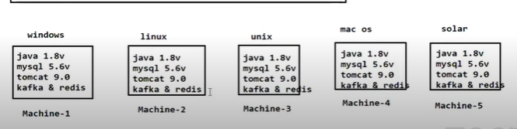

Slide 10
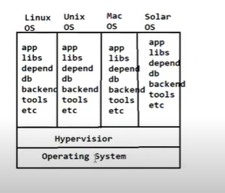

Slide 11
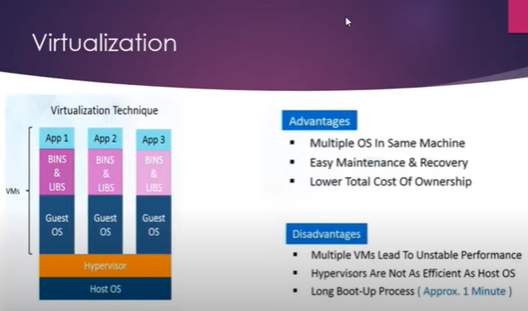

Slide 12
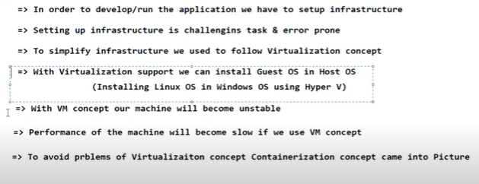

Slide 13
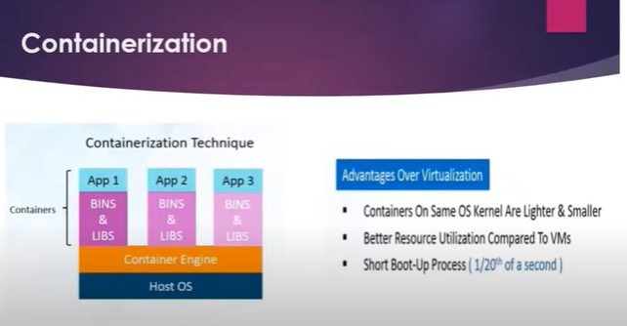

Slide 15
The Docker container can be moved from environment to environment very easily. In a DevOps life cycle, Docker really shines when used for deployment. When you deploy your solution, you want to guarantee that the code tested will actually work in the production environment. In addition, when you're building and testing the code, it's beneficial to have a container running the solution at those stages because you can validate your work in the same environment used for production.

Slide 16
Docker is an OS virtualized software platform that allows IT organizations to quickly create, deploy, and run applications in Docker containers, which have all the dependencies within them. The container itself is a very lightweight package with all the instructions and dependencies—such as frameworks, libraries, and bins—within it.

Slide 17
You can use Docker throughout multiple stages of your DevOps cycle, but it is especially valuable in the deployment stage, especially since it allows developers to use rapid deployment. In addition, the environment itself is highly portable and was designed with efficiencies that will enable you to run multiple Docker containers in a single environment, unlike traditional virtual machine environments.

Slide 18
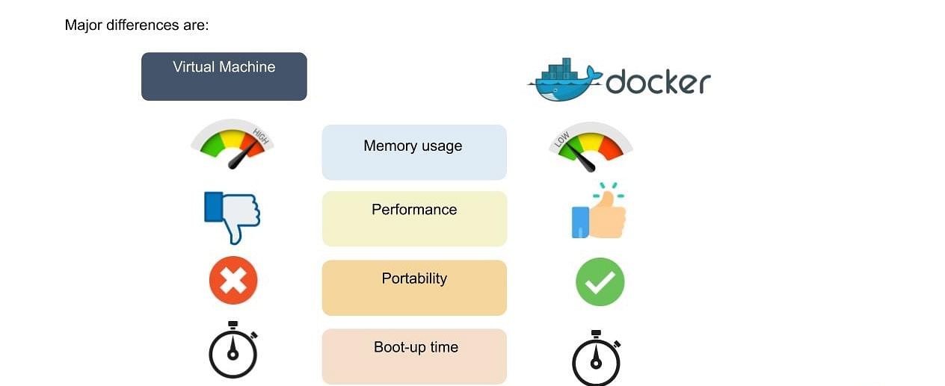

Slide 19
The virtual environment has a hypervisor layer, whereas Docker has a Docker engine layer.
There are additional layers of libraries within the virtual machine, each of which compounds and creates very significant differences between a Docker environment and a virtual machine environment.
With a virtual machine, the memory usage is very high, whereas, in a Docker environment, memory usage is very low.
In terms of performance, when you start building out a virtual machine, particularly when you have more than one virtual machine on a server, the performance becomes poorer. With Docker, the performance is always high because of the single Docker engine.
In terms of portability, virtual machines just are not ideal. They’re still dependent on the host operating system, and a lot of problems can happen when you use virtual machines for portability. In contrast, Docker was designed for portability. You can actually build solutions in a Docker container, and the solution is guaranteed to work as you have built it no matter where it’s hosted.

Slide 20
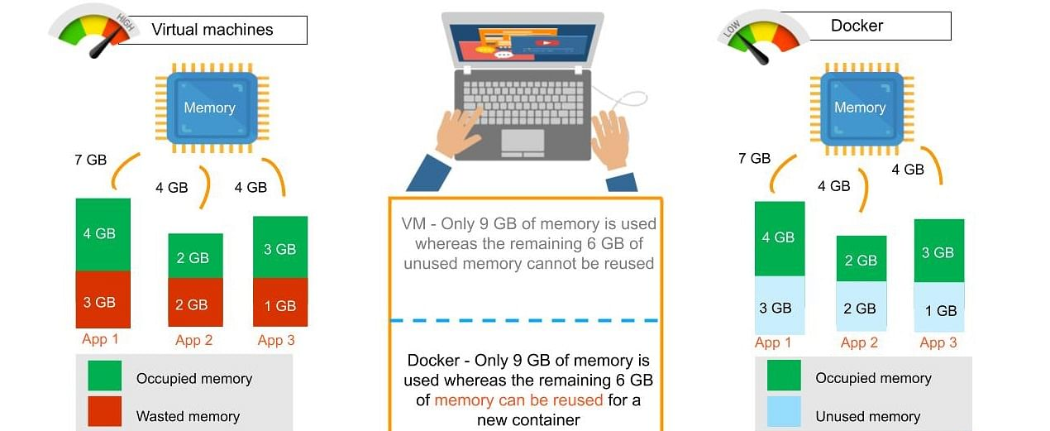
The boot-up time for a virtual machine is fairly slow in comparison to the boot-up time for a Docker environment, in which boot-up is almost instantaneous.

Slide 21
One of the other challenges of using a virtual machine is that if you have unused memory within the environment, you cannot reallocate it. If you set up an environment that has 9 gigabytes of memory, and 6 of those gigabytes are free, you cannot do anything with that unused memory. With Docker, if you have free memory, you can reallocate and reuse it across other containers used within the Docker environment.
Another challenge of virtual machines is that running multiples of them in a single environment can lead to instability and performance issues. Docker, on the other hand, is designed to run multiple containers in the same environment—it actually gets better with more containers run in that hosted single Docker engine.
Virtual machines have portability issues; the software can work on one machine, but if you move that virtual machine to another machine, suddenly some of the software won’t work, because some dependencies will not be inherited correctly. Docker is designed to be able to run across multiple environments and to be deployed easily across systems.
The boot-up time for a virtual machine is about a few minutes, in contrast to the milliseconds it takes for a Docker environment to boot up.

Slide 22
How Does Docker Work?
Docker works via a Docker engine that is composed of two key elements: a server and a client; and the communication between the two is via REST API.
The server communicates the instructions to the client. On older Windows and Mac systems, you can take advantage of the Docker toolbox, which allows you to control the Docker engine using Compose and Kitematic.

Slide 23
REST stands for Representational State Transfer. This means that when a client requests a resource using a REST API, the server transfers back the current state of the resource in a standardized representation.
Kitematic is an open source project built to simplify and streamline using Docker on a Mac or Windows PC. Kitematic automates the Docker installation and setup process and provides an intuitive graphical user interface (GUI) for running Docker containers.
Compose is a tool for defining and running multi-container Docker applications. With Compose, you use a YAML file to configure your application's services.

