Slide 1
INDUSTRIAL ETHICS
Unit-3 Lecture : STARTUP

Slide 2
WHAT IS A STARTUP?
If it is incorporated as a private limited company (as defined in the Companies Act, 2013) or registered as a partnership firm. (registered under section 59 of the Partnership Act, 1932) or a limited liability partnership (under the Limited Liability Partnership Act, 2008) in India.
Up to seven years from the date of its incorporation/ registration; however, in the case of Startups in the biotechnology sector, the period shall be up to ten years from the date of its incorporation/ registration.
If its turnover for any of the financial years since incorporation/ registration has not exceeded Rupees 25 crores.
If it is working towards innovation, development or improvement of products or processes or services, or if it is a scalable business model with a high potential of employment generation or wealth creation.

Slide 3
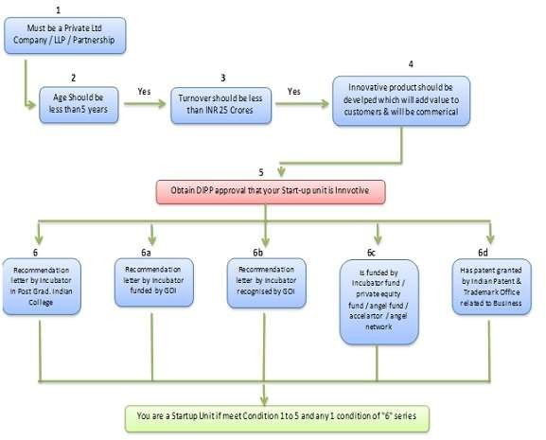
WHAT IS A STARTUP?

Slide 4
Startup India Benefits
IPR Benfits
To promote awareness and adoption of IPRs by Startups and facilitate them in protecting and commercializing the IPRs, Startup India provides access to high quality Intellectual Property services and resources
Fast-tracking of Startup patent applications:
The patent application of Startups is fast-tracked for examination and disposal
Panel of facilitators to assist in filing of IP applications:
A panel of Facilitators is responsible for providing general advisory on different IPRs as also information on protecting and promoting IPRs in other countries.
Government to bear facilitation cost: Central Government bears the entire fees of the facilitators for any number of patents, trademarks or designs that a Startup may file, & Startups only bear the cost of the statutory fees payable.
Rebate on filing of application: Startups are provided an 80% rebate in filing of patents vis-à-vis other companies. This helps them pare costs in the crucial formative years. 50% rebate is also provided in filing of Trademarks vis-à-vis other companies.

Slide 5
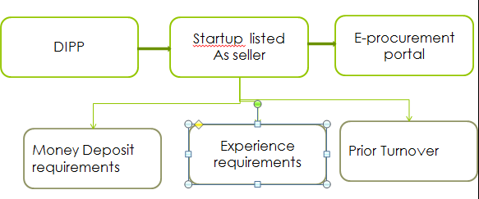
Relaxation in Public Procurement Norms

Slide 6
Relaxation in Public Procurement Norms
DIPP recognised Startups can now get listed as Sellers on the Government of India’s largest e- procurement portal. Government e-Marketplace! They are entitled to avail exemption on:
Prior Turnover and Experience requirements
Earnest Money Deposit requirements

Slide 7
Self-Certification under Labour and Environment Laws
To reduce the regulatory burden on Startups thereby allowing them to focus on their core business and keep compliance cost low, Startups are allowed to self-certify their compliance under 6 Labour and 3 Environment laws for a period of 5 years from the date of incorporation.

Slide 8
Fund of Funds for Startups
To provide equity funding support for development and growth of innovation driven enterprises, the government has set aside a corpus fund of 10,000 crores managed by SIDBI.
The Fund is in the nature of Fund of Funds, which means that the Government participates in the capital of SEBI registered Venture Funds, who further invest in Startups.

Slide 9
Faster Exit for Startups
MCA has notified Startups as ‘fast track firms’ enabling them to wind up operations within 90 days vis-a-vis 180 days for other companies. An insolvency professional shall be appointed for the Startup, who shall be in charge of the company for liquidating its assets and paying its creditors within six months of filing an application in this regard.

Slide 10
Tax Exemption
IMB Certified
The Inter-Ministerial Board validates the innovative nature of the business for granting tax related benefits and is constituted by representatives from DIPP, DBT, DST and MEITY.
Startups incorporated on or after 1st April 2016 can apply for tax benefits and such innovative applications are then moderated by the Inter Ministerial Board before granting the certificate of eligibility.

Slide 11
Tax Exemption for 3 years
The profits of recognised Startups that are granted an Inter-Ministerial Board Certificate are exempted from income-tax for a period of 3 years (out of a block of 7 years). This fiscal exemption is aimed at facilitating growth of business and meeting the working capital requirements during the initial years of operations
Tax Exemption on Investment above Fair Market Value
If a Startup, having certificate from the Inter-Ministerial Board Certificate, receives any consideration for issue of shares that exceeds the face value of such shares, then the aggregate consideration received for such shares as exceeds the fair market value of the shares is exempted from tax.

Slide 12
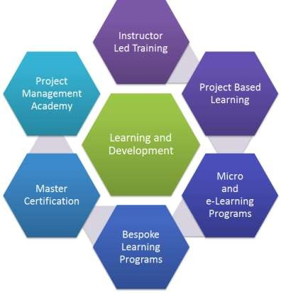
RESOURCES FOR STARTUPS
Learning and Development Program

Slide 13
RESOURCES FOR STARTUPS
Learning and Development Program
The website hosts a variety of courses which broadens the vision of budding entrepreneurs and guides them through the journey of their Startup venture. The program covers lessons on key areas of starting up by 40+ top founders of India in an extensive 4-week program. Not just that, upon completion of the course, the apprentice receives a certificate acknowledging their effort and certifying their learnings in the program.

Slide 14
Government Schemes
Many government departments are working to promote entrepreneurship in India. Startup India has collated various schemes from various ministerial bodies at one place to facilitate and save your time from jumping between websites!
State Government Policies
Startup India presents to you a list of 17 state government policies who offer benefits to Startups! Startups and entrepreneurs across these states can access the policy documents, website links and contact details of the respective nodal agencies.

Slide 15
Pro-Bono Services
In our endeavour to make starting up easy for startups,we bring you the best of some relevant services out there in the market free of cost, only for you. We have collaborated with leading corporates, the likes of Amazon Web Services, Zoho, Vakil search and others to bring you these services. Whether you want to build an app, use cloud credits or get cloud telephony services, everything here is free of cost for you.
Knowledge Bank
Registering a company is not a cake walk if you do not know the legalities. Startup India provides a knowledge bank detailing the requirements for starting a business in India; be it registering a company, filing IPRs, complying to tax policies or understanding the investor landscape in India! Startup India has got you covered and you do not need to spend time surfing the internet or gain information from disintegrated sources!

Slide 16
Market Research Reports
We understand the depth of knowledge you would require about your industry to scale new heights. We bring to you the latest market research reports by leading publishers such as Tracxn, Inc42 and NASSCOM.
Networking And Discussion
All members of the startup ecosystem – Startups, investors, mentors, incubators, accelerators and government bodies can connect with each other on this platform. The platform provides the eco system stakeholders with the opportunity to discuss – express and opine on the forum through discussion threads – blogs and one to one messaging.

Slide 17
10000 STARTUPS
10,000 Startups aims at building a cross-collaborative platform to enable startups to grow to the next level by leveraging our network of investors, mentors, industry experts, and enterprises.
FAME MODEL(Funding, Acceleration, Mentoring, and Enterprise connects)
The 10,000 Startups FAME model is designed to facilitate the ideal connection between startups and Funders, Accelerators, Mentors, and Enterprises with complementary requirements, so that they may mutually benefit from each other

Slide 18
10000 NASSCOM
Funding: The NASSCOM 10,000 Startups programme helps shortlisted startups raise money from a wide range of investors- angels, micro VCs, VCs, and Government funds.
Acceleration: Once shortlisted for the programme, startups can work with the top accelerators. The NASSCOM 10,000 Startups programme presents unprecedented opportunities and a fast track into the top accelerators for shortlisted startups.
Mentoring: Focused group workshops are held for the shortlisted companies on Product Management, Go-to-Market Strategy, Pitching and Industry Insights from the experts.
Enterprise connect: Shortlisted startups get opportunities to showcase their product to top executives across industries and explore strategic partnerships, alliances, M&As , etc., and

Slide 19
PROGRAMS AND EVENTS
Apart from the FAME framework, we also offer a number of programs and events that are designed to help deserving startups through various stages of their growth
Warehouse Program :-
The Warehouse Program is the perfect package to provide fledgling companies with everything they’ll need for the initial stages of their startup journey, from a physical workspace and furniture, to expert guidance and networking opportunities.
Eligibility Criteria
Only startups with a minimum viable technology product are eligible to apply for this program. It is strongly suggested that the product be beyond its ideation phase.
Virtual program :-
Our Virtual Program is designed to help growth-stage startups that have their own workspaces take their business to new heights. The program creates the optimal environment for such startups to scale up by providing support in the form of a startup kit, and connecting the company with our widespread network of evaluators and mentors, who are also investors, accelerators, and industry veterans.
Eligibility Criteria :-
Startups in the growth stage that have a reasonable amount of traction with a product already out in the market may apply for the Virtual Program.

Slide 20
NASSCOM Industry Partnership Program
NASSCOM is India’s largest industry-backed corporate innovation program. The NASSCOM Industry Partnership Program (NIPP) seeks to foster sustained engagement between large corporations and innovative technology ventures
in India.
BENEFITS:-
Direct fast access to senior executives
Branding / PR evangelism
Access to executive mentoring, early technology, and deep expertise
Access to strategic investments and grants
Faster access to global markets and JV/OEM/partnership options
Participate in customer showcases, events, speaking opportunities, and delegations

Slide 21

NIPP Partners

Slide 22
Rockstar program:-
The Rockstar Program is designed with the intent of making India a tech- innovation hub in the global arena. It will bring to the limelight innovations with disruptive potential, helping them gain worldwide recognition and trust.
RECOMMENDED CRITERIA :-
An IT product company incorporated in India whose product development is carried out in India or outside
An IP-backed company involved in technology product or technology platform, with the focus being on SaaS, IoT/robotics, blockchain, AI/ML/deep learning, and AR/VR
A company that has a commercialised product with paying customers
A company that stands out in emerging technologies with the domain focus being health, finance, retail, education, and enterprise

Slide 23
Nasscom Gaming Forum
NASSCOM ® is India’s premier trade body and chamber of commerce for the IT industry, and the NASSCOM Gaming Forum (NGF) was set up ten years ago to provide a common platform to share best practices and knowledge to developers and businesses within the Indian gaming industry, especially the burgeoning indie game dev community.
NASSCOM Game Developer Conference (NGDC)
The NASSCOM Game Developer Conference (NGDC) is India’s primary platform for creators and enthusiasts of computer, mobile, console, web, and social games to showcase, inspire, learn, and interact.

Slide 24
Nasscom Gaming Forum
NASSCOM Game Developer Conference (NGDC)
NGF Awards:-
Student game of the year
Indie game of the year
Studio Game of the Year
Upcoming Game of the year
BYOG
Incubation services
Game Jam Titans

Slide 25





Slide 26
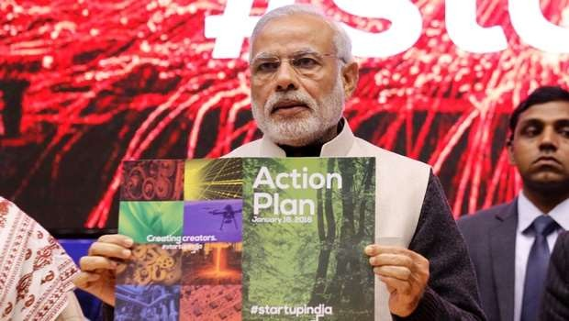
“Startup India Hub will be a single point of contact for the entire ecosystem and enable knowledge exchange and access to funding”
– Startup India Action Plan , Jan 2016
CONSOLIDATE THE CURRENT ECOSYSTEM
Bring all stakeholders to a common
platform
Value proposition for all stakeholders
Launched by Shri Narendra Modi
Hon’ble Prime Minister of India 16th January 2016
GROW THE ECOSYSTEM
Connect with global ecosystem
Stimulate others to join the ecosystem
FACILITATE STAKEHOLDERS
Access to information and knowledge
Handholding support

Slide 27




How to Define a startup?
Government of India Definition
AGE
ENTITY TYPE
TURNOVER
NATURE OF
INNOVATION
7 years from date of incorporation (10 yrs for biotech)
Pvt. Ltd. Company or LLP or
Partnership Firm
Must not exceed INR 25 Cr. in in any fiscal year
Developing new
or improving
existing
product/service
offering

Slide 28
Recognition Procedure
Government of India Recognition
ONLINE APPLICATION FORM
UPLOAD SUPPORTING DOCUMENTS
APPLICATIO N EVALUATION
RECOGNITION AS STARTUP
15 – 20 minutes |  | 24 - 48 hrs
Submit details on Startupindia.gov.in
Founder & Team Details
Entity Details
Business model
IP details
Startup India Team evaluates proposal and takes action within 24 - 48 hrs of
If suitable, then application
approved,
If answers are not suitable, then second chance given to startups to reapply

Slide 29
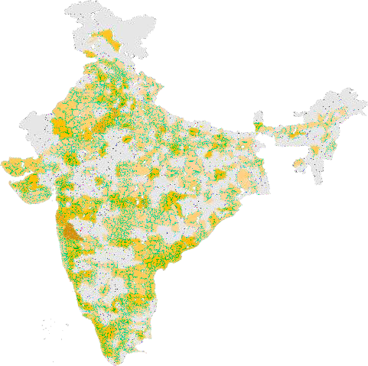

Startup India
Starting a startup revolution
STARTUP INDIA RECOGNITION
0 40 800
NO. OF START0UPS RECOGNIZED
11,634
Startups Recognized with the Government of India
448 | 29 | 6
Districts | States | Union Territories
56% | 27% | 17%
Tier 1 Cities | Tier 2 Cities | Tier 3 Cities

Slide 30

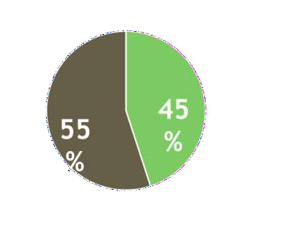


Nation of Job Creators
Shaping a New India
12 Jobs
per startup*
*1,06,618 JOBS REPORTED BY 9,091 STARTUP INDIA RECOGNISED STARTUPS
DISTRIBUTION OF STARTUPS WITH ATLEAST 1 OR MORE WOMEN DIRECTOR (S)

Slide 31





Process simplification
Encouraging startups
Government
Procurement
Patent
Granted
Tax
Benefit
Compliance
Regime
Faster
Exit
2018
Fast Track
Examination
Income Tax Exemption
Self
Certification
Exempted
90 Days
Experience, Turnover, EMD required
Time Consuming Process
2014
Nil
Physical Inspection
> 4 years

Slide 32

Funding Innovation
Fund of Funds
₹ 10,000 Cr. corpus to be provided by Mar’25
DIPP
SIDBI
27 VCFs
142 Startups
₹ 2,200 Cr.
Authorised
₹ 1,285.7 Cr.
committed
₹ 180 Cr.
disbursed
Catalyze investment
of ₹ 600 Cr.
Government Contribution Catalysing 10X Funds for Startups
₹1,285.7 Cr.
Government Commitment
₹ 7,036 Cr.
Corpus made available to startups
₹ 13,888 Cr.
Target Corpus to be made
available to startups

Slide 33

Startup India
Benefits for startups
Relaxation of Public Procurement Norms
Relaxation of turnover, experience, & EMD condition for startups
All Central Public Sector Undertakings to follow procedures and give preferential treatment to startups
DIPP Recognised startups can directly register and sell on Government-e-marketplace (GeM) with no requirement of turnover & experience criteria

Slide 34

Startup India
Benefits for startups
Patent & Trademark Benefits
80% rebate in patent filing fees
50% rebate in trademark filing fees
Empanelled 1,019 facilitators for free of cost
filing & facilitation
Government to reimburse facilitators’ cost
801 applications have received 80% patent rebate
1,226 applications have received 50% trademark
rebate

Slide 35

Startup India
Benefits for startups
Facilitation & Handholding
Dedicated facilitation support team at Invest India to handhold startups
48 hr response time for any startup enquiry made
via email, twitter, or call centre
1,05,230 enquiries have been successfully resolved so far
547 startups mentored and facilitated by team (such as business advisory, financial advisory, tax & legal support, stakeholder introduction etc.)

Slide 36

Startup India
Benefits for startups
Easier Compliances
Inspections against 6 labour & 3 environmental laws relaxed for startups
Startups now allowed to self certify against laws;
easing compliances for startups
Insolvency & Bankruptcy board constituted for fast track exit
90 day period for winding up operations as
opposed to 4 yrs earlier

Slide 37



Startup India
Benefits for startups
Tax Exemptions
Tax exemption on investment from investor against issue of share capital and on profits and gains from income for 3 years
Startups can apply to avail exemption under Section 56 and
Section 80 IAC of the Income Tax Act, 1961
Operating Guidelines Formulated
Evaluation Criteria |  | Inter Ministerial Board
Innovation & Uniqueness Share Capital details Merchant banker report Details of Issue of Shares Investor Details |  | DIP 5. CBD P T DBT 6. SEBI
3. DST
7. RBI
4. Mei
tY
8. MCA

Slide 38

Funding Innovation
Building Capacities
INNOVATORS
Atal Tinkering Labs ₹ 488 cr.
Scheme run by NITI Aayog to set up tinkering labs in schools across India where young minds can give shape to their ideas through hands-on, do-it- yourself learning
2441 schools across India have been selected to setup tinkering labs
Grant-in-aid of INR 20 Lakhs per lab over a period of 5 years

Slide 39
Funding Innovation
Building Capacities
INNOVATORS
MANAK ₹ 30 cr.
Scheme run by Dept. of Science & Technology to strengthen science and technology system, increase R&D human resource base by inviting students from all government and private schools to send their original and creative technological ideas/innovations.
30,678 students received a grant of INR 10,000 each

Slide 40
Funding Innovation
Building Capacities
INNOVATORS
Uchhattar Avishkar Yojana ₹ 258 cr.
Scheme run by Min. of Human Resource Development to jointly fund
research projects, along with private entities, undertaken by IIT students
Funding support provided to 85 research projects at various IITs, for product development & commercialization

Slide 41
Funding Innovation
Building Capacities
INFRASTRUCTURE
Incubation Centres ₹ 244 cr.
Supporting creating of world class incubation facilities across India that will enable entrepreneurs by mentoring and cultivating their ideas into successful ventures
NITI AAYOG
Dept. of Science & Technology
Dept. of Biotechnology

Slide 42
Funding Innovation
Building Capacities
INFRASTRUCTURE
Research Parks ₹ 665 cr.
Scheme run by Min. of Human Resource Development to setting up research facilities for incubation and joint Research and Development (R&D) efforts between academia and industry
Establishment of R&D facilities across 7 IITs & IISc Bangalore ( i.e.
academia-industry collaboration)

Slide 43
Funding Innovation
Building Capacities
INFRASTRUCTURE
Bio Clusters & Regional Centres₹ 412 cr.
Spearheaded by Dept. of Biotechnology to promote innovation among
Biotech companies and support commercialization of research
4 bio-clusters at Kalyani, Bangalore, Faridabad & Pune
3 BIRAC Regional Centres at Hyderabad, Bangalore & Pune

Slide 44






Startup India Online Hub
India’s Largest Virtual Incubation Platform
www.startupindiahub.org.in
Information Discovery
Curated Learning
Discover, Connect, & Engage with Ecosystem Stakeholders
Programs
Invest or
Networking &
Engagement
Ment or
Govt . Bodies
Tools & Templates
St ar t up
Applications to enablers
Incubat or
Accelerat or

Slide 45


Startup India Learning Program
4 weeks long || Free of Cost || English & Hindi
Course Content
Startup India Learning Program
Idea Assessment
Building a Legal Foundation
Finance Basics
Business Planning
Additional Resources
Discussion forums
Online workshops
Templates/ Resources
Fundraising & Valuation
Business Plan

