Slide 1

INTELLECTUAL PROPERTY
Intellectual Property refers to creation that arises from the human intellect i.e. inventions in all fields of human endeavor, scientific discoveries, industrial designs for article, literary & artistic work, symbols etc. used in commerce.
Nature/ characteristics of Intellectual Property:
Creation of human mind (Intellect)
Intangible property (Intangible property, also known as incorporeal property, is something that a person or corporation can have ownership of and can transfer ownership to another person or corporation, but has no physical substance, for example brand identity or knowledge/intellectual)
Exclusive rights given by statutes
Time-bound and Territorial/Jurisdictional
Notes:
The domain of intellectual property is vast.
Copyrights, Patents Trademarks and Designs are
known to have received recognition for a long time.
Newer forms of the protection are also emerging
particularly stimulated by the exciting developments
in scientific and technological activities.
Generally, it encompasses four separate and
distinct types of intangible property namely — patents, trademarks, copyrights, and trade secrets, which
collectively are referred to as “intellectual property.” However, the scope and definition of intellectual property
is constantly evolving with the inclusion of newer forms under the gambit of intellectual property. In recent
times, geographical indications, protection of plant varieties, protection for semi-conductors and integrated
circuits, and undisclosed information have been brought under the umbrella of intellectual property.

Slide 2
What is Intellectual Property Right (IPR)?
Intellectual Property Right
not to be confused with IP
it is a right vested in the asset, not the asset itself. (This means a person or other entity can have a vested interest in a tangible or intangible asset if there are no conditions to its ownership. The time during which a person or entity is required to wait before exercising ownership of the asset is known as the vesting period)
e.g.
an idea / invention is IP, a patent registration is an IPR
a customer / price list is IP, a right of confidentiality is an IPR
a secret production method is IP, a right to a trade secret is an IPR
a particular way of representation is IP, copyright or a design registration is an IPR
a brand / trade name is IP, a trade mark registration is an IPR

Slide 3
How Intellectual Property Law Works
Affirmative Rights, NOT Protection
Allows owner to file a lawsuit against a transgressor(a person who breaks a law or moral rule: The system seems to be designed to punish the transgressor rather than help his victim)
Does not stop a transgressor

Slide 4
Intellectual Property Rights
“COPYRIGHT”
LITERARY
NOVEL
POEM
PLAYS
FILMS
MUSICAL
ARTISTIC
DRAWINGS
PHOTOGRAHS
PERFORMING ARTS
SCULPTURES
SOFTWARE
“INDUSTRIAL PROPERTIES”
PATENTS
INDUSTRIAL DESIGNS
TRADEMARKS
TRADE SECRETS
PLANT VARIETIES
INTEGRATED CIRCUITS
GEOGRAPHICAL
INDICATORS

Slide 5
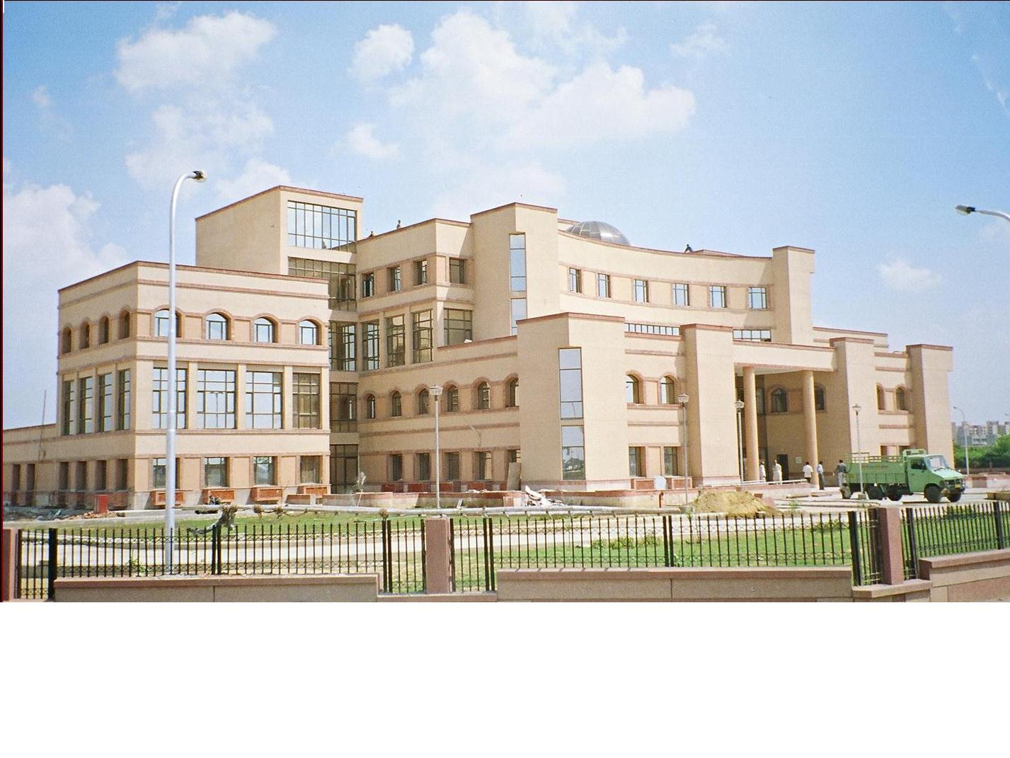

Intellectual property
INDUSTRIAL PROPERTY
+
COPY RIGHT
PATENTS
DESIGNS
TRADEMARKS
Geographical Indications
Patents & Designs
Patent Information
P I S
P A T E N T O F F I C E
T r a d e M a r k s R e g i s t r y
GOVERNMENT OF INDIA
Trade Marks
C o p y r i g h t o f f i c e
Copy Right
GIR
Geographical Indications

Slide 6
INDUSTRIAL PROPERTY
Patents | Designs | Trade- Marks | Geographical Indications
Inventions relating to constructional features | any modification in shape,pattern, configuration | Word Name Logo | Indications of source origin or geography
e.g. Safety Valve, Mechanism of a PRESSURE COOKER | e.g. shape of a handle or body portion of a pressure cooker | e.g. for same Pressure Cooker “PRESTIGE” “HAWKINS” “MAHARAJA” | Darjeeling tea Kanchipuram sarees KolhapurI chappals

Slide 7

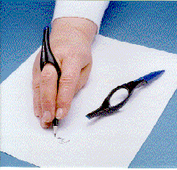
Intellectual Property Rights
PATENT
Design
TRADE MARKS
The RingG-PENTM
Flair, Reynolds, Cello, luxure etc.
© Patent Office ,New Delhi

Slide 8
Trade-Related Aspects of Intellectual Property Rights(TRIPS) in the World Trade Organization Compliance
Agreement enhanced the protection and enforcement of IPRs to the level of solemn international commitment.
India is a signatory of TRIPs Agreement in the Uruguay Round agreement of 1995 and hence, the government has initiated action to bring in the requisite changes.
In the last few years, India has enacted fully TRIPs-compliant Trademarks Act, Copyright Act, Designs Registration Act, Geographical Indications Act and Protection of Layouts for Integrated Circuits Act.

Slide 9
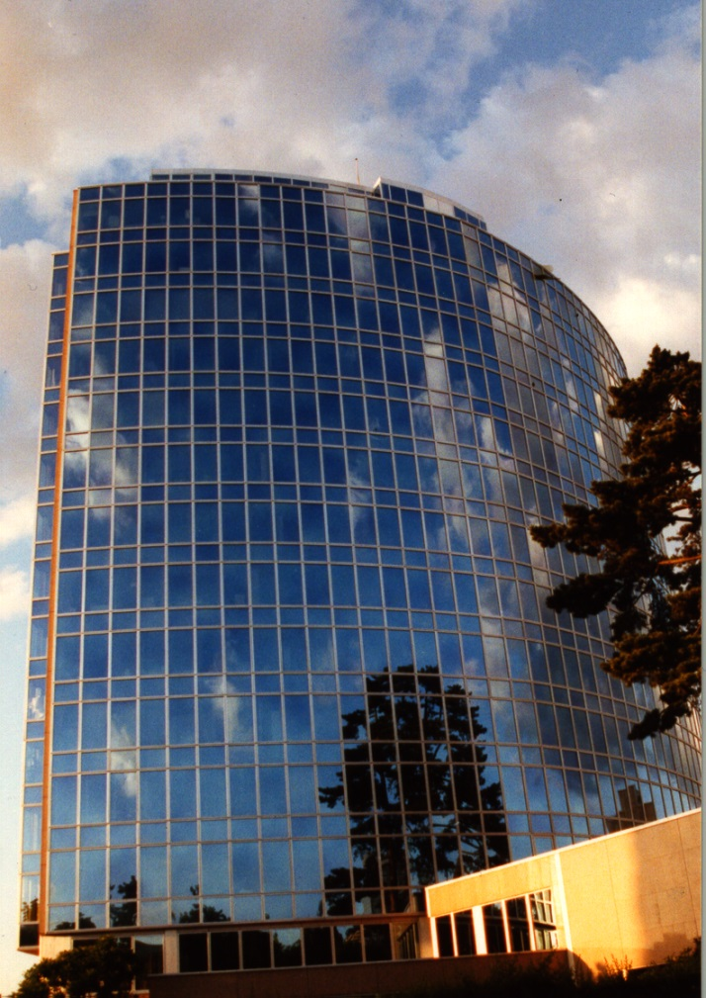
Basic Facts about WIPO
WIPO’s Mission: World Intellectual Property Organization
To promote the protection of IP rights worldwide and extend the benefits of the international IP system to all member States
Status: An int’l intergovernmental organization
Member States: 183
Staff: 915 from 94 countries
Treaties Administered: 24
Decisions by: GA, CC, WIPO Conference (General American)
Guiding Principles: Transparency, Accountability, Consensus

Slide 10
History of Patent Law:
YEAR | ACTS
1856 | THE ACT VI OF 1856 ON PROTECTION OF INVENTIONS BASED ON THE BRITISH PATENT LAW OF 1852. CERTAIN EXCLUSIVE PRIVILEGES GRANTED TO INVENTORS OF NEW MANUFACTURERS FOR A PERIOD OF 14 YEARS.
1859 | THE ACT MODIFIED AS ACT XV; PATENT MONOPOLIES CALLED EXCLUSIVE PRIVILEGES (MAKING. SELLING AND USING INVENTIONS IN INDIA AND AUTHORIZING OTHERS TO DO SO FOR 14 YEARS FROM DATE OF FILING SPECIFICATION).
1872 | THE PATENTS & DESIGNS PROTECTION ACT.
1883 | THE PROTECTION OF INVENTIONS ACT.
1888 | CONSOLIDATED AS THE INVENTIONS & DESIGNS ACT.
1911 | THE INDIAN PATENTS & DESIGNS ACT.
1972 | THE PATENTS ACT (ACT 39 OF 1970) CAME INTO FORCE ON 20TH APRIL 1972.
1999 | ON MARCH 26, 1999 PATENTS (AMENDMENT) ACT, (1999) CAME INTO FORCE FROM 01-01-1995.
2002 | THE PATENTS (AMENDMENT) ACT 2002 CAME INTO FORCE FROM 2OTH MAY 2003
2005 | THE PATENTS (AMENDMENT) ACT 2005 EFFECTIVE FROM Ist JANUARY 2005

Slide 11

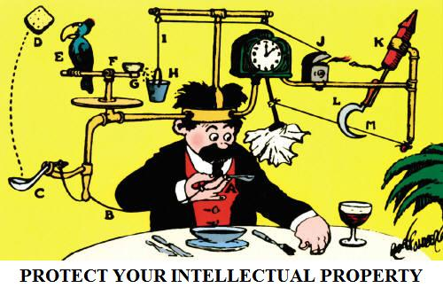
Generate Ideas….. And Own Them…..IPR !
File Patents- Protect Inventions

Slide 12

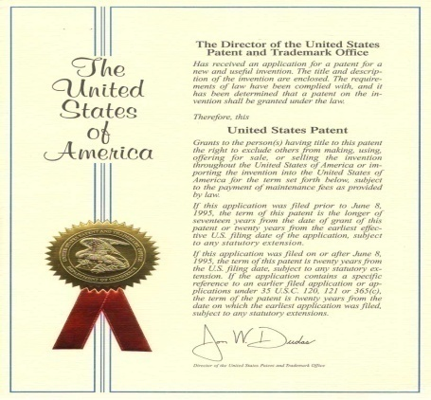
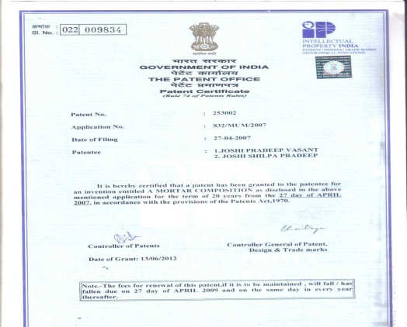
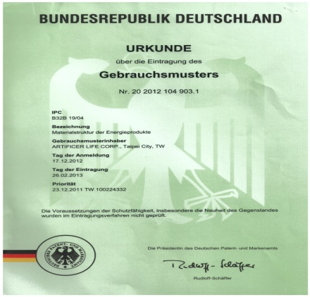
What are Patents?
Exclusive rights given to a person in return for a full and complete disclosure of the invention for which the patent is claimed
Available for both product and process
Granted for 20 years from the date
of filing
Patent rights are “territorial rights”( the central and fundamental right is the right of jurisdiction, which is the right to create and enforce laws )

Slide 13
Patentability Criteria
Novel
Industrial Application
Patentable subject matter
Non-Obvious/ Inventive Step

Slide 14
Patent Grant Procedure (In Brief)
Filing of PATENT APPLICATION
EXAMINATION & NOVELTY SEARCH
ACCEPTANCE OR REFUSAL
NOTIFICATION OF “ACCEPTANCE”
IN THE GAZETTE OF INDIA (part III section 2)
OPPOSITION (if any)
GRANT OF A PATENT

Slide 15
WHERE TO FILE (jurisdiction)
If THE APPLICANT/FIRST MENTIONED APPLICANT-RESIDES/HAS DOMICILE/HAS PLACE OF BUSINESS/HAS ORIGIN OF INVENTION/HAS SERVICE ADDRESS(in case of foreign applicant) IN
STATES JURISDICTION
NORTHERN PATENT OFFICE DELHI
SOUTHERN PAT. OFFICE CHENNAI
WESTERN PAT. OFFICE MUMBAI
REST OF INDIA PAT. OFF. KOLKATTA

Slide 16
Who May File ?
The inventor
Assignee of the inventor
* The natural person
* The legal entity
The legal representative of the deceased applicant
For PCT int. Application:- the applicant or at least one applicant should be a resident or national of india

Slide 17
How to Apply ?
APPLICATION ON FORM –1 with covering letter in the name of controller
SPECIFICATION PROVISIONAL/COMPLETE ON FORM –2
ABSTRACT OF INVENTION
STATEMENT AND UNDERTAKING OF FOREIGN FILING PARTICULARS ON FORM -3- if any
PROOF OF RIGHT—if applicable
DECLARATION OF INVENTORSHIP ON FORM- 5

Slide 18
Contd….
CERTIFIED COPIES OF PRIORITY DOCUMENTS- if applicable
POWER OF ATTOERNEY-if applicable
MAY BE LEFT/SENT TO THE APPROPRIATE OFFICE IN HINDI/ENGLISH
MAY BE FILED IN ELECTRONIC FORM WITH ONE COPY ON WHITE PAPER
IF APPLICATION DISCLOSES SEQUENCE LISTING OF NUCLEOTIDES AND/OR AMINO ACIDS,IT SHOULD BE FILED IN ELECTRONIC FORM

Slide 19
Types of Applications
Ordinary Applications
Convention Application
Patent of Addition Application
Divisional Applications
PCT International Phase Application
PCT National Phase Application

Slide 20
Stages from filing to grant of a patent

Slide 21
STAGES - FILING TO GRANT OF PATENT
FILING OF APPLICATION
PROVNL. / COMPLETE
IF P.S.IS FILED C.S. TO BE FILED WITHIN 12MONTHS
PUBLICATION OF APPLICATION
PROMPTLY AFTER 18 MONTHS FROM P.D.
REQUEST FOR EXAMINATION
WITHIN 48 MONTHS FROM F.D.
EXAMINATION-ISSUE OF FER
3rd Party Representation
ALL OBJECTIONS TO BE COMPLIED WITHIN 12 MONTHS
GRANT OF PATENT
OPPOSITION
WITHIN 12 MONTHS
Decision of
Controller
Appeal
Revocation/Amendment
Appellate Board

Slide 22
Formality Check
An Examiner checks the formal requirements before accepting the application and the fee – this is done immediately
Issue of application number and the cash receipt – this is done the same day
In case of receipt of application by post, cash receipt, application number is sent by post within 2-3 days

Slide 23
A PROCEDURE FROM FILING TO GRANT OF PATENT (Cont.)
GRANT OF PATENT
Rejection of opposition
POST GRANT OPPOSITION
Decision of
Controller
Appellate
Board
REVOCATION OF PATENT
High Court

Slide 24
THE FEE SCHEDULE
On what payable Prov./Comp spec. PAGES EXCEEDING 30 CLAIMS EXCEEDING 10 *Request for extension of time REQUEST FOR EARLY PUBLICATION Request for Examination EXPRESS REQUEST FOR EXAMN. *Change of Applicant *Notice of Opposition *Certified Copy\Certificate *On a petition *Restoration of lapsed patent | Form 2 - - 4 9 18 18 6 7 -- 15 | Individual 1000 100 200 1000/2000/3000 2500 2500 3500 1500 1000 1000 1500 1500 | Company 4000 400 800 4000/8000/1200 10000 10000 14000 2000 6000 4000 4000 6000
RENEWAL FEES 3rd to 6th Year(per year) 6th to 10th Year—do-- 11th to 15th Year---do--- 16th to 20th year----do--- |  | 500 1500 3000 5000 | 2000 6000 12000 20000

Slide 25
IMPORTANT FEES IN DIFFERENT PROCEEDINGS
(Amount in Rupees)
Individual Legal Entity
Application for Grant of Patent 1000 4000
Request for Examination of Application 2500 10000
Request for Publication 2500 10000
Substitution of Applicant 500 2000
Notice of Opposition 1500 6000
Restoration of Lapsed Patent 1500 6000
Renewal Fees (for 20 years) 48000 192000
PS. Professional help Patent Drafting costs around 30000
SKM

Slide 26
DUTIES OF PATENTEE
Maintenance of the patent
Pay renewal fees
Every year till the end of the term
Time limit: before end of the preceeding year ( 6 months extn. Available )
Working of the patents:
Inventions are to be worked in India on commercial scale
Failing which compulsory licence may be issued

Slide 27
Role of Patent Attorney
Drafting of Specification
Possible equivalent variations
Broadest valid claim
Avoid any pitfall
Submission against Office Objections and related Proceedings
To face Opposition Proceedings
Execution of Licence Agreement, Deed of Assignment and other Legal Matters
SKM

