Slide 1

More than a “SBOM button” for compliance:
SBOM quality matters!

Slide 2
Agenda
About me, AboutCode and nexB
What is a SBOM (Software Bill of Materials)?
Minimum requirements, widely used standards, applicable regulations
SBOM quality: things to look out for
Support for package manifests, ecosystems
When is SBOM generated: source, build, analyzed, deployed, runtime
Hidden items: binaries, vendored/copied code, AI generated code
The FOSS community approach matters
Misc: Automation, Open Data, Benchmarks, other BOMs
Questions?

Slide 3
About Ayan
Core maintainer of ScanCode (scancode-toolkit and scancode.io)
also contributes to and helps maintain other AboutCode tools: license-expression licenseDB scancode-workbench PURLdb
Working on license detection, package identification, binary scanning, SBOMs and data summarization
Google Summer of Code Mentor at AboutCode (2021-2025)
participant in GSoC2020 and GSoD2019 (Season of Docs)
Links:
asmahapatra@aboutcode.org
GitHub: https://github.com/AyanSinhaMahapatra/
LinkedIn: https://www.linkedin.com/in/ayansinhaju/

Slide 4
AboutCode and nexB
AboutCode's FOSS-first mission: FOSS for FOSS
Open source tools and open knowledge base (AboutCode stack)
Simple and practical standards (Package-URL)
Applications for Legal/Security Business users (DejaCode, also FOSS)
Trusted experts on Software Composition Analysis (SCA) since 2007
Creator of Package-URL: https://github.com/package-url
Co-founders of SPDX: https://spdx.org
Contributors to CycloneDX: https://cyclonedx.org
Co-founders of ClearlyDefined: https://clearlydefined.io
nexB: professional services for SCA
800+ SCA projects completed to-date
Sponsored development for AboutCode projects
Technical support and advisory for SCA process, and deployments
Notes:
AboutCode is a non-profit open source organisation which all the maintainers and contributors are a part of.
All our projects are Free and Open Source, and our mission is to enable people to reuse
open source package more safely and consciously. And to help do that we
maintain these Open Source tools, and also provide open data and practical open standards.
Some of us the maintainers are also part of nexB, which is a company offering
commercial support and software audit services using these FOSS tools, to
sustain ourselves.

Slide 5
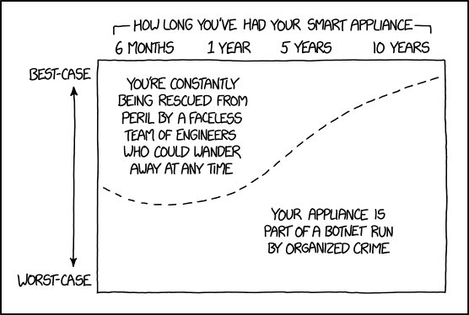
Software Bill Of Materials: why?
We need to:
know what is in our software
reuse and consume FOSS safely
SBOM is a build audit, not a parts list
SPDX and CycloneDx, packageURL
minimum: a list of packageURLs
Regulations:
CRA in EU, US executive order
SEBI CSCRF
CERT-In SBOM Guidelines
https://xkcd.com/1966/ : Smart Home Appliances

Slide 6
PackageURL
Started in ScanCode to uniquely identify packages.
pkg:type/namespace/name@version?qualifiers#subpath
Specification: https://github.com/package-url/purl-spec
PURL examples:
pkg:deb/debian/curl@7.50.3-1?arch=i386&distro=jessie
pkg:github/aboutcode-org/scancode-toolkit@32.4.1
pkg:pypi/django@1.11.1
pkg:rpm/fedora/curl@7.50.3-1.fc25
pkg:golang/google.golang.org/genproto#googleapis/api/annotations
Vers: https://github.com/aboutcode-org/univers/
Notes:
Having a package URL means you can uniquely identify a package, get metadata information on it
and get a download URL from this identifier. And it has the fields required to do this effectively
across package ecosystems, the type is the package ecosystem/repository like pypi for python or github,
namespace can be a owner or an organization and name, version etc.
Another related specification is Vers which describes version ranges and is used to do version comparison,
or to say if a specific version is within a version range.

Slide 7
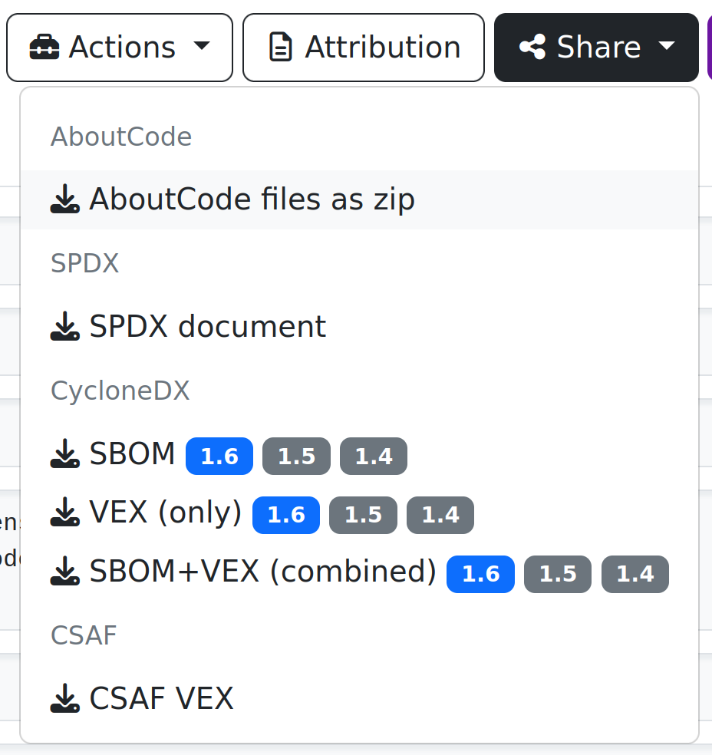
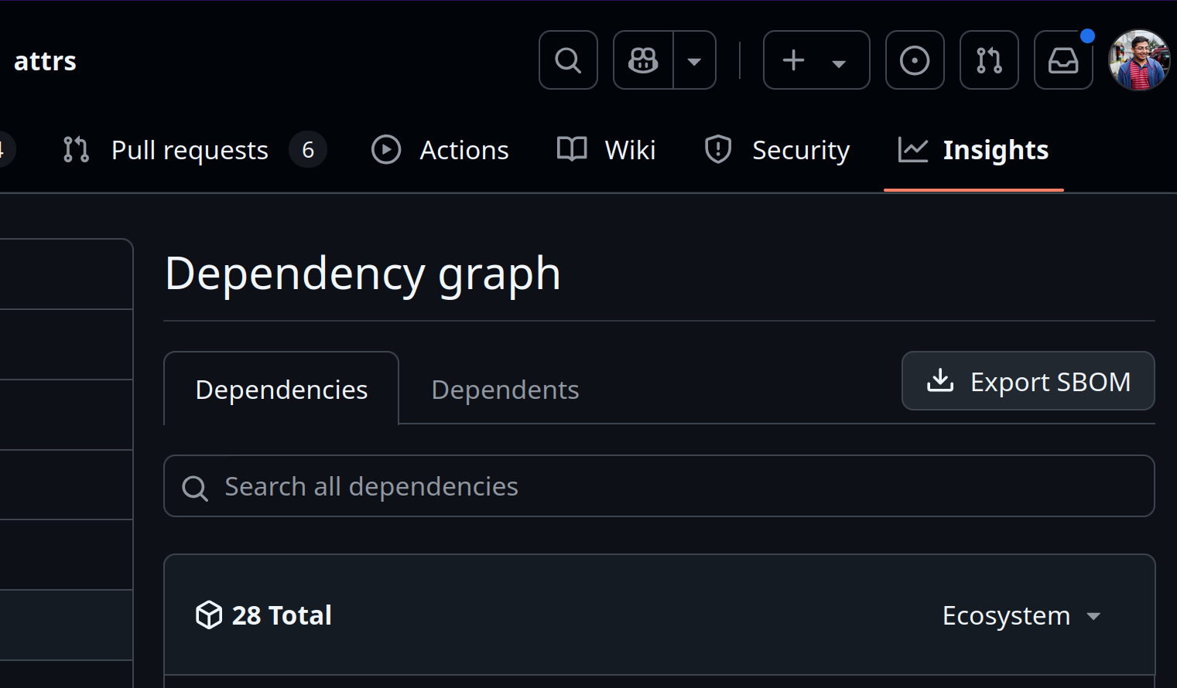
Just click the SBOM button!

Slide 8

0 packages = 0 vulnerabilities
always a new kid in town!
pypi.org/project/poetry: 2018
pypi.org/project/uv: 2024
package ecosystems: 32
types of package manifests: ~135
SPDX licenses: 779
scancode-licensedb: 2579
github.com/package-url/purl-spec/blob/main/PURL-TYPES.rst
scancode-toolkit.rtfd.io/reference/available_package_parsers.html
spdx.org/licenses/
scancode-licensedb.aboutcode.org/

Slide 9

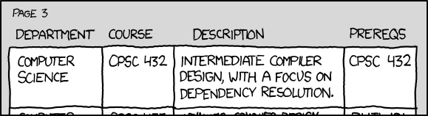
May the source be with you!
github-actions have (vulnerable?) dependencies ?!
not everything is deployed
1 repo -> 20 packages (with mono repos)
dependencies? unresolved
last commit? 10 years ago
end-of-life.date
OpenSSF Scorecard
Source SBOM!
https://xkcd.com/754/ : Dependencies

Slide 10



building deployed binary
binary: bare minimum to run code
massive # of packages in containers/apps
build system has access to origin and results
trust but verify: back2source
reproducible builds
immutable releases
CI: aboutcode-org/scancode-action
Build SBOM &
Deployed SBOM

Slide 11
Not everything is declared in manifests
comes in all sizes: binaries, files, snippets
Convenience: lets just include everything!
Can we get to the source?
which part of the source is deployed
Is this modified?
Index and match by checksums
scan once, then always match
by archives
by directories
by files
snippets

Slide 12

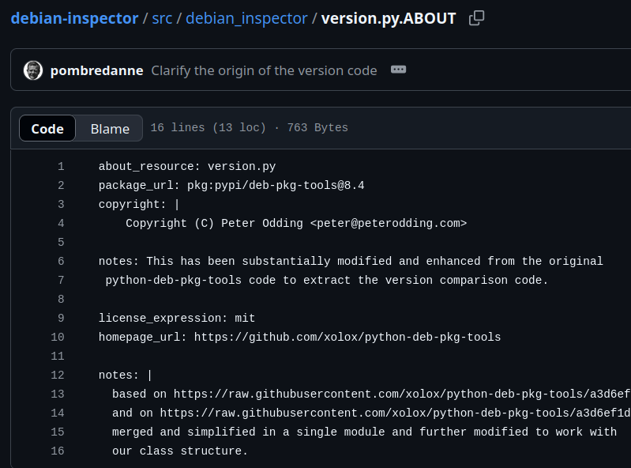
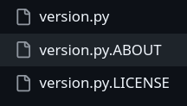
Copying code is okay! But...
Declare
Update periodically
release?
otherwise have to match

Slide 13

AI generated code?
Generated code can be very similar to FOSS code
Finding public code that matches GitHub Copilot suggestions
Approximate snippet matching algorithm
working prototype on popular npm code
need to scale!
LLMs trained on permissively licensed code!
https://huggingface.co/blog/starcoder2
uses scancode to detect licenses

Slide 14
Fix it at the source!
reducing complexity >> modeling complexity
include data on origin/dependencies:
cargo-auditable : auditable production Rust binaries
PEP 725 : Specifying external dependencies
license fixes:
SPDX License identifiers in Linux kernel
PEP 639 : License Clarity with Better Package Metadata
ecosystem wide scans:
fix licensing issues
detect undeclared/vendored code or binaries
open data

Slide 15
What AboutCode is doing differently
Non-profit, fully open source, open data, public instances
coming up soon: AboutCode Foundation!
options: CLI tool, Github action, web app, scans: containers, source/binary
supports and working with package ecosystems
to build better metadata, more transparency
solve ecosystem wide problems at once
Open data (soon: federated data)
Curated, open data on Licensing, Vulnerabilities, Packages
Large community
working with FOSS orgs to improve standards, data and transparency
OSPOs, Security, Lawyers, Specifications, Developers
Notes:
Commercial solutions are are mostly inaccessible to most FOSS projects
in the entire supply chain. But these days they are also becoming
quite costly even to large organizations.
There will always be some identification issues, but if two organizations
are scanning the same package and they have to do the same review
and analysis independently, it’s a waste of time and resources.
Some things that we at AboutCode do is to try to help
ecosystems and communities to fix the problems at source,
and also having open data on scan results to share, collaborate
peer review and reporting to make the tools more effective.
We also have the privilege of having an excellent community of
people from very diverse use cases who help us with their
experience, since it’s open source.

Slide 16
The AboutCode stack:
DejaCode
Policies Licenses
Components
Packages
Vulnerabilities
SBOM
SBOM
Attribution
ScanCode.io
Software Product
Scans
ScanCode Toolkit
FOSS Package
container inspector
package inspectors
LicenseDB
PurlDB
VulnerabilityDB
Notes:
toolkit available also as a standalone command line tool, and as a python package
usable in other products.

Slide 17
AboutCode: Who is using it?
(based on public data)
Most FOSS Orgs, many commercial and open source SCA providers use our libraries or standards
Most FOSS Foundations
Five of the top big tech companies
A leading database company, a leading Linux company
2 leading code hosting companies
European and US government agencies
All major European car manufacturers and most of their vendors
Major US chip and microprocessor providers
All SBOM and VEX standards

Slide 18
Other FOSS SCA tools and projects
ORT: OSS Review Toolkit (Uses ScanCode)
FOSSology (Uses ScanCode)
SW360
TERN (Uses ScanCode)
ClearlyDefined (Uses scancode)
OSSelot
OWASP DependencyTrack
OWASP DepScan
AppThreat projects: atom, chen, vdb
CycloneDx cdxgen
Anchore: syft, grype
Aquasec trivy
Notes:
These are also some other free and open source projects that you can use, and some of them also
do use scancode as a base.

Slide 19
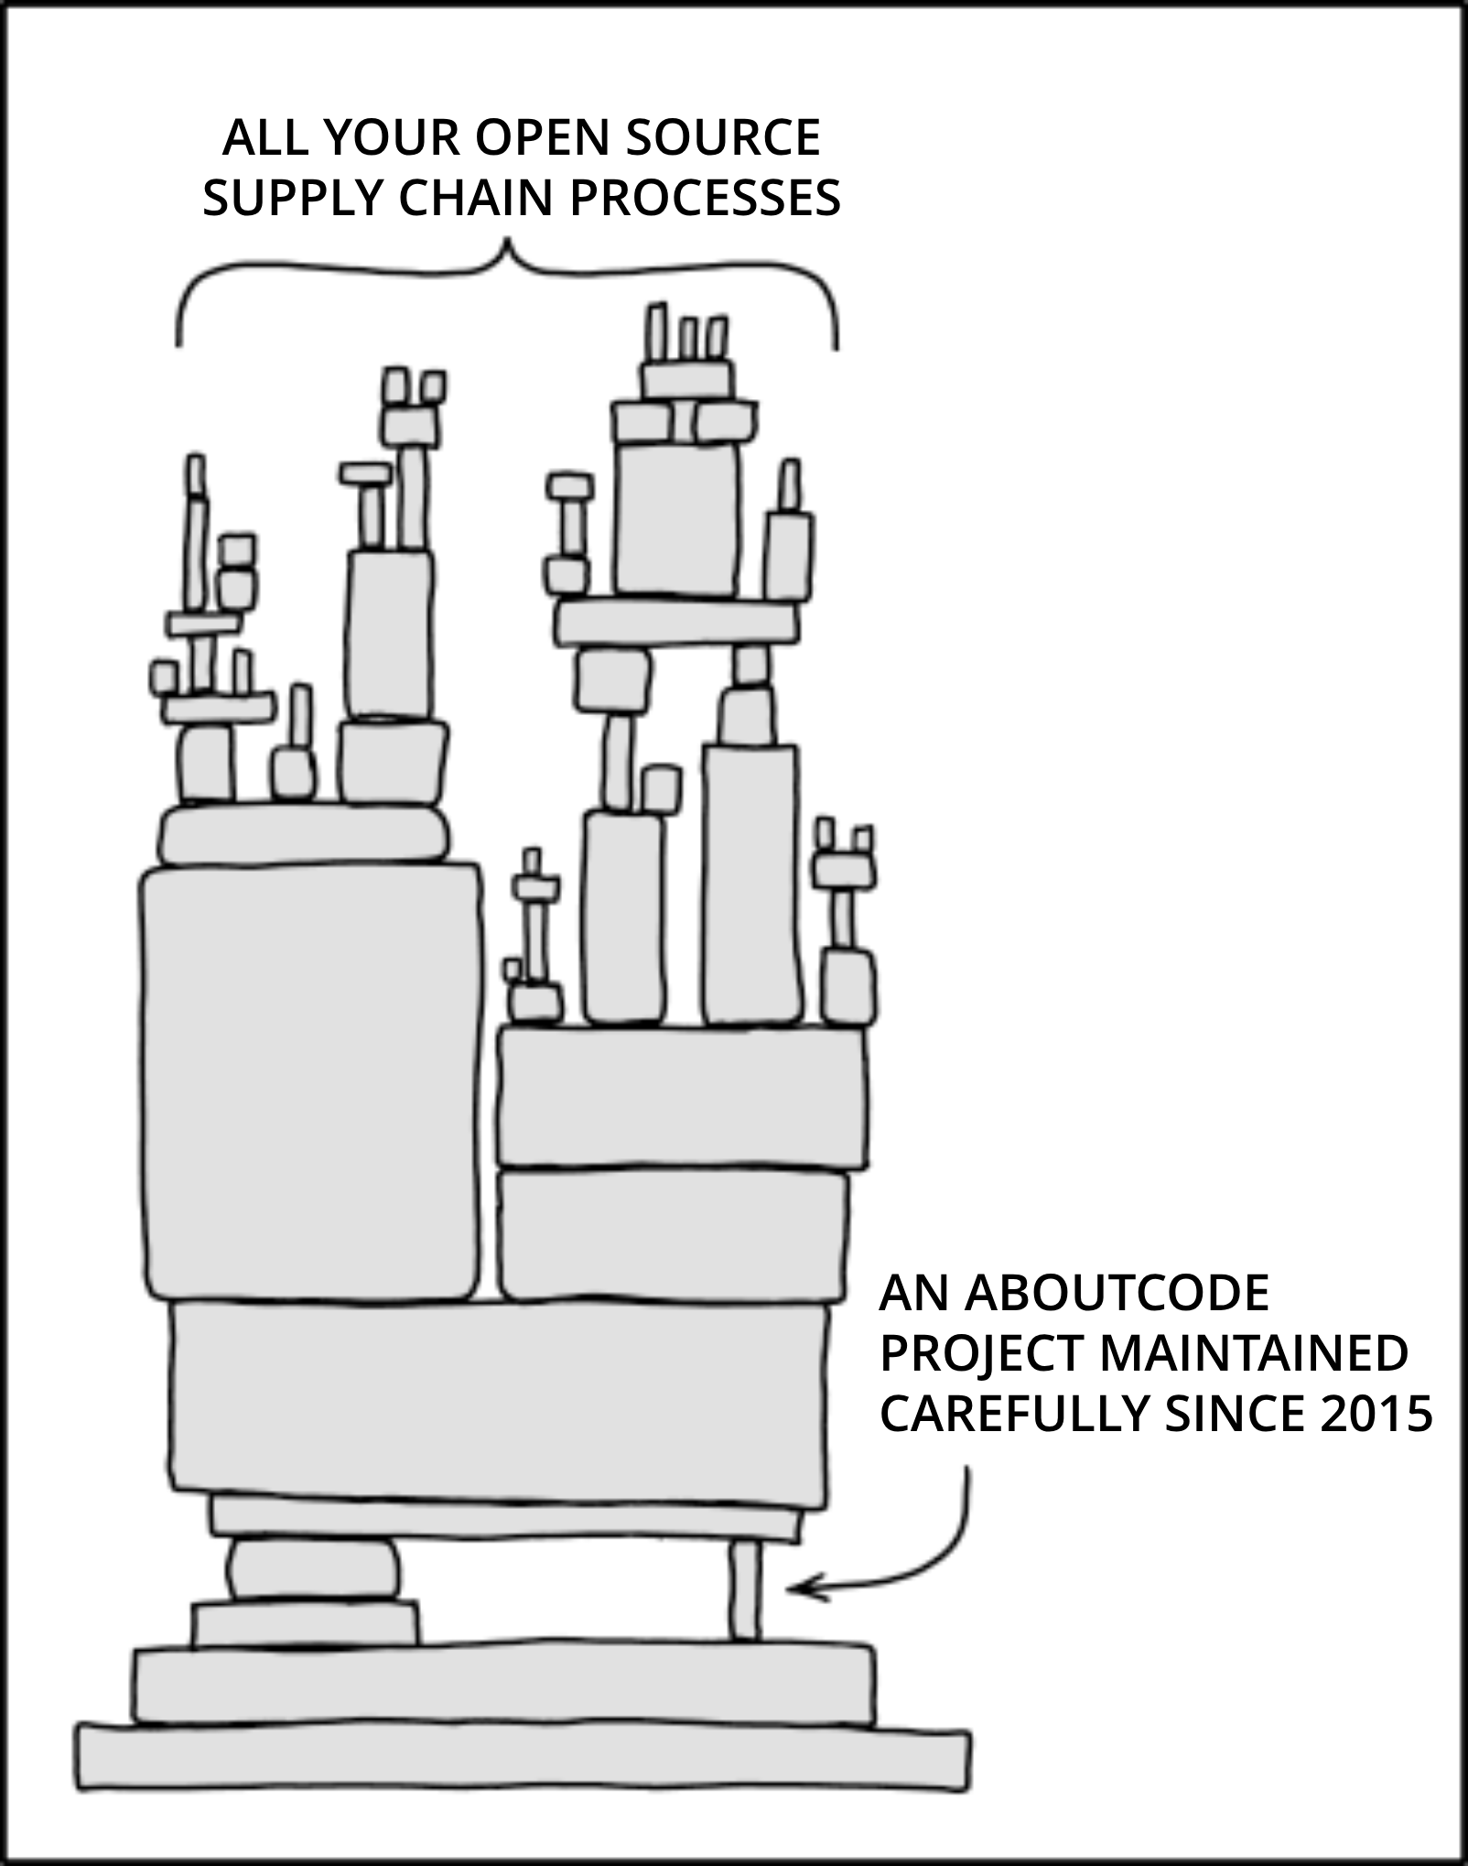
AboutCode also needs your help!
Contribute to an AboutCode project with code, documentation, use cases, bug reports
https://github.com/aboutcode-org
Sponsor AboutCode project maintainers, accelerate development of new features https://github.com/sponsors/aboutcode-org
Buy support, implementation, and advisory services from nexB to pay the maintainers
Join the community:
https://www.aboutcode.org/
https://matrix.to/aboutcode-org_discuss
"Dependency" by xkcd, Modified text from original
Notes:
We do need your help with AboutCode, whether it is with your time or experience, reporting issues or creating patches. Or donations to support the maintenance.

Slide 20

Questions?

Slide 21
Another talk (with live demo):
From Policy to Pipeline: How OSPOs Can Power Regulatory Readiness and Upstream Impact
with Arun Azhakesan
OSPOCon, room: G.01 + G.02

Slide 22
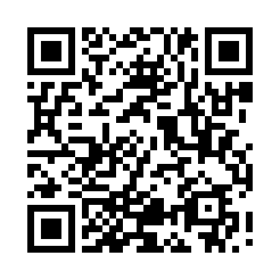
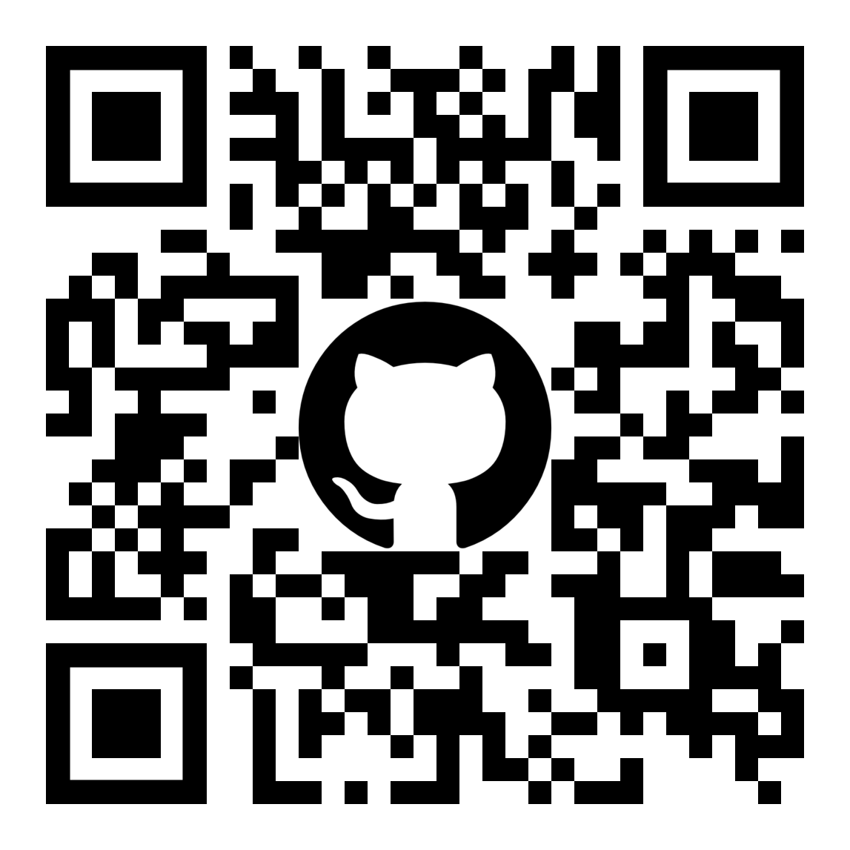
Link to slides
github/aboutcode-org

Slide 23
Credits
Special thanks to all the people who made and released these excellent free resources:
All the open source software authors that make AboutCode possible
Emojis are from https://openmoji.org/ under cc-by-sa-4.0
xkcd comics under cc-by-nc-2.5
Presentation template by SlidesCarnival

