Slide 1

ScanCode to reuse FOSS safely, with FOSS

Slide 2
Agenda
About me, AboutCode, and nexB
Why should we scan code?
Licenses change, vulnerabilities present, quality issues, regulations
How to communicate? Open Standards:
Package-URL (PURL), Vers, SBOMs (SPDX, CycloneDx), VDRs, VEX
Problems and solutions
Knowing your full list of exact dependencies
what can you do to avoid issues
Hard to identify all packages, too much vulnerabilities
Why use FOSS tools for code scanning?
Questions
Notes:
So here’s the Agenda for this talk, we will do the introductions.
Then we will talk about why we need to scan software, how to communicate results, and what
usually happens in these scans. I would also discuss some common problems I faced and
recommendations based on them.

Slide 3
About me
Core maintainer of ScanCode (scancode-toolkit and scancode.io)
Contributes to and helps maintain other AboutCode tools: license-expression licenseDB scancode-workbench PURLdb
Working primarily on license detection, package identification and data summarization
Google Summer of Code Mentor at AboutCode from 2021
participant in GSoC2020 and GSoD2019
Ayan (pronounced like: awyon):
asmahapatra@aboutcode.org
GitHub: https://github.com/AyanSinhaMahapatra/
LinkedIn: https://www.linkedin.com/in/ayansinhaju/
Notes:
My name is Ayon, I am one of the core maintainers of scancode and other AboutCode projects.
I mainly work on package and license identification, along with data summarization for scan results.
AboutCode also participates in Google Summer of Code, and this is
also how I joined AboutCode, by participating in 2019 and 2020.
There are some links on these slides so will also be a QR code at the end of this
presentation to download these slides.

Slide 4
AboutCode and nexB
AboutCode's FOSS-first mission: FOSS for FOSS
Open source tools and open knowledge base (AboutCode stack)
Simple and practical standards (Package-URL)
Applications for Legal Business users (DejaCode, also FOSS) with APIs
Trusted experts on Software Composition Analysis (SCA) since 2007
Creator of Package-URL: https://github.com/package-url
Co-founders of SPDX: https://spdx.org
Contributors to CycloneDX: https://cyclonedx.org
Co-founders of ClearlyDefined: https://clearlydefined.io
nexB: professional services for SCA
800+ SCA projects completed to-date
Sponsored development for AboutCode projects
Technical support and advisory for SCA process, and deployments
Notes:
AboutCode is a non-profit open source organisation which we the maintainers are a part of.
Our mission is to enable people to reuse
open source package more safely and consciously. And to help do that we
maintain these projects which are all Free and Open Source, and also provide open data and practical open standards.
Some of us the maintainers are also part of nexB, which is a company offering
commercial support and software audit services using these FOSS tools, to
sustain ourselves.

Slide 5
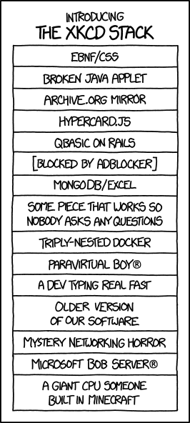
Modern software ecosystem
FOSS software packages are reused
small apps routinely embed 500 FOSS packages
large apps: 10,000+!
Everyday, you have new vulnerabilities, license problems and package updates in your package dependency trees
Impossible to check this manually!
Goal: Discover the problems and help alleviate the pain
Source: https://xkcd.com/1636/
Notes:
These days when we build software/libraries, we are using more and more FOSS packages, and
that is a nice thing! We don’t have to reinvent the wheel and this helps innovation, where
we are only working to improve our collective technical capabilities.
Small apps are routinely using hundreds of FOSS packages, and I’ve scanned large apps and products
where we have 10k or more FOSS packages with individual code files going into millions.
But we are not always aware of all the packages added to our dependency graph, when we add some
package as a dependency.
This creates the problem of managing all the risks and problems in those dependencies,
And it takes a lot of time to check for these manually because of the scale here.

Slide 6
Why is Software License important?
FOSS: Freedom
Freedom and Responsibilities
Can we use the software in different scenarios?
Can we modify and redistribute freely, under my choice of terms?
Give credit, generate attribution
See License categories for more details
Copyrights:
Copyright notices often have to be included and redistributed
History of Litigation
GPL based court rulings to Distribute Source Code
Notes:
So why is a license of a software important?
Here the Free in FOSS is Freedom, and the license terms for a software gives us
the details on how much freedom we have or don’t have, and what are our responsibilities if we
exercise that freedom. A software is open source because it has an open source license.
So do we have the freedom to use the software in different scenarios, like commercially or like SaaS which is
over network? If you make modifications for your use, do you have to redistribute the modified source code?
Can you redistribute it under other licenses?
You might also have to preserve and redistribute the original copyrights notices and license
text when we redistribute, or give credit to the author.
There are other types of licenses too, like proprietary licences, source available licenses and you
can refer to our open database of licenses, the scancode-licensedb, with clear types.

Slide 7
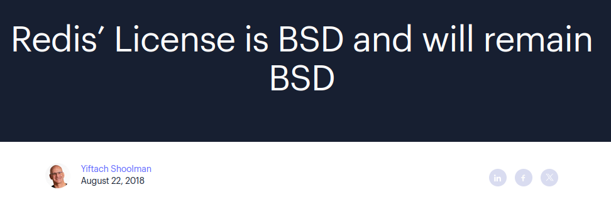
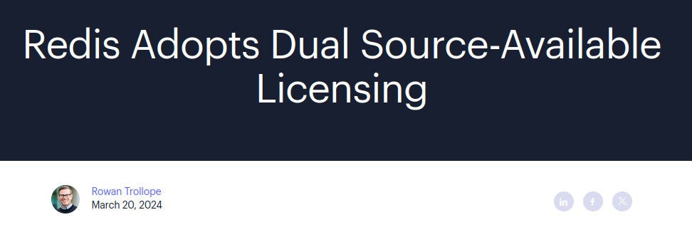
Why is identification important?
Modifications can be released under different terms
License could change between versions
packages/products often decide to change their license
https://redis.com/blog/redis-adopts-dual-source-available-licensing/
https://www.elastic.co/blog/elastic-license-update
Notes:
Sometimes projects do change their license.
A recent example of this is the license change at Redis, and as you can see even though projects make
promises, things change. Sometimes what happens after license changes in popular projects is some users
fork the project. Elasticsearch also did a similar license switch in 2021 from a permissive license to a source-available license, terraform
did similar license switches.

Slide 8
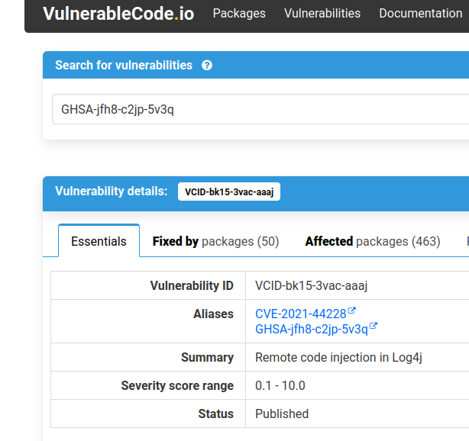
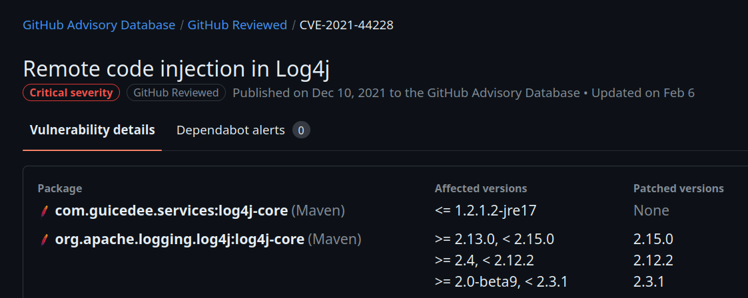
Why is identification important?
Vulnerabilities are introduced and fixed by versions (or not!)
Sources:
https://public.vulnerablecode.io/vulnerabilities/VCID-bk15-3vac-aaaj?search=GHSA-jfh8-c2jp-5v3q
https://github.com/advisories/GHSA-jfh8-c2jp-5v3q
Notes:
We also have vulnerabilities published from different sources for specific packages,
and they mostly have an affected version range, and a fixed version, if there is a
fix added. They also have information on how it is vulnerable, whether there
is proof that it can be exploited or is being exploited.

Slide 9
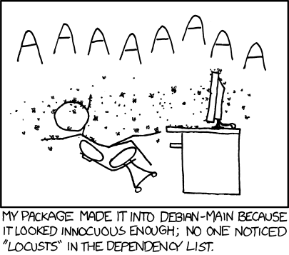
Why is software quality important?
Better maintained: more secure
at least a correlation!
Code review, branch protection and other quality checks are important
Great FOSS projects on quality:
OpenSSF Scorecard
endoflife.date
CHAOSS: auger, grimorelab
Still lots of context not captured by metrics, not clearly actionable
Source: https://xkcd.com/797/
Notes:
There’s another type of security issue which is not directly linked to vulnerabilities in
code, but other gaps how it is maintained or other shoddy security practices , and there are many
instances of popular packages having malicious code injected or malicious packages with
similar names or social engineering attacks targeting weak security or maintainance.
A famous example is the xz-utils package being compromised.
There are package quality parameters which tell you about these and there are
some very nice FOSS projects on this, like the OSSF Scorecard and
endoflife.date, and CHAOSS projects like auger and grimorelab. scorecard and
endoflife also publish open data on popular or critical projects.

Slide 10
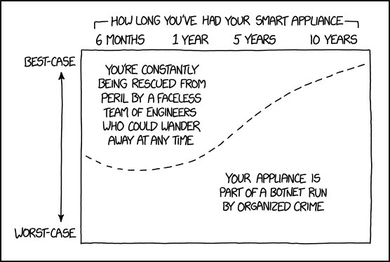
How to communicate? SBOMs, VDRs
How to disclose security vulnerabilities in my software?
lots of legacy software used all around us
What are the software licenses for all the packages used?
Machine readable!
Transparency
Source: https://xkcd.com/1966/
Notes:
So if you are running a particular software or installing a specific package
from somewhere, what data do you want, and how do you want it.
You want data on what license are present, are there vulnerabilities, and are
these packages somewhat nicely maintained.
You definitely want it to be machine readable, because of the scale of packages being
used. And you want the data for all the entire dependency tree as all your direct and
transitive dependencies might have some access to your system and build systems,
based on the context. And you want information on which exact versions/ of these packages
are used as licenses can change, vulnerabilities can be introduced or fixed, and old
versions can be unmaintained.
This is effectively a Software Bill of materials (SBOM in short) for
the particular package.
So SBOM are about software transparency. Now software is be used in
lots of critical use cases, from networking devices to health monitoring devices, IOT devices.
So it’s very important to have some transparency to know what is in your software.

Slide 11
And really why?
In the US , Europe, and India, it’s the law.
US: executive order 14028
SBOM for any software business with the government.
Europe: CRA (Cyber Resilience Act)
Maintainers, Open Source Stewards, Manufacturers
https://github.com/orcwg/cra-hub/blob/main/faq.md
India:
CERT-In SBOM guidelines
CSCRF for SEBI REs
Often required by companies: using a product/acquiring company
Similar legislation/requirements likely in everywhere else
Notes:
And sometimes you need to do this because it’s mandated by the law. There is a US executive order
to produce SBOMs for any software the govt uses, and in EU the Cyber Resilience Act which mandates
vulnerability and some other disclosures for anyone making money from selling/distributing software.
In India we have a published SBOM guideline from CERT (Computer Emergency Response Team) which
deals with security incidents. There is also a mandate called cyber security and cyber resilience framework
from SEBI (Securities and Exchange Board of India) for regulated entities like banks and other financial
institutions having digital infra, to produce SBOMs and scan code for security issues.
In the case of CRA and the SEBI mandate there are fines for non-compliance or specific security incidents.
There are guidelines and regulations present or coming up in other countries too, Japan, UK and Germany also
has SBOM guidelines from govt agencies. SBOMs are also used in software audits and for due-diligences,
when companies acquire or buy a software product.

Slide 12
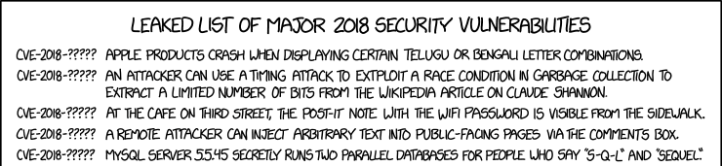
What are the key ingredients?
standard package identifiers: PURL
standard license identifiers: SPDX
standard vulnerability identifiers: CVE, GHSA etc
standard documents to exchange all this information:
SBOMs: CycloneDx, SPDX
VEX: CycloneDx VEX, OpenVEX, CSAF VEX
Source: https://xkcd.com/1957/
Notes:
So one key ingredient here is standard identifiers for package, license and vulnerabilities information,
because software is global, across companies and geographies. And these are identifiers are being widely
adopted because of their value, PackageURLs for package identifiers, SPDX for license identifiers, and
the 2 SBOM formats, SPDX and CycloneDx.

Slide 13
Package-URL
Started in ScanCode to uniquely identify packages.
pkg:type/namespace/name@version?qualifiers#subpath
Specification: https://github.com/package-url/purl-spec
PURL examples:
pkg:deb/debian/curl@7.50.3-1?arch=i386&distro=jessie
pkg:github/package-url/purl-spec
pkg:pypi/django@1.11.1
pkg:rpm/fedora/curl@7.50.3-1.fc25
pkg:golang/google.golang.org/genproto#googleapis/api/annotations
Vers: https://github.com/aboutcode-org/univers/
Notes:
Having a package URL means you can uniquely identify a package, get metadata information on it
and get a download URL from this identifier. And it has the fields required to do this effectively
across package ecosystems, the type is the package ecosystem/repository like pypi for python or github,
namespace can be a owner or an organization and name, version etc.
Another related specification is Vers which describes version ranges and is used to do version comparison,
or to say if a specific version is within a version range.

Slide 14
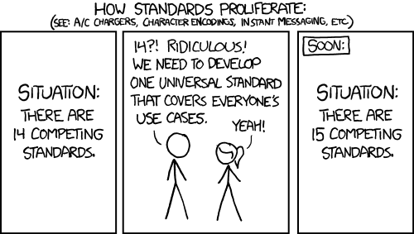
Are these just more standards?
Package-URL (PURL):
An identifier to uniquely identify and download packages
Vers:
Version range specification for package requirements
Source: https://xkcd.com/927/
Notes:
These practical standards were created in scancode for AboutCode projects, but are these just another new standard?

Slide 15
Who is using Package-URL and Vers?
Everyone!
GitHub Dependency Submission API
OWASP Dependency-Track
Two major SBOM standards: CycloneDX and SPDX
OSS Index
OSV Schema and OSV.dev (Google)
AboutCode tools: Scancode Toolkit scancode.io dejacode vulnerablecode
ORT: OSS Review Toolkit, Osselot
Anchore, Trivy, Microsoft and GitHub, Chainguard, Snyk
cve.org, NVD (soon)
Vers is used at vulnerablecode, Google OSV, AppThreat vulnerability-db
Notes:
So not really, a lot of projects and organizations are now using these standards.

Slide 16
4 Fs of Open Source
The Three Fs of Open Source Puppy Care: Michael Winser
Complete dependency graph
Fix
Engage with maintainers, open Issues/PRs
Fork
Maintain your version, apply patches
Forget
Use something else!
Fund!
relationships with dependencies are important!
Notes:
So if you scan a piece of code you are more aware of all your dependencies and what could
be happening in their life cycles. And if you are getting some value out using/building on top of the
package/software you are scanning, there is also some risk that you inherit from them. So
sometimes the most practical option is to engage with them and help fix some of their
issues upstream by reporting or even fixing them. If they’re not interested in accepting or maintaining your code,
or do not work according to your timelines, then it might be easier for you to maintain a fork with your
modifications, even for a short period of time. And lastly if a dependency is causing more problems than
the value they bring and there are other similar projects you can always forget them and choose something
else. Giving them a share of the value you are generating directly as money can also be beneficial for both of
you. So what code scanning does is it makes you have a better relationship with your dependencies, maybe
you hang out and interact in their github or chatrooms, and these relationships and your intuition from interacting
with them could be more valuable than metrics or data.

Slide 17
Package identification can be hard
Binaries have limited metadata
Most scanners only scan package manifests!
Code included from different origins
vendored (copied partially/fully)
distributed with binaries (maven uberjars, jars inside jars)
Code matching (MatchCode and PurlDB)
Exact archive and file matching
Finding source repo is not trivial:
metadata on source repo missing/incorrect, monorepos
Customized build systems + metadata formats together
build systems have most information, create SBOMs there
Notes:
Now we can scan the same package in different contexts, we can
scan the source package or a binary form of the package. The problem is
there is typically less metadata in the binary form about package origin
and license terms. And just by scanning the source of packages you
won’t get all the exact versions being built or used in a specific
context. So typically the build systems have access to a lot of
information as they know which subset of the source is being used,
what are the exact versions of the dependencies being used and so
it’s nice if we scan and generate the SBOMs together in the same process
where we build our software, so they are accurate and complete.
A lot of scanners only scan package manifests which are present,
like package.jsons or pyproject.toml files. But dependencies are not
always declared in package manifests, sometimes people copy one file
or a whole module of a package and keep it in their source tree. In java
there is shading or uber jars where one package might have a lot of
other packages bundles inside. So it’s harder to detect the exact versions
or packages. This is more difficult when only a portion of some code is
copied.
There is a lot of package manifests and ecosystems and every once in a
while there are new ones. For example we support in scancode almost 130
types of package manifests from more than 30 different package ecosystems/types which
is present in the packageURL spec and 30 more which are in the draft phase. Each
has their own peculiarities or challenges.

Slide 18
Vulnerabilities
overwhelmed by data!
Transitive dependencies can be exploited
dependency graph: how was a specific package version introduced
might not be applicable
vulnerable code not used (reachability) or not deployed (test/docs)
only applicable in specific types of deployments/environments/builds
has this vulnerability been exploited
score/severity can be good indication, but not absolute
CI/CD or build dependencies can be problematic too
update packages regularly
if you cannot, you must be more proactive there about issues
Notes:
If you run a vulnerability scan in the context of your whole dependency tree in a big app,
chances are you will get a lot of vulnerable packages. If you have not updated
your dependencies in a couple years, you will probably be drowned.
Now not all vulnerabilities you see there are applicable potentially.
We typically only use a small subset of our dependency, so it's likely
that the vulnerable function is not used. Or the vulnerability might be
for specific contextual use or valid in specific environments, which
might not be applicable for you. These are problems because
you still need to look through them to find actual vulnerabilities
which might be problematic. Some sources publish proof
on how a vulnerability can be exploited or how likely is it that its actually being
exploited in real life, and these are probably more important to get
rid of. Severity scores can be a good indication for which ones to
prioritize, but of course this is not absolute.

Slide 19
What AboutCode is doing differently
Fully open source
options: CLI tool, Github action, web app, scans: containers, source/binary etc
supports and working with package ecosystems
to build better metadata, more transparency
solve ecosystem wide problems at once
Don’t scan twice
Open data on Licensing, Vulnerabilities
Reuse Scan Results
Only scan the different parts
Large community
OSPOs, security, lawyers, specification groups, developers
Notes:
Commercial solutions are are mostly inaccessible to most FOSS projects
in the entire supply chain. But these days they are also becoming
quite costly even to large organizations.
There will always be some identification issues, but if two organizations
are scanning the same package and they have to do the same review
and analysis independently, it’s a waste of time and resources.
Some things that we at AboutCode do is to try to help
ecosystems and communities to fix the problems at source,
and also having open data on scan results to share, collaborate
peer review and reporting to make the tools more effective.
We also have the privilege of having an excellent community of
people from very diverse use cases who help us with their
experience, since it’s open source.

Slide 20
The AboutCode stack:
DejaCode
Policies Licenses
Components
Packages
Vulnerabilities
SBOM
SBOM
Attribution
ScanCode.io
Software Product
Scans
ScanCode Toolkit
FOSS Package
container inspector
package inspectors
LicenseDB
PurlDB
VulnerabilityDB
Notes:
toolkit available also as a standalone command line tool, and as a python package
usable in other products.

Slide 21
AboutCode: Who is using it?
(based on public data)
Most FOSS Orgs, many commercial and open source SCA providers use our libraries or standards
Most FOSS Foundations
Five of the top big tech companies
A leading database company, a leading Linux company
2 leading code hosting companies
European and US government agencies
All major European car manufacturers and most of their vendors
Major US chip and microprocessor providers
All SBOM and VEX standards
Used to create a database of permissive code to train an open code LLM
See https://huggingface.co/blog/starcoder2

Slide 22
Other FOSS SCA tools and projects
ORT: OSS Review Toolkit (Uses ScanCode)
FOSSology (Uses ScanCode)
TERN (Uses ScanCode)
ClearlyDefined (Uses scancode)
OWASP DependencyTrack
DepScan (and other AppThreat projects)
CycloneDx cdxgen
Anchore: syft, grype
Notes:
These are also some other free and open source projects that you can use, and some of them also
do use scancode as a base.

Slide 23
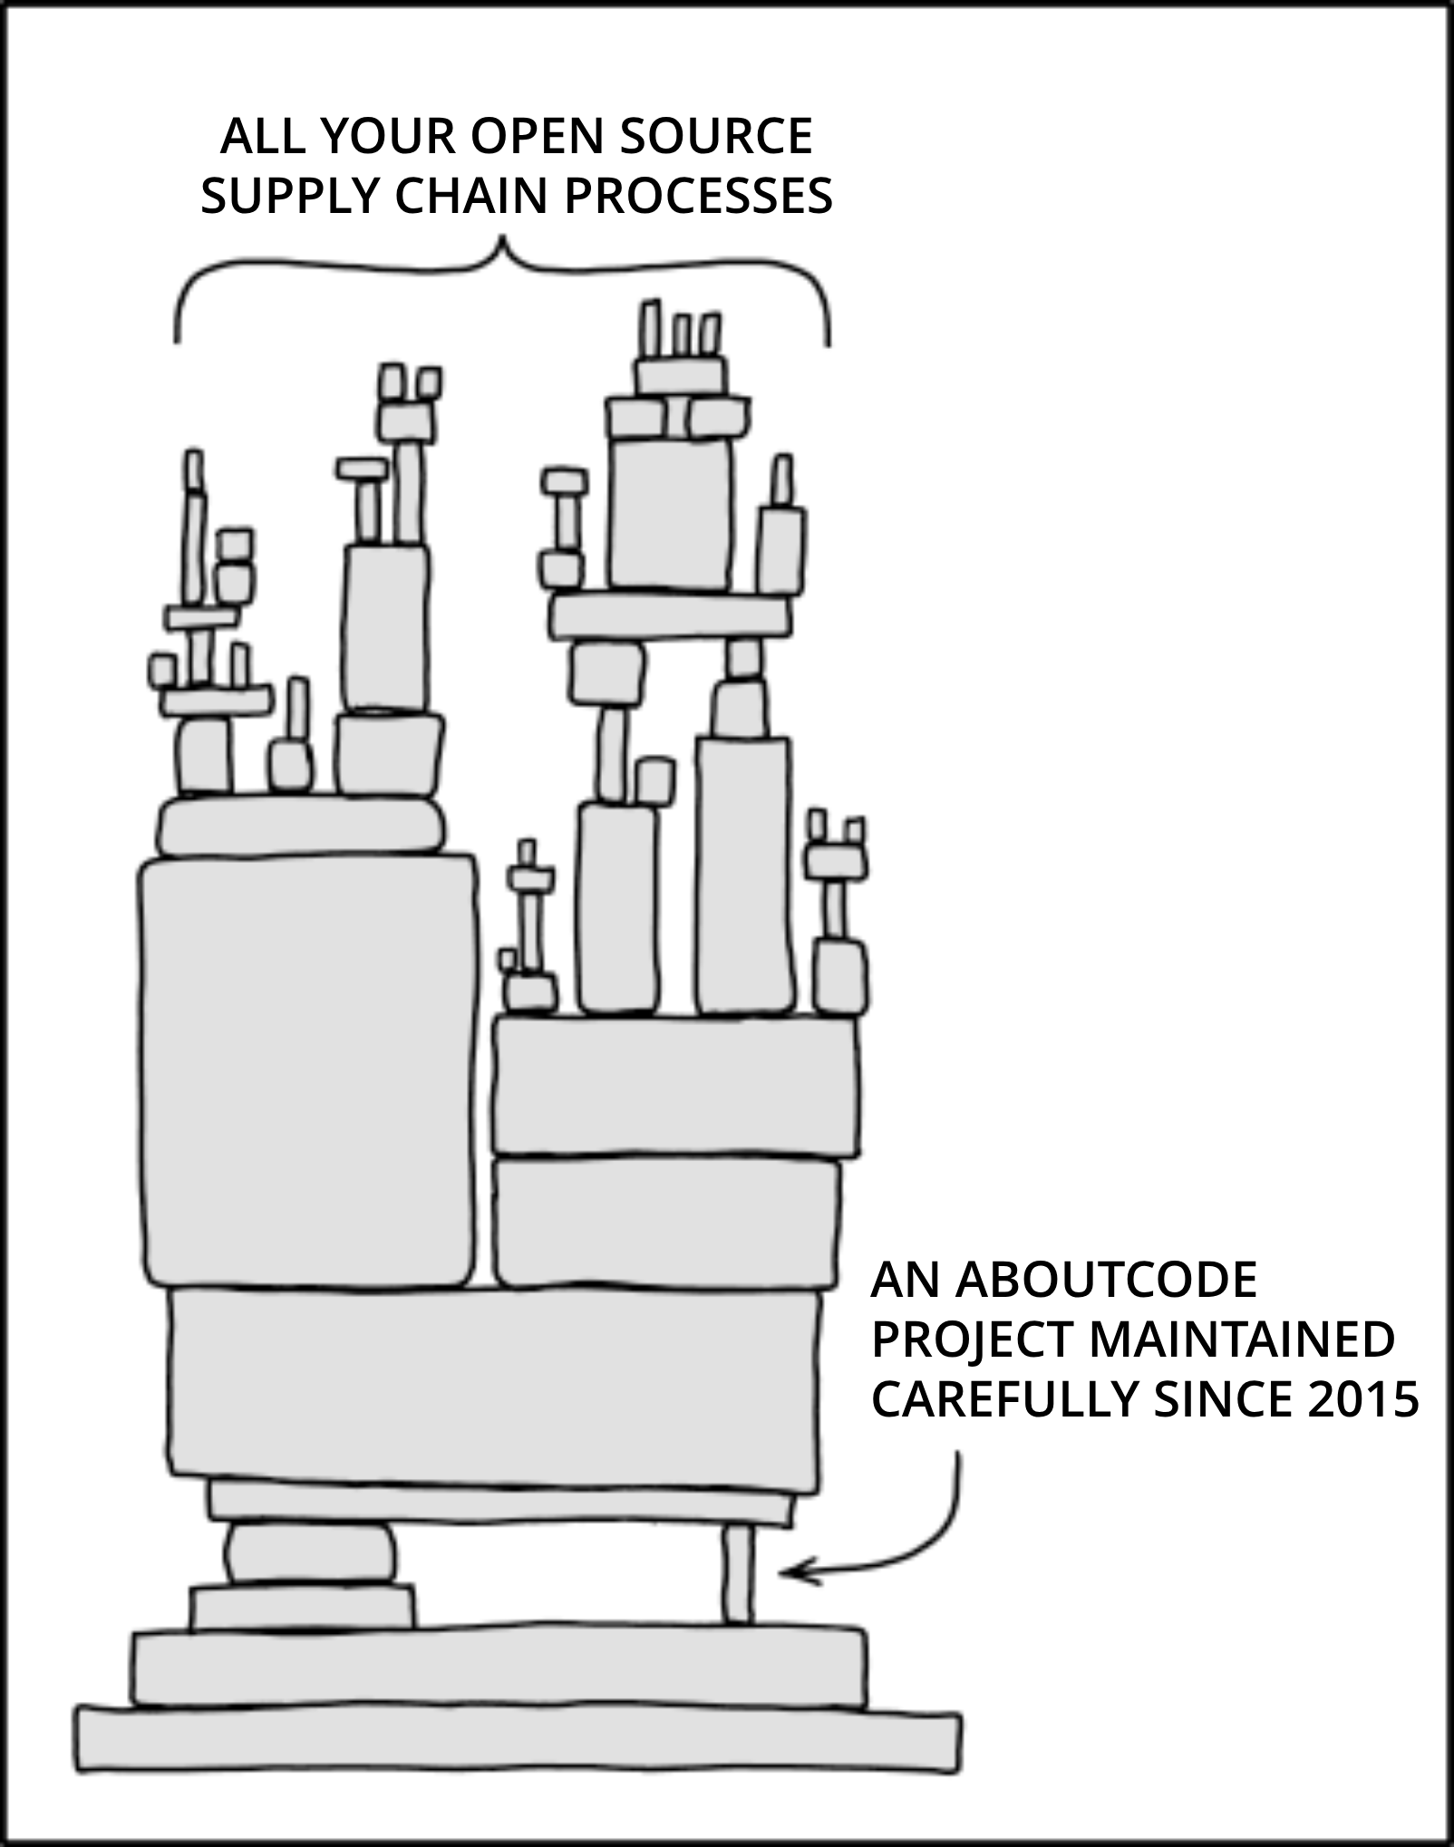
AboutCode also needs your help!
Contribute to an AboutCode project with code, documentation, use cases, bug reports
https://github.com/aboutcode-org
Sponsor AboutCode project maintainers, accelerate development of new features https://github.com/sponsors/aboutcode-org
Buy support, implementation, and advisory services from nexB to pay the maintainers
Join the community:
https://www.aboutcode.org/
https://matrix.to/aboutcode-org_discuss
"Dependency" by xkcd, Modified text from original
Notes:
We do need your help with AboutCode, whether it is with your time or experience, reporting issues or creating patches. Or donations to support the maintenance.

Slide 24

Questions?

Slide 25
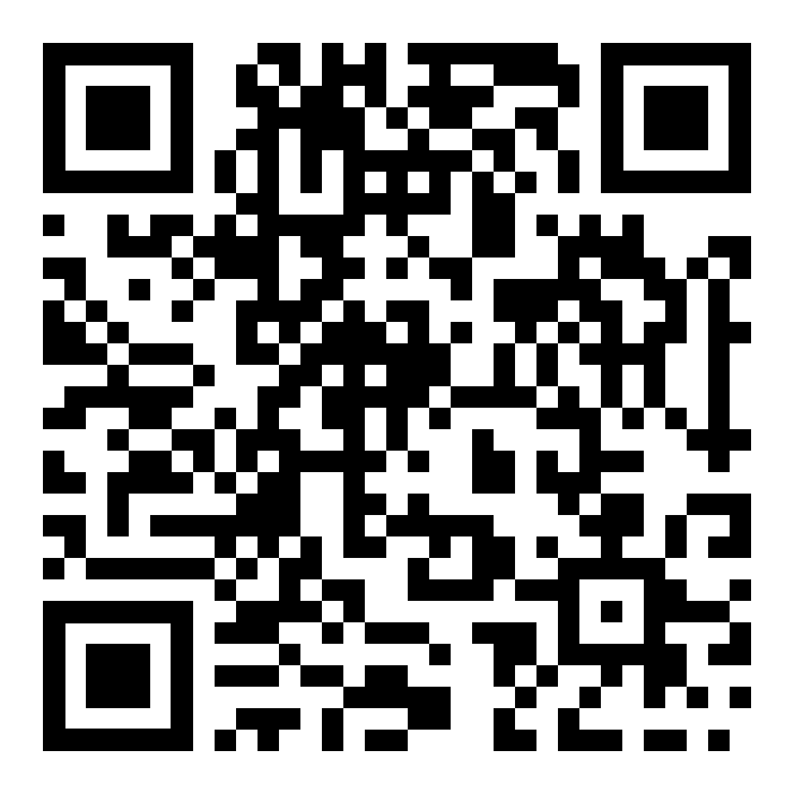
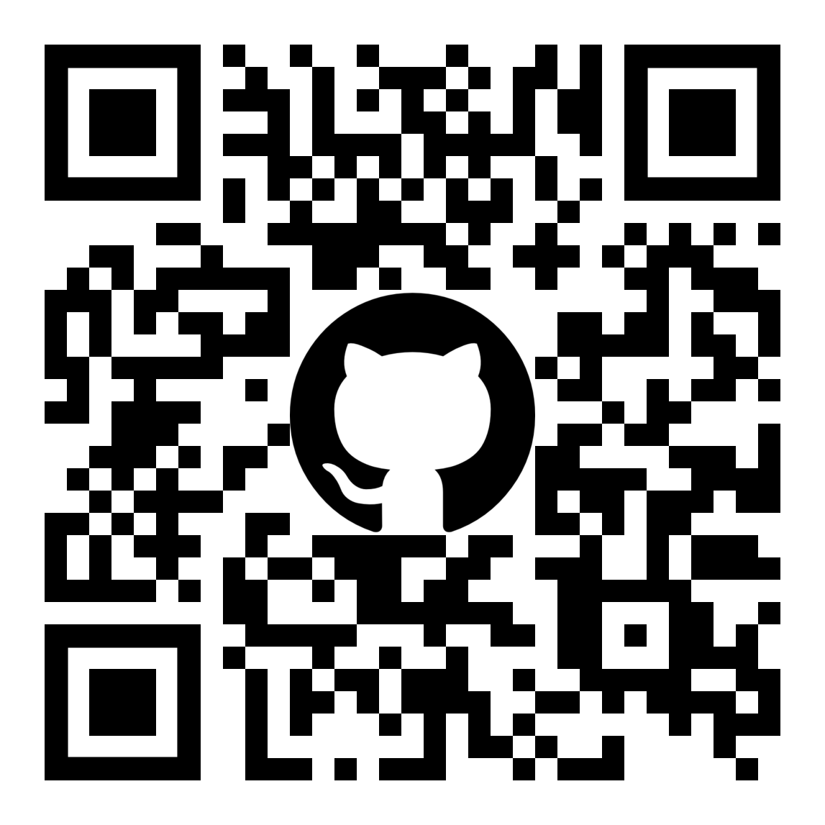
Note: QR Codes are without any tracking

Slide 26
Credits
Special thanks to all the people who made and released these excellent free resources:
All the open source software authors that make AboutCode possible
xkcd comics under cc-by-nc-2.5
Presentation template by SlidesCarnival

