Slide 1
From Policy to Pipeline: How OSPOs Can Power Regulatory Readiness and Upstream Impact

Slide 2
Agenda
About us
Policy and Regulations:
India: SEBI CSCRF, CERT-In SBOM and CS Audit Guidelines
EU CRA, US executive order, other guidelines
How OSPOs can help
Interpret and implement region-specific regulatory requirements
Collaboration between different teams in an organization
Participate and foster open standards and communities
Contribute and engage upstream for ecosystem wide readiness
AboutCode: Live Demo
Questions?

Slide 3
About Arun
Head of Secure Development Lifecycle: Corporate Cybersecurity Technology at Siemens Healthineers
Leading teams for Open Source Software License and Security Compliance for Medical Devices
Links:
LinkedIn: https://www.linkedin.com/in/arunazhakesan

Slide 4
About Ayan and AboutCode
Core maintainer of ScanCode (scancode-toolkit and scancode.io)
Working on license detection, package identification, binary scanning, devel/deployed mapping, SBOMs and data summarization
AboutCode's FOSS-first mission: FOSS for FOSS
Open source tools and open data (AboutCode stack)
Simple and practical standards (Package-URL)
Applications for Legal Business users (DejaCode, also FOSS)
Links:
asmahapatra@aboutcode.org
GitHub: https://github.com/AyanSinhaMahapatra/
LinkedIn: https://www.linkedin.com/in/ayansinhaju/

Slide 5
Regulations readiness
India
Cyber Security and Cyber Resilience Framework for SEBI Regulated Entities
Vulnerability disclosure, SBOMs
CERT-In guidelines:
Technical guidelines on SBOMs
Cyber Security Audit Policy Guidelines
EU’s Cyber Resilience Act (CRA)
US Executive order 14028
Global trend: regulators expecting detailed visibility into their software supply chains — and to prove it

Slide 6
OSPOs: Policy to Pipeline
Requirements:
Generate and produce SBOMs
Vulnerability Disclosure
Secure development lifecycle
License Attribution
MNCs: regulatory requirements are region specific
Enable automation and policies

Slide 7
OSPOs: Policy to Pipeline
Organizations have many stakeholders in FOSS
Product security
Legal and Compliance
Engineering teams
Business functions
OSPOs can facilitate collaboration
embed compliance into the development lifecycle

Slide 8
OSPOs: Policy to Pipeline
Participation in open standards
Openchain
SBOM standards: SPDX, CycloneDx
Cross-organisation collaboration
Tools and automation
Open data

Slide 9
OSPOs: Policy to Pipeline
Contribute upstream!
Identify projects with risk/need for help
Help with development, maintenance, funds
Cost-effective solutions: supporting FOSS vs buying products

Slide 10
OSPOs: Policy to Pipeline
The Three Fs of Open Source Puppy Care: Michael Winser
relationships with dependencies are important!
Complete dependency graph
Fix
Engage with maintainers, open Issues/PRs
Fork
Maintain your version, apply patches
Forget
Use something else!
Fund!

Slide 11
Tools to empower OSPOs
Enable automation and verification
Embed into development lifecycle
(CIs) Continuous Integration
Flag licensing and security compliance issues
Risk analysis for all dependencies
Empower reusing FOSS safely
Help with curation and oversight
Help meet regulatory requirements
Generate SBOMs, Vulnerability Disclosure, License Attribution
Map outputs to compliance artifacts required by regulators across regions

Slide 12
The AboutCode stack:
DejaCode
Policies Licenses
Components
Packages
Vulnerabilities
SBOM
SBOM
Attribution
ScanCode.io
Software Product
Scans
ScanCode Toolkit
FOSS Package
container inspector
package inspectors
LicenseDB
PurlDB
VulnerabilityDB

Slide 13
Why AboutCode?
Non-profit, fully open source and open data
options: CLI tool, Github action, web app, scans: containers, source/binary etc
supports and working with package ecosystems
to build better metadata, more transparency
solve ecosystem wide problems at once
Open data
Curated and open data on Licensing, Vulnerabilities, reuse scan results
Large community
working with FOSS orgs to improve standards, data and transparency
OSPOs, Security, Lawyers, Specifications, Developers

Slide 14
Live Demo!
Notes:
Brief overview of AboutCode stack Demo:
ScanCode.io: scans docker images, source/binary archives, codebases
ScanCode.io: scan for licenses, copyrights, enables looking into each details
ScanCode.io: looking for known vulnerabilities, look into vulnerability details
Purldb: reuse package scans, get metadata and scan results by packageURL
Matchcode: match files, package archives, and code snippets
ScanCode.io: setting license policy, detailed compliance alerts
ScanCode.io: also works in CI, as CLI tool
Dejacode: track products, versions and policies, enable curations
SBOM, VDR, attribution generation

Slide 15
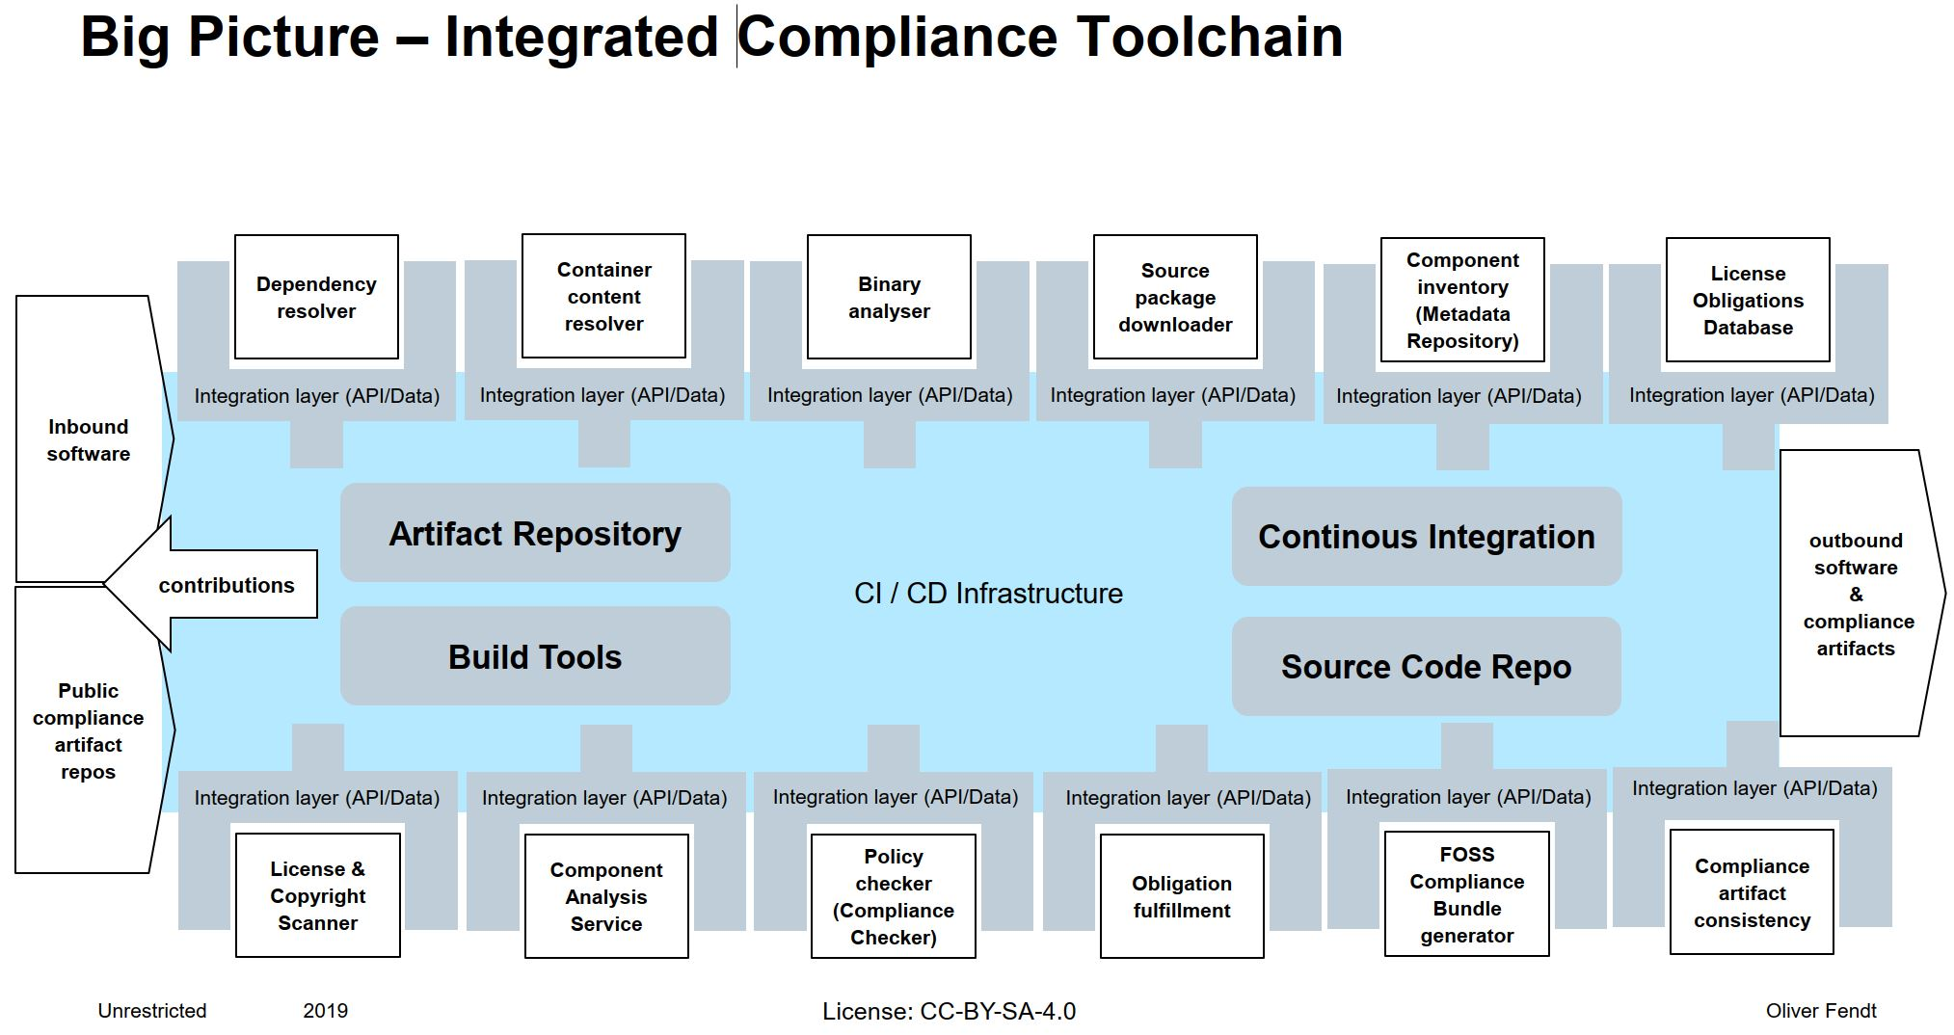
Notes:
These are also some other free and open source projects that you can use, and some of them also
do use scancode as a base.

Slide 16
Other FOSS SCA tools and projects
ORT: OSS Review Toolkit (Uses ScanCode)
FOSSology (Uses ScanCode)
SW360
TERN (Uses ScanCode)
ClearlyDefined (Uses scancode)
OSSelot
OWASP DependencyTrack
OWASP DepScan
AppThreat projects: atom, chen, vdb
CycloneDx cdxgen
Anchore: syft, grype
Aquasec trivy
Notes:
These are also some other free and open source projects that you can use, and some of them also
do use scancode as a base.

Slide 17
Questions?

Slide 18
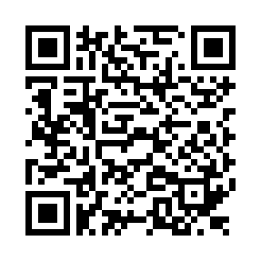

Link to slides
github/aboutcode-org

Slide 19
Credits
Special thanks to all the people who made and released these excellent free resources:
All the open source software authors that make AboutCode possible
xkcd comics under cc-by-nc-2.5
Presentation template by SlidesCarnival

