Slide 1
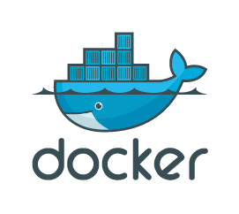
SCHOOL OF COMPUTER SCIENCE AND ENGINEERING
LOVELY PROFESSIONAL UNIVERSITY
JALANDHAR
DevOps Virtualization and Configuration Management
(INT-332)
Readers Garden – Library Management System
Containerized Infrastructure with CI/CD Pipeline
Submitted By:
Name – Ayan Yadav
Section- KO129
Roll no.- 22
Reg no.-12222524

Slide 2
PROJECT OVERVIEW
Developed a full-stack Library Management System to streamline book lending and inventory tracking.
Frontend built using React with Vite for enhanced speed and development experience.
Backend developed with Node.js and Express, managing API requests and server logic.
Includes a user interface for browsing books, borrowing/returning, and managing user accounts, with MongoDB as the database.
Features an admin panel for managing book inventory, tracking borrow history, and overseeing user activities in real-time..
Containerized the application using Docker to run frontend and backend as separate containers.
Implemented a CI/CD pipeline using GitHub Actions for automation.
Deployed on Vercel for fast, reliable delivery and version control.
Demonstrates practical skills in full-stack development, containerization, and DevOps.

Slide 3
PROBLEM STATEMENT AND SOLUTION
PROBLEMS:-
Outdated Interface that result in poor user experience.
Manual deployment process that slow down the rollout of new features.
Inconsistence environment between deployment and production causing unexpected errors.
Lack of automation testing and Integration.
SOLUTIONS:-
Developing a user friendly and modern website using MERN stack.
Containerizing the application using Docker to ensure consistence environment across the deployment.
Implementing CI/CD pipeline for automated testing.
The Combination of containerization and CI/CD will streamline the development without disrupting user experience.

Slide 4
TECHNOLOGIES STACK
CATEGORY | TECH USED
FRONTEND | REACT with VITE
BACKEND | NODE JS + EXPRESS
DATABASE | MONGO-DB
CONTAINERIZATION | DOCKER
CI/CD | GITHUB ACTIONS

Slide 5
PROJECT ARCHITECTURE

Slide 6
CONTAINERIZATION AND CI/CD PIPELINES
Docker Containerization
Containerized both frontend and backend as separate services.
Used separate Dockerfile for each and one docker-compose.yml in root directory.
Ensures environment consistency across all stages.
CI/CD Pipeline
GitHub Actions:
Triggers on every push and pull request on the master branch.
Runs tests and builds the source code and other required libraries.

Slide 7
CHALLENGES FACED AND LEARNING OUTCOMES
Challenges Faced:-
Integrating Docker with Vite & Node.js.
Managing secrets during deployment.
Implementing CI/CD via GitHub Actions.
Learning Outcomes:-
Hands-on experience with CI/CD.
Real-world DevOps concepts: Docker, GitHub Actions.
Improved full-stack development and deployment understanding.

Slide 8
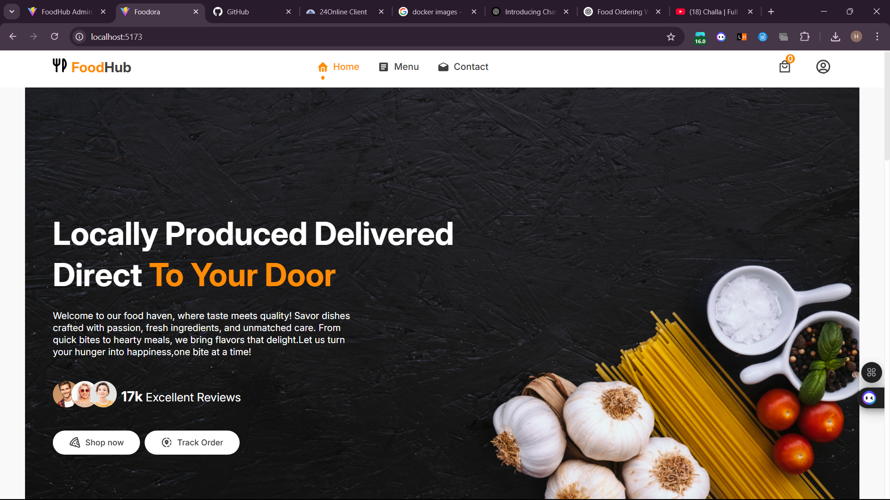
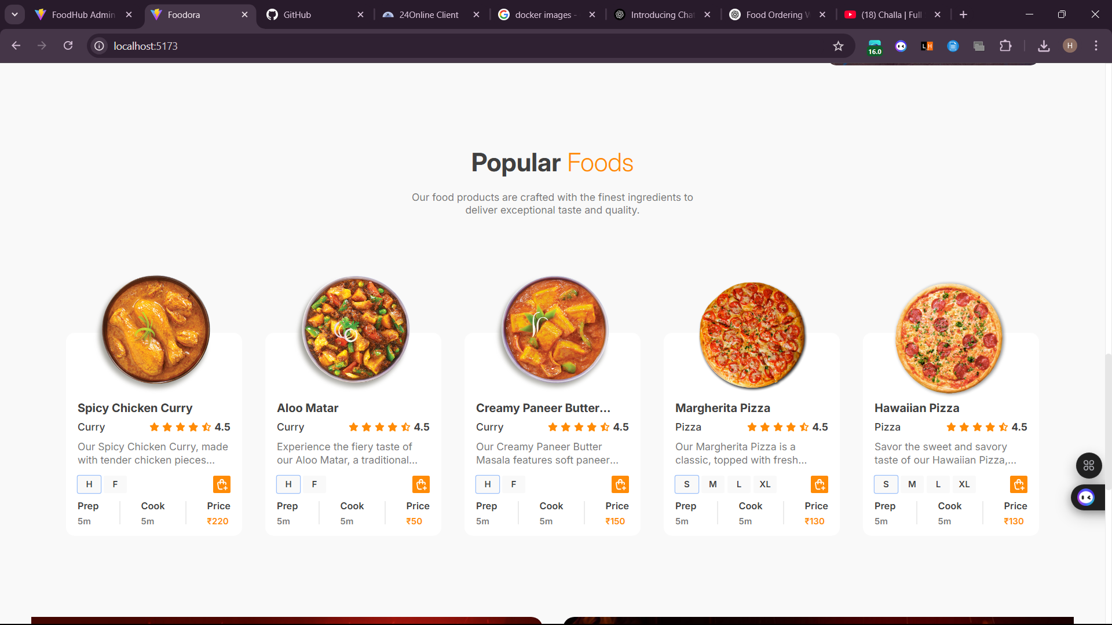
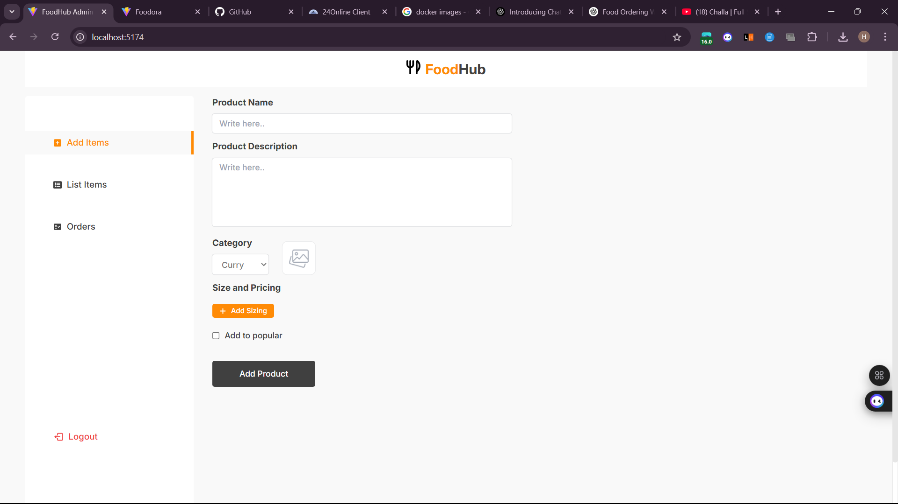
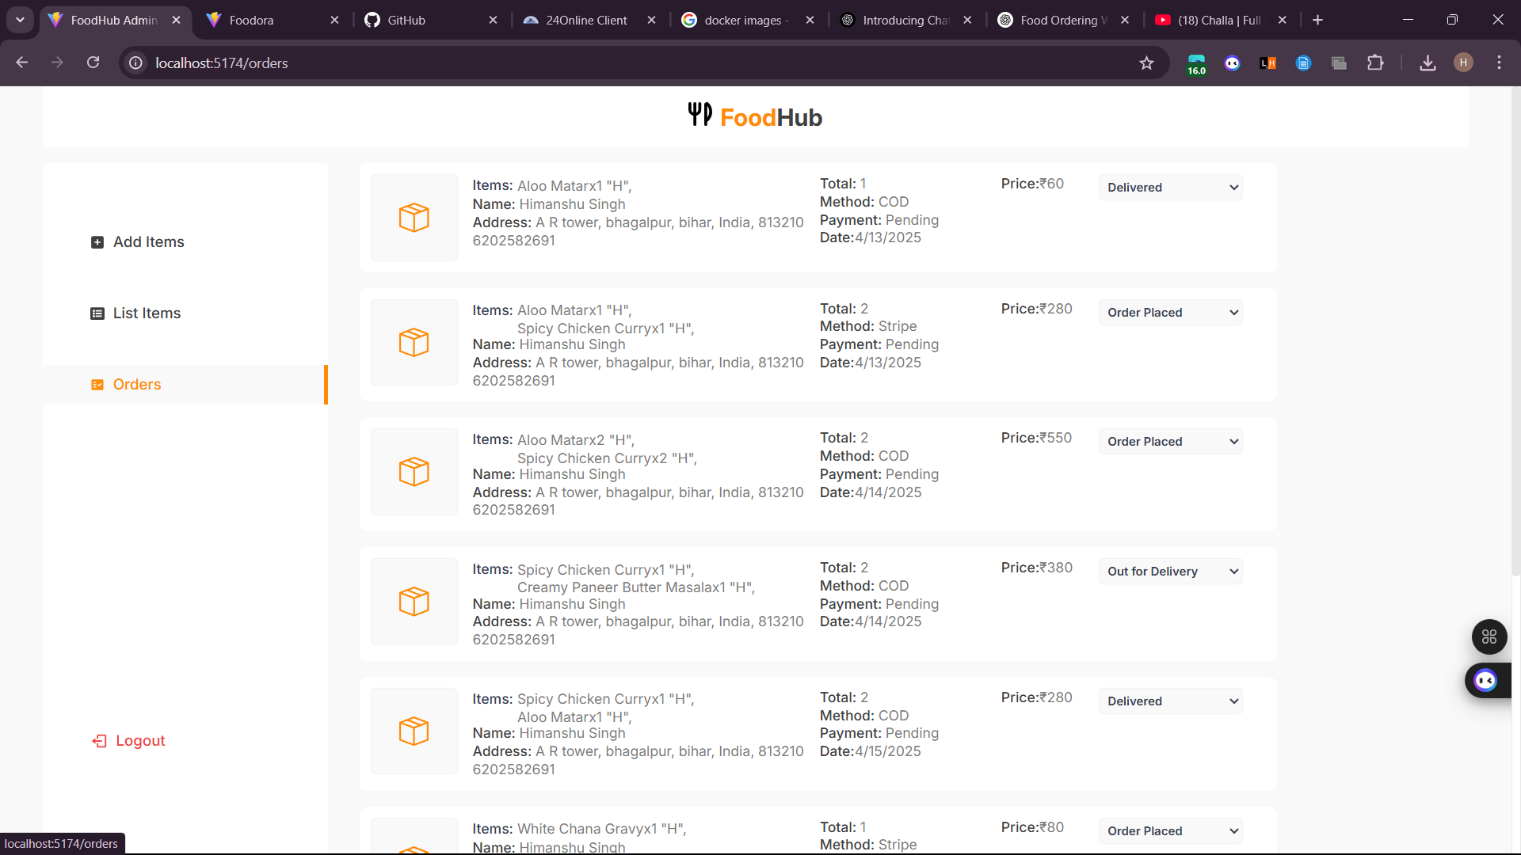
SNAPSHOTS OF PROJECT AND CODE

Slide 9
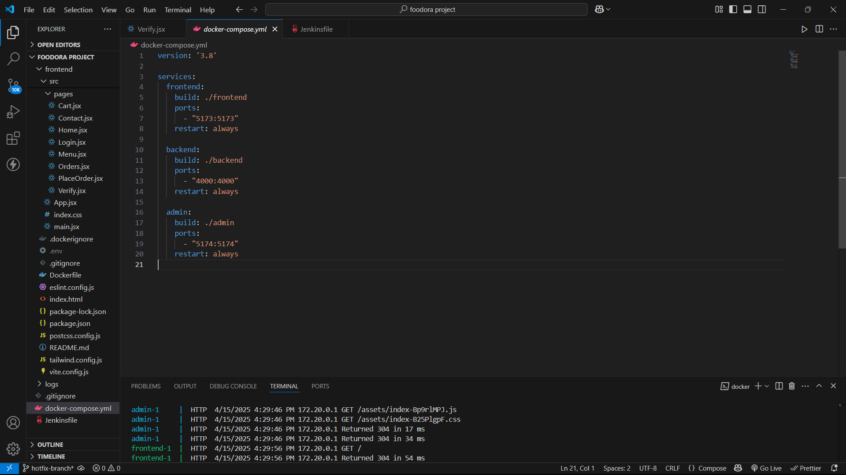
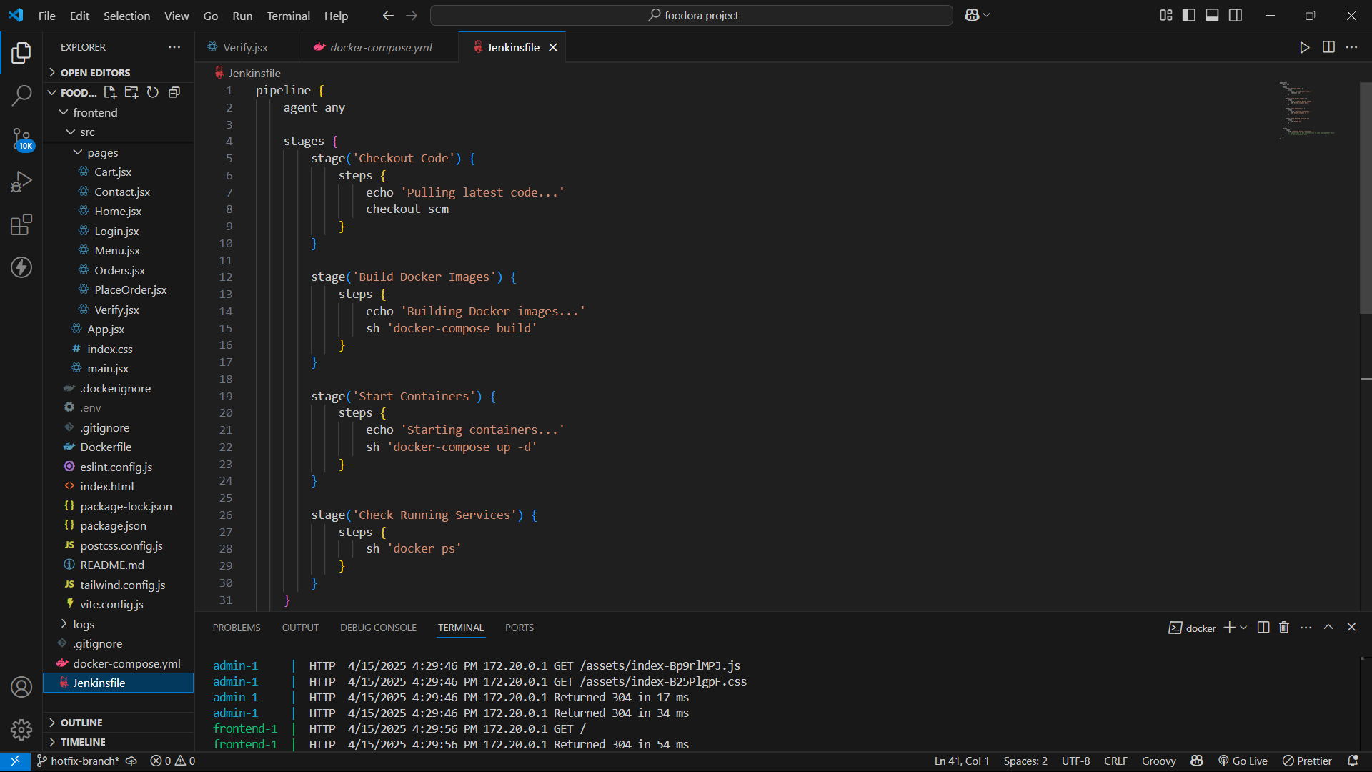
SNAPSHOT OF DOCKER-COMPOSE.YML FILE
SNAPSHOT OF JENKINSFILE

Slide 10
CONCLUSION AND FUTURE SCOPE
Conclusion:-
Successfully built and deployed a scalable food ordering platform.
Integrated modern DevOps practices like Docker and CI/CD to ensure smooth and automated deployments.
The project is optimized for real-world use, with features for both users and admins, and a clean deployment pipeline for continuous updates.
Future Scope:-
💳 Payment Gateway Integration
Enables secure online transactions for seamless order processing.
📍 Delivery Tracking
Tracks order status in real-time, improving transparency and customer experience.
📩 SMS/Email Notifications
Sends instant updates to customers about order confirmation, dispatch, and delivery.
🤖 AI-Powered Suggestions (If implemented or planned)
Suggests popular items or upsells based on user behavior (can be basic rule-based or ML-based).

