Slide 1
Not all angles can be trisected using ruler and compass
An understandable, step by step approach
Yifan Mo

Slide 2
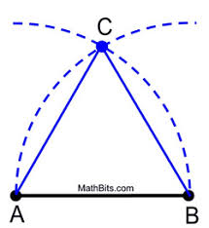
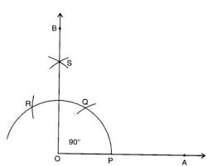
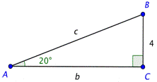
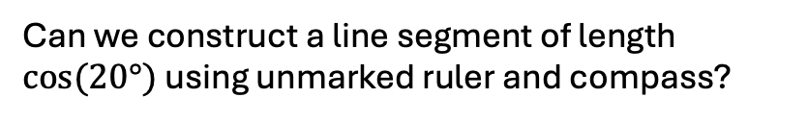
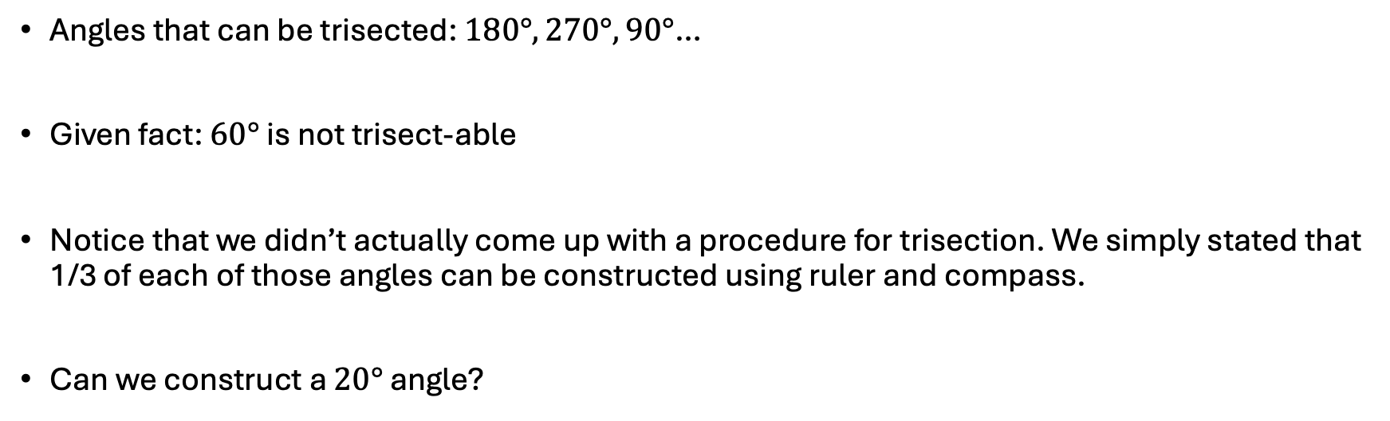

Investigating the statement
Angles that can be trisected: $180°, 270°, 90°$…
Given fact: $60°$ is not trisect-able
Notice that we didn’t actually come up with a procedure for trisection. We simply stated that 1/3 of each of those angles can be constructed using ruler and compass.
Can we construct a $20°$ angle?
1
Can we construct a line segment of length $cos⁡(20°)$ using unmarked ruler and compass?
$$cos⁡(20°)$$
Gauss–Wantzel theorem: $θ$ is constructible if and only if $\frac{360°}{θ}=2^{k}p_{1}p_{2}…p_{n}$ where $p_{i}$ are distinct fermat primes

Slide 3
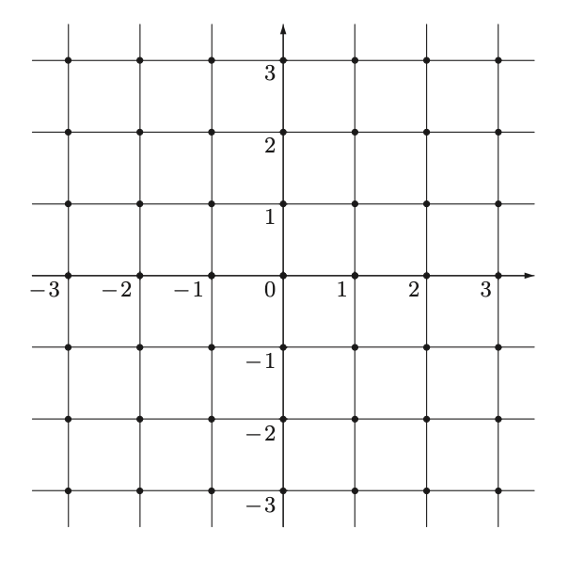
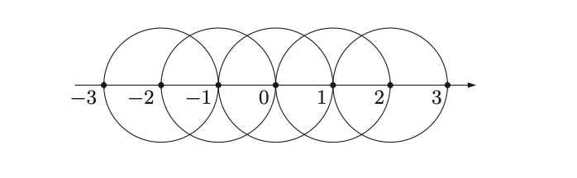
Constructible numbers
Line segment of length what length CAN we draw?
Integers
Still Integers …… but in two directions

Slide 4
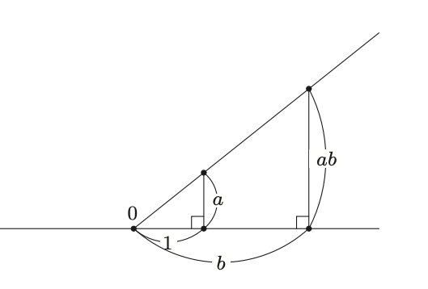
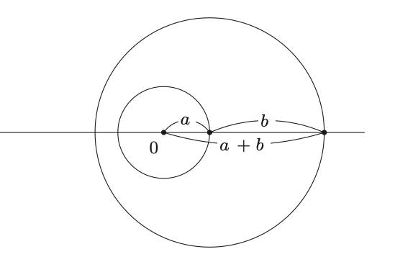
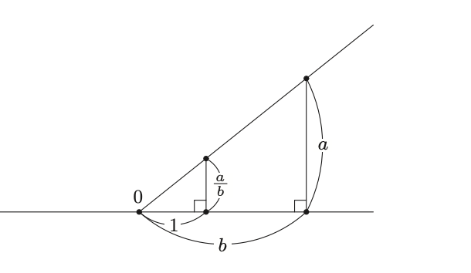
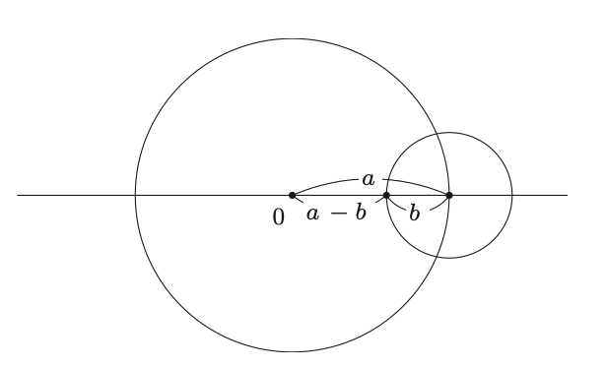
Constructible numbers
Addition
Multiplication
Division
Subtraction

Slide 5








Constructible numbers
All rational numbers can be expressed as $\frac{p}{q} , p,q∈ℤ , q≠0.$ $ℤ$ is constructible
$⟹ ℚ$ is constructible
🗿 Treat numbers as fields. $ℤ⊂ℚ⊂D$
$$+−×$$
$$D$$
$$ℚ$$
$$ℤ$$
Extension via$÷$
?

Slide 6
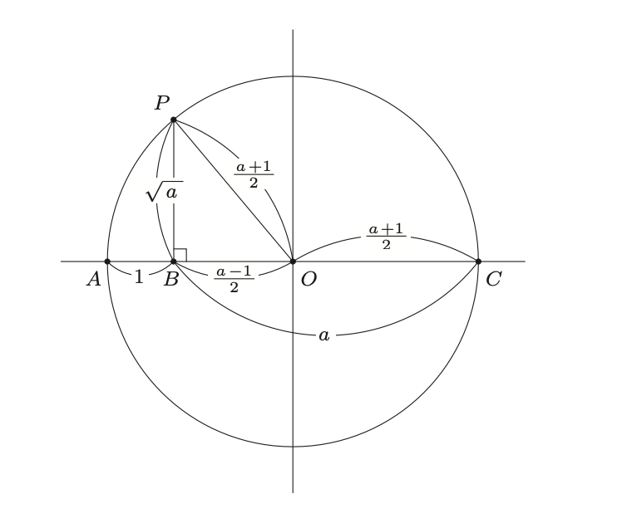

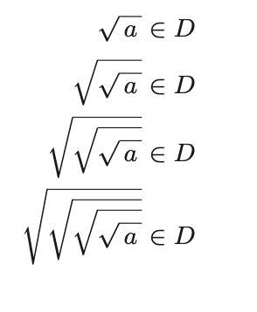
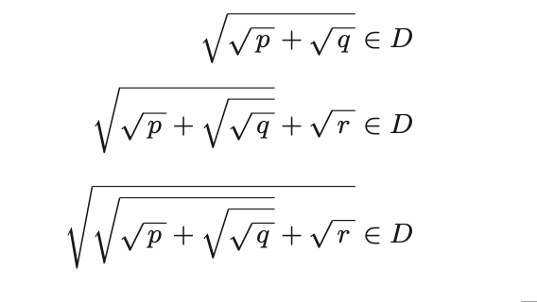
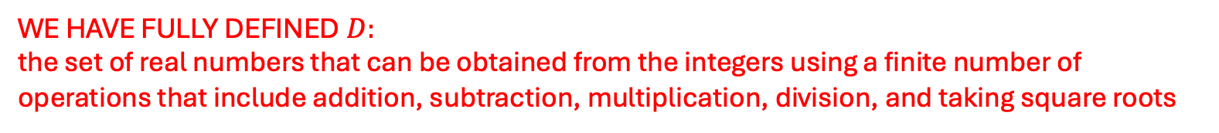



Constructible numbers $D$
($2^{n}$th sqrt root)
Not allowed:$\sqrt[3]{a}, \sqrt[5]{a}, …$
WE HAVE FULLY DEFINED $D:$
the set of real numbers that can be obtained from the integers using a finite number of operations that include addition, subtraction, multiplication, division, and taking square roots

Slide 7


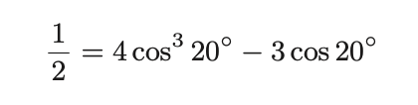




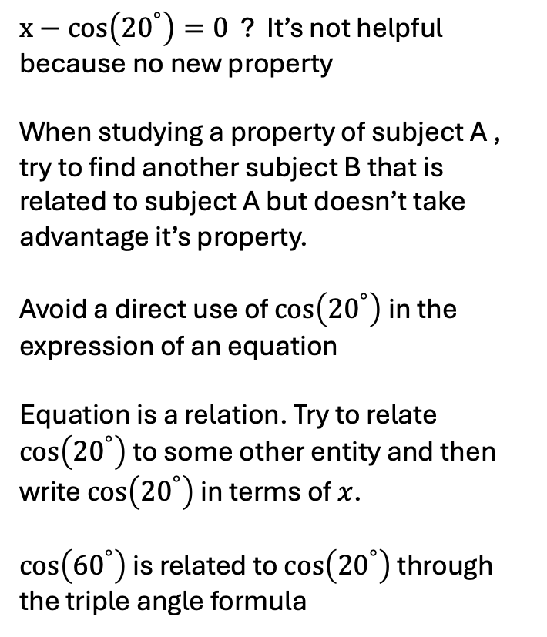




Leap of faith: investigating equations and roots
Goal: find an equation that has $cos\left({20}^{°}\right)$ as one of its solutions.
is a root of
$$cos⁡(20°)$$
$x−cos\left({20}^{°}\right)=0$ ? It’s not helpful because no new property
When studying a property of subject A , try to find another subject B that is related to subject A but doesn’t take advantage it’s property.
Avoid a direct use of $cos\left({20}^{°}\right)$in the expression of an equation
Equation is a relation. Try to relate $cos\left({20}^{°}\right)$ to some other entity and then write $cos\left({20}^{°}\right)$ in terms of $x$.
$cos\left({60}^{°}\right)$ is related to $cos\left({20}^{°}\right)$ through the triple angle formula
is not in
Some magic equation
$$θ=20°$$
$$D$$
has no solutions in
$$\cos\left(60°\right)=1/2$$
rearrange
Let $2\cos\left(20°\right)=x$
… has $cos⁡(20°)$ as one of its solutions

Slide 8
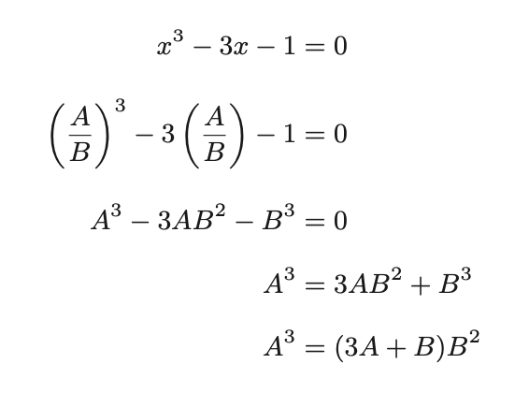


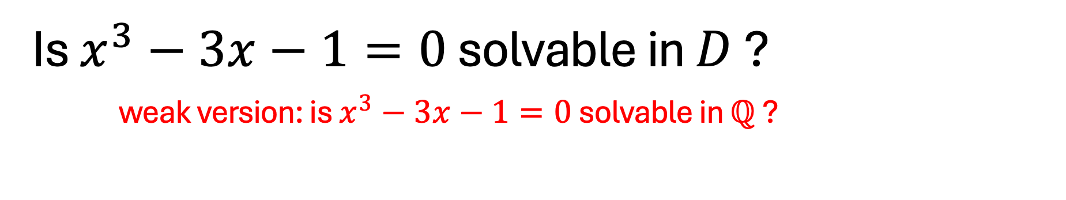

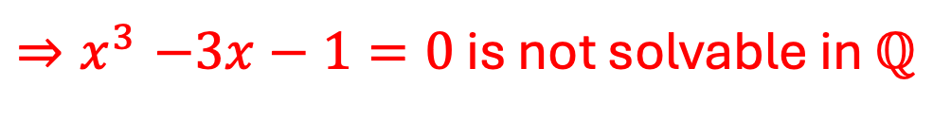
Is $x^{3}−3x−1=0$ solvable in $D$ ?
weak version: is $x^{3}−3x−1=0$ solvable in $ℚ$ ?
Suppose solution exists: $x=\frac{A}{B}$ , $A$ and $B$ are co-prime
$A=1 ⇒\left(3+B\right)B^{2}=1$ Reject
$A=−1⇒\left(B−3\right)B^{2}=−1$ Reject
$A=0 ⇒B=0$ Reject
$A$ has prime factor $p≠1 or −1$. Without loss of generality, let $A>0$
$A^{3}=0 mod p \left(3A+B\right)=B mod p, so B^{2}=0 mod p$ which is impossible
Investigate divisibility !
${⇒x}^{3}−3x−1=0$ is not solvable in $ℚ$

Slide 9


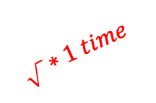
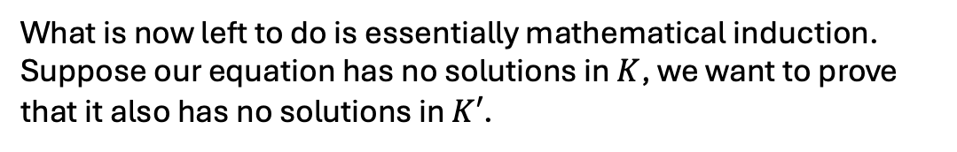


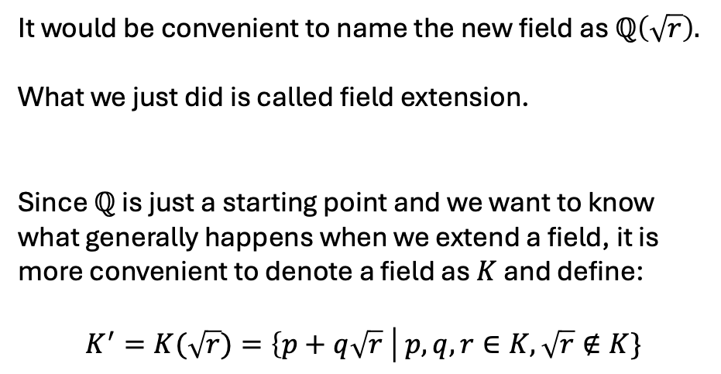



Getting from $ℚ$ to $D$
It would be convenient to name the new field as $ℚ\left(\sqrt{r}\right).$
What we just did is called field extension.
Since $ℚ$ is just a starting point and we want to know what generally happens when we extend a field, it is more convenient to denote a field as $K$ and define:
$$K^{′}=K(\sqrt{r})=\left\{p+q\sqrt{r} \right| p,q,r∈K, \sqrt{r}∉K\}$$
$$\sqrt{ }∗finite times$$
$$\frac{1}{3}+2\sqrt{5}$$
$$ℚ$$
$$D$$
Our equation is insolvable here
$$1−\sqrt{2+\sqrt{3}}$$
$$\sqrt{ }∗1 time$$
…
$$\sqrt{ }∗1 times$$
What is now left to do is essentially mathematical induction.
Suppose our equation has no solutions in $K$, we want to prove that it also has no solutions in $K′$.

Slide 10
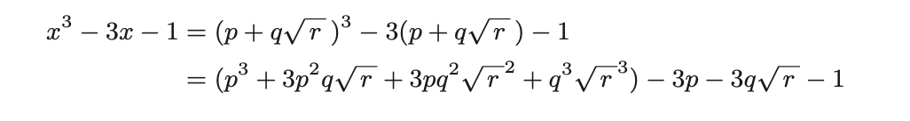
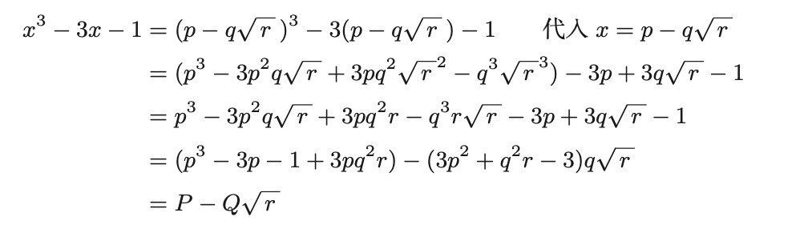
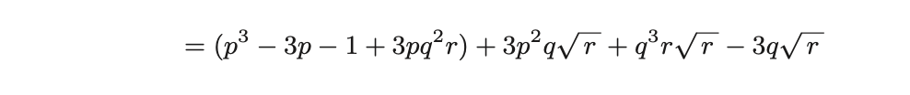

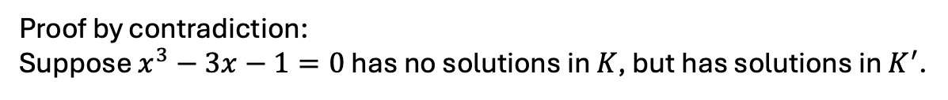

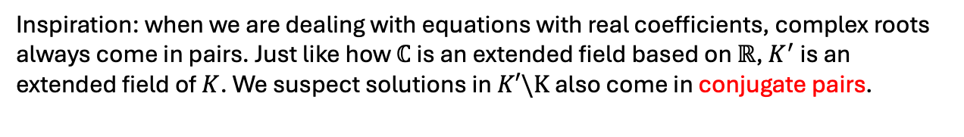
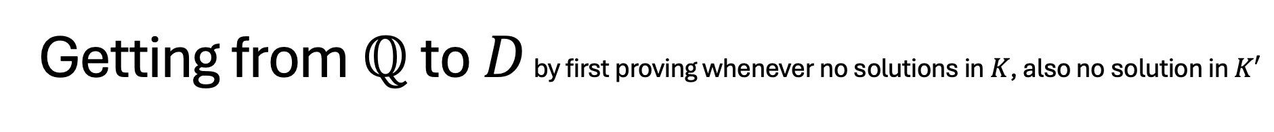


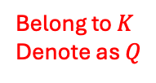
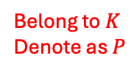

Getting from $ℚ$ to $D$ by first proving whenever no solutions in $K$, also no solution in $K′$
Proof by contradiction:
Suppose $x^{3}−3x−1=0$ has no solutions in $K$, but has solutions in $K^{′}$.
Denote that solution as $p+q\sqrt{r}, q≠0$. Plug it into equation:
Plug $x=p−q\sqrt{r}$ into expression:
= 0
?
If $P−Q\sqrt{r}=0$, then $p−q\sqrt{r}$ is a solution
Belong to $K$
Denote as $P$
Belong to $K$
Denote as $Q$
Lemma: $P+Q\sqrt{r}=0 ⟺P=Q=0$
What we want to show: there are no solutions in $K$.
What we just assumed: one of the three roots is in $K′$
Inspiration: when we are dealing with equations with real coefficients, complex roots always come in pairs. Just like how $ℂ$ is an extended field based on $ℝ$, $K^{′}$ is an extended field of $K$. We suspect solutions in $K′\backslash K$ also come in conjugate pairs.
$$P−Q\sqrt{r}=0$$

Slide 11
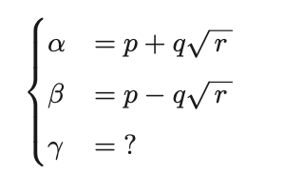

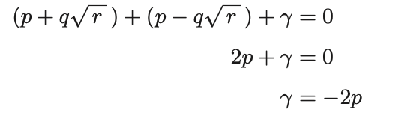


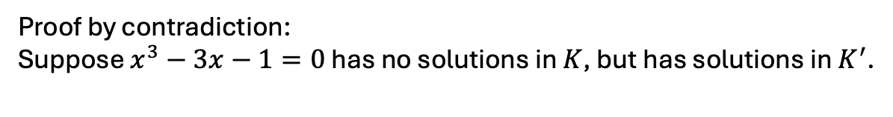
Getting from $ℚ$ to $D$ by first proving whenever no solutions in $K$, also no solution in $K′$
Proof by contradiction:
Suppose $x^{3}−3x−1=0$ has no solutions in $K$, but has solutions in $K^{′}$.
Apply the special power of equations: relationship between roots and coefficients.
$$⇒$$
Because $p∈K, −2p∈K.$
$⇒$If $x^{3}−3x−1=0$ has solutions in $K′$, then one of its roots is in $K$.
Contradiction. Thus whenever no solutions in $K$, also no solution in $K′$
Proof by mathematical induction: $x^{3}−3x−1=0$ has no solutions in $D$

Slide 12





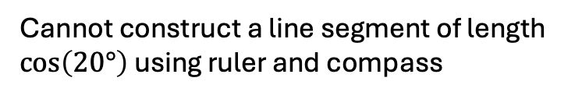
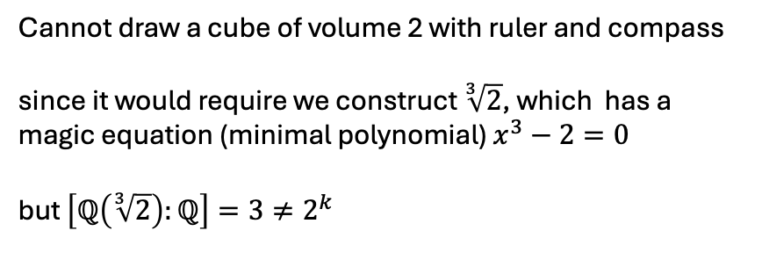
Summing it up, and more
$x^{3}−3x−1=0$ has no solutions in $ℚ$
Applications of our conclusion (in math, not real life):
$x^{3}−3x−1=0$ has no solutions in $D$
The notion of constructible numbers and field extention appear frequently in Galois theory.
$$\cos\left(20°\right)∉D$$
degree of extension = degree of minimal polynomial
Cannot construct a line segment of length $\cos\left(20°\right)$ using ruler and compass
$x^{3}−3x−1=0$ is one example of a “minimal polynomial” of degree $3$.
Cannot draw a cube of volume 2 with ruler and compass
since it would require we construct $\sqrt[3]{2}$, which has a magic equation (minimal polynomial) $x^{3}−2=0$
but $\left[ℚ\left(\sqrt[3]{2}\right):ℚ\right]=3≠2^{k}$
Cannot construct $20°$ using ruler and compass
Cannot trisect $60°$ using ruler and compass

Slide 13
Thank You!
Yifan Mo
Angle trisection. (2024). In Wikipedia. https://en.wikipedia.org/w/index.php?title=Angle_trisection&oldid=1257084030
Constructible polygon. (2024). In Wikipedia. https://en.wikipedia.org/w/index.php?title=Constructible_polygon&oldid=1253496815
Yūki, H., & Gonzalez, T. (2021). Math girls 5: Galois theory (First edition). Bento Books.

