Slide 1
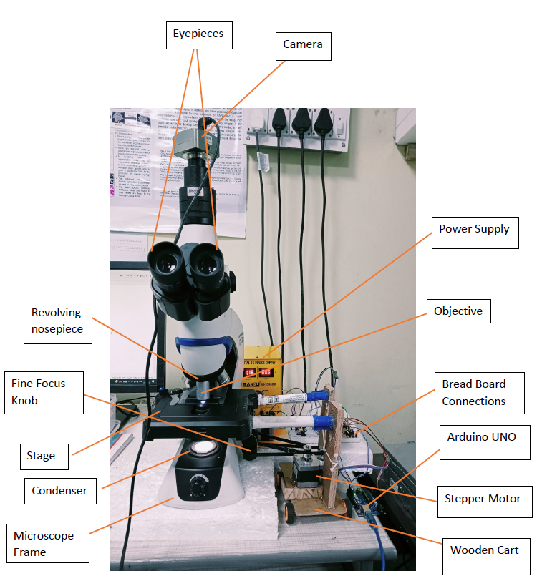

Slide 3
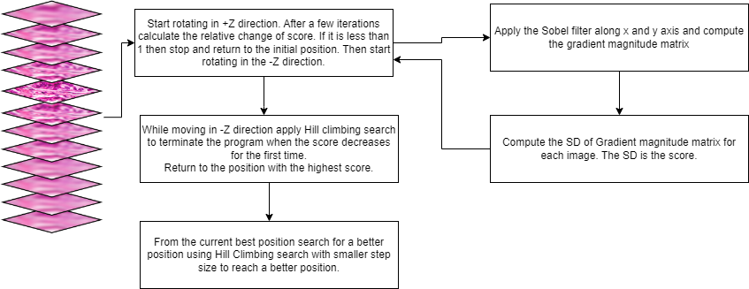

Slide 4


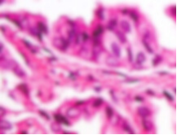
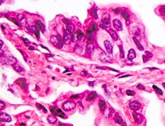

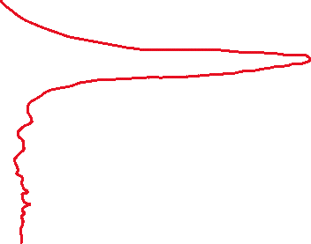



Image Sharpness
Image Sharpness
Image Sharpness
Z axis
Z axis
Image Sharpness
Z axis
Z axis

Slide 5



Image Sharpness
Z axis

Slide 6











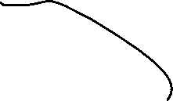
Image Sharpness
Image Sharpness
Z axis
Z axis

Slide 8
