Slide 1
Insurance Business Performance Analysis
Group 3
AYAN BASU
LAXMI SHARMA
SUKHADA BORADE

Slide 2
Insurance Analytics is a project that focuses on leveraging data to gain data-driven insights and make informed decisions in the insurance industry
Data visualization plays a crucial role in insurance analytics as it allows for the effective communication of complex information and trends

Slide 3
Tools Used
Excel
Power BI
Tableau
SQL
3

Slide 4
KPI List used for the Analysis:
No of Invoice by Account Executive
Yearly Meeting Count
Cross Sell-Target, Achieved, New
New-Target, Achieved, New
Renewal-Target, Achieved, New
Stage Funnel by Revenue
No of meeting By Account Executive
Top Open Opportunity
4

Slide 5
No of Meeting
Year | Count of Meeting
2019 | 3
2020 | 31
Grand Total | 34
5

Slide 6
No of Invoices by Account Executive
6

Slide 7
This dashboard is to discuss the performance of business within Ahmedabad branch by considering Cross sell, New and Renewal Numbers
Cross-selling refers to the practice of selling additional insurance policies to an existing customer
Renewal refers to the process of extending an existing insurance policy
New business refers to the process of selling insurance policies to new customers.
7

Slide 8
Achievement
Cross Sell
1.3 Cr
New
35 Lacs
Renewal
1.85 Cr
8

Slide 9
Percentage of Achievement for Placed & Invoiced
Cross Sell
Cross Sell
65%
14%
New
Placed
Invoiced
New
18%
3%
Renewal
Renewal
150%
67%
9

Slide 10
Opportunity Overview
Total
49
Open
44
Top 4 by Revenue
500K
400K
400K
350K
Fire
DB Mega Policy
EL Group Mediclaim
CVP GMC
10

Slide 11
Stage Funnel by Revenue
Quality
5920K
Negotiate
899K
Propose
Solution
60K
11

Slide 12
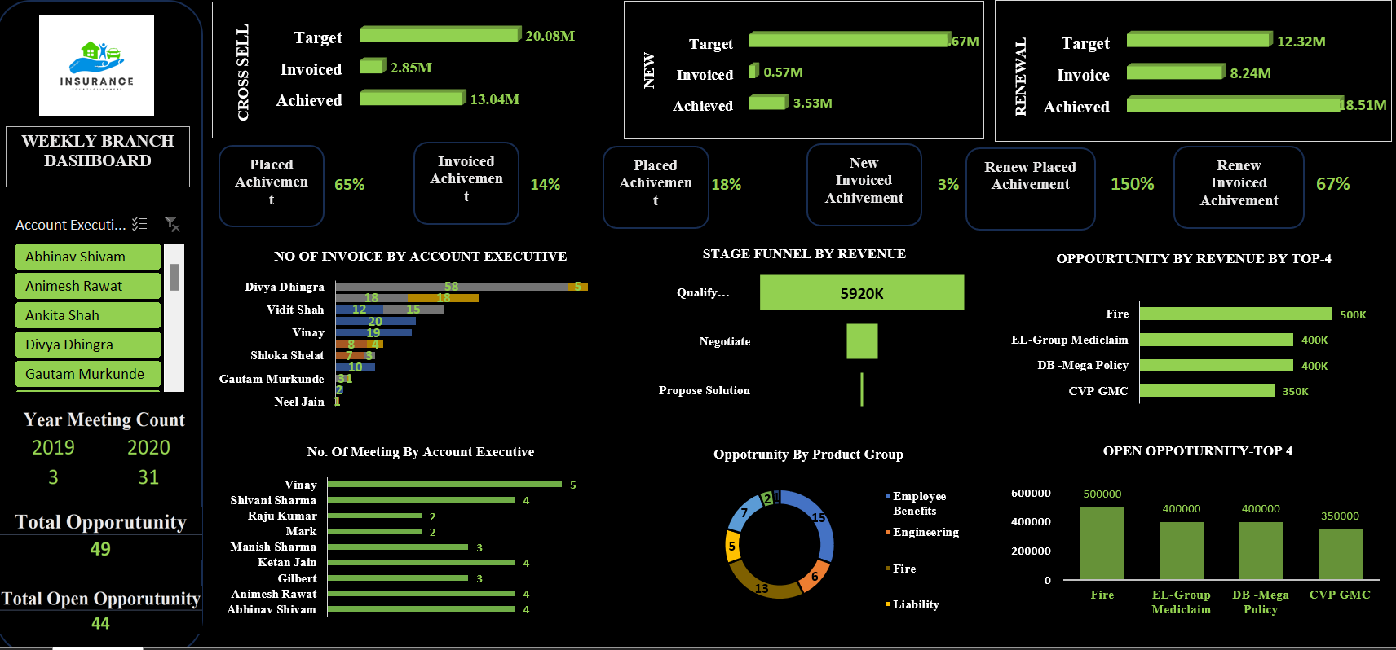
Excel Dashboard
12

Slide 13
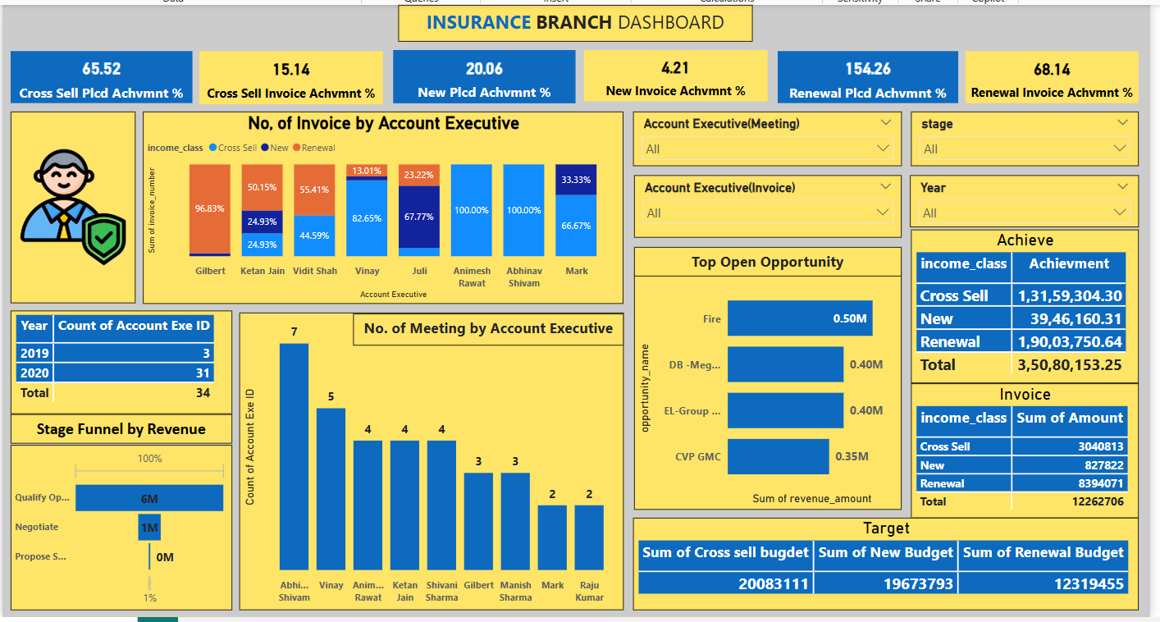
Power BI Dashboard
13

Slide 14
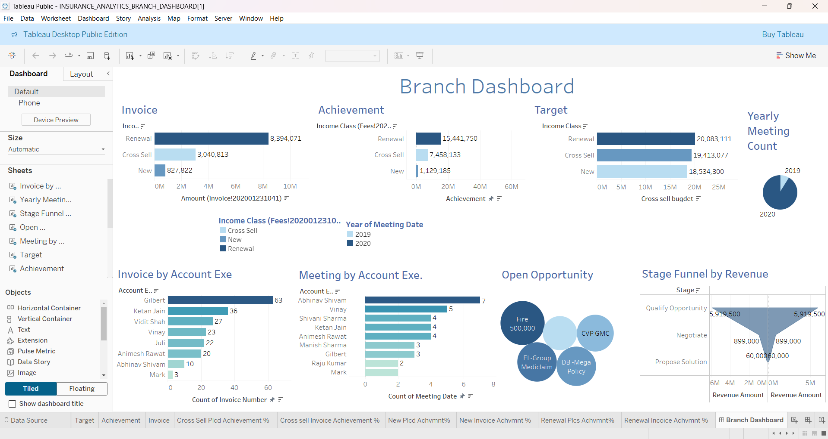
Tableau Dashboard
14

Slide 15
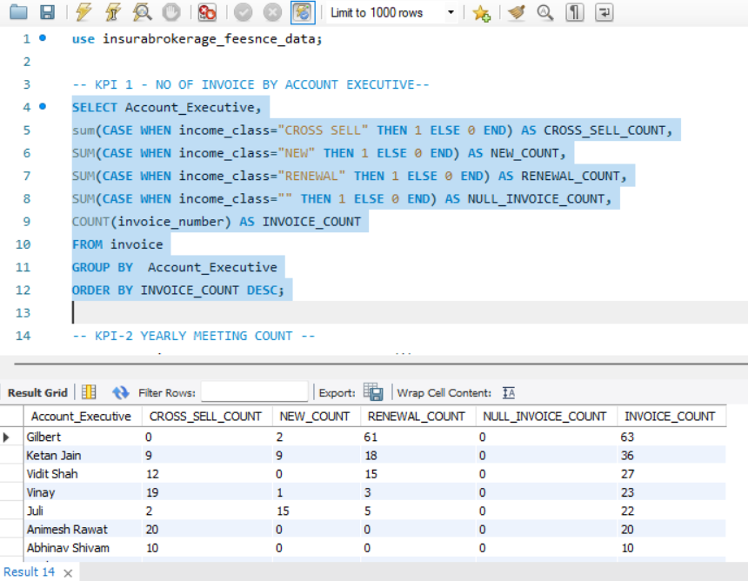
SQL
KPI 1 - NO OF INVOICE BY ACCOUNT EXECUTIVE
15

Slide 16
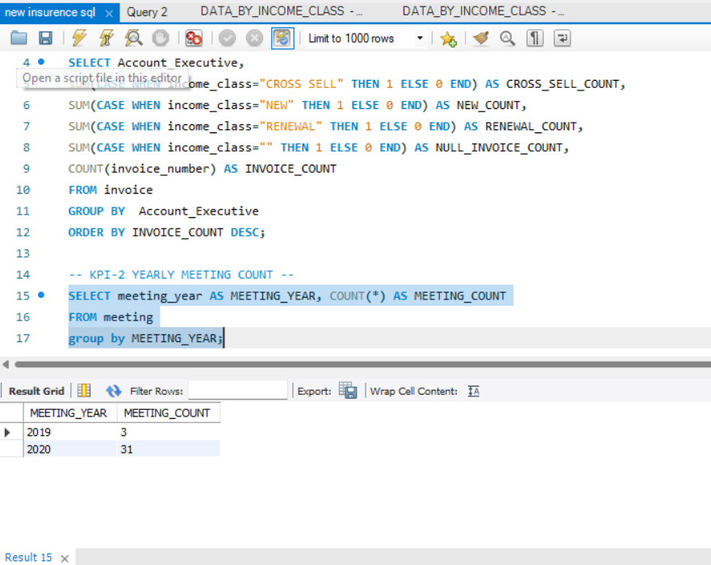
SQL
KPI-2 YEARLY MEETING COUNT
16

Slide 17
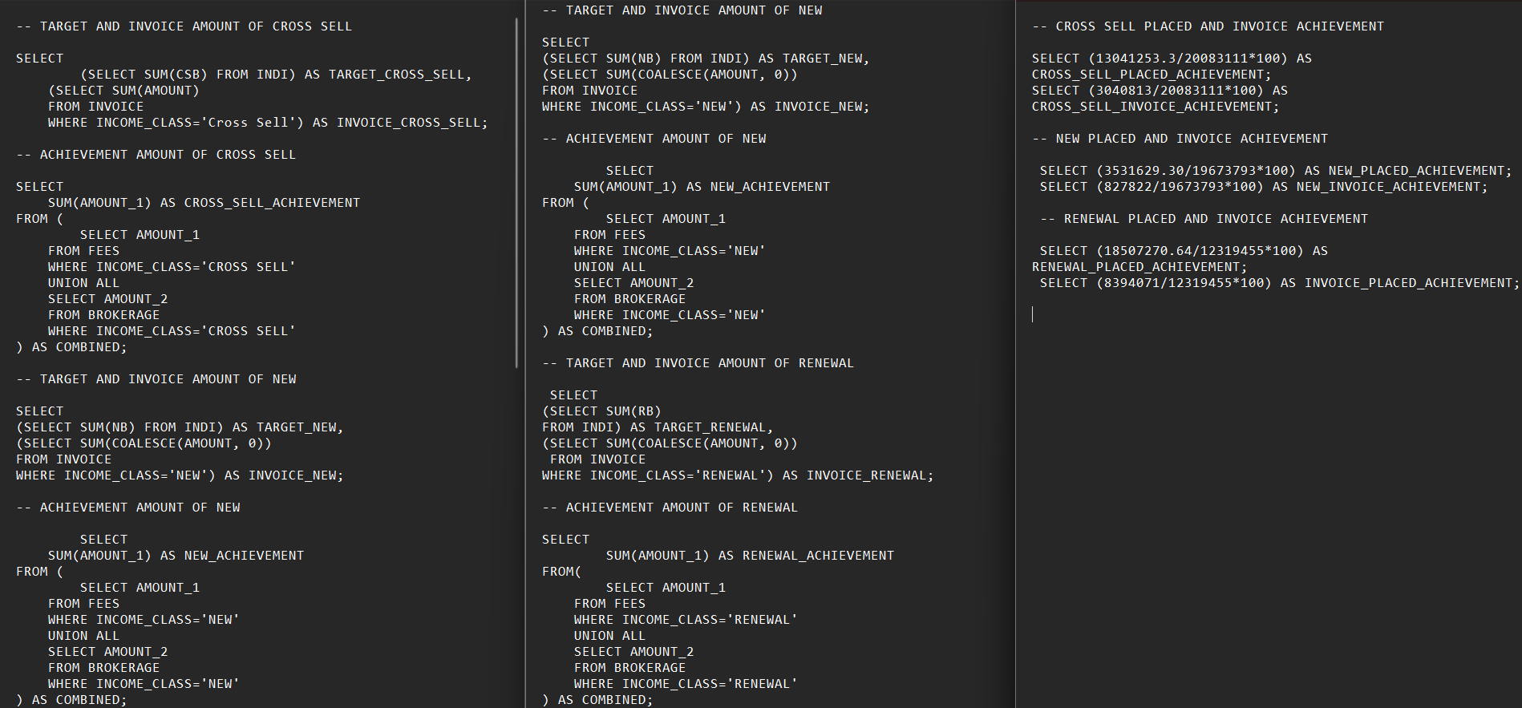
SQL
KPI3-TARGET,INVOICE,ACHIEVED#PLACED_ACHIEVED_PERCENTAGE,INVOICED_ACHIEVED_PERCENTAGE BY INCOME_CLASS#CROSS_SELL,NEW,RENEWAL
17

Slide 18
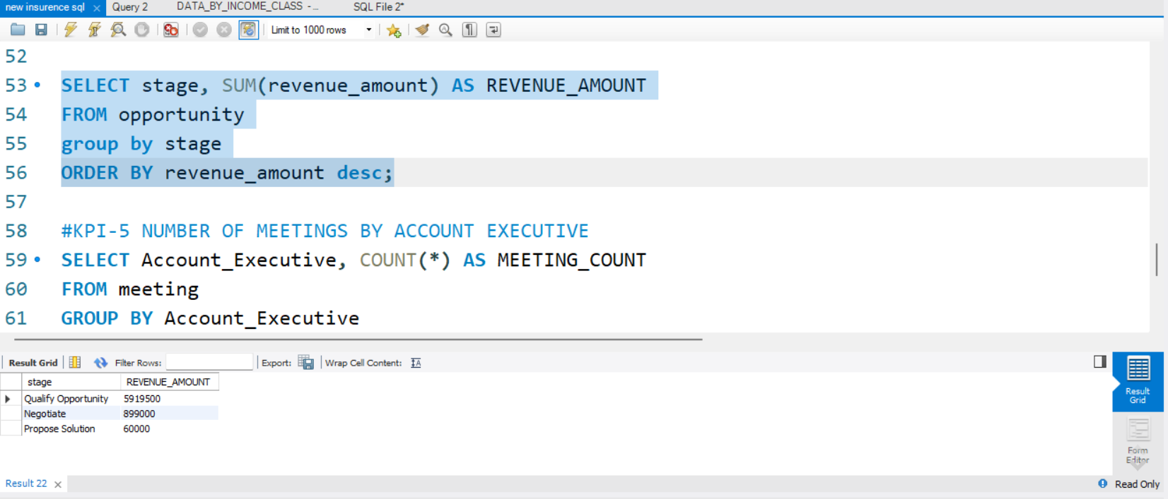
SQL
KPI-4 STAGE FUNNEL BY REVENUE
18

Slide 19
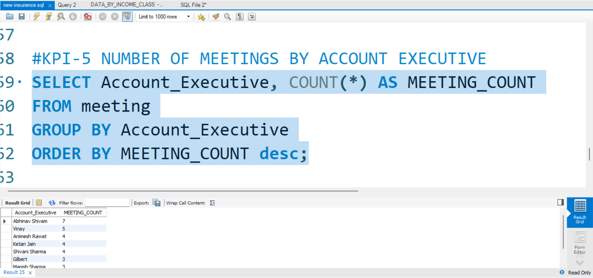
SQL
KPI-5 NUMBER OF MEETINGS BY ACCOUNT EXECUTIVE
19

Slide 20
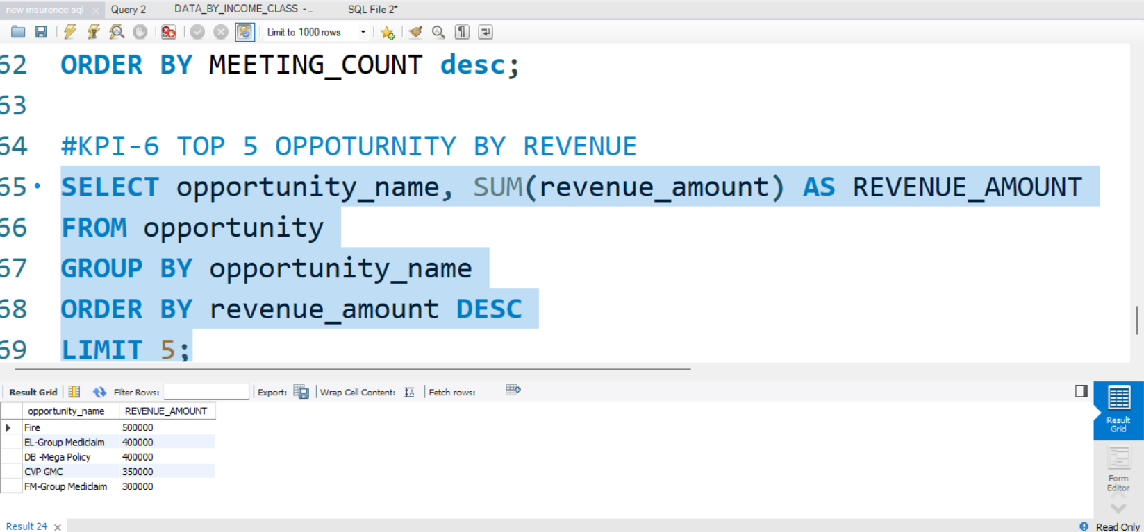
SQL
KPI-6 TOP 5 OPPOTURNITY BY REVENUE
20

Slide 21
Insights
New policies
Steady growth with the decent profit margin. Need to focus on increasing the growth rate.
Cross sell Policies
High profitability and significant growth. continue leveraging cross-selling opportunities
Renewal polices
Exceptional performance in renewals with very high profitability and growth. Maintain strong focus
CAC
Need to check Customer Acquisition Cost and incentivize new business
21

Slide 22
Challenges faced
🛠 Data Integration Struggles – Merging SQL, Excel, and other sources led to inconsistencies and required extensive data cleaning.
⏳ Static Data Limitations – With no live data, keeping insights relevant over time became a challenge.
🚀 Performance Bottlenecks – Complex SQL queries and high-volume visualizations slowed down dashboard responsiveness.
✅ Accuracy & Validation – Ensuring KPIs matched across Power BI, Tableau, and Excel required repeated checks.
🎨 Design Consistency – Aligning visuals across multiple platforms while maintaining clarity was tricky.
22

Slide 23
Solutions
🛠 Data Integration Struggles → 🔄 Standardized Cleaning ✔ Used SQL transformations & Power Query to ensure a unified structure.
⏳ Static Data Limitations → 📅 Scenario-Based Analysis ✔ Created historical trends & predictive models to compensate for real-time gaps.
🚀 Performance Bottlenecks → ⚡ Query Optimization ✔ Used indexing, aggregations & minimized heavy joins to improve speed.
✅ Accuracy & Validation → 📊 Cross-Platform Reconciliation ✔ Validated KPIs by comparing results across Power BI, Tableau, & Excel.
🎨 Design Consistency → 🎭 Unified Visualization Standards ✔ Used predefined themes & layouts for a cohesive dashboard experience.
23

Slide 24
Next Steps & Action Items
🚀 Enhancing Interactivity – Implement dynamic filters & drill-through features for deeper analysis.
📊 Expanding KPI Coverage – Incorporate additional metrics like claim processing time & policy lapse rates.
🛠 Automation & Efficiency – Explore automating data refreshes & integrating scheduled SQL queries.
🔍 Validation & Accuracy – Conduct cross-platform data verification to ensure consistency across Power BI, Tableau, and Excel.
📈 Advanced Analytics – Introduce predictive modeling to identify customer retention & cross-sell opportunities.
24

Slide 25
Thanks For Watching

