Slide 1

G H Raisoni College of Engineering & Management, Pune
(An Empowered Autonomous Institute Affiliated to Savitribai Phule Pune University)
Department of Information Technology
--------------------------------------------------------------------------------------------------------------------------------------------------
Title:
MicroAPI Guard: Real-Time API Anomaly Detection Using ML & DL.
Project Review I
Presented By:
1) Sunny Nirmal [BTech ITC32]
2) Tausib Patel [BTech ITC37]
3)Yash Patil [BTech ITC54]
Guided By:
Mrs.Priyanka kumbhar

Slide 2
Contents
Abstract
Introduction
Problem Statement
Objectives
Literature Survey
Proposed methodology
Existing System
Architecture
Software and Hardware Requirements
Implementation
Conclusion
References

Slide 3
Abstract
This project proposes MicroAPI Guard, a deployable API security gateway designed to detect anomalous API traffic using a learned stacking ensemble model. Unlike traditional API gateways that rely only on rate limiting or signature-based detection, the proposed system performs three parallel stages of analysis:
Statistical Rate Limiter
Isolation Forest (Machine Learning)
Deep Autoencoder (Deep Learning)
The outputs of these detectors are combined using a Logistic Regression stacking ensemble to classify requests as Normal or Anomalous.
The system is implemented using FastAPI and Redis, enabling near real-time detection with minimal latency. A Streamlit dashboard provides live visualization of alerts and model predictions, while a calibration phase allows deployment across different REST-based applications without retraining.

Slide 4
Introduction
Modern applications are increasingly built using microservice architectures, where services communicate through REST APIs.
As the number of exposed APIs grows, the attack surface also increases, making APIs a major target for cyberattacks.
Traditional security mechanisms such as API Gateways, Web Application Firewalls (WAFs), and static rate-limiting rely on predefined rules and struggle to detect unknown or evolving threats.
Machine Learning techniques like Isolation Forest and Deep Learning models such as Autoencoders can identify abnormal API behavior by learning traffic patterns instead of depending on fixed signatures.
MicroAPI Guard is proposed as an intelligent API Security Gateway that combines Static Rules, Isolation Forest, Autoencoder, and a Logistic Regression stacking ensemble to perform real-time anomaly detection and automatically block malicious requests while forwarding legitimate traffic.

Slide 5
Problem Statement
The rapid adoption of microservice architectures has significantly increased the number of exposed REST APIs, expanding the application-layer attack surface. Traditional API security mechanisms, such as rule-based API Gateways and Web Application Firewalls (WAFs), rely on predefined static rules and struggle to detect modern application-layer attacks. An open and adaptive framework capable of learning API traffic behavior, detecting anomalies in real time, and automatically blocking malicious requests before they reach backend services is therefore required to provide effective API security.

Slide 6
Objectives
To develop a FastAPI-based real-time API protection gateway that intercepts HTTP requests and blocks malicious traffic with minimal latency.
To implement a learned stacking ensemble using Static Rules, Isolation Forest, Autoencoder, and Logistic Regression for accurate anomaly detection.
To establish a calibration mechanism that adapts the framework to different REST-based backends without retraining from scratch.
To evaluate the proposed system using standard performance metrics such as Precision, Recall, F1-Score, ROC-AUC, and PR-AUC.
To build a Streamlit dashboard for real-time monitoring and explainable visualization of anomaly detection results.

Slide 7
Literature Survey
Sr. No | Paper Name | Proposed Methodology/ Algorithm | Key Findings | Future Scope
1 | Huang et al. (2026) | API Gateway with EWMA & Z-score | Achieved 98.5% recall for DDoS detection. | Apply Deep Learning for unknown attack detection.
2 | Sowmya et al. (2023) | Random Forest + Bagging | Achieved 97.77% accuracy and 0.97 F1-score. | Extend IDS to IPS and support HTTP POST requests.
3 | Sadaf & Sultana (2020) | Autoencoder + Isolation Forest | Achieved 95.4% detection accuracy. | Validate on real-world cloud and fog traffic.

Slide 8
Sr. No | Paper Description | Proposed Methodology/ Algorithm | Key Findings | Future Scope
4 | Levi & Dubin (2025) | Automatic OpenAPI Mapping | High precision with low request processing time. | Improve payload inspection and support GraphQL/gRPC.
5 | Mahmoud et al. (2025) | Deep Stacking Ensemble | Improved detection accuracy with low false positives. | Develop lightweight models for edge deployment.

Slide 9
Proposed Methodology
1. API Request Interception:
The FastAPI Gateway intercepts every incoming API request.
2. Feature Extraction:
Security Middleware extracts behavioral features using Redis-based sliding windows and payload analysis..
3. Parallel Anomaly Detection:
Static Rules, Isolation Forest, and Autoencoder independently generate anomaly scores.
4. Stacking Ensemble Classification:
Logistic Regression combines the anomaly scores to produce the final prediction.
5. Inline Request Handling:
Malicious requests are blocked (HTTP 403), while legitimate requests are forwarded to the backend.
6. Real-Time Monitoring:
Request logs, anomaly scores, and gateway decisions are visualized through a Streamlit dashboard.

Slide 10
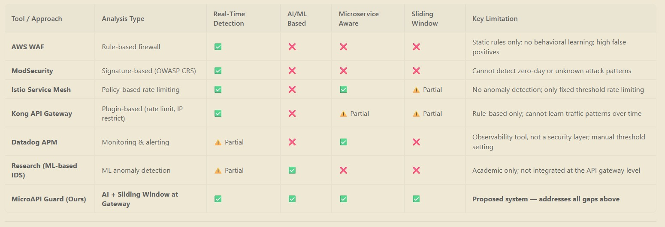
Existing System

Slide 11
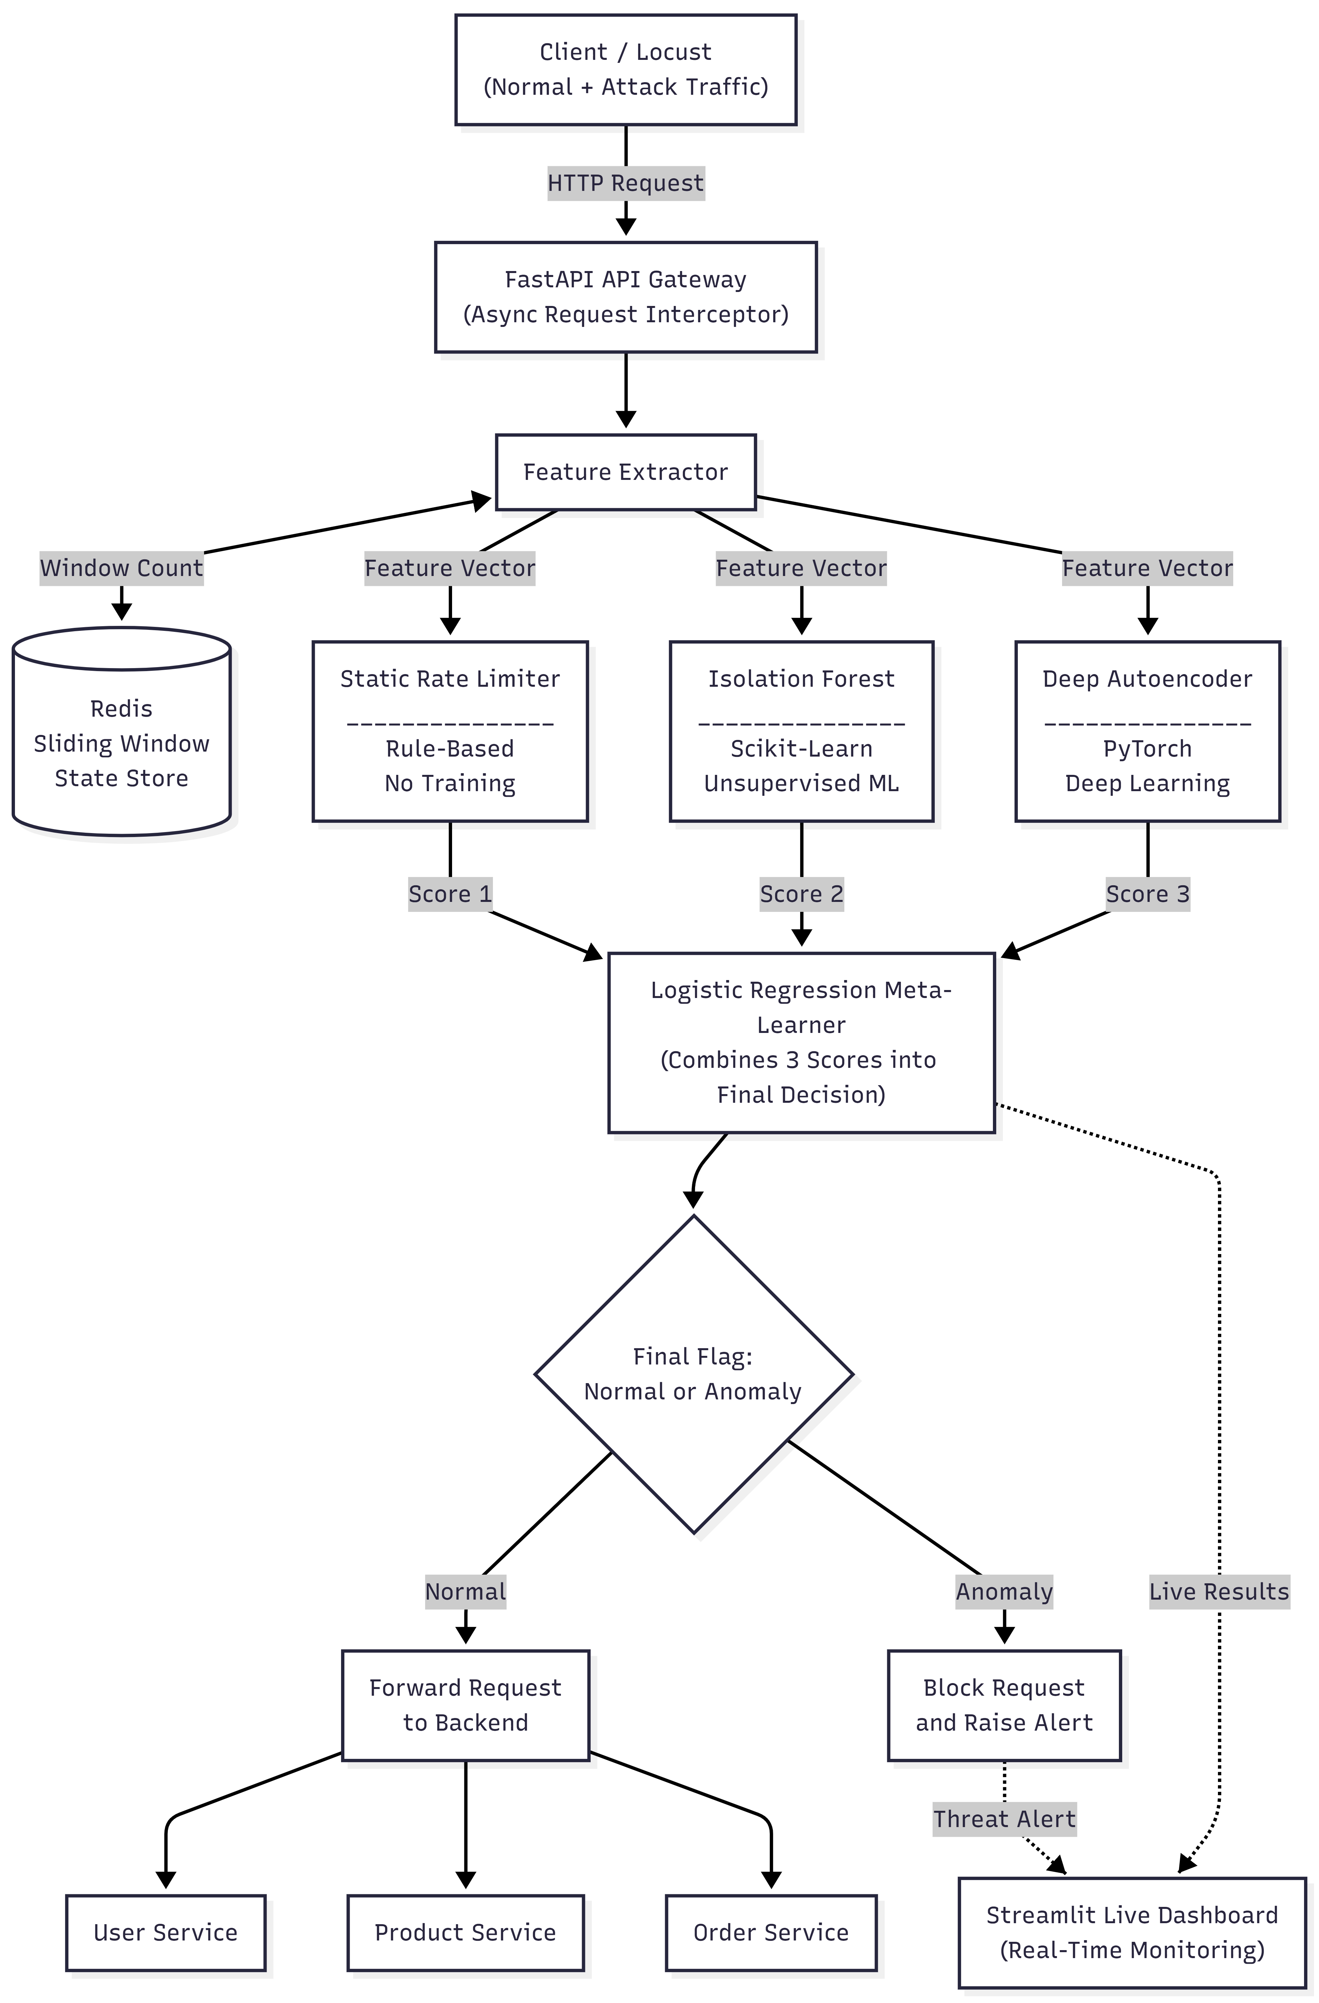
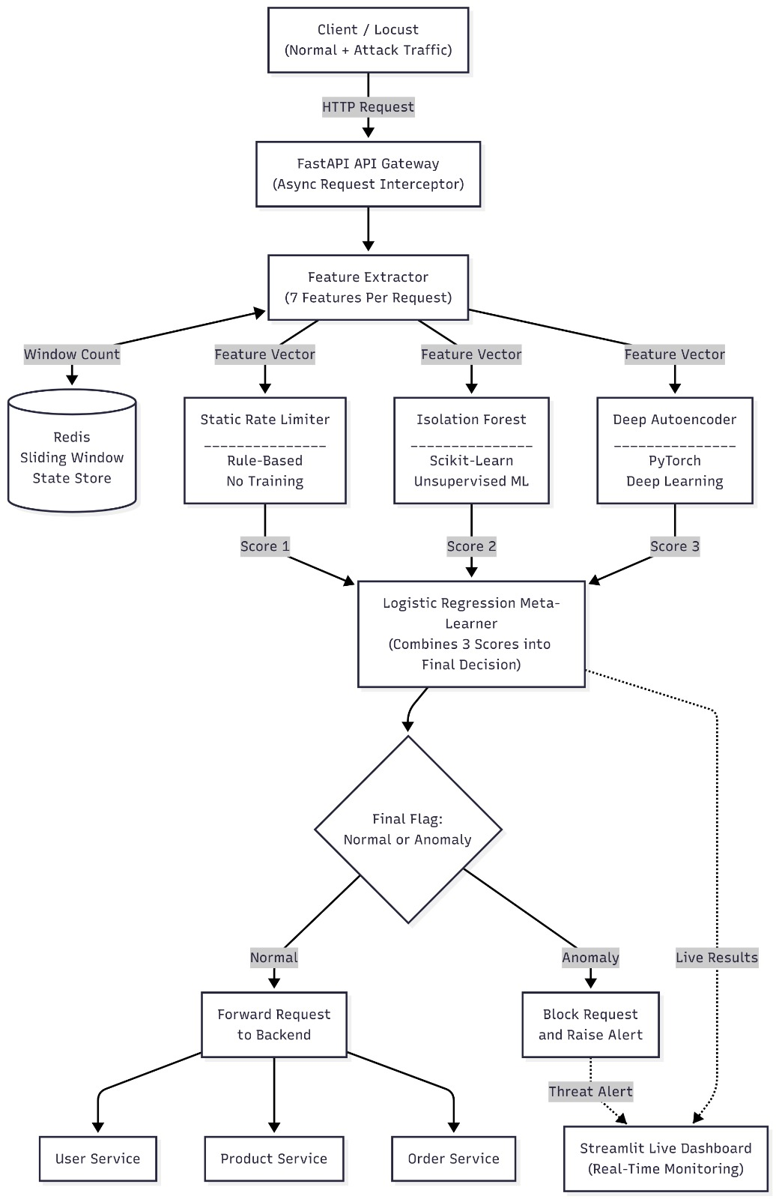
Architecture Daigram

Slide 12
Software and Hardware Requirement
Software | Purpose
Python 3.10+ | Backend development & ML models
FastAPI | API Gateway & Microservices
Redis | Real-time feature extraction
Scikit-learn | Isolation Forest & Logistic Regression
PyTorch | Autoencoder implementation
Locust | API traffic simulation
Streamlit | Monitoring Dashboard
Docker | Containerization
Hardware | Specification
Processor | Intel Core i5 / AMD Ryzen 5 or higher
RAM | 8 GB (Minimum)
Storage | 256 GB SSD
Operating System | Windows 10/11 or Linux
Internet | Stable Internet Connection

Slide 13
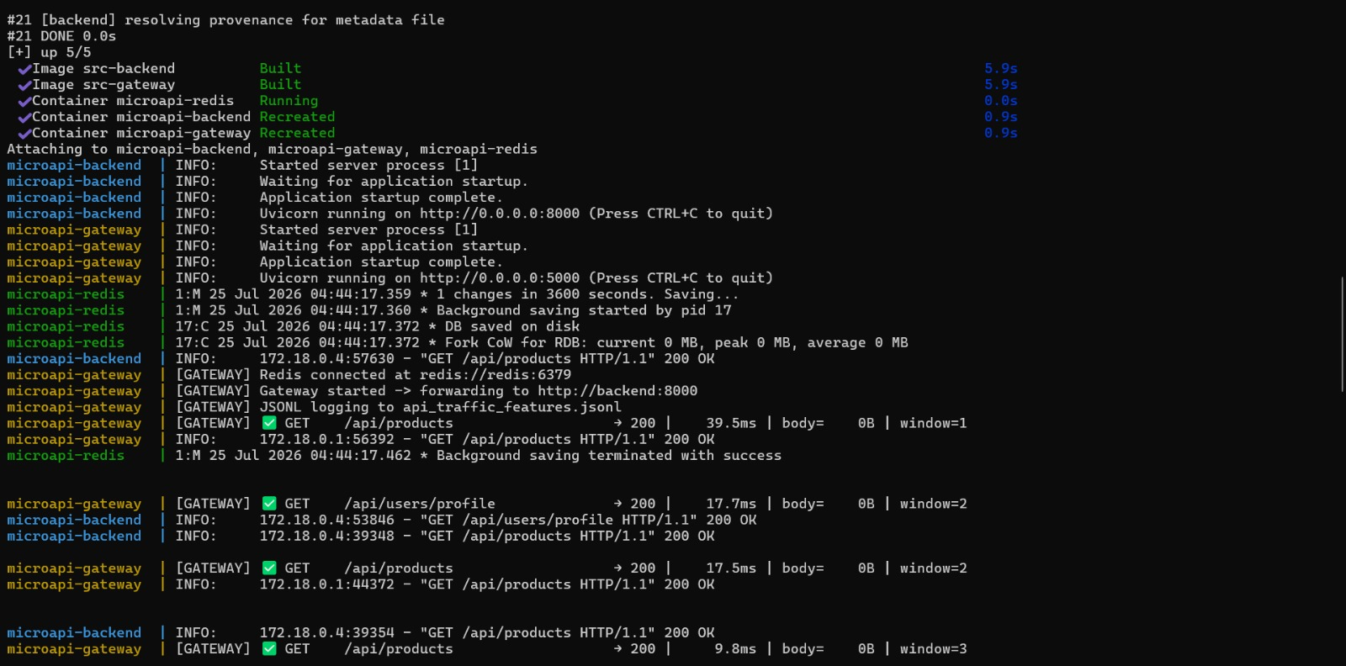
Implementation

Slide 14
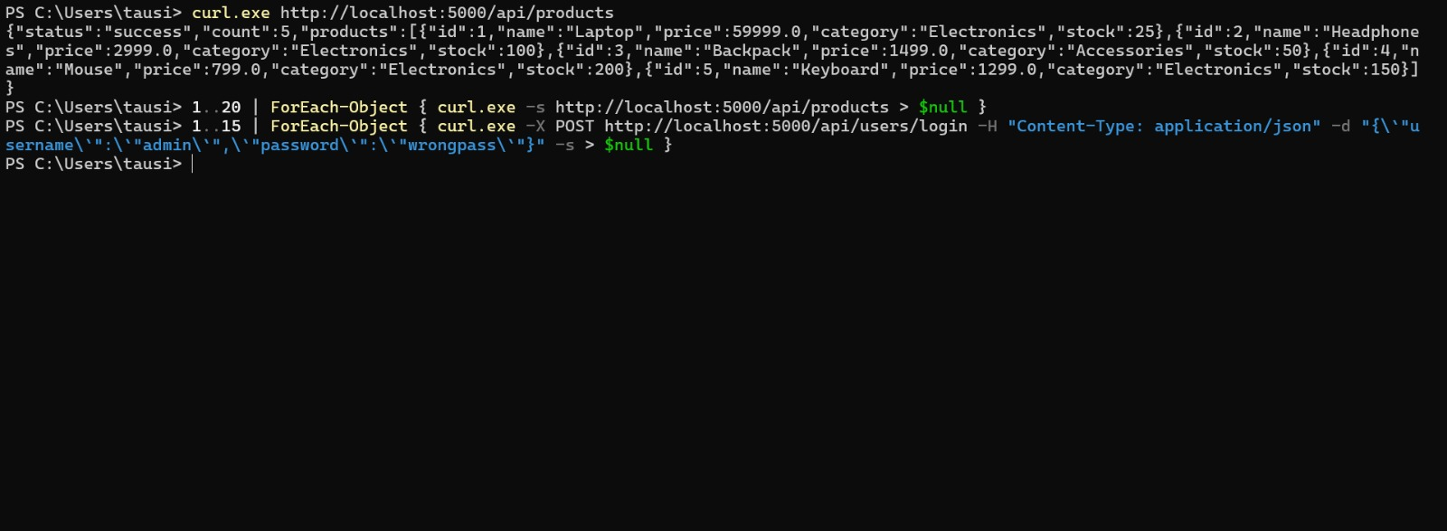

Slide 15
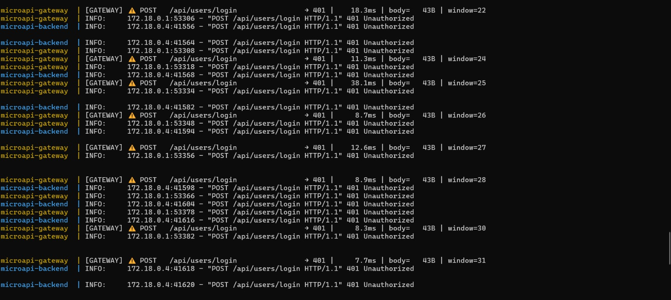

Slide 16
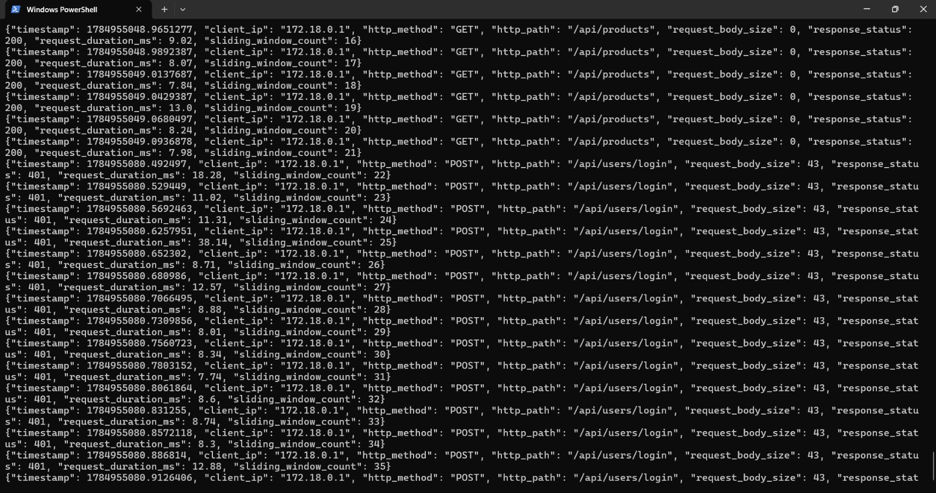

Slide 17
Current Status:
Dockerized MicroAPI Guard environment with FastAPI Gateway, Backend Service, and Redis.
API Gateway successfully intercepts and forwards HTTP requests to backend microservices.
Redis integrated for real-time sliding window request tracking.
JSONL logging mechanism implemented for storing API traffic features.
REST APIs for User and Product services are developed and tested.
Synthetic API traffic generated using PowerShell/cURL for normal and attack scenarios.
Request monitoring with response status, latency, payload size, and sliding window count is successfully working.

Slide 18
Conclusion
The proposed MicroAPI Guard framework aims to provide intelligent and real-time API security using Machine Learning and Deep Learning techniques. The initial implementation successfully establishes the FastAPI Gateway, Redis-based request monitoring, API traffic logging, and traffic simulation environment. The next phase of the project focuses on integrating the anomaly detection models, implementing the stacking ensemble, and developing a real-time monitoring dashboard to enhance API security against evolving cyber threats.

Slide 19
References
[1] H. Huang, Q. Qiang, Y. Shao, R. Li, and Y. Huang, "Design and Application Research of an Intelligent API Gateway for Traffic Anomaly Detection in Microservices Architecture," 2026 5th International Conference on Big Data, Information and Computer Network (BDICN), pp. 1–6, 2026.
[2] M. Sowmya, M. D. Irfan, A. J. Rai, P. B. Honnavalli, V. Spoorthi, and S. Nagasundari, "API Traffic Anomaly Detection in Microservice Architecture," 2023 IEEE/ACM 23rd International Symposium on Cluster, Cloud and Internet Computing Workshops (CCGridW), pp. 206–213, 2023.
[3] K. Sadaf and J. Sultana, "Intrusion Detection Based on Autoencoder and Isolation Forest in Fog Computing," IEEE Access, vol. 8, pp. 164917–164928, 2020.
[4] Y. Levi and R. Dubin, "API Security Based on Automatic OpenAPI Mapping," arXiv Preprint, 2025.
[5] L. Mahmoud, M. Liyanage, J. Singla, and S. Gangopadhyay, "DSEM-NIDS: Enhanced Network Intrusion Detection System Using Deep Stacking Ensemble Model," IEEE Open Journal of the Computer Society, 2025.

Slide 20
Thank You..

