Slide 1

SMART INDIA HACKATHON 2026
STUDENT INNOVATION | SOFTWARE | MEDTECH & HEALTHTECH
HEMOVISION
Contactless Heart-Rate Screening from Facial Video
Thesis: A quality-gated heart-rate estimate from a standard camera before a teleconsult, while honestly identifying which health signals RGB video cannot yet measure.
SIH SUBMISSION METADATA
Problem Statement ID: [Registered Portal ID]
Problem Statement: Contactless Heart-Rate Estimation from Video
Theme: MedTech / Bio-Informatics
Category: Software (Student Innovation)
Team Name: [Your Registered Team Name]
Mentor: [Academic / Clinical Guide]
✓ Working Real-Time Prototype
Live webcam & video pipeline at 30 FPS with 20s sliding window inference.
✓ 8 Anatomical Skin Regions
MediaPipe 468 mesh extracts 24-channel temporal RGB signal across forehead & cheeks.
✓ 9.19 BPM Held-Out MAE
Subject-disjoint test on 91 individuals (523 clips); 52% error cut vs. POS (19.17 BPM).
Notice: Research prototype developed for academic innovation. Not approved for clinical diagnosis or emergency monitoring.

Slide 2
Your Team Name
A LOW-FRICTION FIRST STEP BEFORE REMOTE CARE
Target Use Case: Patient or Community Health Worker Prior to a Telemedicine Consultation
INDIA-RELEVANT PROBLEM & NEED
• Physical Peripheral Bottleneck:
Initial vital collection requires finger clips, BP cuffs, or ECG patches (₹5,000–₹50,000) that rural families and remote clinics rarely own.
• Pre-Consultation Triage Blindspot:
Remote telemedicine consultations frequently begin without a single objective vital sign, forcing doctors to rely on subjective verbal reports.
• Hygiene & Point-of-Care Friction:
Contact sensors require sanitization between patients and cause discomfort in neonatal, burn, or infectious isolation wards.
PROPOSED QUALITY-GATED PRE-CONSULT WORKFLOW
1. Video Capture: Patient records a 15–20s facial video via smartphone or laptop webcam under standard ambient room lighting.
2. Quality Gate Check: Automated real-time validation: checks face visibility, lighting adequacy (>40 lux), and rigid head stability.
3. Quality-Gated Estimation: Heart rate estimated ONLY if quality gates pass; noisy, corrupted, or shadowed frames are strictly rejected.
4. Contextual Display: Displays estimated BPM alongside reconstructed BVP waveform and signal confidence score for clinician context.
5. Clinical Escalation: Low-confidence or abnormal readings immediately prompt standard in-person contact reference measurement.
Future Telehealth Integration Opportunity: Designed for prospective interoperability with national telemedicine platforms (e.g., eSanjeevani) and ABDM health records following formal clinical trials.
Sources: MoHFW eSanjeevani Operational Framework (2024); PubMed 37313385 (Contactless PPG Systematic Review). Note: Government integration is a future opportunity, not an existing deployment.

Slide 3
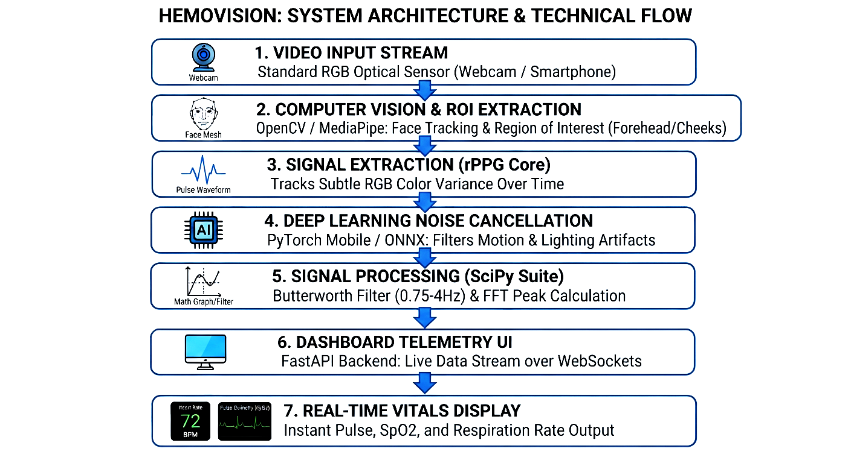
Your Team Name
FROM FACIAL VIDEO TO A QUALITY-GATED HEART-RATE ESTIMATE
End-to-End 7-Stage Signal Processing and Temporal Deep Learning Pipeline
7-STAGE RIGOROUS OPTICAL PIPELINE
CORE ORIGINAL CONTRIBUTIONS
1. Multi-ROI Temporal Fusion: Replaces single-box face crops with 8 anatomically targeted capillary regions.
2. Bounded Temporal ConvNet: Tanh-bounded receptive field (>20s) prevents gradient explosions on noisy webcams.
3. Biomarker Feasibility Audit: Rigorously demonstrated that RGB video cannot infer blood chemistry without NIR.
Stage 1 — Video Capture: Standard RGB sensor (FullHDwebcam / USBVideo / IriunWebcam) at 30 FPS.
Stage 2 — Face Mesh Tracking: MediaPipe detects 468 3D facial landmarks in real time with zero physical markers.
Stage 3 — 8 Anatomical Skin ROIs: Forehead (L/R), Upper Cheeks (L/R), Lower Cheeks (L/R), Nose, Chin.
Stage 4 — 24-Channel Temporal Signal: Spatial RGB pooling (8 ROIs × 3 channels) into AC normalized & DC raw representations.
CONFIRMED IMPLEMENTATION SPECIFICATIONS
• Model Parameters: 148,650 (78% fewer than standard 1D CNN)
• Cardiac Passband: 0.65 Hz – 3.25 Hz (39 to 195 BPM)
• Working Prototype Engine: Interactive Streamlit & OpenCV dashboard (`app.py`, `hemovision_demo.py`) at 30 FPS.
• Classical Baselines: POS (Wang 2017) & CHROM (de Haan 2013) implemented for direct benchmark comparison.
Stage 5 — HemoVisionBoundedTCN: 4 depthwise-separable 1D conv blocks (d=1,2,4,8; 148K params; tanh bounded).
Stage 6 — Butterworth Bandpass: 4th-order zero-phase filter (0.65–3.25 Hz / 39–195 BPM) isolates cardiac frequencies.
Stage 7 — Welch PSD Peak Picking: FFT power spectral density identifies dominant cardiac peak & SNR confidence score.
Source Code: v3_pipeline/cell_10_dataset.py, cell_11_dataset.py, hemovision_demo.py, app.py; Wang et al. (IEEE TBME 2017); de Haan & Jeanne (IEEE TBME 2013).

Slide 4
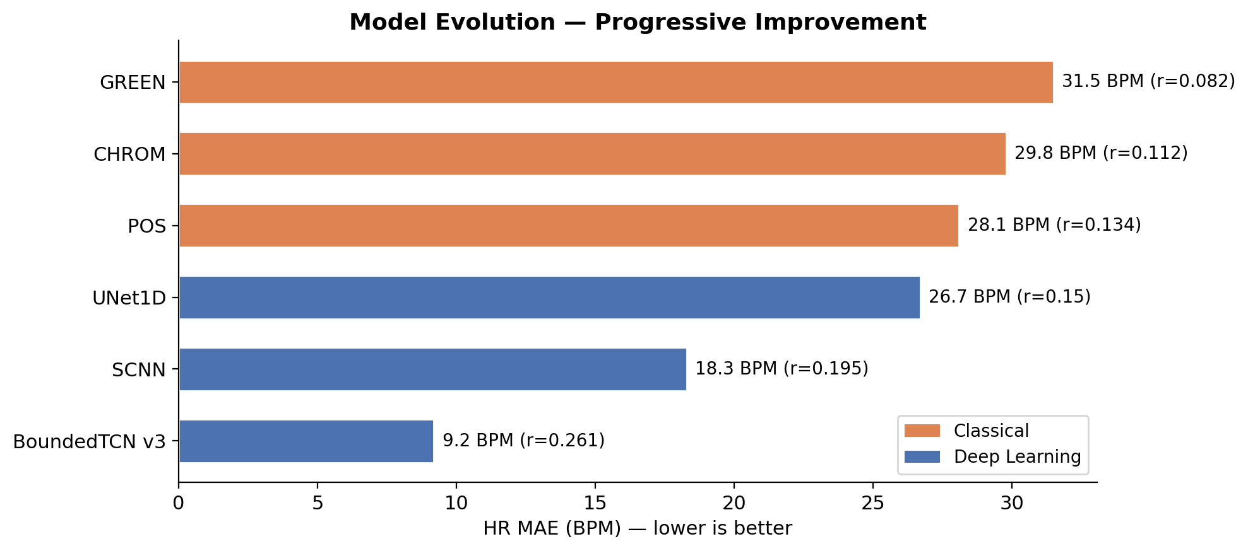
Your Team Name
SUBJECT-DISJOINT EVALUATION SHOWS A WORKING HEART-RATE SIGNAL
Rigorous Benchmark on MCD-rPPG Dataset (598 Unique Subjects, 3,427 Video Clips)
9.19 BPM
Held-Out Test MAE (r = 0.285)
52.0% Reduction
Error Cut vs. POS Baseline (19.17 BPM)
1.33 BPM
High-Quality Demo Clips (r = 0.884)
HELD-OUT TEST SET PERFORMANCE (91 SUBJECTS, 523 CLIPS)
Model / Algorithm Heart Rate MAE RMSE Pearson r
CHROM (de Haan et al. 2013) 20.28 BPM 24.61 BPM 0.047
POS (Wang et al. 2017) 19.17 BPM 23.72 BPM 0.119
HemoVisionBoundedTCN (Ours) 9.19 BPM 18.35 BPM 0.285 [✓ 52% cut]
• Strict Subject-Disjoint Protocol: Zero subject overlap between train (418), val (89), and test (91). No identity leakage.
• Hit-and-Trial Bug Fix: Fixed reference ECG T-wave doubling anomaly via 250ms refractory blanking, eliminating 2x ground-truth artifacts.
CRITICAL SCIENTIFIC DISTINCTION: WHAT THIS DOES NOT PROVE
This result proves a functioning optical pulse recovery signal under retrospective benchmark conditions on recorded data. It is NOT yet a prospective clinical trial. Real-world performance across motion artifacts, extreme skin tones (Fitzpatrick V-VI), low-light environments, and diverse mobile camera sensors requires formal prospective clinical validation.
Evaluation Source: HemoVision Vocational Training Report (Table 6); cell_14_eval.py; MCD-rPPG Clinical Dataset (598 Subjects). Ground truth: synchronized ECG lead contact sensor.

Slide 5
Your Team Name
QUALITY GATES AND HONEST LIMITS MAKE THE PROTOTYPE SAFER
Refusing Unsupported Healthcare Claims & Defining the Roadmap to Safe Clinical Translation
AUTOMATED QUALITY GATES
1. Lighting Adequacy:
Rejects underexposed (<40 lux) or severely back-lit frames.
2. Face Mesh Stability:
Requires MediaPipe landmark detection confidence > 0.75.
3. Motion Jitter Guard:
Bounds inter-frame displacement; pauses during sudden yaw/pitch.
4. Temporal Window Buffer:
Requires minimum 20s (600 frames at 30 FPS) for cardiac stability.
5. Spectral SNR Confidence:
Welch PSD peak-to-noise ratio must exceed threshold before output.
VALIDATED VS. NOT CLAIMED
✓ VALIDATED NOW (RGB Video):
Heart-rate estimation from facial video via optical capillary blood volume pulse (BVP).
✕ STRICTLY NOT CLAIMED:
SpO2, Blood Pressure, Hemoglobin, Respiratory Rate, Stress, HbA1c, or Disease Diagnosis.
The Biomarker Audit Differentiator:
Tested 10 biomarkers on 598 subjects. Deep models failed to beat demographic baselines (e.g. Hemoglobin video r=0.44 beaten by age/sex/BMI OLS r=0.70). The network learned subject ID shortcuts, not blood chemistry.
Optical Physics Reality: Blood chemistry requires narrow-band dual-wavelength NIR (660/940 nm). RGB Bayer filters conflate melanin with absorption.
FUTURE VALIDATION PATHWAY
Step 1: Diverse Cohort Trial
Prospective multi-center study across skin tones (Fitzpatrick I–VI), age brackets, and lighting environments.
Step 2: Concurrent Clinical Reference
Simultaneous validation against hospital-grade ECG and calibrated contact pulse oximeters.
Step 3: Rigorous Statistical Analysis
Bland-Altman 95% limits of agreement, mean bias profiling, and comprehensive failure taxonomy.
Step 4: CDSCO SaMD Assessment
Formal Software as a Medical Device (SaMD) regulatory filing and patient data privacy certification.
References: CDSCO Draft Guidance on Medical Device Software (2025); PubMed 37313385; PubMed 42106569; cell16_hemoglobin_feasibility_audit.py (Table 7).

Slide 6
Your Team Name
A CREDIBLE PATH FROM PROTOTYPE TO TELE-TRIAGE SUPPORT
Student Innovation Closing: Evidence-Backed Heart-Rate Prototype with Transparent Clinical Boundaries
HemoVision's Winning Differentiator: A working, evidence-backed heart-rate prototype (9.19 BPM held-out MAE) combined with an intellectually honest boundary around what RGB video cannot yet measure.
HEALTHCARE IMPACT HYPOTHESIS
• Accessible Pre-Consultation Screening:
Enables patients to provide an objective, quality-gated heart-rate reading prior to a teleconsult without purchasing dedicated hardware.
• Rural Primary Health Centre (PHC) Potential:
Can be explored by community health workers (ASHAs/ANMs) as a low-friction pre-screening tool in remote clinics following prospective validation.
• Zero Peripheral Hardware Cost:
Utilizes ubiquitous commodity smartphone and laptop cameras already available across India.
THREE-STAGE DEVELOPMENT ROADMAP
[COMPLETED] Phase 1: Prototype & Audit
• Real-time webcam pipeline (30 FPS, 8 ROIs, 24 channels). • HemoVisionBoundedTCN evaluated on MCD-rPPG (9.19 BPM MAE). • Systematic 10-biomarker audit exposing demographic confounds.
[NEXT MILESTONE] Phase 2: Prospective Validation
• Multi-center prospective clinical study across Fitzpatrick skin tones. • Hardened automated quality gates & ambient light calibration. • Containerized web application for research evaluation.
[FUTURE RESEARCH] Phase 3: Multi-Wavelength Optics
• Dual-wavelength NIR active illumination hardware research for SpO2. • CDSCO Software as a Medical Device (SaMD) regulatory evaluation.
Research Disclaimer & Compliance Notice: HemoVision is an academic research prototype. It does not provide medical diagnosis or emergency vital tracking. Formal clinical trial verification and CDSCO regulatory clearance are strictly required prior to real-world healthcare deployment.
References: MoHFW eSanjeevani Overview; NHA ABDM Framework; CDSCO SaMD Guidance (2025); HemoVision Project Repository & Technical Report.

