Slide 1

SMART INDIA HACKATHON 2026
TITLE PAGE
Problem Statement ID –
Problem Statement Title-
Theme-
PS Category- Software/Hardware
Team ID-
Team Name (Registered on portal)

Slide 2
HEMOVISION Contactless Vital-Sign Estimation from Facial Video
Remote Photople thysmography (rPPG) | Deep Learning | Clinical Validation
Your Team Name
THE PROBLEM- Traditional vital monitoring requires physical contact like cuffs or sensors, causing healthcare bottlenecks. This equipment is often unavailable, slows outpatient triage, and is unfeasible for remote telemedicine.
OUR IDEA- HemoVision uses standard webcams or phones to extract vital signs contactlessly from video. Deep learning reconstructs pulses from skin color alone, enabling zero-cost, scalable mass screenings.
TRADITIONAL MONITORING
• Requires physical contact - cuffs, clips, wired sensors
• Equipment isn't always available at point of care
• Slows down outpatient triage at high volumes
• Uncomfortable for continuous / long-term monitoring
• Not feasible for remote / telemedicine screening
OUR APPROACH: HEMOVISION
• Just a face on ordinary video - no sensor to attach
• Works with any standard camera - webcam or phone
• Deep learning reconstructs the pulse from color alone
• Non-invasive, instantaneous, zero additional cost
• Scalable to mass screening & telemedicine

Slide 3
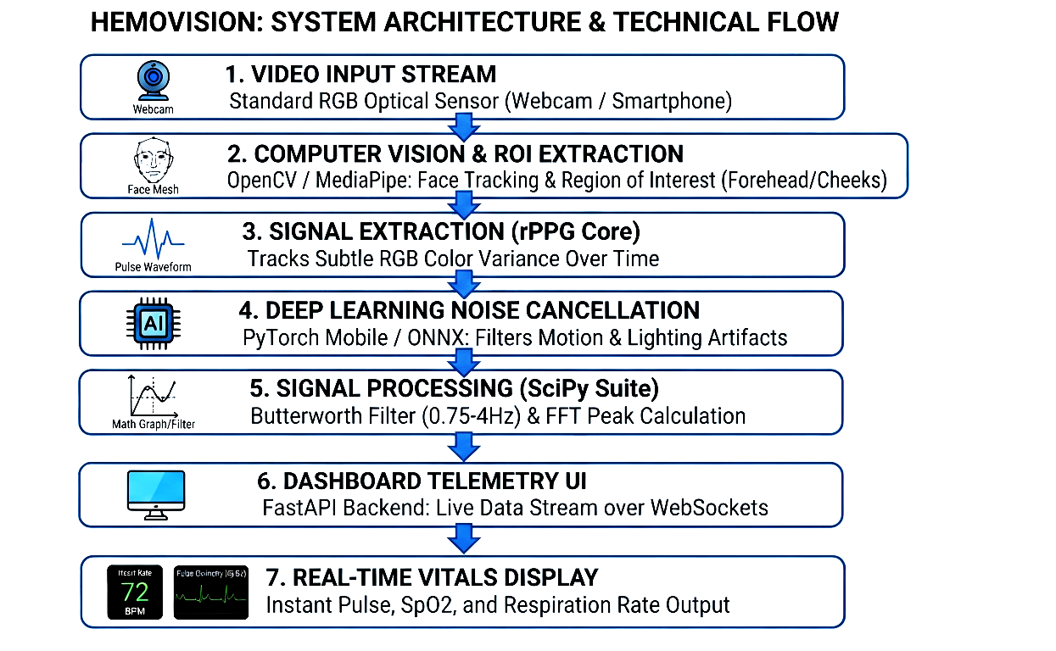
TECHNICAL APPROACH
Your Team Name
Hardware & Software-
• 1080p Webcam (Logitech C920): Captures high-quality facial video to track subtle skin color changes. • NVIDIA Jetson Nano / Raspberry Pi 5: Runs the AI models and processes data locally at the edge. • Li-ion Power Bank (20,000 mAh): Provides portable, continuous battery power for remote medical setups. • 5-inch Touchscreen LCD: Displays real-time heart rate graphs and patient vital signs on screen. • Python / NumPy / SciPy: Handles data math, filters out noise, and calculates final heart rate values. • OpenCV / Google MediaPipe: Tracks 468 facial points instantly to lock onto the forehead and cheeks. • PyTorch Mobile / ONNX Runtime: Runs lightweight AI models to remove movement and lighting errors. • FastAPI / WebSockets: Streams video data and patient results to the display dashboard instantly.

Slide 4
FEASIBILITY AND VIABILITY
Your Team Name
Feasibility-
• Software-driven deployment: Runs entirely on standard RGB cameras, eliminating initial specialized medical hardware dependencies. • Edge-compute compatibility: Operates locally on low-cost units like Raspberry Pi 5 without requiring expensive cloud servers. • Simulated testing environment: Uses pre-recorded public facial video datasets to validate accuracy safely before real-time testing. • Open-source foundation: Built on stable frameworks like OpenCV and PyTorch, ensuring high flexibility and zero licensing costs.
Commercial feasibility-​
• Zero hardware overhead: Enables hospitals to upgrade to contactless vitals tracking using their existing webcams. • B2B SaaS subscription model: Targets steady, recurring revenue from telemedicine platforms, smart clinics, and remote health apps. • High-margin scalability: Software-only distribution ensures near-zero replication costs and rapid global market expansion.
• Reduced hospital operational costs: Drastically shortens outpatient triage times, allowing clinics to handle higher patient volumes with fewer physical sensors.
Challenges-​
• Ambient illumination noise: Changing indoor lighting or flickering fluorescent bulbs can corrupt subtle skin color signals. • Subject motion artifacts: Sudden head movements or talking causes the face tracker to lose the specific skin regions. • Clinical validation barriers: Proving consistent, medical-grade accuracy across diverse skin tones to secure regulatory approvals.
Strategy-​
• Deep learning filtration: Trains the PyTorch core model to actively filter out sudden shadows and ambient light flashes. • Dynamic ROI tracking: Uses MediaPipe’s 468-point mesh to lock onto the forehead and cheeks, even during movement. • Phased clinical partnerships: Teams up with local clinics to run parallel validation tests alongside standard pulse oximeters.

Slide 5
IMPACT AND BENEFITS
Your Team Name
Direct Impact on Target Users
Instant Access: Users check their heart rate immediately using their current phone or computer webcam without buying extra gear.
Effortless Monitoring: Tracks vitals automatically and quietly in the background during normal screen time with zero setup.
Zero Discomfort: Provides a completely touchless experience that eliminates skin irritation from tight straps or sticky patches.
No Battery Hassles: Eliminates the daily chore of charging, updating, or syncing another physical wearable device.
Early Peace of Mind: Detects subtle health changes early from home, helping users know exactly when to consult a doctor.
Economic & Strategic Benefits-
Massive Cost Savings: Eradicates the need to buy, maintain, or replace expensive hardware wearables and medical sensors.
Instant Global Reach: Deploys immediately to millions of users via the web, completely bypassing manufacturing and shipping bottlenecks.
Low Operational Overhead: Operates as a pure software-as-a-service (SaaS) model, drastically lowering production and distribution costs.
High Market Disruption: Weakens the market hold of traditional fitness trackers by transforming everyday webcams into health tools.
B2B Revenue Streams: Opens lucrative licensing opportunities with virtual clinics, workplace wellness programs, and insurance apps.
Strategic Impact
Market Disruption: Challenges expensive wearables by turning standard webcams into health monitors.
Frictionless Scaling: Bypasses hardware supply chains to deploy instantly worldwide via software.
Telehealth Expansion: Embeds real-time vital tracking directly into standard video clinic calls.

Slide 6
RESEARCH AND REFERENCES
Your Team Name
Details / Links of the reference and research work

