Slide 1

Data Analysis
Analyze Shows on NetFlix
Made by: Savinova Anastasia IA-213

Slide 2

Problem: Analyze Shows on NetFlix
Chosen Dataset: Dataset: NetFlix Shows
Scope and Objectives:
Find out potentially successful kind of shows
Find out variability of Netflix Shows

Slide 3
Data Summary
Categorical Variables: type, title, director, cast, country, rating, listed in, description, date added
Numerical Variables: release year, duration

Slide 4



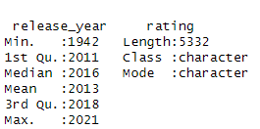
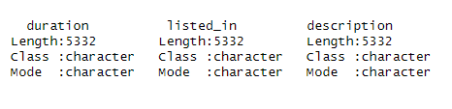
Data Summary given by the R function « summary »

Slide 5
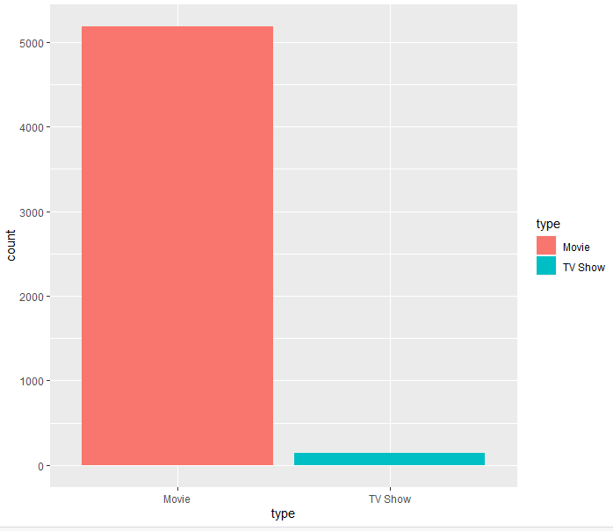
Get the type of NetFlix Shows

Slide 6
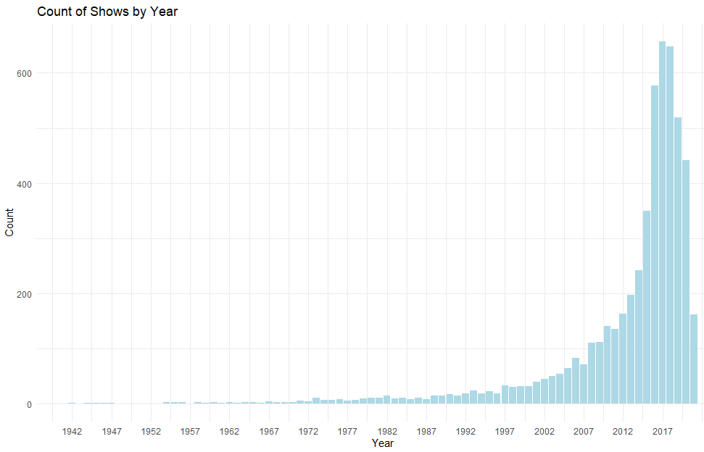

Slide 7
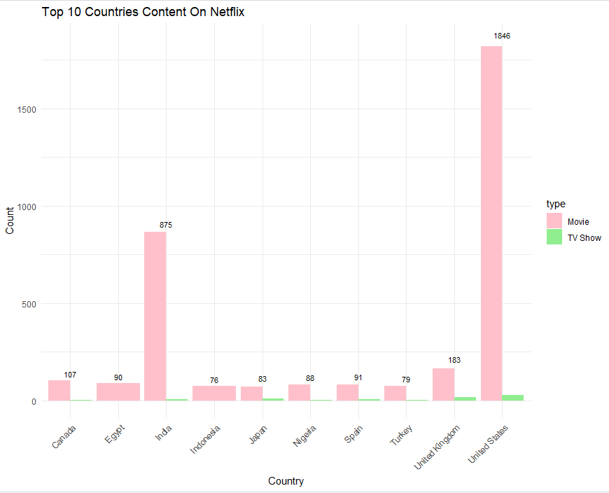

Slide 8
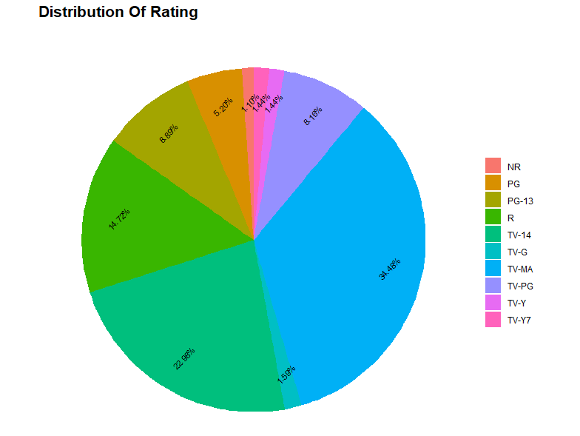

Slide 9
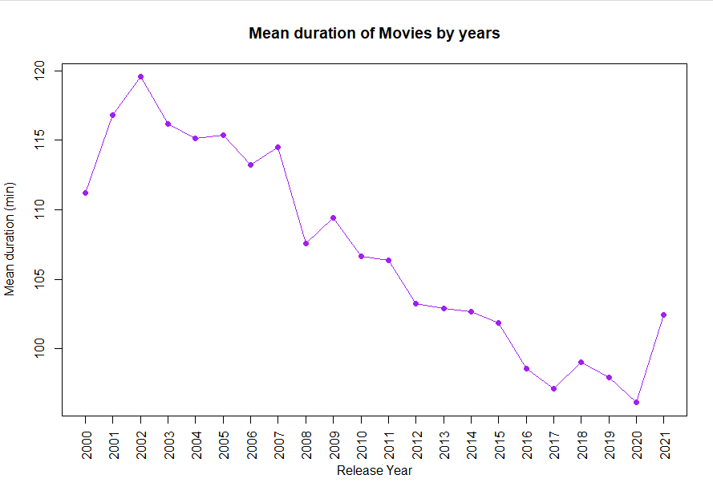

Slide 10
Model for Predicting the Number of Films by Genre
Problem: Given a year predict the number of films by genre that will release that year
Chosen Statistical Model: Linear Regression with one variable: y = wx + b, where x is the year and y is the number of films

Slide 11
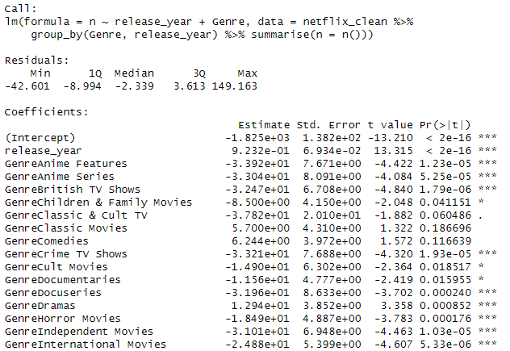
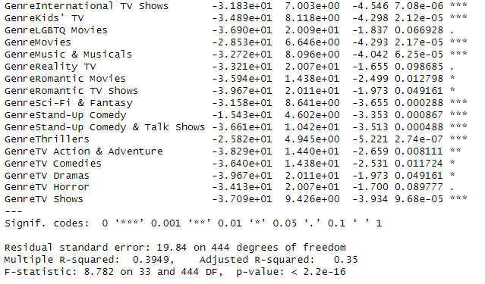
Model Summary

Slide 12
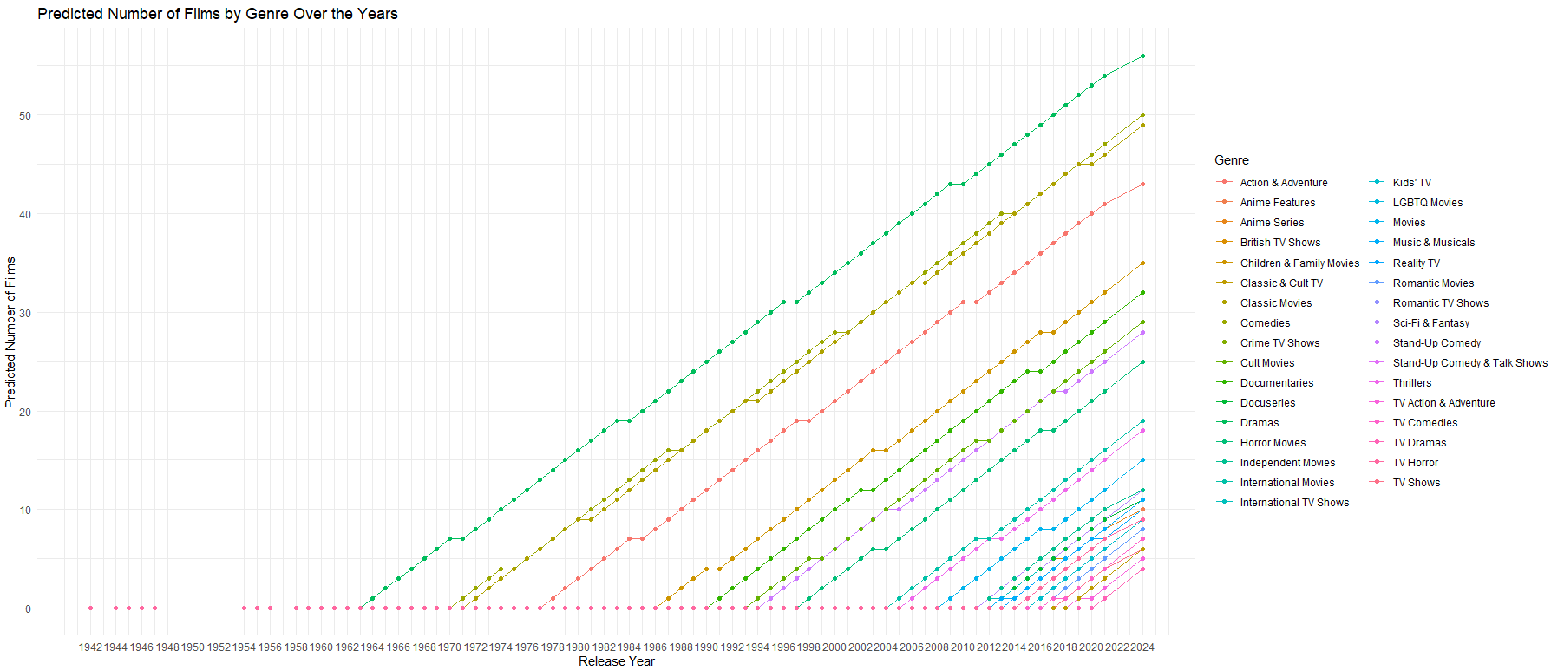
Prediction on Number of Films by Genre for the 2024

Slide 13
BIBLIOGRAPHY
https://www.kaggle.com/datasets/infamouscoder/dataset-netflix-shows/ - Used Dataset

