Slide 1


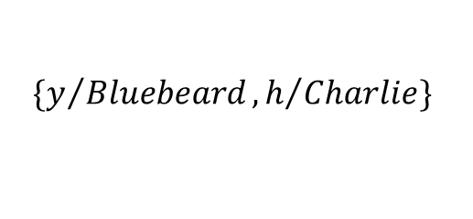






$$∃h Horse(h)$$
$$Horse(h)$$
$$Offspring(h, y)$$
$$Horse(Bluebeard)$$
$$Parent(y,h)$$
$$Offspring(Bluebeard, y)$$
…
$$\{y/{Bluebeard}, h/{Charlie}\}$$
$$Parent(y,Bluebeard)$$
$$Offspring(Bluebeard, y)$$
…

