Slide 1
011144 Computer Networks
Exercise 3

Slide 2
1. Which one is NOT provided by TCP/UDP (multiple choices)
(a) flow control
(b) connection setup and teardown
(c) delay guarantee
(d) congestion control
(e) loss recovery
(f) bandwidth reservation
(g) in-order delivery
Ans: (c)(f)

Slide 3
2. Compute 8-bit checksum for 01100010 and 10111001, and use an example to show that if the two numbers each has a 1-bit error, the checksum can not detect the error.
Ans:
传输过程中，0110010发生1个bit翻转，成为0110000；10111001发生1个bit翻转，成为10111011，结果不变。
01100000
10111011
--------------
100011011
00011100
11100011
01100010
10111001
--------------
100011011
00011100
11100011

Slide 4
3. Host A sets up a TCP connection with Host B, fill in the blanks the appropriate acknowledgement numbers.
Ans:
Ack=40
Ack=60

Slide 5
Ans:
Ack=40
Ack=40
Ack=70

Slide 6
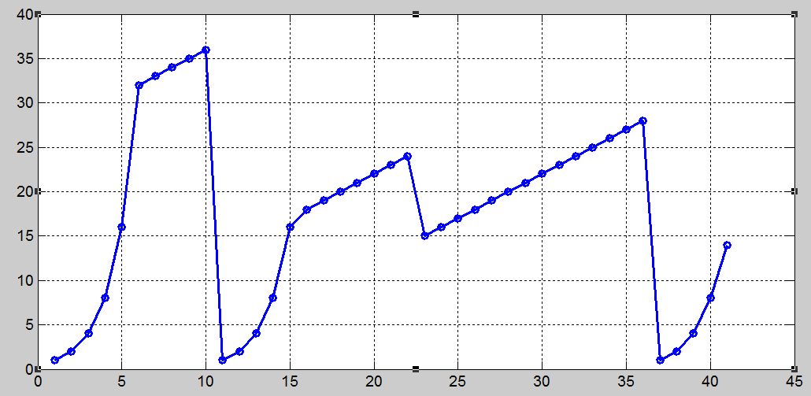
4. Consider the following cwnd evolution at a TCP sender:

Slide 7
Is this TCP Tahoe or TCP Reno?
Ans: TCP Reno
What is the sender’s initial ssthresh?
Ans: ssthresh = 32 MSS
What happens at time 10? What is ssthresh and cwnd at time 11?
Ans: Timeout, ssthresh = 18 MSS, cwn = 1 MSS.

Slide 8
What happens at time 22? What is ssthresh and cwnd at time 23?
Ans: Triple duplicate ACK, ssthresh = 12 MSS, cwd = 15 MSS
What happens at time 36? What is ssthresh and cwnd at time 37?
Ans: Timeout, ssthresh = 14 MSS, cwnd = 1 MSS.
When is the 50th segment is sent?
Ans: Time 6.

Slide 9
True or false?
Host A is sending Host B a large file over a TCP connection. Assume Host B has no data to send Host A. Host B will not send acknowledgments to Host A because Host B cannot piggyback the acknowledgments on data. (False)
The size of the TCP rwnd never changes throughout the duration of the connection. (False)
Suppose Host A is sending Host B a large file over a TCP connection. The number of unacknowledged bytes that A sends cannot exceed the size of the receive buffer. (True)

Slide 10
Suppose Host A is sending a large file to Host B over a TCP connection. If the sequence number for a segment of this connection is m, then the sequence number for the subsequent segment will necessarily be m+1. (False)
The TCP segment has a field in its header for rwnd. (True)
Suppose that the last SampleRTT in a TCP connection is equal to 1 sec. The current value of TimeoutInterval for the connection will necessarily be ≥ 1 sec. (False)
Suppose Host A sends one segment with sequence number 38 and 4 bytes of data over a TCP connection to Host B. In this same segment the acknowledgment number is necessarily 42. (False)

