Slide 1
USED CAR RETAILER STRATEGY REVIEW
OBJECTIVE
Explain what the listing data tells us, how we reached the findings, and what the teams can act on.
Pricing patterns and inventory decisions
QUESTIONS THIS PRESENTATION ANSWERS
1
What information explains differences in asking prices?
2
How reliable are the estimates and comparisons?
3
Which decisions are supported, and what evidence is still missing?
Mohammed Ayan Syed
Scope: 5,500 listings. Prices are asking prices. Vehicle age uses reference year 2024.
October 2026
Notes:
I analysed 5,500 listings to support pricing and inventory decisions. I will first show the data quality and observed relationships, then explain the model comparison and its limits. I will finish with the decisions we can support and the missing information needed for purchasing decisions. The full submitted deck includes the supporting evidence, with every slide visible.
Source: task.pdf; dataset_clean.csv. All pages are visible. Full evidence deck for reading. The live route can summarise supporting pages to meet the task’s 2–5 minute limit.

Slide 2
TECHNICAL TEAM REVIEW
What can we trust in the cleaned data?
Keeping incomplete records preserves coverage. Repeated minimum values need source verification.
1,329
14-16%
22.1%
5.0%
complete rows out of 5,500
missing in nine fields
1,216 prices exactly $500
273 mileages exactly 100
Retain all rows. Deleting incomplete rows would lose 75.8%.
Keep Unknown visible. Numeric model inputs have no gaps.
Flag the recorded pattern. Its origin is unconfirmed.
Verify the source. Median vehicle age is one year.
Conclusion: the data supports analysis, with explicit missing-ness and source-quality limits.
quality_report.json; decision/mileage_minimum_audit.json. All 5,500 listings.
02
Notes:
Only 1,329 rows are complete. Deleting every incomplete row would remove 75.8% of the data. I retained all rows, standardised categories and represented missing categorical information as Unknown. The age, mileage and owners inputs have no missing values. I preserved genuine numeric gaps rather than inventing values. I flagged the repeated minimum prices and mileage values for verification. The price-derived flag never enters the model because it reveals the target.
Source: quality_report.json; decision/mileage_minimum_audit.json. All 5,500 listings.

Slide 3
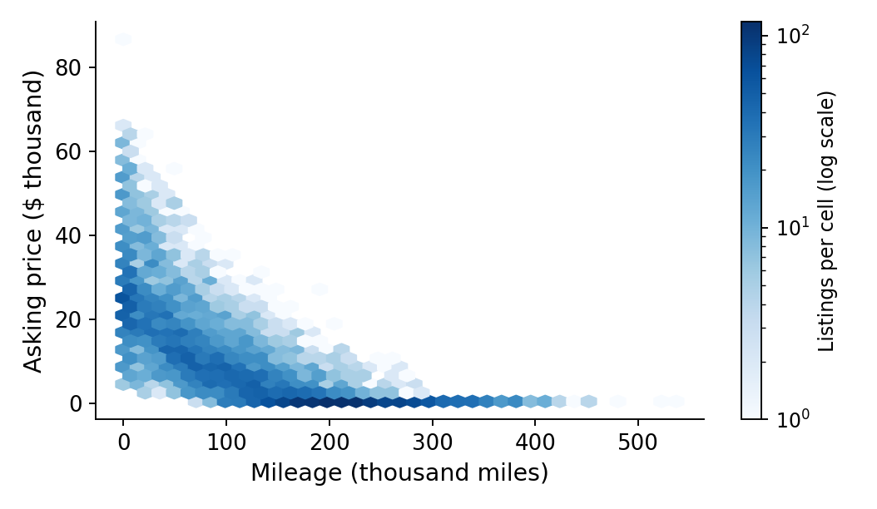
TECHNICAL TEAM REVIEW
How do age and mileage relate to asking price?
Older and higher-mileage listings generally have lower asking prices.
Lines at the 25th and 75th percentiles bound the middle 50% of listings at each age (not a confidence interval). Age and mileage correlate at 0.78: their information overlaps.
Conclusion: compare age and mileage together. Neither plot alone establishes depreciation.
dataset_clean.csv; exploratory/tables/age_profile.csv; correlations.csv. All 5,500 listings.
03
Notes:
The median asking price falls with vehicle age, and the mileage plot shows a similar pattern. The lighter lines mark the 25th and 75th percentiles, or the middle half of listings at each age, not a confidence interval. Age and price have Spearman correlation minus 0.88 and mileage and price minus 0.83. Age and mileage correlate at 0.78, so their information overlaps. These plots establish association rather than an independent causal effect.
Source: dataset_clean.csv; exploratory/tables/age_profile.csv; correlations.csv. All 5,500 listings.

Slide 4
TECHNICAL TEAM REVIEW
Which relationships persist beyond the $500 group?
Age, mileage and owners keep strong associations. Engine size and horsepower have weak overall associations.
Strong and stable
Age, mileage and owners stay strongly negative above $500.
Weak overall
Engine size and horsepower are near zero. Owners overlap with the vehicle mix.
Conclusion: priorities age and mileage comparisons. Check model and segment effects before dismissing other attributes.
exploratory/tables/correlations.csv. Spearman correlations, available records per variable.
04
Notes:
A rank correlation describes whether higher values tend to accompany higher or lower prices. The age, mileage and owners relationships remain negative after excluding the $500 listings, so they are not solely a minimum-price effect. Engine size and horsepower have weak overall monotonic associations in both populations. This does not prove they never matter within a specific model or trim. Owners also overlaps with age and mileage. I would avoid interpreting any raw correlation as a separate causal contribution.
Source: exploratory/tables/correlations.csv. Spearman correlations, available records per variable.

Slide 5
TECHNICAL TEAM REVIEW
Can we isolate accident, service and body differences?
Comparable groups give narrower evidence. Coverage and model mix limit general claims.
Accident: Yes vs No
Full service vs none
SUV vs sedan
-$2,315
Withhold
+$2,561
Interval: -$2,534 to -$2,064
Retained cars average about 1.6-1.7 years
Interval: +$2,165 to +$3,003
Coverage 16.4% / 16.2%
Coverage 6.9% / 11.2%
Coverage 95.5% / 95.8%
Directional within narrow overlap
No fleet-wide premium claim
Descriptive. Includes model mix
Accident and service matching uses model, age and mileage. SUV vs sedan uses fuel, age and mileage. Intervals cover resampling only.
Conclusion: verify condition, but avoid a universal accident discount or service premium from these comparisons.
05
Notes:
For accident history, I compare cars within the same model and age and mileage blocks. The retained accident group is about $2,315 lower, but only about 16% of each group overlaps. Widening the age blocks changes the gap to about $1,798 and changes coverage, showing sensitivity to the comparison design. Service comparisons retain mainly very young cars and little of the data, so I withhold a fleet-wide premium. SUV and sedan differences include model mix because model is not controlled. Bootstrap intervals reflect resampling within retained groups and do not remove confounding.
Source: decision/comparable_group_summary.csv. All listings; 3-year age blocks and 50,000-mile blocks.

Slide 6
TECHNICAL TEAM REVIEW
Does vehicle detail improve prediction?
Vehicle model adds substantial information beyond age and mileage.
How to read
Average miss in dollars. Lower is better.
Model matters
Without model: MAE about $4,701. More attributes do not always help.
Conclusion: compare the vehicle model as well as age and mileage. Predictive value does not establish causation.
exploratory/tables/fixed_staged_models.csv. Same five development folds, 4,400 rows.
06
Notes:
The baseline predicts the training median for every listing. Its average error is about $9,696. Age and mileage reduce this to $5,574, curved relationships to $4,658, and adding vehicle model to $2,832. Removing model from the full staged specification raises error to $4,701. These are fixed development comparisons, not test scores. Some unconstrained stages produce negative estimates and serve as diagnostic comparisons only. More variables do not automatically improve predictions: condition adds a small gain and the other attributes do not improve this specification.
Source: exploratory/tables/fixed_staged_models.csv. Same five development folds, 4,400 rows.

Slide 7
TECHNICAL TEAM REVIEW
Did bounded tuning improve the estimate?
The selected forest reduces reserved-test MAE by 36.9% versus the fixed forest.
-36.9%
reserved-test MAE vs fixed forest
Selected configuration
250 trees. Depth: no explicit limit.
Minimum leaf: 2. Features per split: 100%.
Reserved R-squared: 0.971
Internal reservation from previously explored data. New-period and external-market validation remain untested.
Conclusion: C080 is the recommended tested configuration. The search does not prove a global optimum.
tuning/search_results.csv; selected_parameters.json; test_metrics.csv. 1,100 reserved rows, 859 above $500.
07
Notes:
I evaluated one predeclared search: one baseline, 48 Ridge and 36 forest settings. All candidates used the same five development folds. Exact recorded descriptions stayed together, although these groups cannot replace VIN-based identity. I chose the simpler candidate within one approximate CV standard error of the best score. The 500-tree candidate improved CV MAE by only $4. The selected forest uses 250 trees, unrestricted maximum depth, minimum two records per leaf and all features at each split. I froze the choice before scoring the reserved sample. The Ridge comparison is the fixed reference, not the best tuned Ridge.
Source: tuning/search_results.csv; selected_parameters.json; test_metrics.csv. 1,100 reserved rows, 859 above $500.

Slide 8
TECHNICAL TEAM REVIEW
Where are prediction errors largest?
Error rises with asking-price band. Over-$30k listings tend to be under-predicted.
Price band | At $500 | >$500-5k | >$5k-15k | >$15k-30k | >$30k
Listings (n) | 241 | 185 | 318 | 251 | 105
Mean residual | -$204 | -$626 | +$154 | +$645 | +$1,833
Residual = asking price - estimate; positive means under-prediction. Overall 90th-percentile absolute error: $3,384.
Conclusion: check errors by segment and use independent comparables before acting on an individual estimate.
tuning/test_errors_by_price_band.csv. Selected model C080, reserved listings only.
08
Notes:
The overall average error hides segment differences. At $500 the MAE is $204. Above $30,000 it is $3,169, and the average signed residual is plus $1,833: asking prices are above the estimates on average. Across all reserved listings the 90th percentile absolute error is $3,384. That is an error summary, not a prediction interval for each car. These limitations matter before using estimates for repricing or reviewing an expensive vehicle.
Source: tuning/test_errors_by_price_band.csv. Selected model C080, reserved listings only.

Slide 9
TECHNICAL TEAM REVIEW
What does the listing mix mean for inventory analysis?
Ages 0-9 hold 85.3% of asking value. SUVs and sedans represent 89.9% of listings.
Body type, share of listings
Conclusion: describe composition separately from price patterns. Stock allocation needs costs and sales outcomes.
management/age_concentration.csv; dataset_clean.csv. Asking value is the sum of listed prices.
09
Notes:
The age groups have roughly equal numbers of listings, but their asking values differ greatly. Ages zero to nine represent 49.7% of records and 85.3% of asking value. SUVs and sedans dominate the sample, at 49.1% and 40.7% of listings. These are composition and asking-price observations, not demand, profit, or invested capital. They support a starting focus for price-comparison work and a separate assessment of old minimum-priced listings. They do not support a new purchase ratio.
Source: management/age_concentration.csv; dataset_clean.csv. Asking value is the sum of listed prices.

Slide 10
TECHNICAL TEAM REVIEW
Can model gaps identify genuine pricing issues?
The selection methods show bias. Actual issue detection remains unverified.
What it establishes
Dollar gaps concentrate on expensive cars. Percentage gaps are sensitive to small denominators.
Balanced vs random
Price bands matched; brand mix still differs (28 vs 19 premium).
Conclusion: a model gap supports investigation. This dataset alone cannot verify a pricing error or review benefit.
decision/queue_composition.csv; balanced_audit.csv; random_controls.csv. Development CV predictions.
10
Notes:
I tested how different rankings select records. Dollar gaps chose 40 premium cars out of 50. Percentage gaps chose 36 $500 records. A balanced audit and random controls each use ten records per price band, but premium composition still differs, 28 versus 19. This is completed analysis of selection patterns. It does not establish mispricing. A real issue check needs verified condition, trim and independent comparable prices that this CSV lacks. The proposed review comparison measures actionable findings and review time. It is supporting validation rather than the main analytical result.
Source: decision/queue_composition.csv; balanced_audit.csv; random_controls.csv. Development CV predictions.

Slide 11
TECHNICAL TEAM REVIEW
Which decisions does the analysis support?
Use the observed relationships for price comparisons and collect commercial evidence for purchasing decisions.
SUPPORTED DECISION
UNANSWERED QUESTION AND EVIDENCE NEEDED
Compare age, mileage and model
→
Transaction value: realized sale prices
Verify $500 and 100-mile patterns
→
Source meaning: data-owner documentation
Use estimates as analytical support
→
Accuracy over time: independent validation
Assess older/$500 records separately
→
Segment economics: costs and time to sale
Measure review before expansion
→
Issue detection: verified analyst outcomes
Recommendation: improve comparison and data verification now. Base purchasing changes on commercial outcomes.
All preceding source files. Recommendations distinguish measured findings from proposed actions.
11
Notes:
The key technical conclusions are clear. Age, mileage and model matter for asking-price comparisons. We retain missing categories explicitly and verify repeated minima. The tuned model improves internal predictive results, but high-price error and absent future validation prevent automatic repricing. The inventory observations describe the listing mix and asking values. Profit, turnover and purchasing allocation need actual costs, sale prices and dates. The next work should resolve those gaps rather than add more algorithms.
Source: All preceding source files. Recommendations distinguish measured findings from proposed actions.

