Slide 1
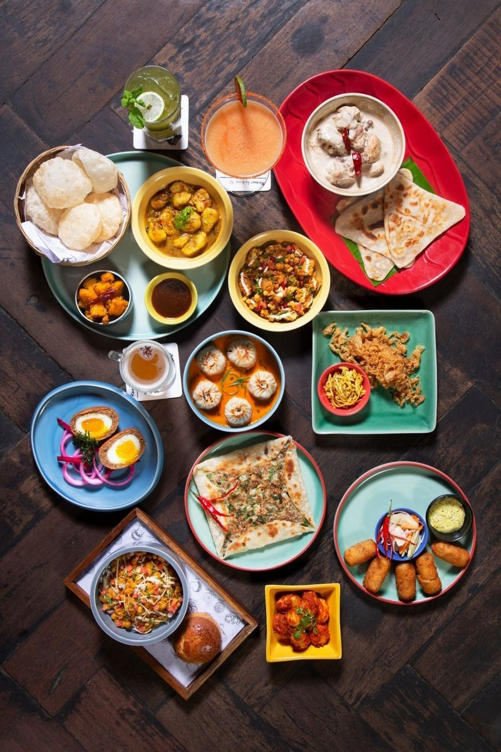
RESTAURANT ORDER ANALYSIS
By Ayantika Chowdhury

Slide 2
Table of contents
Introduction
Objectives
Data Analysis
Insights and recommendations

Slide 3
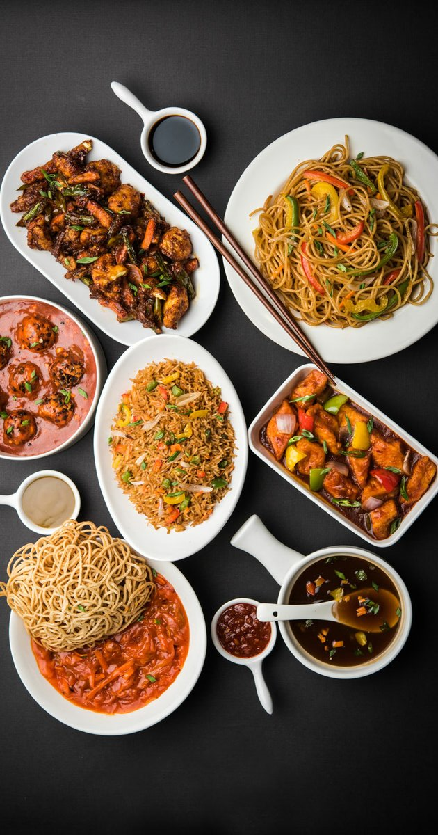
INTRODUCTION

Slide 4
Introduction
This project analyzes a restaurant order datset. It includes two tables:
1.order details table (order_details_id, order_id, order_date, order_time, item_id )
2. Menu items table(menu_item_id, item_name, category, price )
The orders table contains three months of order data (from January 1, 2023, to March 31, 2023) from an International cuisine restaurant, while the menu table contains details of menu items.

Slide 5
OBJECTIVES

Slide 6
Objectives
Analyze order data to identify the top 5 most and bottom 5 least popular menu items and their types of cuisine.
Find peak order hours and items ordered during peak hours
Revenue generated from top 5 highest orders
Total orders as per day of week
Category wise menu items,total orders and revenue
Find bestestselling items
Top 3 items in each cuisines based on the number of orders
Top 5 highest value order IDs with item names and amount spent

Slide 7
DATA ANALYSIS

Slide 8
Monthly order trend

Slide 9
Top 5 most ordered items
select item_name,category, count(item_id) as numberOFordersfrom order_details o inner join menu_items m on o.item_id=m.menu_item_idgroup by item_name,categoryorder by 3 desclimit 5;

Slide 10
Bottom 5 least ordered items
select item_id,item_name,category, count(item_id) from order_details o inner join menu_items m on o.item_id=m.menu_item_idgroup by item_id,item_name,categoryorder by 4 limit 5;

Slide 11
Orders by hour of the day
select timeoftheday,count(distinct order_id) as numberofordersfrom order_details group by timeoftheday order by 1;

Slide 12
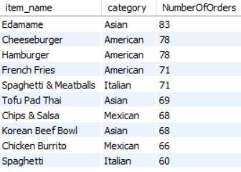
Top 10 items ordered during peak time period
with peaktime as (select timeoftheday,count(distinct order_id) as numberofordersfrom order_detailsgroup by timeofthedayorder by 2 desclimit 1)select m.item_name, m.category, count(distinct order_id) NumberOfOrdersfrom order_details o inner join menu_items m on o.item_id = m.menu_item_id inner join PeakTime p on o.TimeOfTheDay = p.TimeOfTheDaygroup by m.item_name, m.categoryorder by NumberOfOrders Desclimit 10;

Slide 13
Total orders by day of week
select day_name, count(distinct order_id) as numberofordersfrom order_detailsgroup by day_name order by 2 desc;

Slide 14
Top 5 highest value order IDs with item names and amount spent
with highestvalue as (select order_id,sum(price) as totalorderPRICEfrom order_details o inner join menu_items m on o.item_id = m.menu_item_idgroup by order_idorder by 2 desc limit 5)select h.order_id , item_name, sum(price) over (partition by h.order_id,item_name order by sum(price) desc) as totalpricefrom order_details o inner join menu_items m on o.item_id = m.menu_item_id inner join highestvalue h on o.order_id = h.order_idgroup by order_id , item_name;

Slide 15
Category wise total items ordered in top 5 highest value orders
select category, count(item_id) as total_items_orderedfrom order_details o inner join menu_items m on o.item_id=m.menu_item_idwhere order_id in(440,2075,1957,330,2675)group by categoryorder by 2 desc;

Slide 16
Top 10 bestselling items with total order price
with top5 as (with highestvalue as (select order_id,sum(price) as totalorderPRICEfrom order_details o inner join menu_items m on o.item_id = m.menu_item_idgroup by order_idorder by 2 desc limit 5)select h.order_id , item_name, sum(price) over (partition by h.order_id,item_name order by sum(price) desc) as totalpricefrom order_details o inner join menu_items m on o.item_id = m.menu_item_id inner join highestvalue h on o.order_id = h.order_idgroup by order_id , item_name)select item_name, sum(totalprice) total_pricefrom top5group by item_nameorder by 2 desc limit 10;

Slide 17
Category wise total items in top 5 orders
with highestvalue as (select order_id,sum(price) as totalorderPRICEfrom order_details o inner join menu_items m on o.item_id = m.menu_item_idgroup by order_idorder by 2 desc limit 5)select category, count(item_id) as number_of_itemsfrom order_details o inner join menu_items m on o.item_id = m.menu_item_id inner join highestvalue h on o.order_id = h.order_idgroup by categoryorder by 2 desc;

Slide 18
Category wise menu items
Category wise orders
Category wise revenue
select category , count( order_id) total_number_of_ordersfrom order_details o inner join menu_items m on o.item_id = m.menu_item_idgroup by categoryorder by 2 desc;
select category , count( menu_item_id) as total_menu_items from menu_items group by categoryorder by 2 desc;
select category , sum( price) as total_revenue from order_details o inner join menu_items m on o.item_id = m.menu_item_idgroup by categoryorder by 2 desc;

Slide 19
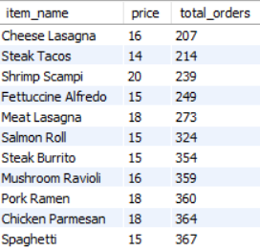
List of items that are expensive but underperforming

Slide 20
Top 3 items in each cuisines/ category based on the number of orders
category | item_name | number of orders | rank
American | Hamburger | 622 | 1
American | Cheeseburger | 583 | 2
American | French Fries | 571 | 3
Asian | Edamame | 620 | 1
Asian | Korean Beef Bowl | 588 | 2
Asian | Tofu Pad Thai | 562 | 3
Italian | Spaghetti & Meatballs | 470 | 1
Italian | Eggplant Parmesan | 420 | 2
Italian | Spaghetti | 367 | 3
Mexican | Steak Torta | 489 | 1
Mexican | Chips & Salsa | 461 | 2
Mexican | Chicken Burrito | 455 | 3
with cte as (select category, item_name, count(order_id) as numberOForders, rank () over (partition by category order by count(order_id) desc) as rnkfrom order_details o inner join menu_items m on o.item_id=m.menu_item_idgroup by category,item_name )select * from cte where rnk<=3;

Slide 21
INSIGHTS AND RECOMMENDATIONS

Slide 22
Insights from data
The Data shows that even if Mexican food items are offered more in menu but they are underperforming, but Asian food items are performing well(more orders and revenue) despite of being offered less in menu.
Peak hours are12pm- 1 pm and in evening 5pm- 6 pm. Lesser number of orders during 2 pm-4 pm.
Lowest number of orders are on Wednesday.
Top 5 highest value orders help to understand customer preferences and indicates they are crucial for business and indicates bestselling items.

Slide 23
Recommendations
Menu Re-engineering
Placing underperforming Mexican items in high visibility areas of the menu (e.g. in a box or at the top) and add high quality photos of those items. Update the item with new name and use unique ingredients.
Improve Efficiency
Improving workflow, training staff, managing inventory ,optimizing resource utilization and optimizing online ordering can boost revenue. To boost sales of expensive but underperforming items price can be revised, customer feedback can be taken.
Enhance marketing
Introduce afternoon-happy-hour and social media ads, promotions, send sms to increase sells during off peak hours 2pm-4pm and introduce special Wednesday offers to boost orders.
Feature underperforming items in combos and creating limited time offers

Slide 24
THANK
YOU

