Slide 1

UBER RIDE BOOKING ANALYSIS

Slide 2
Introduction
This project analyzes Uber ride booking dataset (Delhi NCR) for the year 2024. It provides insights into booking patterns, vehicle performance, revenue streams, cancellation behaviours, and customer satisfaction metrics.
Dataset Overview
The dataset captures 148,770 total bookings across multiple vehicle types and provides a complete view of ride-sharing operations including successful rides, cancellations, customer behaviours and financial metrics.

Slide 3
Objectives
Finding Top 10 pickup locations by total revenue
Payment method wise revenue contribution and number of complete rides
Identify Peak demand hours
Identify high demand days using average daily booking
Hour wise booking volume during high demand days
Monthly bookings & revenue trend
Identify easons behind ride cancellation by customers and drivers
Top 5 Pickup locations with highest driver-cancellation rate
Vehicle wise number of bookings and Revenue
What proportion of customers are repeat users

Slide 4
Top 10 pickup location by total revenue
select pickup_location,sum(bookingvalue) as total_revenuefrom ride where booking_status="completed"group by pickup_locationorder by 2 desclimit 10;

Slide 5
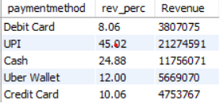
Payment method wise revenue contribution
select paymentmethod,round((sum(bookingvalue)*100)/sum(sum(bookingvalue))over(),2) as rev_perc,sum(bookingvalue) as Revenuefrom ridewhere booking_status="completed"group by paymentmethod;

Slide 6
Payment method wise completed rides
select paymentmethod,count(bookingid) as no_of_completedridesfrom ridewhere booking_status="completed"group by paymentmethodorder by 2 desc;

Slide 7
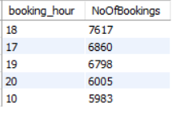
Peak hours
select hour(booking_time_new) as booking_hour, count(bookingid) as NoOfBookingsfrom ridewhere booking_status="completed"group by hour(booking_time_new)order by 2 desc limit 5;

Slide 8
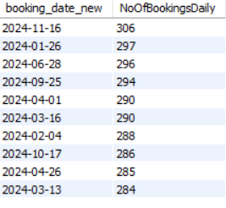
High demand days(top 10)
select booking_date_new,count(bookingid) as NoOfBookingsDailyfrom ridewhere booking_status="completed" group by booking_date_newhaving count(bookingid)>(select round(avg(NoOfBookingsDaily),2)from(select booking_date_new,count(bookingid) as NoOfBookingsDailyfrom ridewhere booking_status="completed"group by booking_date_new) as AB)order by 2 desc
Limit 10;

Slide 9
Hour wise booking volume during high demand days
select hour(booking_time_new) as booking_hour,count(bookingid) as noOFbookingsfrom ridewhere booking_status="completed"and booking_date_new in (select booking_date_newfrom ridewhere booking_status="completed" group by booking_date_newhaving count(bookingid)>(select round(avg(NoOfBookingsDaily),2)from(select booking_date_new,count(bookingid) as NoOfBookingsDailyfrom ridewhere booking_status="completed"group by booking_date_new) as AB))group by hour(booking_time_new)order by 1;

Slide 10
Monthly bookings & revenue trend
select month(booking_date_new),monthname(booking_date_new),count(bookingid) as noOFbookings,sum(bookingvalue) as totalRevenuefrom ridewhere booking_status="completed"group by month(booking_date_new),monthname(booking_date_new)order by 1;

Slide 11
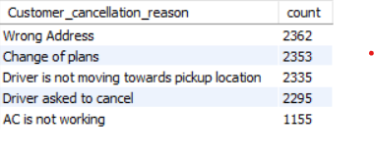
Reasons behind ride cancellation by customer
select Customer_cancellation_reason,count(*) as count from ridewhere Customer_cancellation_reason<>"null"group by Customer_cancellation_reasonorder by 2 desc;

Slide 12
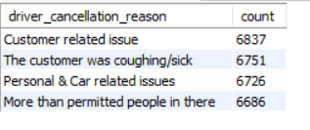
Reasons behind ride cancellation by driver
select driver_cancellation_reason,count(*) as count from ridewhere driver_cancellation_reason<>"null"group by driver_cancellation_reasonorder by 2 desc;

Slide 13
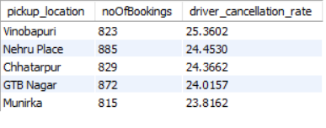
Top 5 Pickup locations with highest driver-cancellation rate
select pickup_location, count(bookingid) as noOfBookings,(sum(if(booking_status="cancelled by driver",1,0))/sum(if(booking_status in ("cancelled by driver","cancelled by customer","completed"),1,0)))*100 as driver_cancellation_ratefrom ridegroup by pickup_locationorder by 3 desc limit 5;

Slide 14
Vehicle wise number of bookings
select vehicle_type,count(*) as noOFbookingsfrom ridewhere booking_status="completed"group by vehicle_type;

Slide 15
Vehicle wise Revenue
select vehicle_type,sum(bookingvalue) as TotalRevenuefrom ridewhere booking_status="completed"group by vehicle_type;

Slide 16
Insights from data
1. Peak booking hours are 9 am -11am. and 5pm- 8 pm.
2. UPI is the leading payment method, accounting for the highest number of completed rides, followed by Cash . UPI accounts for highest share of revenue.
3. Auto has the highest completed-ride volume and also generates the highest revenue among vehicle types.
4. Certain pickup locations generate substantially higher revenue, with Barakhamba Road and Khandsa among the highest-revenue locations in the analysis.

Slide 17
Recommendations
1. Optimize driver availability during peak hours by aligning driver supply with high-demand morning and evening periods.
2. Prioritize high-performing pickup locations for driver allocation and operational monitoring to capture demand efficiently.
3. Strengthen digital payment adoption, particularly UPI, while maintaining alternative payment options for customer convenience.
4. Focus vehicle availability on high-demand categories, especially Auto, while monitoring demand and revenue contribution across other vehicle types.
5. Investigate locations with high driver-cancellation rates to identify operational issues and improve ride completion rates.

