Slide 1
SUB PROJECT WORK
HOUSE PRICE
PREDICTION
Machine Learning Based Price Estimation
STUDENT NAME
MAHAMMADAYAN VHORA
ROLL NO.
04
CLASS
M.Sc. Data Science
COLLEGE
C. P. Patel & F. H. Shah Commerce College, Anand
PROJECT TITLE
House Price Prediction
DATA • MODEL • PREDICTION
HOUSE PRICE PREDICTION • MAHAMMADAYAN VHORA • M.Sc. DATA SCIENCE

Slide 2
01 • OVERVIEW
02
Project at a Glance
The complete story in one visual sequence
01
WHY
02
DATA
03
ANALYZE
04
PREPARE
Problem & purpose
10,000 × 26
EDA & relationships
Encoding & split
05
MODEL
06
VALIDATE
07
PREDICT
3 regressors
MAE • RMSE • R²
₹209.43 Lakhs
RAW DATA → CLEANING → EDA → PREPROCESSING → MODELING → EVALUATION → PREDICTION
HOUSE PRICE PREDICTION • MAHAMMADAYAN VHORA • M.Sc. DATA SCIENCE

Slide 3
02 • INTRODUCTION
03
What is this project?
A supervised-learning regression workflow for house-price estimation
1
INPUT
2
LEARNING
3
OUTPUT
Property characteristics such as location, property type, BHK, size, amenities and distances.
Regression models learn relationships between the prepared features and observed house prices.
A predicted continuous value for the target variable: Price_in_Lakhs.
PROJECT ENDPOINT: FINAL HOUSE PRICE PREDICTION
HOUSE PRICE PREDICTION • MAHAMMADAYAN VHORA • M.Sc. DATA SCIENCE

Slide 4
03 • MOTIVATION
04
Why was this project developed?
The motivation behind converting property data into a prediction
01
MULTI-FACTOR PROBLEM
02
DATA-DRIVEN APPROACH
03
ACADEMIC OBJECTIVE
House prices depend on several property characteristics simultaneously.
Machine learning can learn patterns from historical property observations.
Demonstrate a complete Data Science workflow from raw data to prediction.
The project is designed as an academic demonstration of the end-to-end regression process.
HOUSE PRICE PREDICTION • MAHAMMADAYAN VHORA • M.Sc. DATA SCIENCE

Slide 5
04 • PROBLEM
05
Problem Statement
How can structured property data be used to estimate house prices?
THE QUESTION
TARGET
How can multiple property features be transformed into a model-ready representation and used to estimate Price_in_Lakhs?
Price_in_Lakhs
TEST SET
2,000 records
FINAL OUTPUT
Predicted price
HOUSE PRICE PREDICTION • MAHAMMADAYAN VHORA • M.Sc. DATA SCIENCE

Slide 6
05 • OBJECTIVES
06
Project Objectives
What the implementation accomplishes
1
Understand the property dataset
2
Validate missing values and duplicates
3
Explore price patterns with visualizations
4
Separate numerical and categorical features
5
Apply One-Hot Encoding
6
Create an 80/20 train-test split
7
Train Linear Regression, Decision Tree and Random Forest
8
Evaluate, compare and generate the final prediction
HOUSE PRICE PREDICTION • MAHAMMADAYAN VHORA • M.Sc. DATA SCIENCE

Slide 7
06 • SCOPE
07
Project Scope
Focused on analysis, machine learning and final prediction
✓
INCLUDED
◎
EVIDENCE
!
BOUNDARY
Dataset loading
Data quality checks
EDA
Preprocessing
Model training
Evaluation
Final prediction
Notebook execution
Dataset statistics
Graphs
Model metrics
22 screenshots
Final prediction output
The academic presentation ends at the final house-price prediction.
REPORT-FIRST • PROOF-OF-WORK
HOUSE PRICE PREDICTION • MAHAMMADAYAN VHORA • M.Sc. DATA SCIENCE

Slide 8
07 • VALUE
08
Project Benefits
What the completed workflow provides within its documented scope
1
DATA-DRIVEN
2
STRUCTURED
Uses multiple property attributes together instead of relying on one factor.
Transforms raw data into a model-ready representation.
3
MEASURABLE
4
PREDICTIVE
Compares models using MAE, RMSE and R².
Produces a final price estimate for a specified property.
Benefits are described within the demonstrated project scope; the model output is an estimate, not a guaranteed market price.
HOUSE PRICE PREDICTION • MAHAMMADAYAN VHORA • M.Sc. DATA SCIENCE

Slide 9
08 • TECHNOLOGY
09
Technology Stack
Libraries and tools evidenced in the project implementation
1
Python
2
Pandas
3
NumPy
4
Matplotlib
Core implementation
Data handling
Numerical operations
Visualization
5
Seaborn
6
Scikit-learn
7
Joblib
Statistical graphics
ML + preprocessing + metrics
Model persistence
HOUSE PRICE PREDICTION • MAHAMMADAYAN VHORA • M.Sc. DATA SCIENCE

Slide 10
09 • WORKFLOW
10
End-to-End Project Workflow
Seven stages connect the raw dataset to the final prediction
01
LOAD
02
CHECK
03
EXPLORE
04
PREPARE
05
TRAIN
06
EVALUATE
07
PREDICT
›
›
›
›
›
›
RAW DATA → INSIGHT → MODEL → EVIDENCE → PREDICTION
HOUSE PRICE PREDICTION • MAHAMMADAYAN VHORA • M.Sc. DATA SCIENCE

Slide 11
10 • DATASET
11
Dataset Snapshot
Verified from the uploaded CSV and notebook
ROWS
COLUMNS
TARGET
MISSING VALUES
10,000
26
Price_in_Lakhs
0
N
NUMERICAL FEATURES
C
CATEGORICAL FEATURES
Property_ID • BHK • Bathrooms • Balconies • Size_in_SqFt • Floor_No • Age_of_Property • distance features
State • City • Locality • Property_Type • Parking • Furnished_Status • Facing and other categorical fields
HOUSE PRICE PREDICTION • MAHAMMADAYAN VHORA • M.Sc. DATA SCIENCE

Slide 12
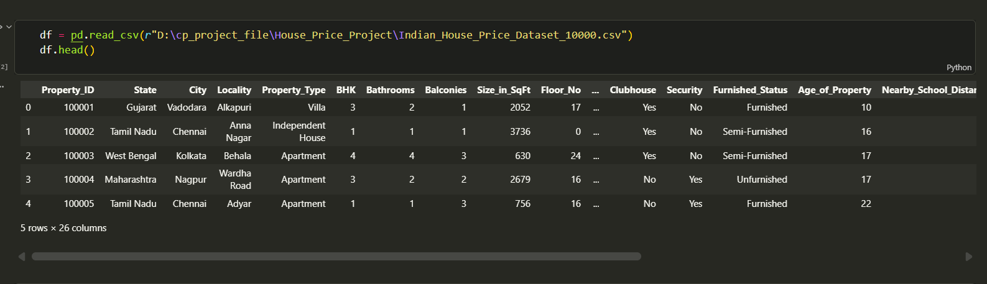
11 • PROOF OF WORK
12
Raw Dataset — Code Execution Evidence
Loading the CSV and inspecting the first records
01
CODE
pd.read_csv(...)
02
OUTPUT
First records displayed
03
PROVES
Dataset successfully loaded
Screenshot 02 • Dataset loading + df.head()
HOUSE PRICE PREDICTION • MAHAMMADAYAN VHORA • M.Sc. DATA SCIENCE

Slide 13
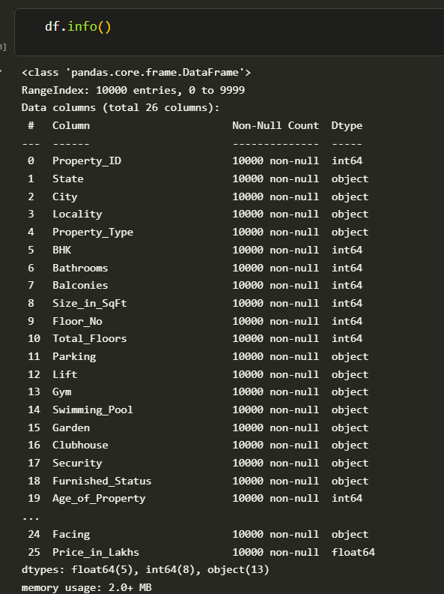
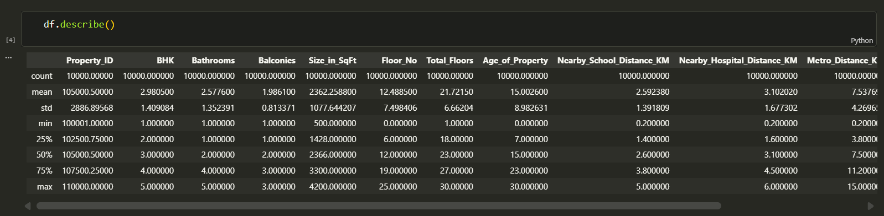
12 • PROOF OF WORK
13
Dataset Structure & Statistical Summary
The notebook inspects shape, data types and numerical statistics
Screenshot 03 • df.info()
Screenshot 04 • df.describe()
HOUSE PRICE PREDICTION • MAHAMMADAYAN VHORA • M.Sc. DATA SCIENCE

Slide 14
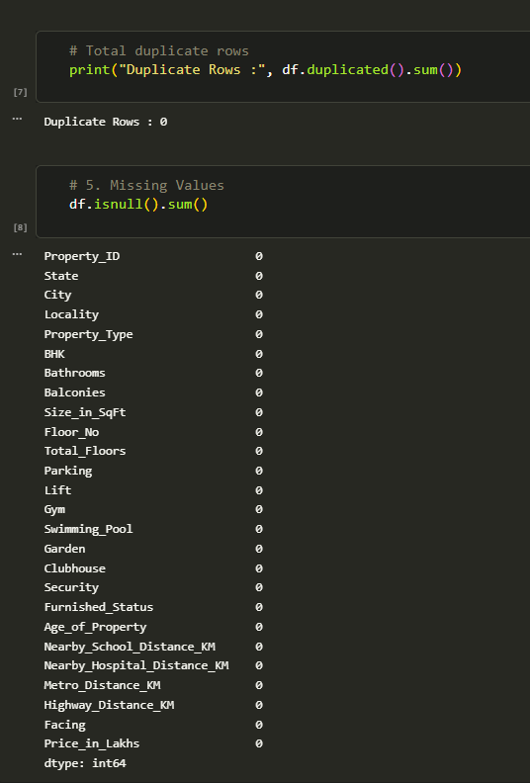
13 • DATA QUALITY
14
Quality Validation
Checking the dataset before analysis and model training
DUPLICATES
0
MISSING VALUES
0
✓
EVIDENCE
Quality checks executed successfully.
Screenshot 05 • Missing values + duplicate rows
HOUSE PRICE PREDICTION • MAHAMMADAYAN VHORA • M.Sc. DATA SCIENCE

Slide 15
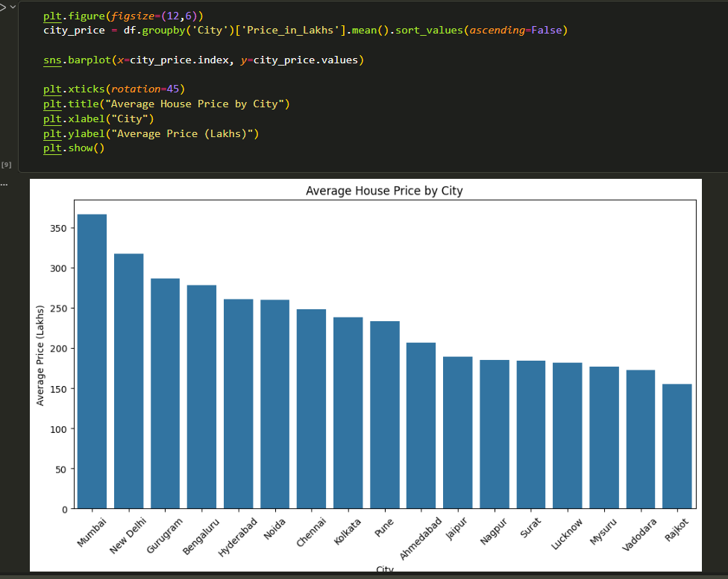
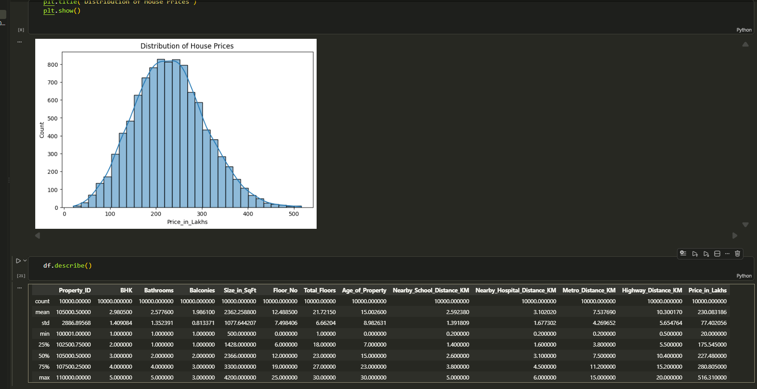
14 • EDA
15
Price Distribution & City Analysis
Exploring the target and location-level price differences
Screenshot 06 • Price distribution
Screenshot 07 • Average price by city
HOUSE PRICE PREDICTION • MAHAMMADAYAN VHORA • M.Sc. DATA SCIENCE

Slide 16
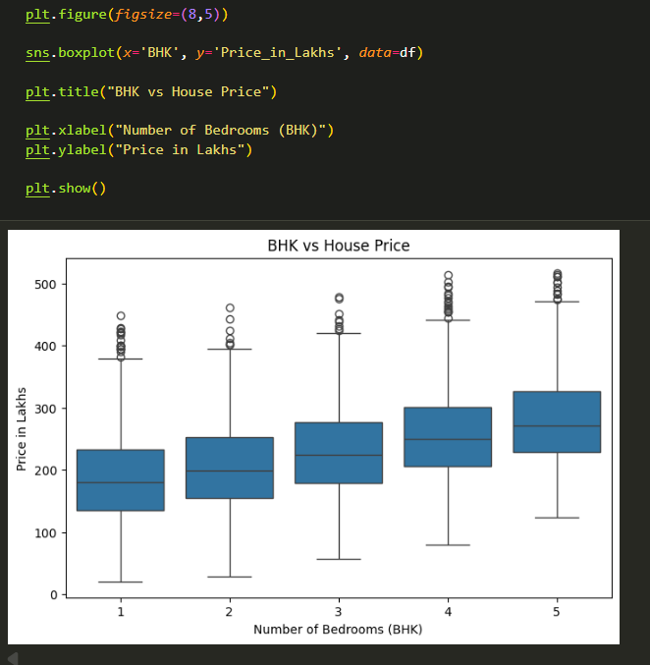
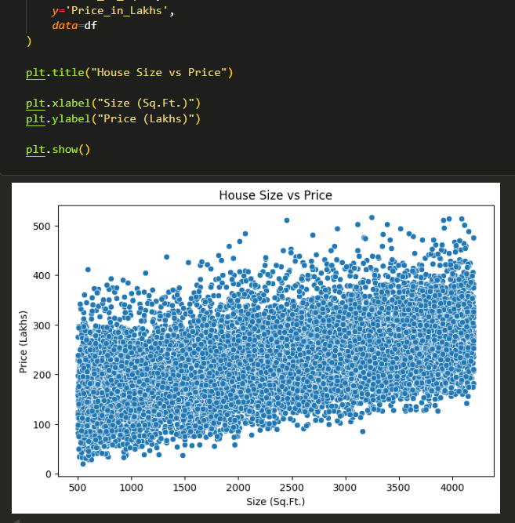
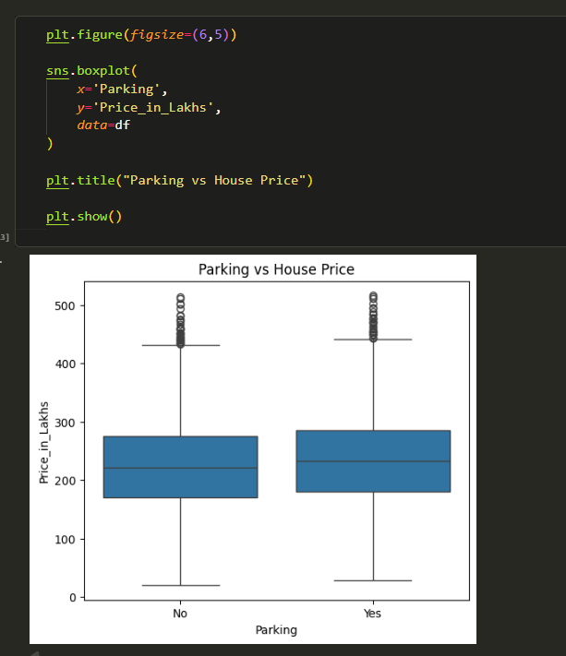
15 • EDA
16
Property Feature Analysis
BHK, size and parking relationships with house price
Screenshot 08 • BHK vs price
Screenshot 09 • Size vs price
Screenshot 10 • Parking vs price
HOUSE PRICE PREDICTION • MAHAMMADAYAN VHORA • M.Sc. DATA SCIENCE

Slide 17
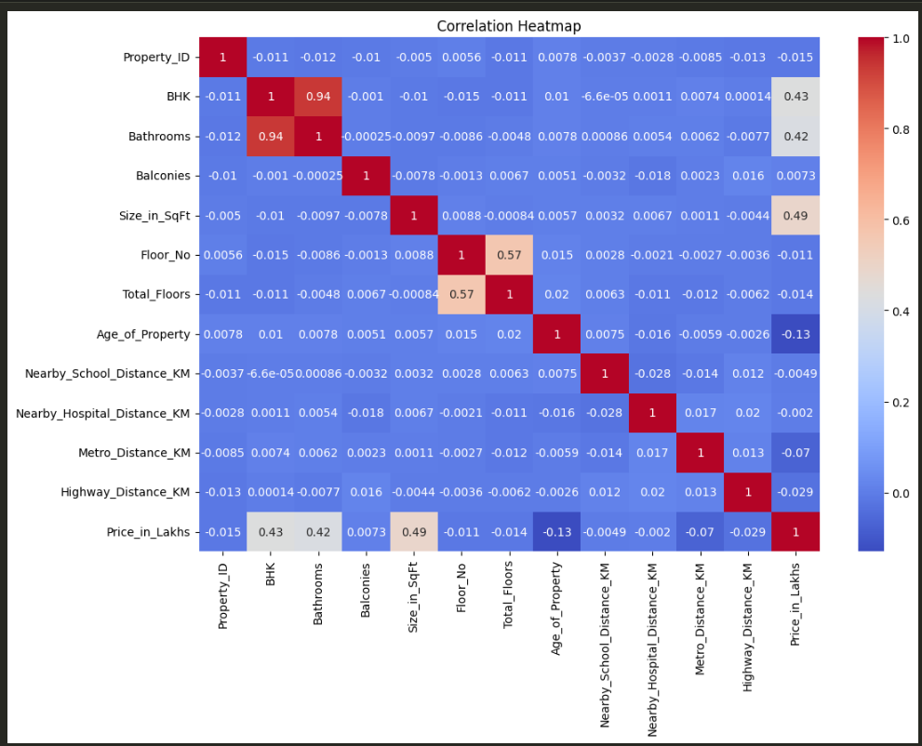
16 • RELATIONSHIPS
17
Correlation Analysis
A numerical relationship map for feature understanding
SIZE → PRICE
≈ 0.49
BHK → PRICE
≈ 0.43
BATHROOMS → PRICE
≈ 0.42
Screenshot 11 • Correlation heatmap
HOUSE PRICE PREDICTION • MAHAMMADAYAN VHORA • M.Sc. DATA SCIENCE

Slide 18
17 • FEATURES
18
Feature Classification
Inputs are separated into numerical and categorical groups
$
TARGET
N
NUMERICAL
C
CATEGORICAL
Price_in_Lakhs
Continuous value the model learns to predict.
BHK • Bathrooms • Balconies
Size_in_SqFt • Floor_No
Age • Distance features
State • City • Locality
Property_Type • Parking
Furnished_Status • Facing
HOUSE PRICE PREDICTION • MAHAMMADAYAN VHORA • M.Sc. DATA SCIENCE

Slide 19
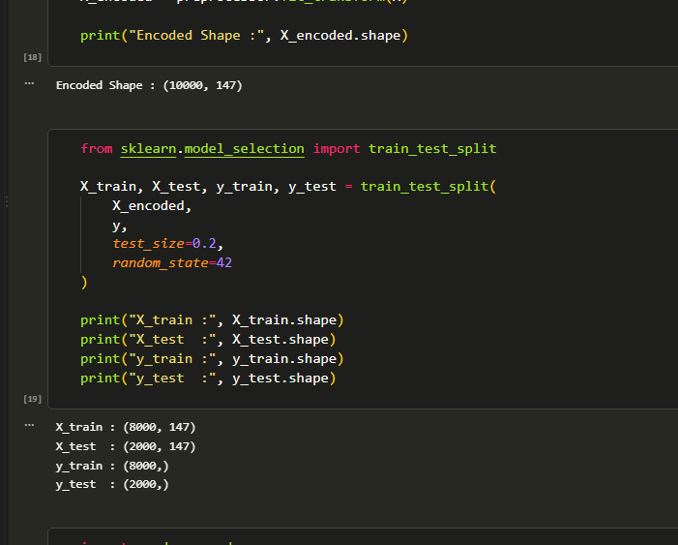
18 • PREPROCESSING
19
One-Hot Encoding & Train-Test Split
Preparing categorical data and separating training from testing
ENCODED FEATURES
147
TRAINING
8,000
TESTING
2,000
Screenshot 12 • Encoding + split output
HOUSE PRICE PREDICTION • MAHAMMADAYAN VHORA • M.Sc. DATA SCIENCE

Slide 20
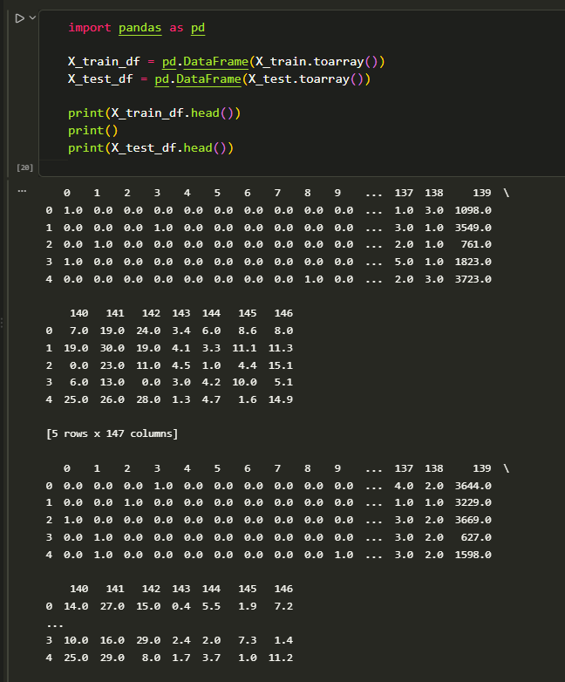
19 • PROOF OF WORK
20
Encoded Model Input
The transformed matrices are inspected before model training
01
WHY
Categorical text must be represented numerically.
02
RESULT
147 transformed feature columns.
03
NEXT
Regression model training.
Screenshot 13 • Encoded train/test data
HOUSE PRICE PREDICTION • MAHAMMADAYAN VHORA • M.Sc. DATA SCIENCE

Slide 21
20 • MODELING
21
Regression Models
The documented comparison evaluates three models
01
LINEAR REGRESSION
02
DECISION TREE
03
RANDOM FOREST
A linear baseline for continuous price prediction.
Learns rule-based splits for regression.
Combines multiple decision trees as an ensemble.
Gradient Boosting and Extra Trees appear in the import cell, but are not part of the documented three-model comparison.
HOUSE PRICE PREDICTION • MAHAMMADAYAN VHORA • M.Sc. DATA SCIENCE

Slide 22
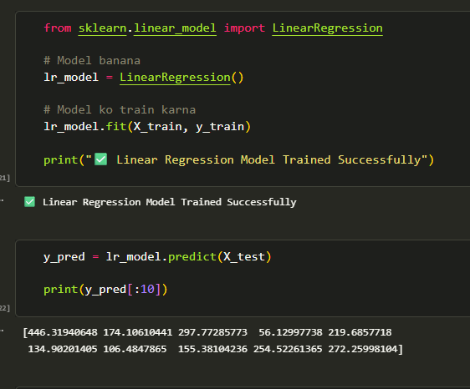
21 • PROOF OF WORK
22
Linear Regression — Training Evidence
The notebook confirms successful model fitting
TRAINING
SUCCESS
TEST PREDICTIONS
GENERATED
→
NEXT STAGE
Evaluate prediction quality
Screenshot 18 • Linear Regression training
HOUSE PRICE PREDICTION • MAHAMMADAYAN VHORA • M.Sc. DATA SCIENCE

Slide 23
22 • EVALUATION
23
Model Performance
Actual values from the notebook's three-model comparison
LINEAR REGRESSION • R²
DECISION TREE • R²
RANDOM FOREST • R²
0.987541
0.825619
0.922218
LINEAR • MAE
TREE • MAE
FOREST • MAE
7.483221
25.132585
17.022721
LINEAR • RMSE
TREE • RMSE
FOREST • RMSE
8.722437
32.631679
21.793527
HOUSE PRICE PREDICTION • MAHAMMADAYAN VHORA • M.Sc. DATA SCIENCE

Slide 24
23 • COMPARISON
24
Model Comparison
MAE, RMSE and R² are compared on the test set
MODEL
MAE
RMSE
R² SCORE
Linear Regression
7.483221
8.722437
0.987541
Decision Tree
25.132585
32.631679
0.825619
Random Forest
17.022721
21.793527
0.922218
✓
DOCUMENTED RESULT
Linear Regression has the highest R² and the lowest MAE and RMSE in the three-model comparison shown in the notebook.
HOUSE PRICE PREDICTION • MAHAMMADAYAN VHORA • M.Sc. DATA SCIENCE

Slide 25
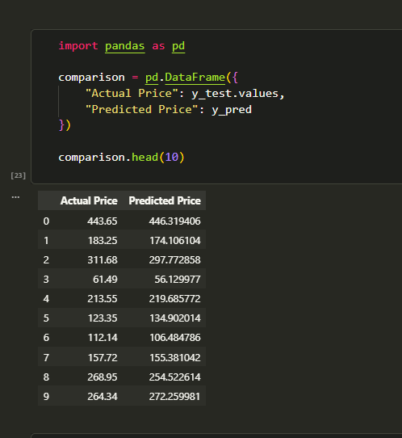
24 • VALIDATION
25
Actual vs Predicted Values
Record-level evidence of model predictions
01
WHAT
Observed and predicted values are shown side-by-side.
02
WHY
Makes individual prediction differences visible.
03
EVIDENCE
Notebook output
Screenshot 19 • Actual vs Predicted table
HOUSE PRICE PREDICTION • MAHAMMADAYAN VHORA • M.Sc. DATA SCIENCE

Slide 26
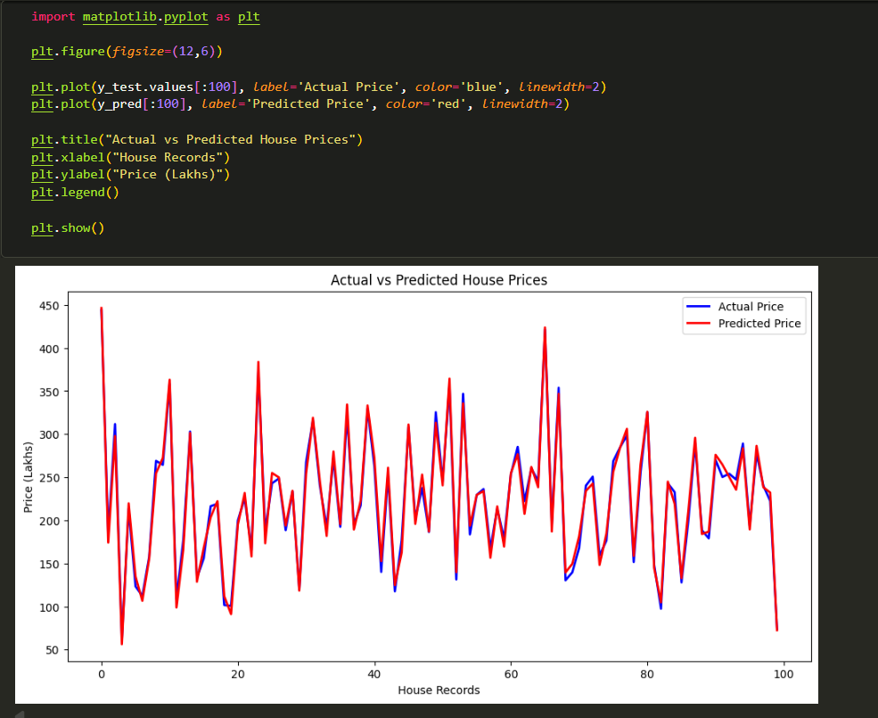
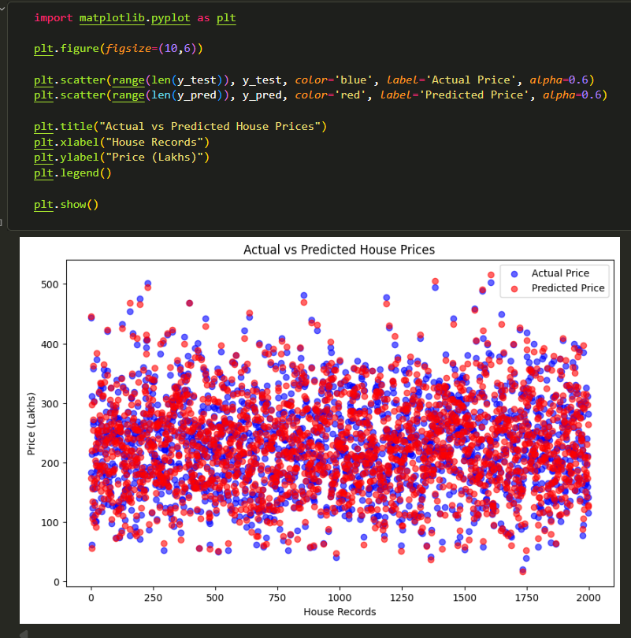
25 • VALIDATION
26
Prediction Visualizations
Two visual checks of actual versus predicted values
Screenshot 20 • Actual vs Predicted line graph
Screenshot 21 • Actual vs Predicted scatter plot
HOUSE PRICE PREDICTION • MAHAMMADAYAN VHORA • M.Sc. DATA SCIENCE

Slide 27
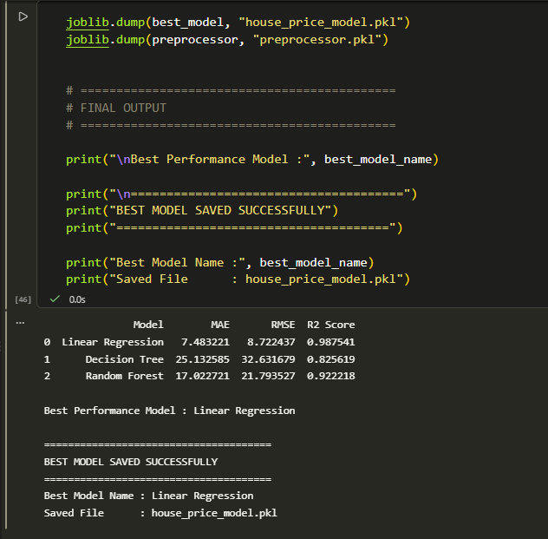
26 • PERSISTENCE
27
Final Model & Model Saving
The documented best-performing model is saved for reuse
BEST MODEL
Linear Regression
MODEL FILE
house_price_model.pkl
PREPROCESSOR
preprocessor.pkl
Screenshot 17 • Best model saved successfully
HOUSE PRICE PREDICTION • MAHAMMADAYAN VHORA • M.Sc. DATA SCIENCE

Slide 28
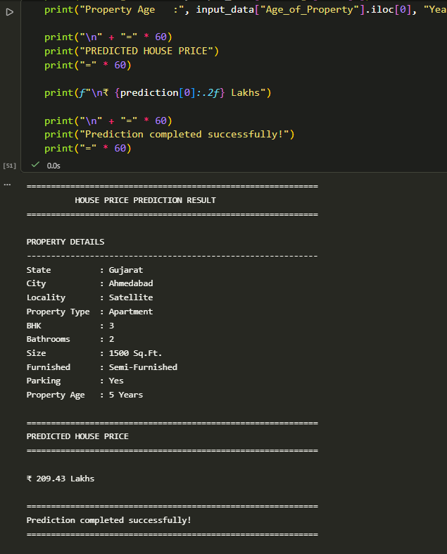
27 • FINAL OUTPUT
28
Final House Price Prediction
The academic project reaches its final output here
PREDICTED PRICE
₹ 209.43 Lakhs
₹
PROPERTY INPUT
Gujarat • Ahmedabad
Satellite • Apartment
3 BHK • 2 Bathrooms
1,500 Sq.Ft. • Semi-Furnished
Parking: Yes • Age: 5 Years
Screenshot 22 • Final prediction output
HOUSE PRICE PREDICTION • MAHAMMADAYAN VHORA • M.Sc. DATA SCIENCE

Slide 29
28 • REFLECTION
29
Limitations & Future Scope
A balanced view of the current project
!
LIMITATIONS
↗
FUTURE SCOPE
• Prediction depends on the available dataset and features.
• Historical patterns may not capture every real-world market factor.
• A model estimate is not a guaranteed transaction price.
• Performance is measured on the project's evaluated test set.
• Add richer real-world property and location data.
• Expand feature coverage.
• Experiment with additional validated regression methods.
• Re-evaluate models on broader and newer datasets.
HOUSE PRICE PREDICTION • MAHAMMADAYAN VHORA • M.Sc. DATA SCIENCE

Slide 30
29 • CONCLUSION
From Data → Model → Evidence → Prediction
A complete academic machine-learning workflow for house-price prediction.
1
DATA
2
QUALITY
3
PREP
4
MODELS
5
R²
6
OUTPUT
10,000 × 26
0 missing • 0 duplicate
147 encoded features
3 evaluated
0.987541
₹209.43 Lakhs
THANK YOU
MAHAMMADAYAN VHORA • Roll No. 04 • M.Sc. Data Science
HOUSE PRICE PREDICTION
HOUSE PRICE PREDICTION • MAHAMMADAYAN VHORA • M.Sc. DATA SCIENCE

