Slide 1
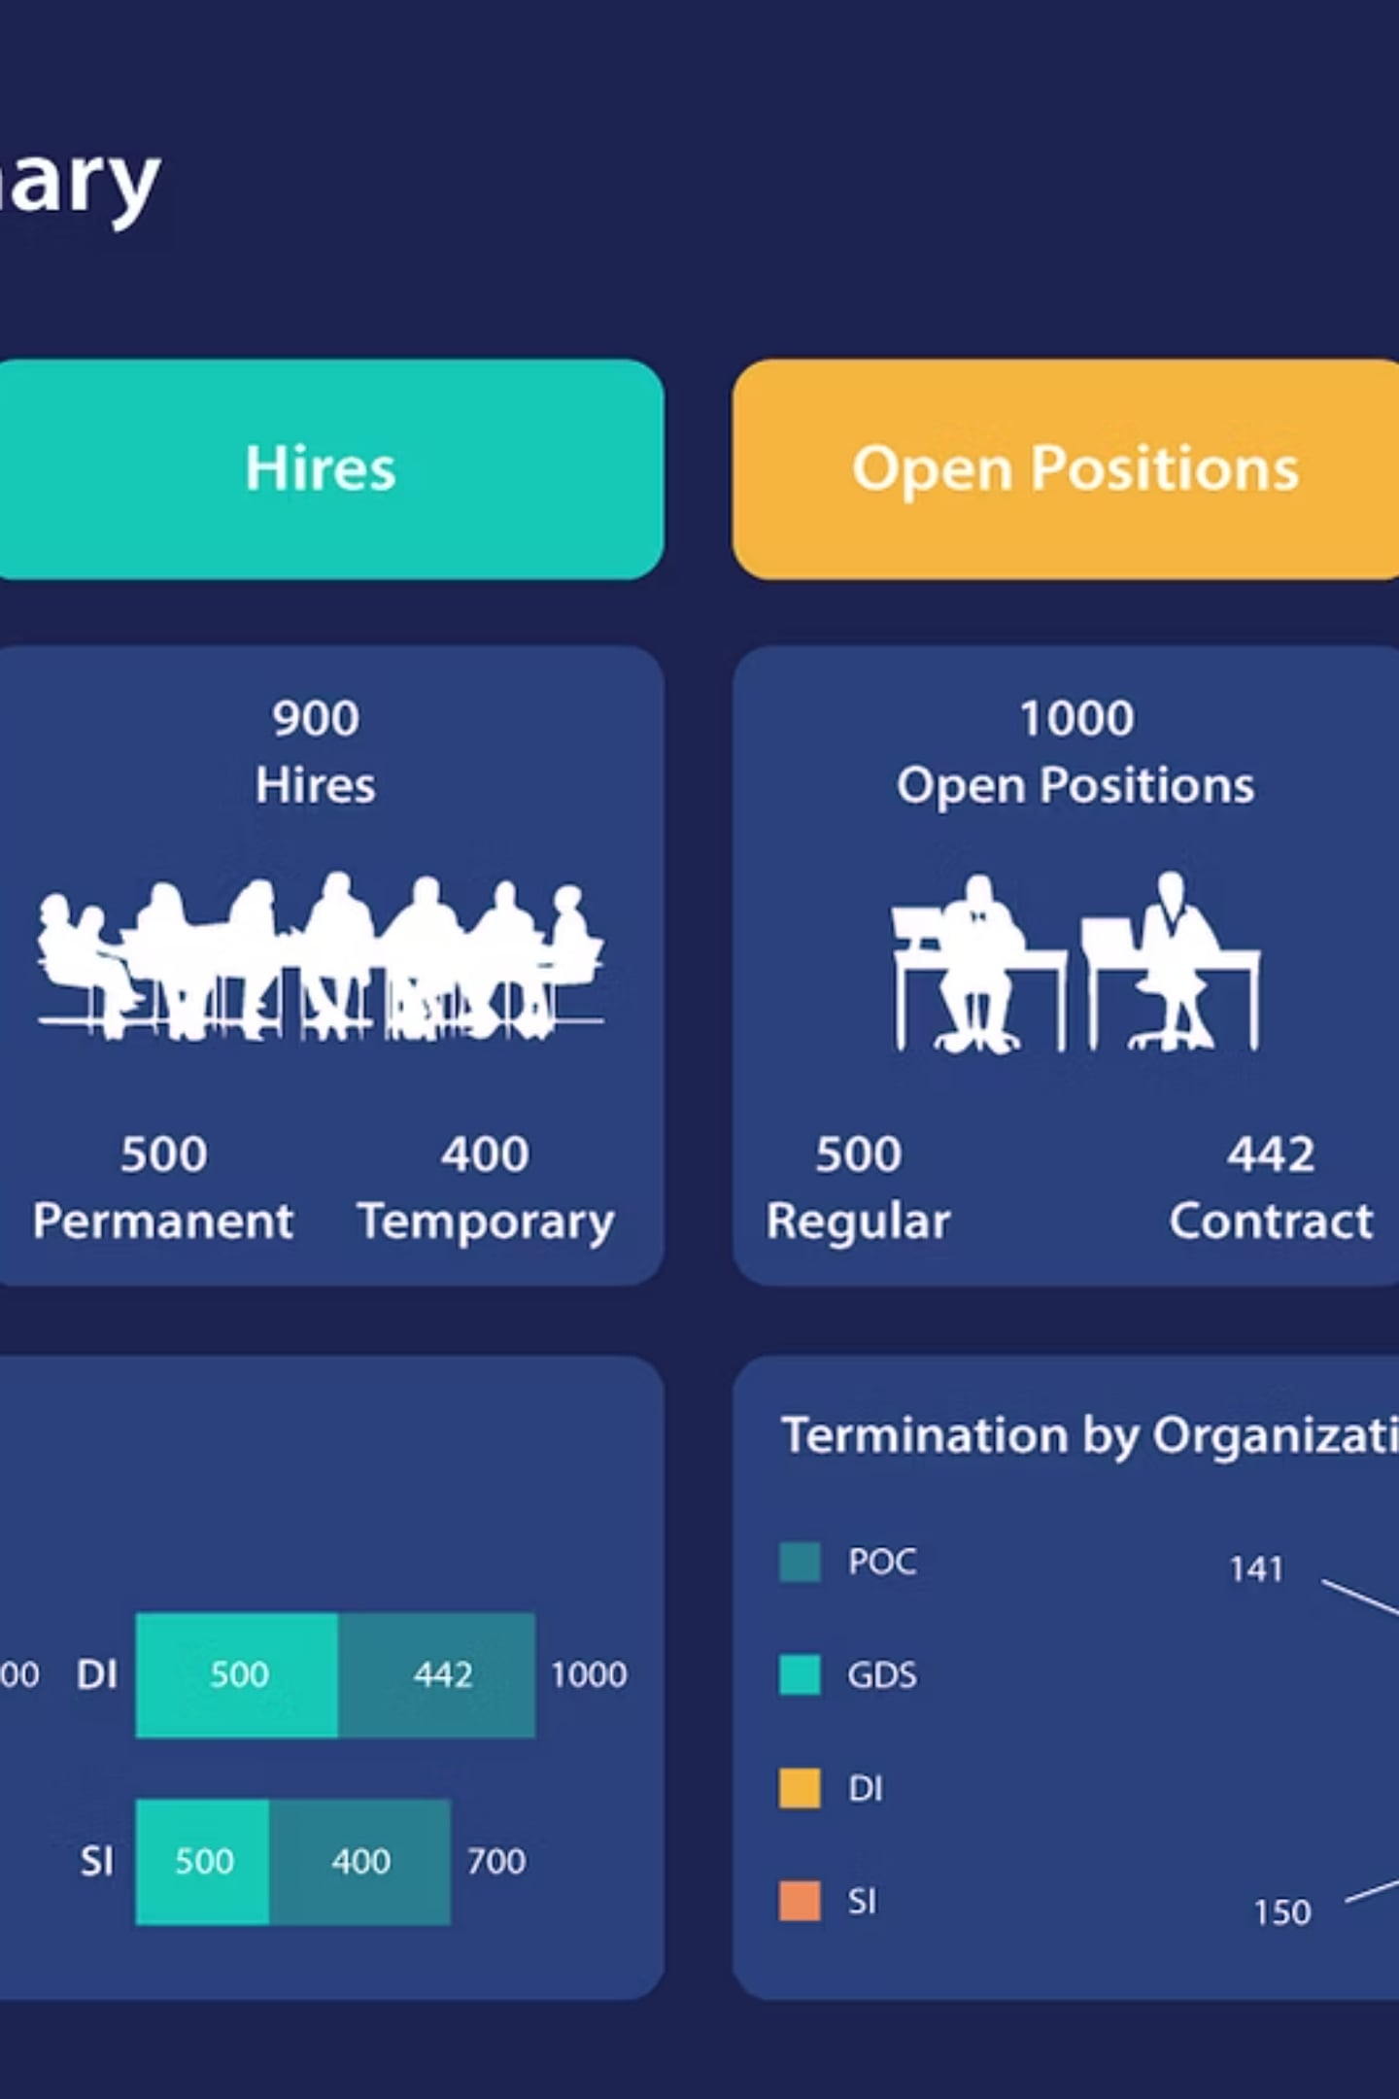
HR Analytics Dashboard
Transforming Workforce Data into Strategic Decisions
Prepared for Executive Leadership | HR Director · CEO · Business Managers · Recruiters
406
Total Employees
20.7%
Attrition Rate
322
Active Workforce
5.23 Yrs
Avg Experience

Slide 2




The Business Problem: Why HR Data Matters Now
Six forces creating a talent crisis — and why the status quo is no longer viable
The Cost of Inaction
Structural Blind Spots
High Attrition Costs
Poor Workforce Planning
Replacing one employee costs 50–200% of their annual salary — unplanned exits drain budgets and strip the organization of institutional knowledge built over years.
Siloed data across departments prevents leadership from seeing headcount gaps, skill shortages, or succession risks until the damage is already done.
Lack of HR Visibility
Low Job Satisfaction
Manual Excel reports delay decisions by weeks. Leadership acts on stale data, not real-time intelligence — a critical handicap in competitive talent markets.
Disengaged employees are 18% less productive and 3× more likely to leave within 12 months. Satisfaction is a leading indicator — not a lagging one.
No Early Warning System
Reactive Hiring
Without attrition signals, organizations lose top performers before retention interventions can be deployed. Prevention costs a fraction of replacement.
Without predictive data, HR teams scramble to fill roles. Average time-to-hire stretches to 42 days, costing $4,700+ per hire in direct and indirect expenses.
At a 20.7% attrition rate — 38% above industry benchmark — inaction compounds talent loss quarter over quarter. Executive intervention is required now.

Slide 3




Project Overview: Building the HR Analytics Engine
One source of truth replacing 10+ manual reports — built for executive-grade decision-making
Technology Stack
Objective
Develop an interactive, executive-grade HR Analytics Dashboard to monitor workforce health in real time across all departments and employee cohorts.
Power BI
Interactive dashboards, drill-through reports, real-time visuals
Scope of Monitoring
Employee Count · Attrition Rate · Department Performance · Demographics · Salary Analysis · Workforce Trends
SQL
Data extraction, transformation, and relational queries across HR systems
Outcome
A single source of truth for HR leadership — replacing 10+ manual reports with one live dashboard refreshed automatically.
Excel + Power Query
Source data management, pivot analysis, and automated ETL pipeline
DAX
Custom KPI calculations — attrition rate, avg. tenure, salary bands
Stakeholders: HR Director, CEO, Department Heads, Talent Acquisition, Finance

Slide 4

Dashboard KPIs: The Six Numbers That Drive Decisions
Every strategic workforce decision anchors to these six metrics — know them, act on them
406
322
Total Employees
Active Employees
Full organizational headcount baseline; benchmarks all workforce ratios and capacity planning
Current productive workforce; gap vs. total (84) signals immediate hiring or retention urgency
84
20.7%
Attrition Count
Attrition Rate
Employees who exited; each departure = lost productivity, knowledge, and recruitment cost
Critically above industry benchmark of 10–15%; every 1% reduction saves ~$200K+ in replacement costs
28.94
5.23
Average Age
Avg Experience (Yrs)
Young workforce signals high growth potential but elevated flight risk — Gen Z and Millennial retention strategies are essential
Mid-early career profile; most vulnerable to poaching — targeted L&D and career pathing are critical retention levers
Benchmark Alert: An attrition rate of 20.7% is 38% above the industry norm of 10–15%. At current trajectory, the organization risks losing 1 in 5 employees every year — a compounding talent debt.

Slide 5
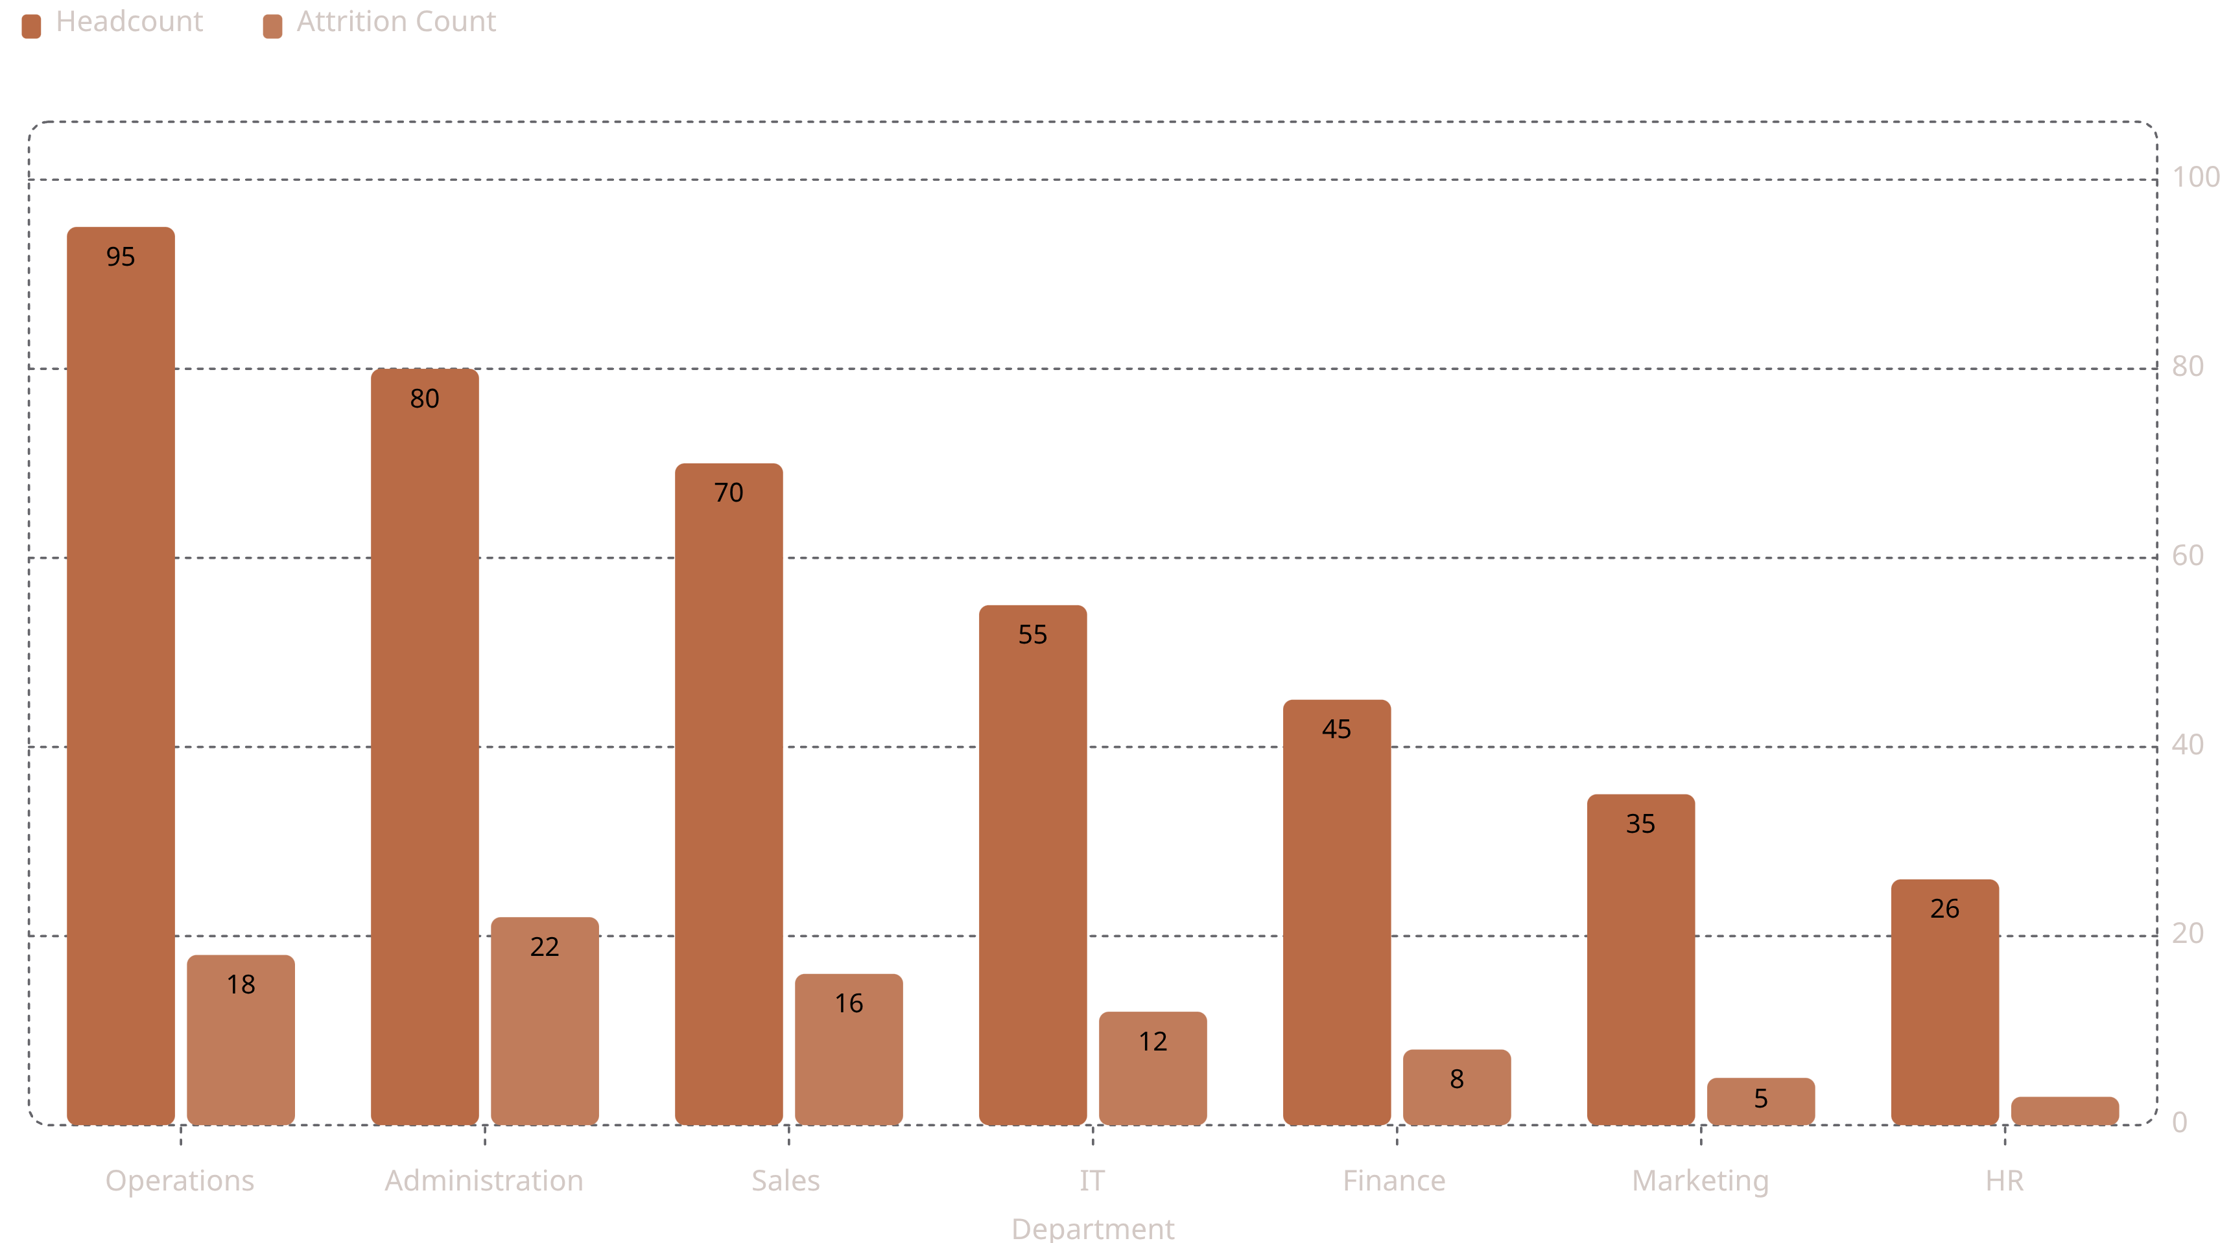
Department Analysis: Where the Workforce Lives and Leaves
Attrition is not an organization-wide problem — it is concentrated in three departments
🔴 Administration
🟡 Sales
🟢 Finance
🟢 HR
Highest attrition despite mid-range headcount. Immediate engagement programs and role clarity reviews required.
Performance pressure and variable compensation drive exits. Recommend commission restructuring and recognition programs.
Stable workforce. Focus on succession planning for senior roles nearing retirement eligibility.
Low attrition — strong internal culture signal. Leverage HR team as change champions for org-wide initiatives.
🟡 IT
⚙️ Operations
Competitive external market drives poaching risk. Counter with career development tracks and remote flexibility.
Largest workforce. Scale demands standardized HR processes and proactive engagement to contain attrition creep.

Slide 6
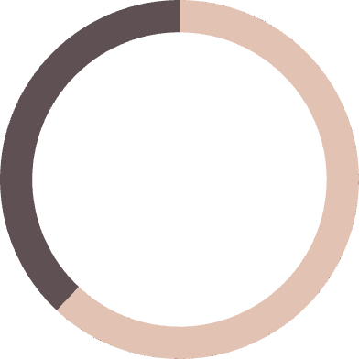
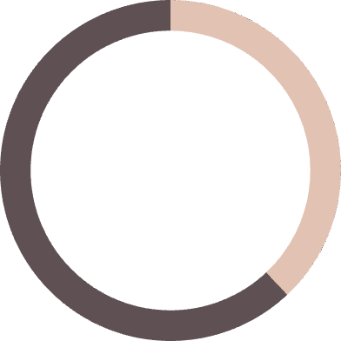
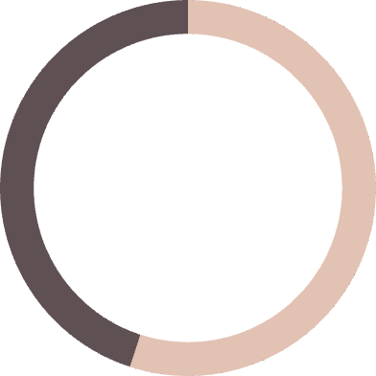
Employee Demographics: Know Your Workforce
Demographics define risk — the 26–35 cohort is your largest asset and your most mobile talent pool
Age Distribution Insight
Gender & Experience Patterns
The majority of employees fall in the 26–35 age band — a high-ambition, high-mobility cohort. Without clear career progression paths, this group will self-select out within 18–24 months of stagnation.
Average age of 28.94 years signals a young, energetic workforce. High adaptability comes paired with high turnover risk unless structured growth opportunities are consistently visible.
Gender Distribution: Slight male majority across the organization. Female employees show higher exit rates in Administration and Sales — a clear signal of inclusion gaps requiring immediate structural review.
Experience Concentration: The 3–7 year tenure band is the most densely populated — and the most dangerous. This is the "mid-career danger zone" where employees reassess trajectories and are most recruitable by competitors.
Hiring Strategy
Succession Planning
Target age-aligned sourcing channels — LinkedIn, campus recruitment, and diversity pipelines to replenish the 26–30 cohort.
Identify high-potential employees in the 30–40 age band for leadership development tracks before they exit to competitors.
Retention Milestones
62%
Design tenure-based milestone recognition at 1, 3, and 5 years to reduce mid-career exits at the critical decision points.
Male Workforce
Slight majority; monitor gender-split attrition by department
38%
Female Workforce
Higher exit rate in Admin and Sales — inclusion programs needed
55%
3–7 Year Tenure
Peak vulnerability band — career plateau triggers external search

Slide 7
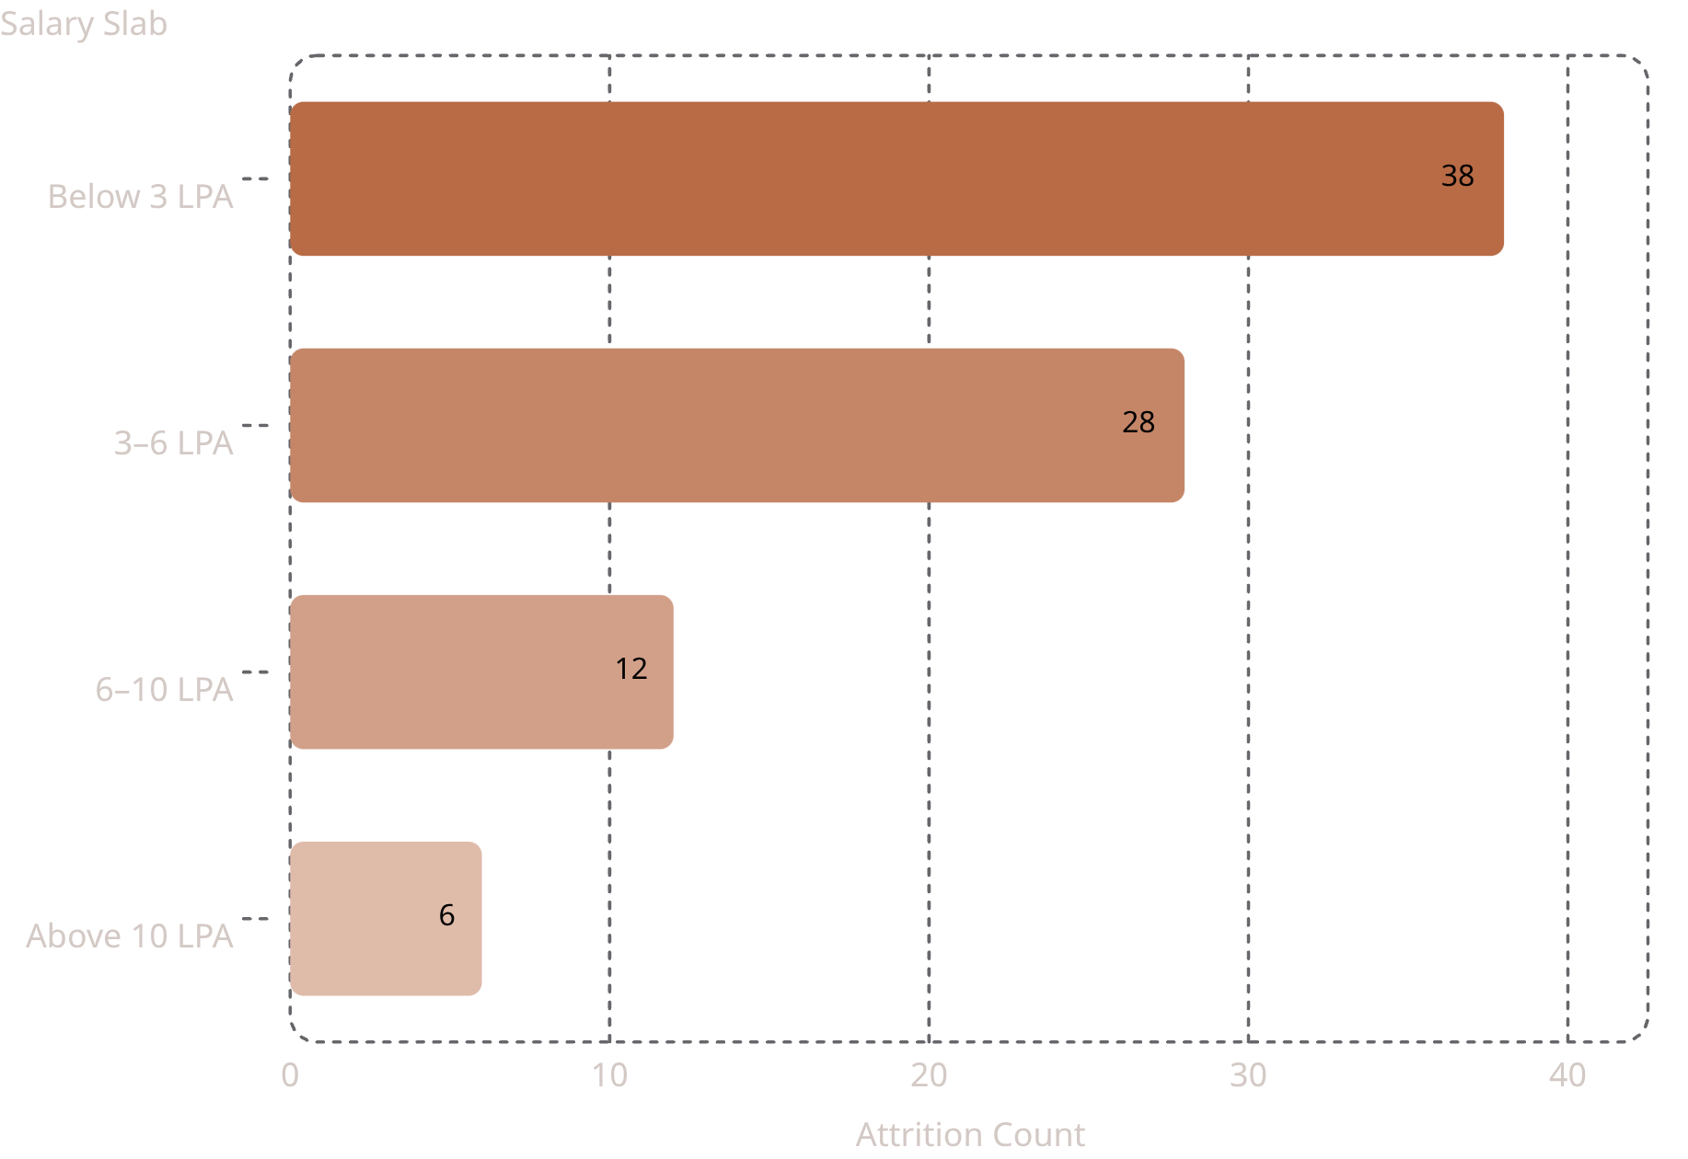


Attrition Analysis: Decoding Why Employees Leave
Lower salary + low satisfaction = highest attrition risk — the data leaves no ambiguity
By Experience
By Job Satisfaction
Mid-level employees with 3–7 years' tenure show peak attrition. The "5-year cliff" — where career stagnation triggers active job searches — is real and measurable.
Employees rating satisfaction 1–2 out of 4 are 3× more likely to leave. Satisfaction scores are a leading indicator — act before resignations, not after.
By Job Role
Predictability Factor
Roles including Sales Executive and Lab Technician show disproportionately high turnover. Role-specific retention plans are more cost-effective than blanket programs.
80% of exits show 3+ warning signals 6 months prior. Attrition is not random — it is predictable, preventable, and measurable with the right data infrastructure.
Employees earning below 6 LPA account for 79% of all attrition (66 of 84 exits). Compensation is the #1 exit driver — salary benchmarking against market rates is urgent. Note: LPA = Lakhs Per Annum; data reflects estimated proportions from dashboard visuals.

Slide 8
Executive Insights: 10 Data-Driven Findings
Ten findings that demand executive attention — each backed by data, each linked to business impact
🔴 Administration Leads Exits
💰 Below-6 LPA = 3× Turnover
~26% of all exits despite not being the largest department. Immediate targeted intervention required.
Compensation gap is the single most actionable lever. 79% of attrition concentrated in lowest salary bands.
👥 26–35 Age Group Dominates
😞 Satisfaction Predicts Exits
High-potential but high-flight-risk. Gen Z / Millennial retention is a strategic board-level priority.
Scores of 1–2 out of 4 correlate directly with resignation within 6 months. Act before it's too late.
⚧ Gender Attrition Gaps
📈 Mid-Career Cliff at 5–7 Yrs
Female attrition higher in Administration and Sales. Inclusion and flexibility programs needed urgently.
Career plateau effect triggers external searches. Structured IDPs at this stage can retain top talent.
🏭 Operations: Scale Risk
🎯 Attrition is Concentrated
Largest workforce demands standardized HR processes and proactive engagement before attrition scales up.
3 departments account for 70%+ of exits. Targeted fixes yield outsized ROI versus org-wide programs.
⏱️ 5.23 Yrs: Retention Window
📊 20.7%: 38% Above Benchmark
Structured 5-year career milestones at this average tenure can meaningfully extend retention curves.
Industry norm is 10–15%. Compounding talent loss is underway. Immediate executive action required.

Slide 9

Strategic Recommendations: The 9-Point Retention Roadmap
A sequenced, measurable action plan to reduce attrition by 15–25% within 12 months
1. Salary Benchmarking
1
Conduct market compensation analysis — bring below-6 LPA roles to competitive parity within Q1
2
2. Career Development
Launch structured Individual Development Plans (IDPs) for all employees at 3–7 year tenure mark
3. Pulse Surveys
3
Implement quarterly engagement surveys; act on results within 30 days to build trust and reduce silent attrition
4
4. L&D Investment
Deploy upskilling programs — employees with active L&D access show 34% lower attrition (LinkedIn 2024)
5. Recognition Programs
5
Peer-to-peer and manager recognition platforms; milestone rewards at 1, 3, and 5 years of service
6
6. Employee Wellness
Mental health support, flexible work arrangements, and Employee Assistance Programs (EAP)
7. Manager Training
7
Train frontline managers on retention conversations — 70% of employee engagement is driven by direct managers
8
8. Internal Mobility
Create visible internal job boards; prioritize internal candidates before external hiring to reduce cost-to-fill
9. Predictive Monitoring
9
Deploy ML-based attrition risk scoring in Power BI — flag at-risk employees 6 months before likely exit
Implementation Sequence: Steps 1–3 are immediate (0–90 days). Steps 4–6 are medium-term (Q2–Q3). Steps 7–9 are structural investments for sustained competitive advantage.

Slide 10
Business Impact: Measurable Value from HR Analytics
For a 406-person organization at 20.7% attrition — the financial case for HR Analytics is undeniable
15–25%
20%
Attrition Reduction
Retention Improvement
Targeted retention programs in high-risk departments eliminate the most preventable exits first
Career development + compensation alignment extends average tenure by 1.5–2 years per employee
18%
15%
Productivity Increase
Hiring Cost Reduction
Stable, engaged teams outperform high-turnover environments — reduced onboarding drag, stronger continuity
Lower attrition + internal mobility reduces external recruitment spend and agency fees significantly
25%
90%
Satisfaction Improvement
Faster HR Reporting
Data-driven engagement interventions move satisfaction scores from reactive firefighting to proactive design
Power BI dashboard replaces 10+ manual reports — HR decisions made in hours, not weeks
$1.2M – $2.4M Estimated Annual Savings
A 20% reduction in attrition across a 406-person organization at 20.7% exit rate — factoring replacement, onboarding, and lost productivity costs — delivers $1.2M to $2.4M in annual savings. HR Analytics is not a cost center. It is the highest-ROI investment on the talent agenda.
Next Step: Pilot
Next Step: Measure
Next Step: Scale
Deploy dashboard in Administration and Sales first — highest ROI departments for rapid proof of value
Baseline current attrition KPIs and track 90-day movement against retention program milestones
Expand predictive attrition scoring org-wide by Q3 — full ML integration with Power BI live refresh

