Slide 1








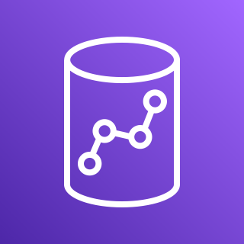



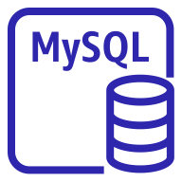
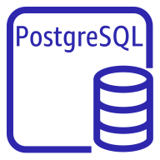
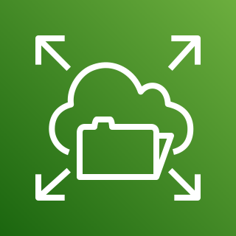
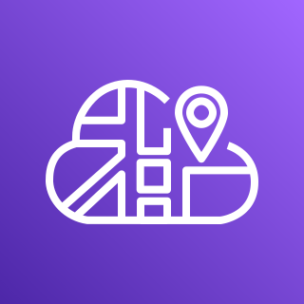
Client
AWS Cloud
Connected Dataset
Internet gateway
VPC
Availability Zone
Availability Zone
Public subnet
Public subnet
Amazon Athena
Application Load Balancer
NAT gateway
NAT gateway
Amazon Redshift
Private subnet
Private subnet
Fargate for ECS
ClickHouse
Redis
Node
Init
Superset
Celery Worker
Celery Beat
DB
MySQL
PostgreSQL
Amazon EFS
AWS Cloud Map

