Slide 1








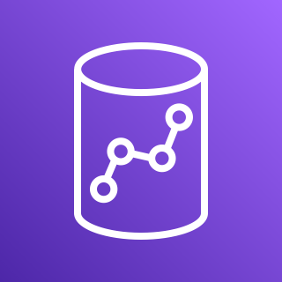

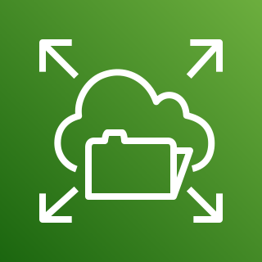


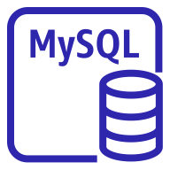
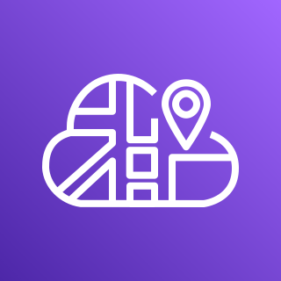

AWS Cloud
Availability Zone 1
Availability Zone 1
VPC
Connected dataset
Client
Internet gateway
Public subnet
Application Load Balancer
Public subnet
Amazon Athena
NAT gateway
NAT gateway
Private subnet
Private subnet
Amazon Redshift
Fargate for Amazon ECS
Amazon EFS
Redis
Node
Init
Redis
Node
Init
ClickHouse
Superset
Celery Beat
Database
Superset
Celery Beat
Database
MySQL
instance
AWS Cloud Map
Celery Worker
Celery Worker
PostgreSQL instance

