Slide 1
SPRINGHUB
Community-Driven Spring Restoration Platform
Full-Stack Portfolio · Ayatullah Reza Chalid
Next.js · PostgreSQL · Redis · Docker · Xendit
SpringHub Portfolio · Ayatullah Reza Chalid · 1/14

Slide 2
THE BIG PICTURE
Masalah
Solusi
70% mata air Indonesia terancam kritis. Erosi, alih fungsi lahan, dan tidak ada data terpusat membuat upaya restorasi sulit dilakukan secara terukur.
Platform berbasis komunitas yang memungkinkan siapa pun melaporkan kondisi mata air, mendapatkan poin, mendanai proyek restorasi, dan memantau dampak secara transparan.
Dampak
✅ Warga bisa melaporkan kondisi mata air dalam 5 menit
✅ Setiap laporan diverifikasi +24 jam oleh admin
✅ Donasi tersalurkan langsung ke proyek spesifik
✅ Poin & reward system untuk volunteer aktif
✅ Peta interaktif real-time untuk monitoring publik
SpringHub Portfolio · Ayatullah Reza Chalid · 2/14

Slide 3
SYSTEM ARCHITECTURE
Cloudflare
Nginx
Next.js 14
PostgreSQL 16
DNS · Proxy · WAF
Reverse Proxy · SSL · Rate Limit
App Router · SSR · 54 API Routes
Prisma ORM · 16 Models · RLS
Redis 7
BullMQ Worker
Docker
Xendit
Cache · Queue · Rate Limit
Email · Sync · Points Engine
5 Containers · Healthcheck · Compose
Invoice · Webhook · HMAC
Browser → Cloudflare → → Nginx (443) → → Next.js SSR → → PostgreSQL/Redis
SpringHub Portfolio · Ayatullah Reza Chalid · 3/14

Slide 4
BACKEND STACK
[object Object],[object Object][object Object],[object Object][object Object],[object Object][object Object],[object Object][object Object],[object Object][object Object],[object Object]
SpringHub Portfolio · Ayatullah Reza Chalid · 4/14

Slide 5
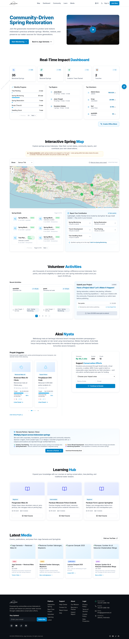
FRONTEND STACK
[object Object],[object Object][object Object],[object Object][object Object],[object Object][object Object],[object Object][object Object],[object Object][object Object],[object Object]
SpringHub Portfolio · Ayatullah Reza Chalid · 5/14

Slide 6
FITUR UTAMA
[object Object],[object Object][object Object],[object Object][object Object],[object Object][object Object],[object Object][object Object],[object Object][object Object],[object Object]
SpringHub Portfolio · Ayatullah Reza Chalid · 6/14

Slide 7
KEAMANAN
[object Object],[object Object][object Object],[object Object][object Object],[object Object][object Object],[object Object][object Object],[object Object][object Object],[object Object][object Object],[object Object][object Object],[object Object]
SpringHub Portfolio · Ayatullah Reza Chalid · 7/14

Slide 8
INFRASTRUKTUR & DEVOPS
Hostinger VPS → Docker Compose → 5 container
Cloudflare: DNS, proxy, WAF, SSL termination
Nginx: reverse proxy, rate limiting, caching, security headers
PostgreSQL: connection pooling (PgBouncer), daily pg_dump backup
Redis: requirepass, session cache, BullMQ queue
fail2ban: DOCKER-NGINX jail untuk blocking IP abuse
Healthcheck: Docker HEALTHCHECK tiap container + heartbeat monitoring
Backup: cron daily 3am pg_dump, rotated 7 hari
CI/CD: push ke GitHub → docker compose build → compose up -d
SpringHub Portfolio · Ayatullah Reza Chalid · 8/14

Slide 9
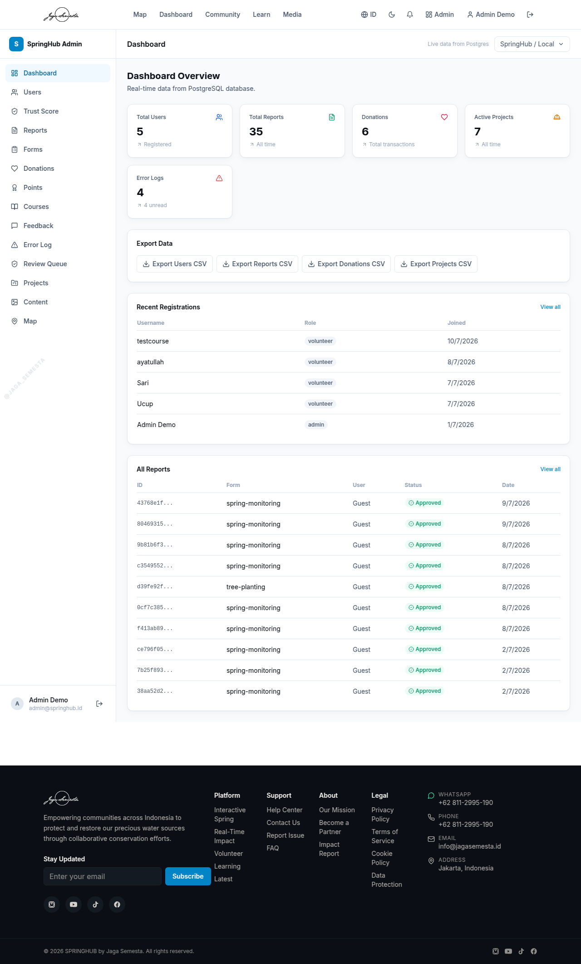
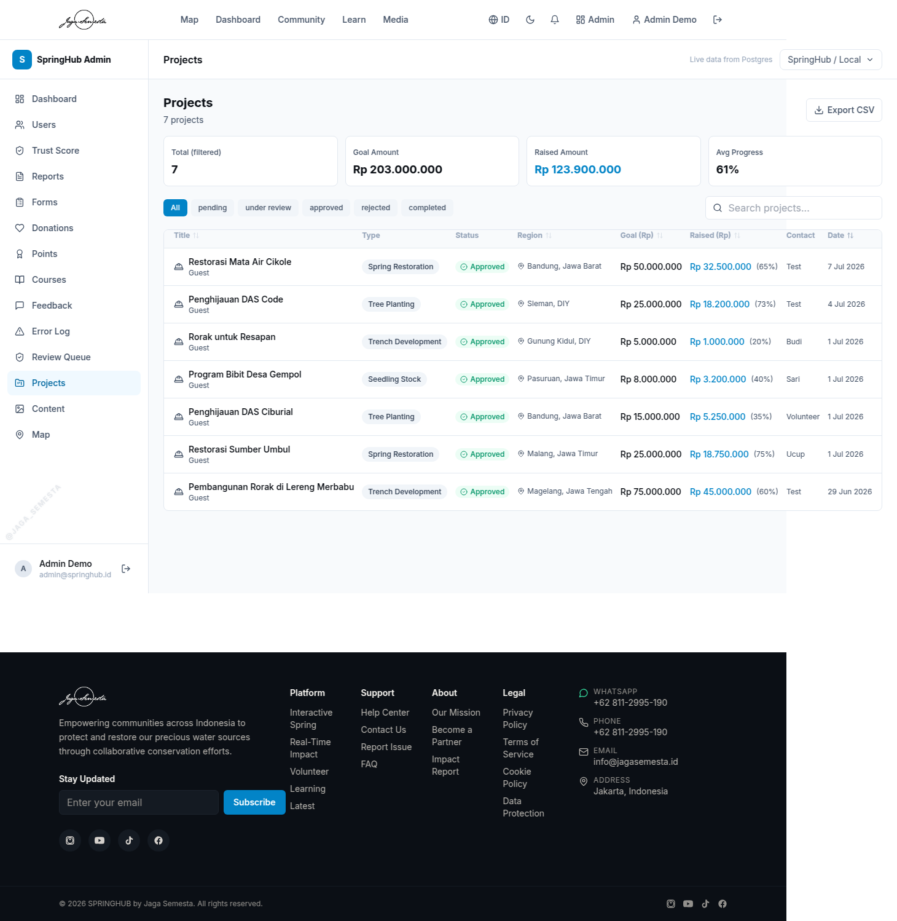
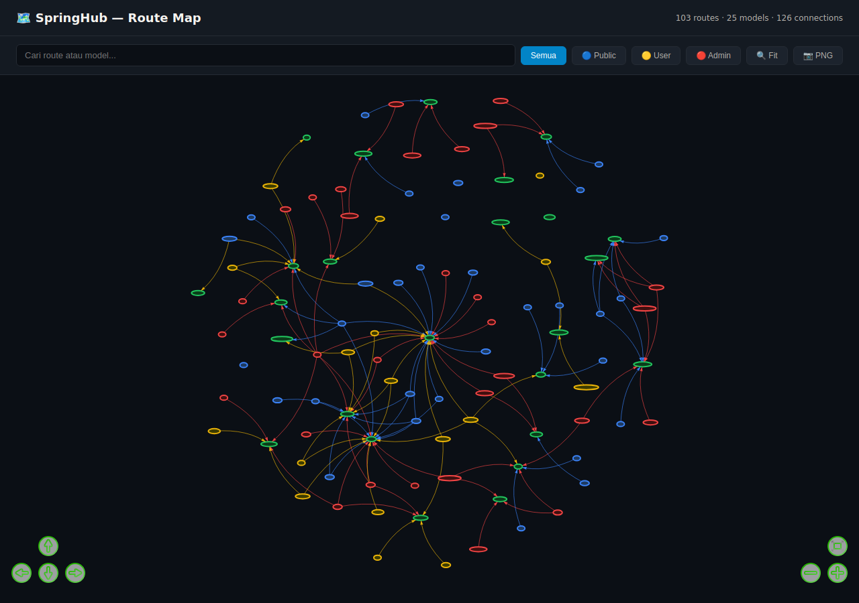
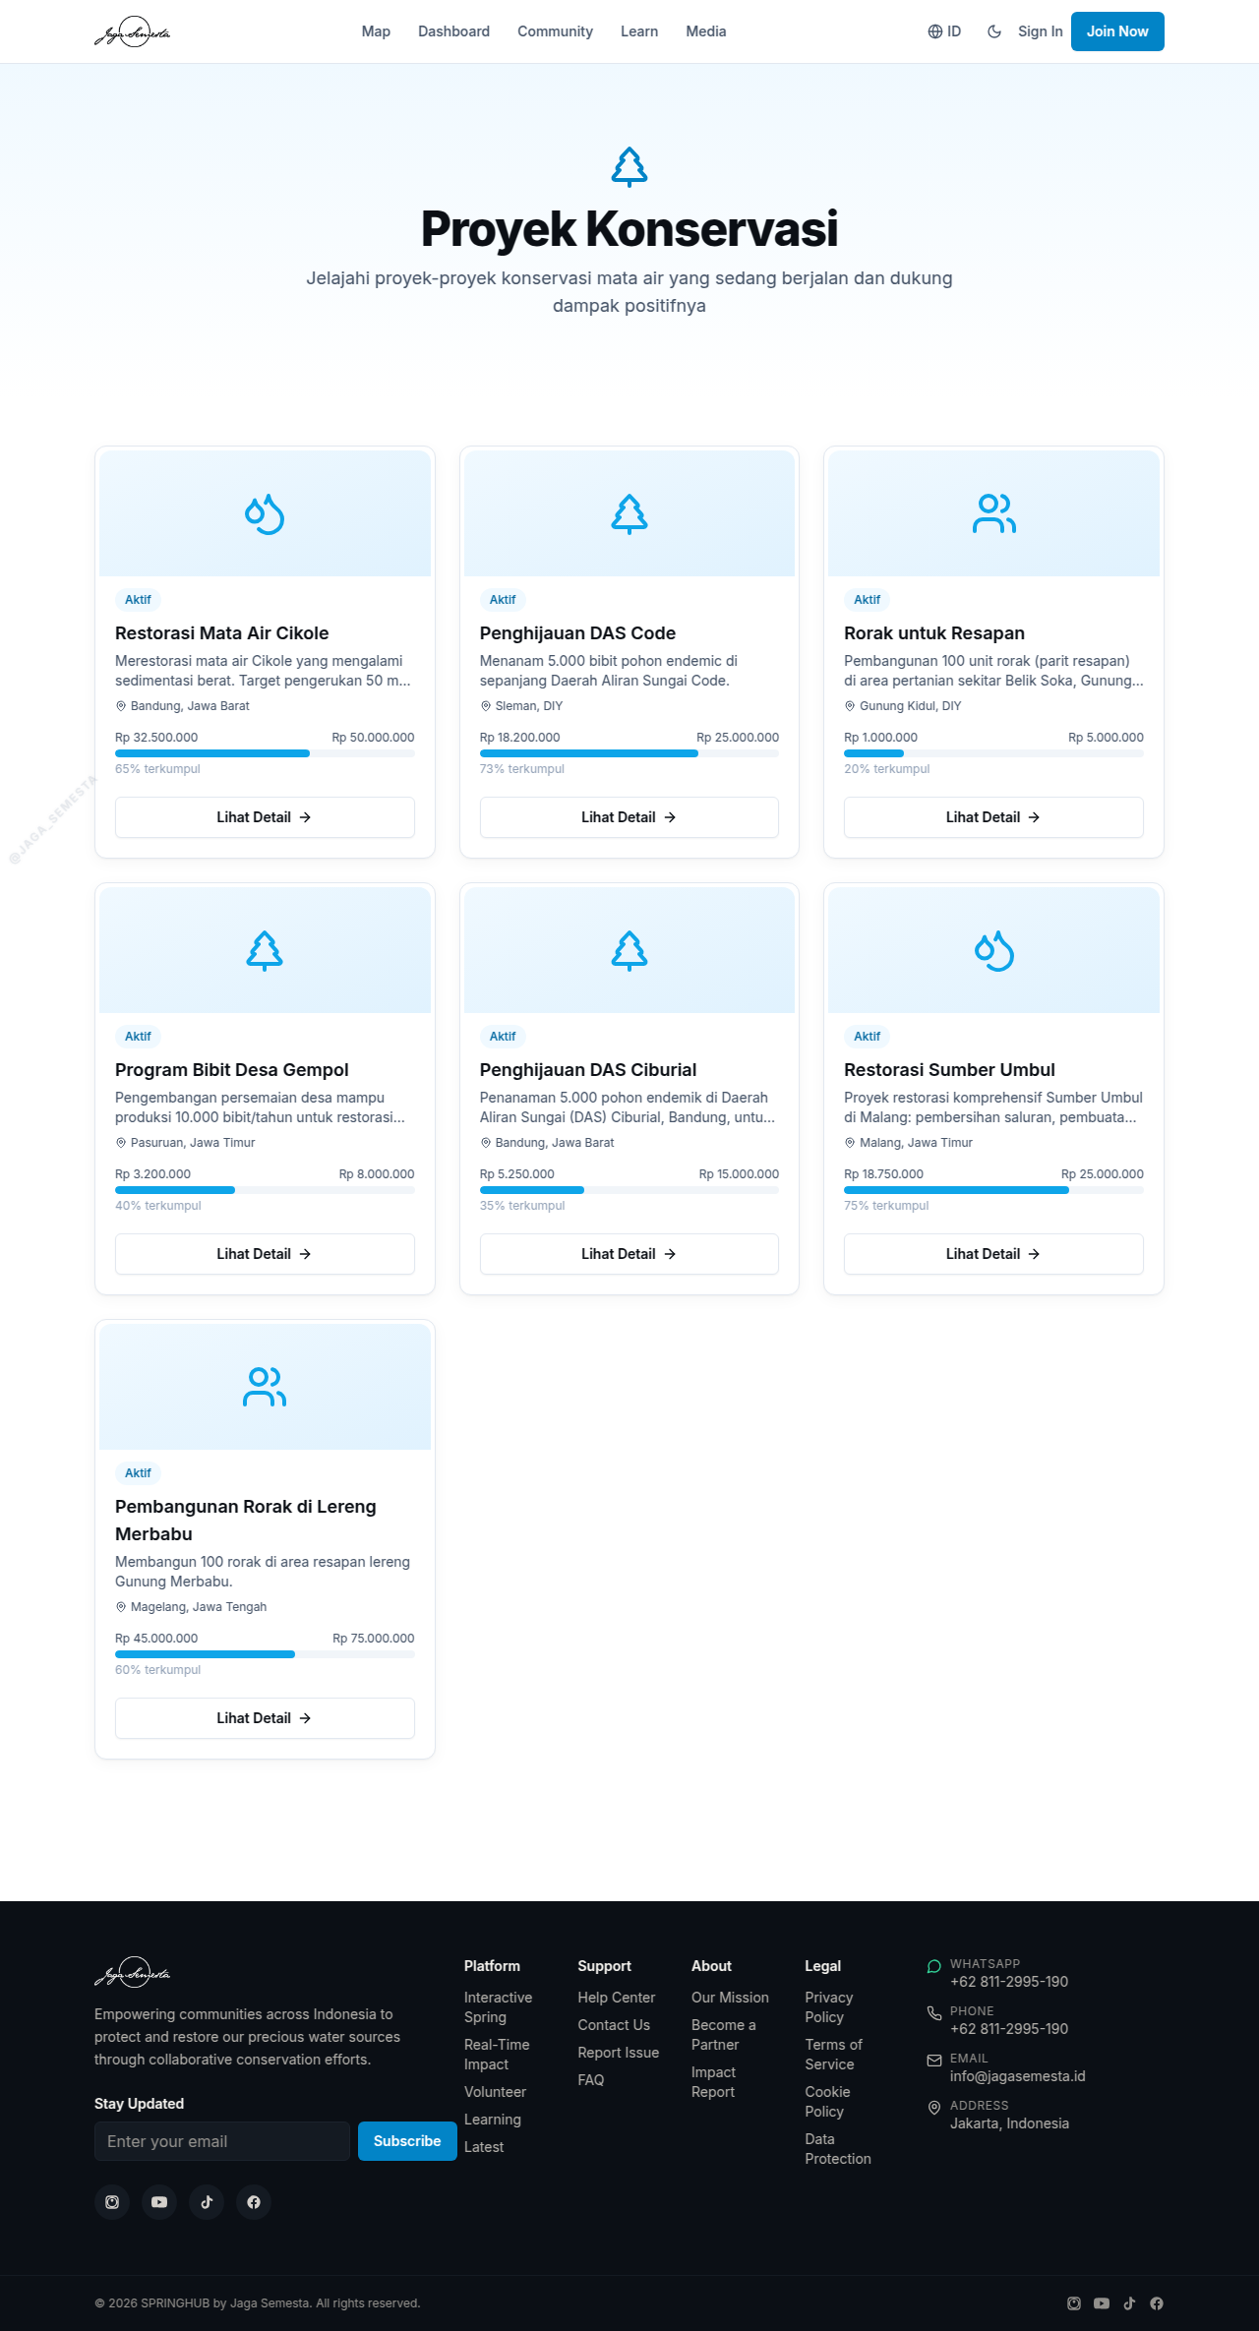
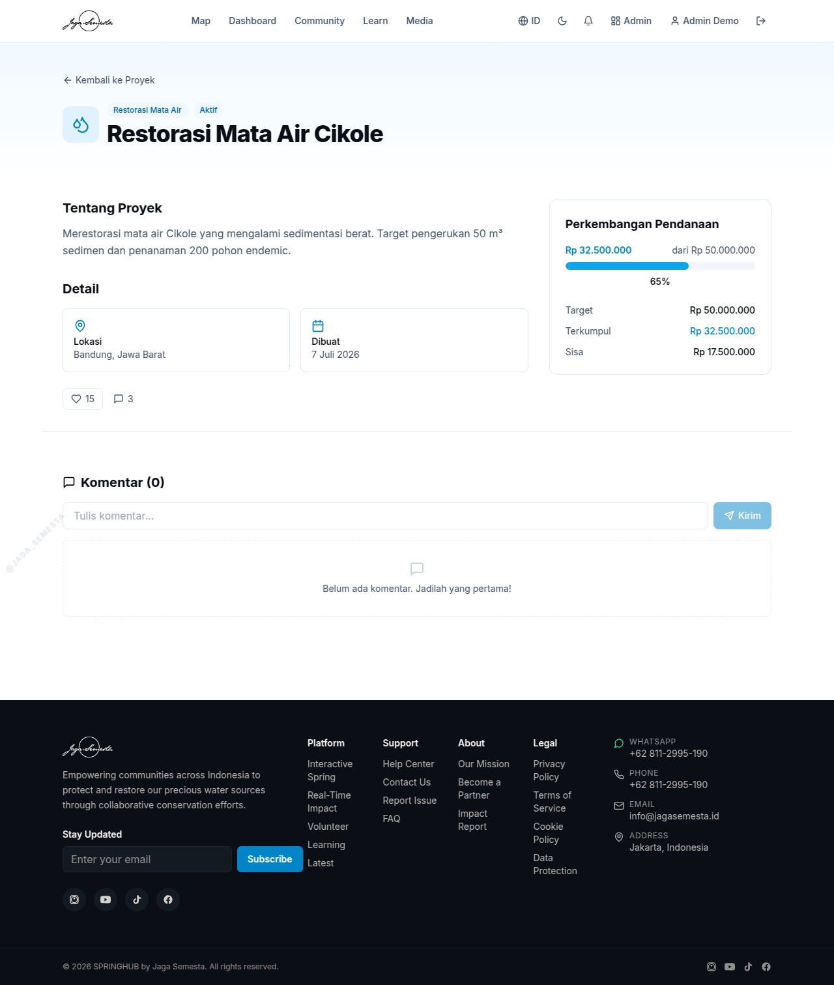
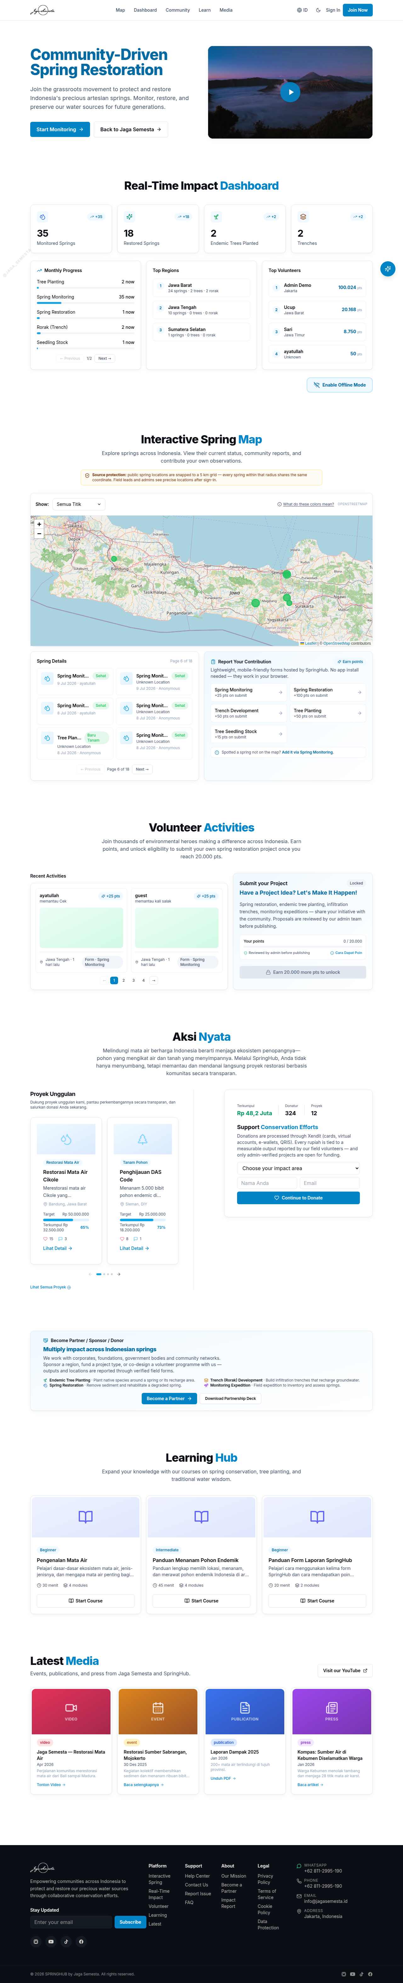
SCREENSHOTS
Admin Dashboard
Admin — Projects
API Route Map
Projects List
Project Detail
Featured + Donate
SpringHub Portfolio · Ayatullah Reza Chalid · 9/14

Slide 10
DATABASE SCHEMA
Profile (22) — User, roles, points, trust score, 2FA secret
Report (11) — Field data, snapped+precise location, status, photos
Project (16) — Title, goal, raised, likes, status, contact info
Donation (12) — Amount, tier, status, Xendit invoice, project FK
PointsLog (6) — Amount, reason, metadata, user FK + report FK
Comment (4) — Text, user FK, project FK
Like (4) — User FK, project FK (unique constraint)
Notification (7) — Type, message, isRead, user FK
Course + Module (8) — Slug, title, modules, progress tracking
Form + Field — Dynamic forms, field types, map type FK
ContentBlock — CMS sections: media, projects, stats
AppError — Error logging, level, source, stack, read status
SpringHub Portfolio · Ayatullah Reza Chalid · 10/14

Slide 11
API SURFACE
Auth (7)
login, register, logout, me, forgot/reset, claim-guest
Projects (4)
GET list, GET detail, POST create, POST like, comments
Donations (2)
POST invoice (CSRF), POST webhook (HMAC)
Reports (6)
GET/POST reports, upload/delete photos, forms
Courses (3)
GET courses, GET detail, PUT progress + points
Public (14)
map, spring, gallery, leaderboard, dashboard, newsletter, feedback
Admin (25)
CRUD users, reports, forms, courses, content, points, map, export
SpringHub Portfolio · Ayatullah Reza Chalid · 11/14

Slide 12
CHALLENGES & SOLUTIONS
[object Object],[object Object][object Object],[object Object][object Object],[object Object][object Object],[object Object][object Object],[object Object][object Object],[object Object]
SpringHub Portfolio · Ayatullah Reza Chalid · 12/14

Slide 13
TESTING & QUALITY
[object Object],[object Object][object Object],[object Object][object Object],[object Object][object Object],[object Object][object Object],[object Object][object Object],[object Object]
CI: GitHub push → Docker build → typecheck → lint → deploy
SpringHub Portfolio · Ayatullah Reza Chalid · 13/14

Slide 14
TERIMA KASIH
Built with passion for Indonesia's water security
Ayatullah Reza Chalid
Full-Stack Engineer
Live: springhub.id · GitHub: github.com/Ayatull4h/springhub
SpringHub Portfolio · Ayatullah Reza Chalid · 14/14

