Slide 1

MINI PROJECT – II
2019
Design and implementation of Android
Application for easy driving

Slide 2
Supervised By Mr. Neeraj Khanna
Assistant professor Training Department of Computer Engineering & Applications
Team Members Ayaz Khan (161500154) Honey Vishwakarma (161500243) Shivangi Tripathi (161500278) Zaved Alam (161500646)

Slide 3
Presentation outline
Introduction
Objectives
Academic Objectives
Application Technology Platform
Reason for chossing Android
Android Lifecycle
System Features
Application Snapshots
Future Work
Learning from Project
Conclusion
Q&A

Slide 4
Introduction
Driving a vehicle is a very careful task. It requires a level of expertise and license along with the documents. As a vehicle owner, you are responsible for keeping your vehicle in roadworthy condition as well as presenting it for roadworthiness testing. It requires documents/ certificate for proof.
Carrying all the documents and certificates daily is challenging. Sometimes people lose or forget them to carry. Suppose the vehicle is stolen, we lose our documents too as we tend to keep the documents inside the vehicle.

Slide 5
Objectives
To develop an android application for the necessary documents requires. By the help of this application we won’t need to worry about carrying and thus losing our documents. We could also save our time and money to obtain a new document.

Slide 6
Academic Objectives
Learn the process of the mobile application development.
Understand how Android applications work, their life cycle.
Design and develop useful Android applications with compelling user.
Learning Android's APIs for data storage, retrieval, user preferences, files, databases, and content providers.
Utilize the power of back ground services , threads , and notifications.
Finally, develop a Drivezy system for android platform.

Slide 7
Technology Platform
User Interface : Mobile or Tablet
Application development framework : Android
Developing language : Java
User Interface Language : XML
Android API level : 10 and above.
Android Emulator : SDK Version 2.2 or higher
Database : Google Firebase

Slide 8
Reason for Choosing Android
Android is open source.
All development tools for android is free.
Development is possible most OS platform where iOS development is possible only on MAC and all tools are not free.
Most of the smart phone users in India share using Android since to reach maximum users we choose android as app development platform.
Huge resource available.

Slide 9
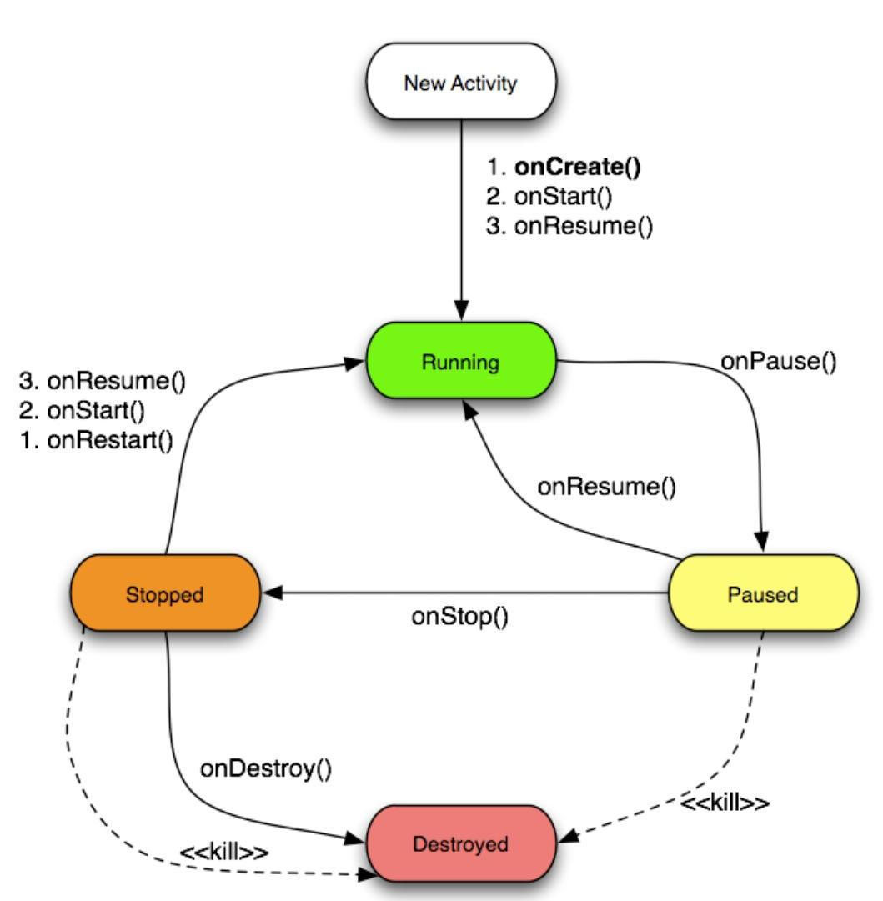
Android Lifecycle

Slide 10
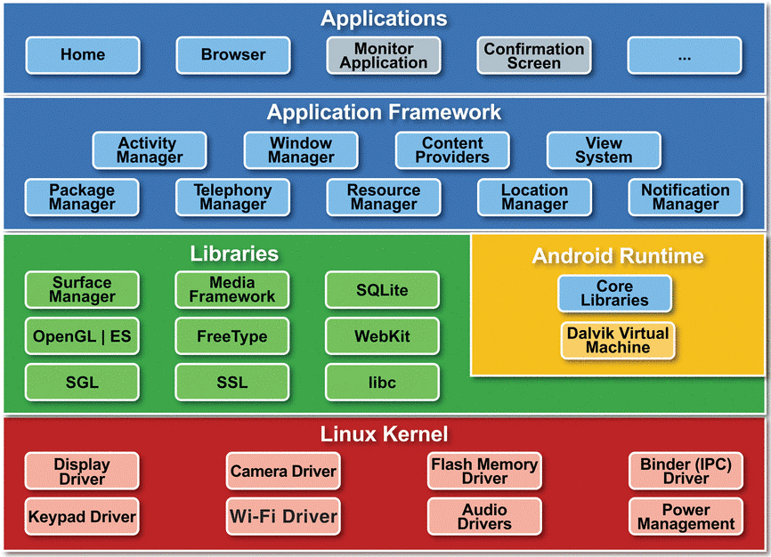
Android Architecture

Slide 11
Android Application Components
Activities - visual user interface focused on a single thing a user can do
Services - no visual interface–they run in the background
Broadcast Receivers - receive and react to broadcast announcements.
Content Providers - allow data exchange between applications.

Slide 12
System Features
Traffic Police Login :- Traffic police will login with his/her ID and password.
View Vehicle and Driver Location :-Admin can view vehicle and driver location.
Registration :- Admin will register the driver by entering driver details.
User Login :- User can login with user ID and password.
Service Entry :- A servicing Entry for misused to maintain the servicing data for each vehicle in per month.
Beneficiary :- Beneficiary can check his/her authority of driving vehicle.

Slide 13
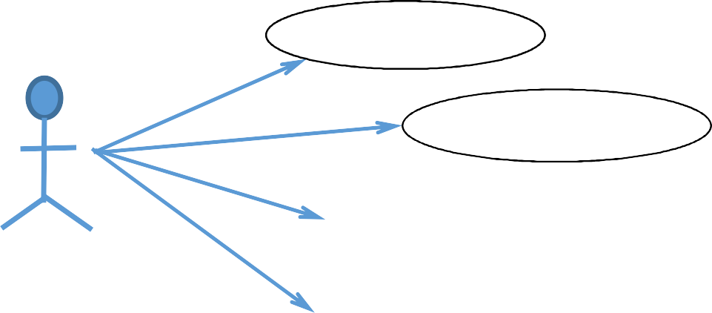

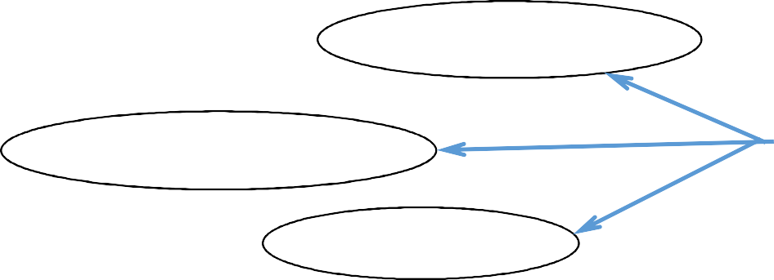

Use Case Diagram
Search Vehicle
Check Beneficiary
Verify Documents
TrafficPolice
Search Faculty Detail
Login
AddDocumentsDetail
AddBeneficiary
Owner

Slide 14
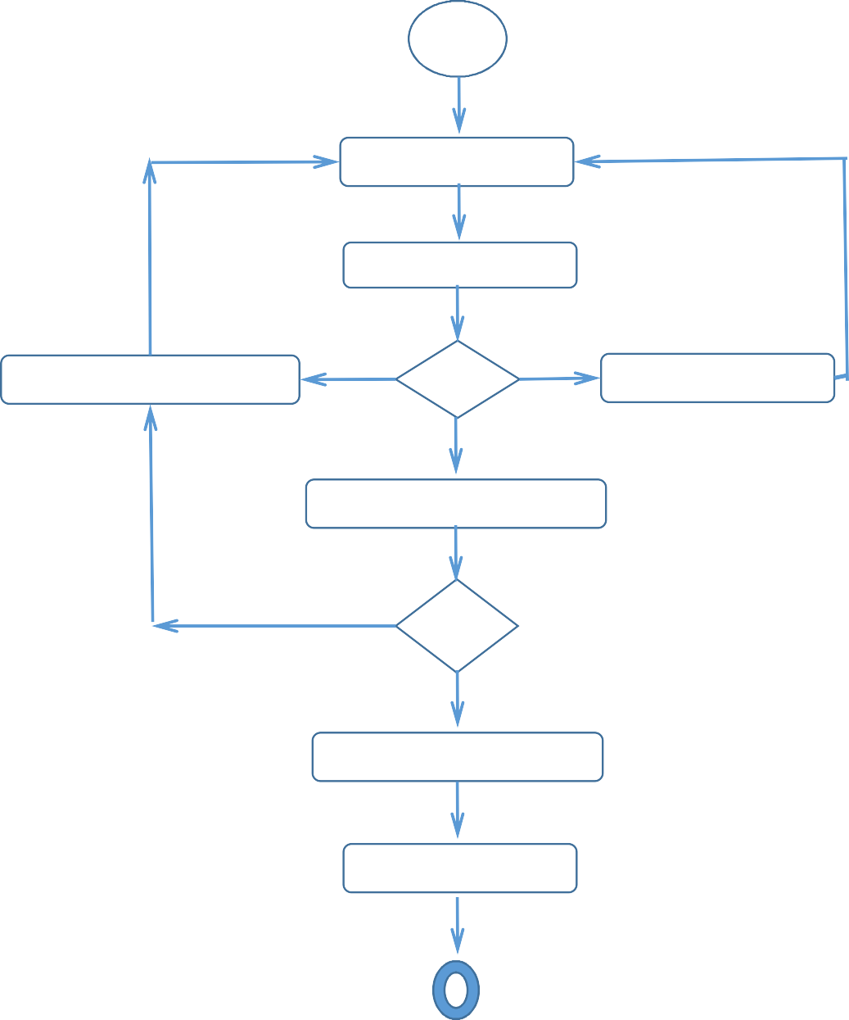
Flow Diagram
EnterUserID
EnterPassword
FillTheManadatoryField
IDPaddNotValid
VerificationMandatoryField
Add/Remove Beneficiary
AddDocument

Slide 15
Application Snapshots
This chapter highlights the results of the project & the snapshots for each of the activities are shown along with the discussion of each activity describing its working .
Each snapshot describes every single step of the “Drivezy Application”.

Slide 16
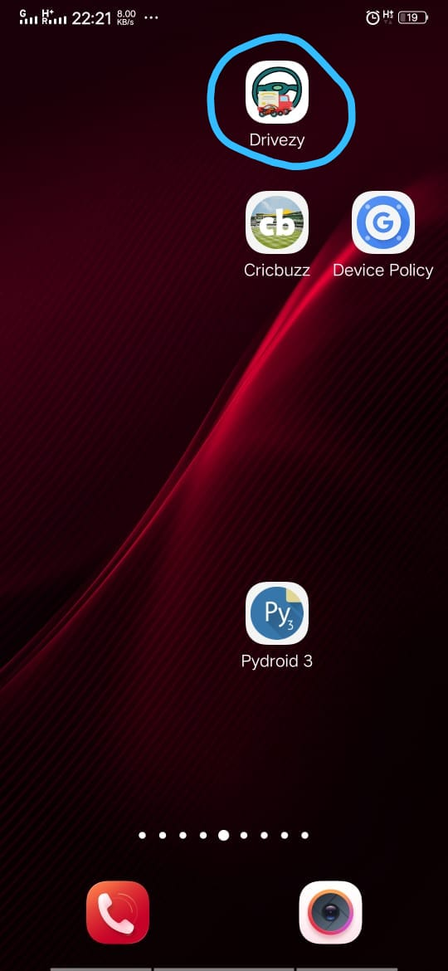
Snapshot
The blue marked item represent the Drivezy application ,on clicking it would open the application Which result the creation of main activity.

Slide 17
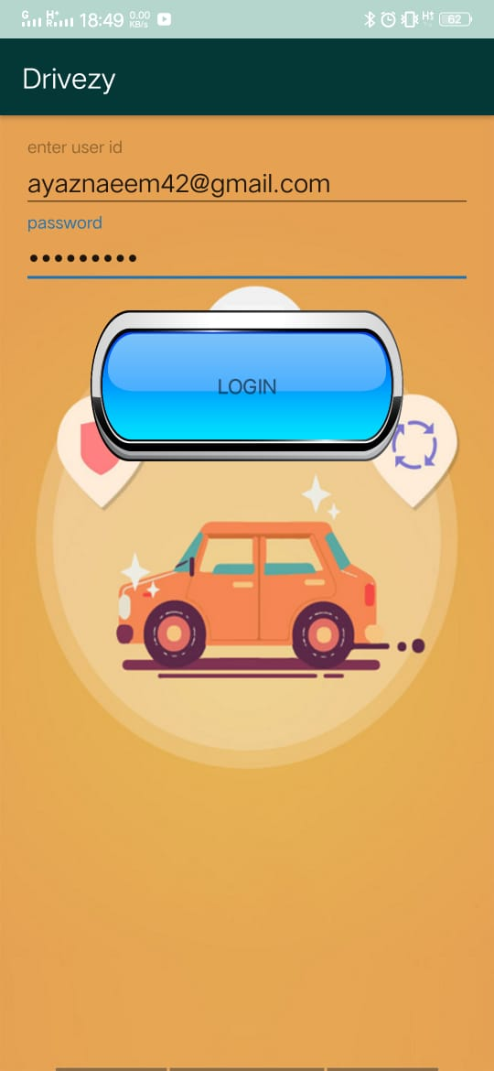
Snapshot(Continued)
After app main activity launched if user click RTO Button of device,the login screen will be appeared.

Slide 18
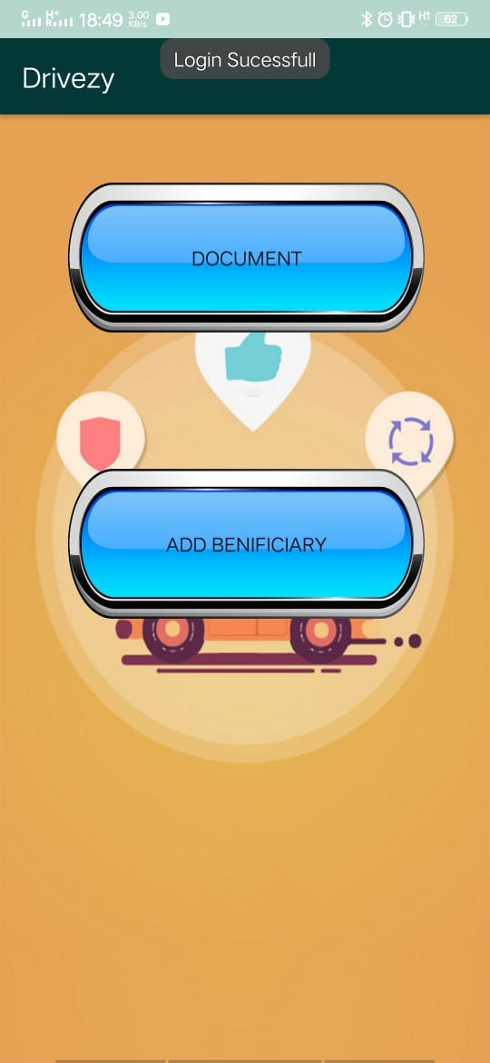
Snapshot(Continued)
After Successfully login ,User or customer may get their documents of vehicle or he/she may add there benificiary of there vehicle.

Slide 19
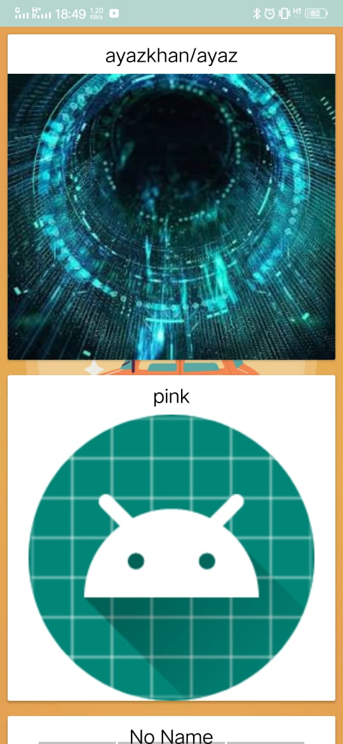
Snapshot(Continued)
In device list activity,there is an option for documents ,on clicking over documents,We may get our all documents related to your vehichle.

Slide 20
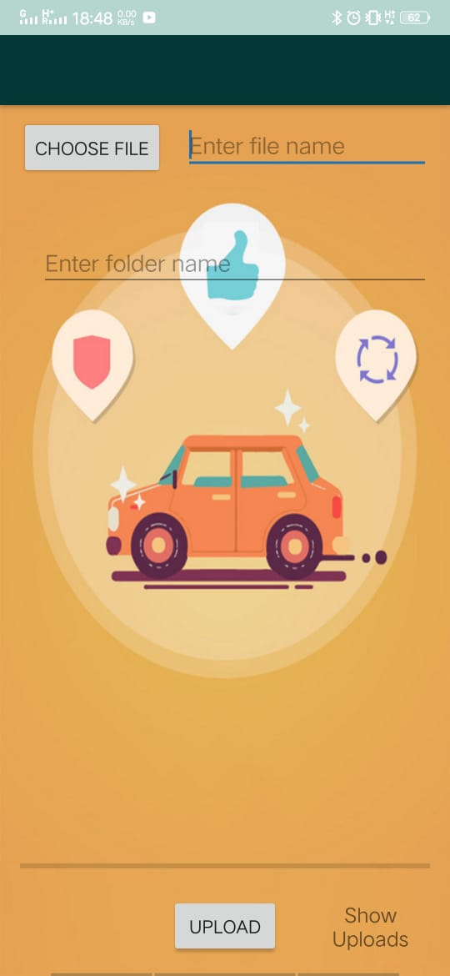
Snapshot(Continued)
This is the simple activity which shows,RTO may upload all vehicle related documets, after successful evaluation of documents.

Slide 21
Future Scope
This is helpful for people as well as RTO and Police stations investigating a lost vehicle. The road worthiness certificates are easy to check as it would be readily available.
This project helps in saving time,effort and money.It also helps in detection of fake documents and stolen vehicles.

Slide 22
Learning From Project
Android App development fundmental.
Familiarity with eclips Integrated Development Enviroment.
Java Programming language basics.
Use of XML for Layout Definition
Use of Firebase for database management in Android.
Android apps running and development.
Different technique of debugging android application.

Slide 23
References
Android System Programming –RogerYe
ANDROID : www.W3school.com
ANDROID : www.Javatpoint.com
Udemy Android Course
Wikipedia : www.wikepedia.com

Slide 24
Conclusion
People face problem as stated. We have come up with an innovative and effective solution which would solve the given social problem.

