Slide 1
Feature Extraction for Vibration Analysis Using Machine Learning

Slide 2
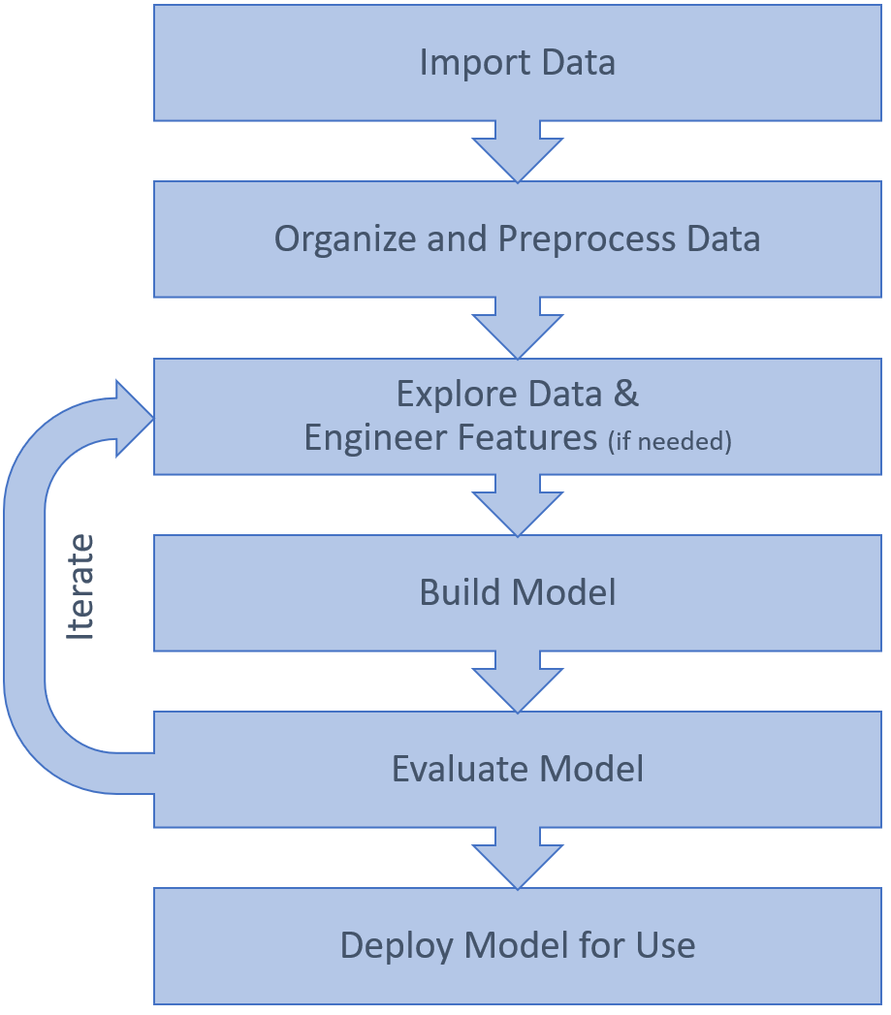
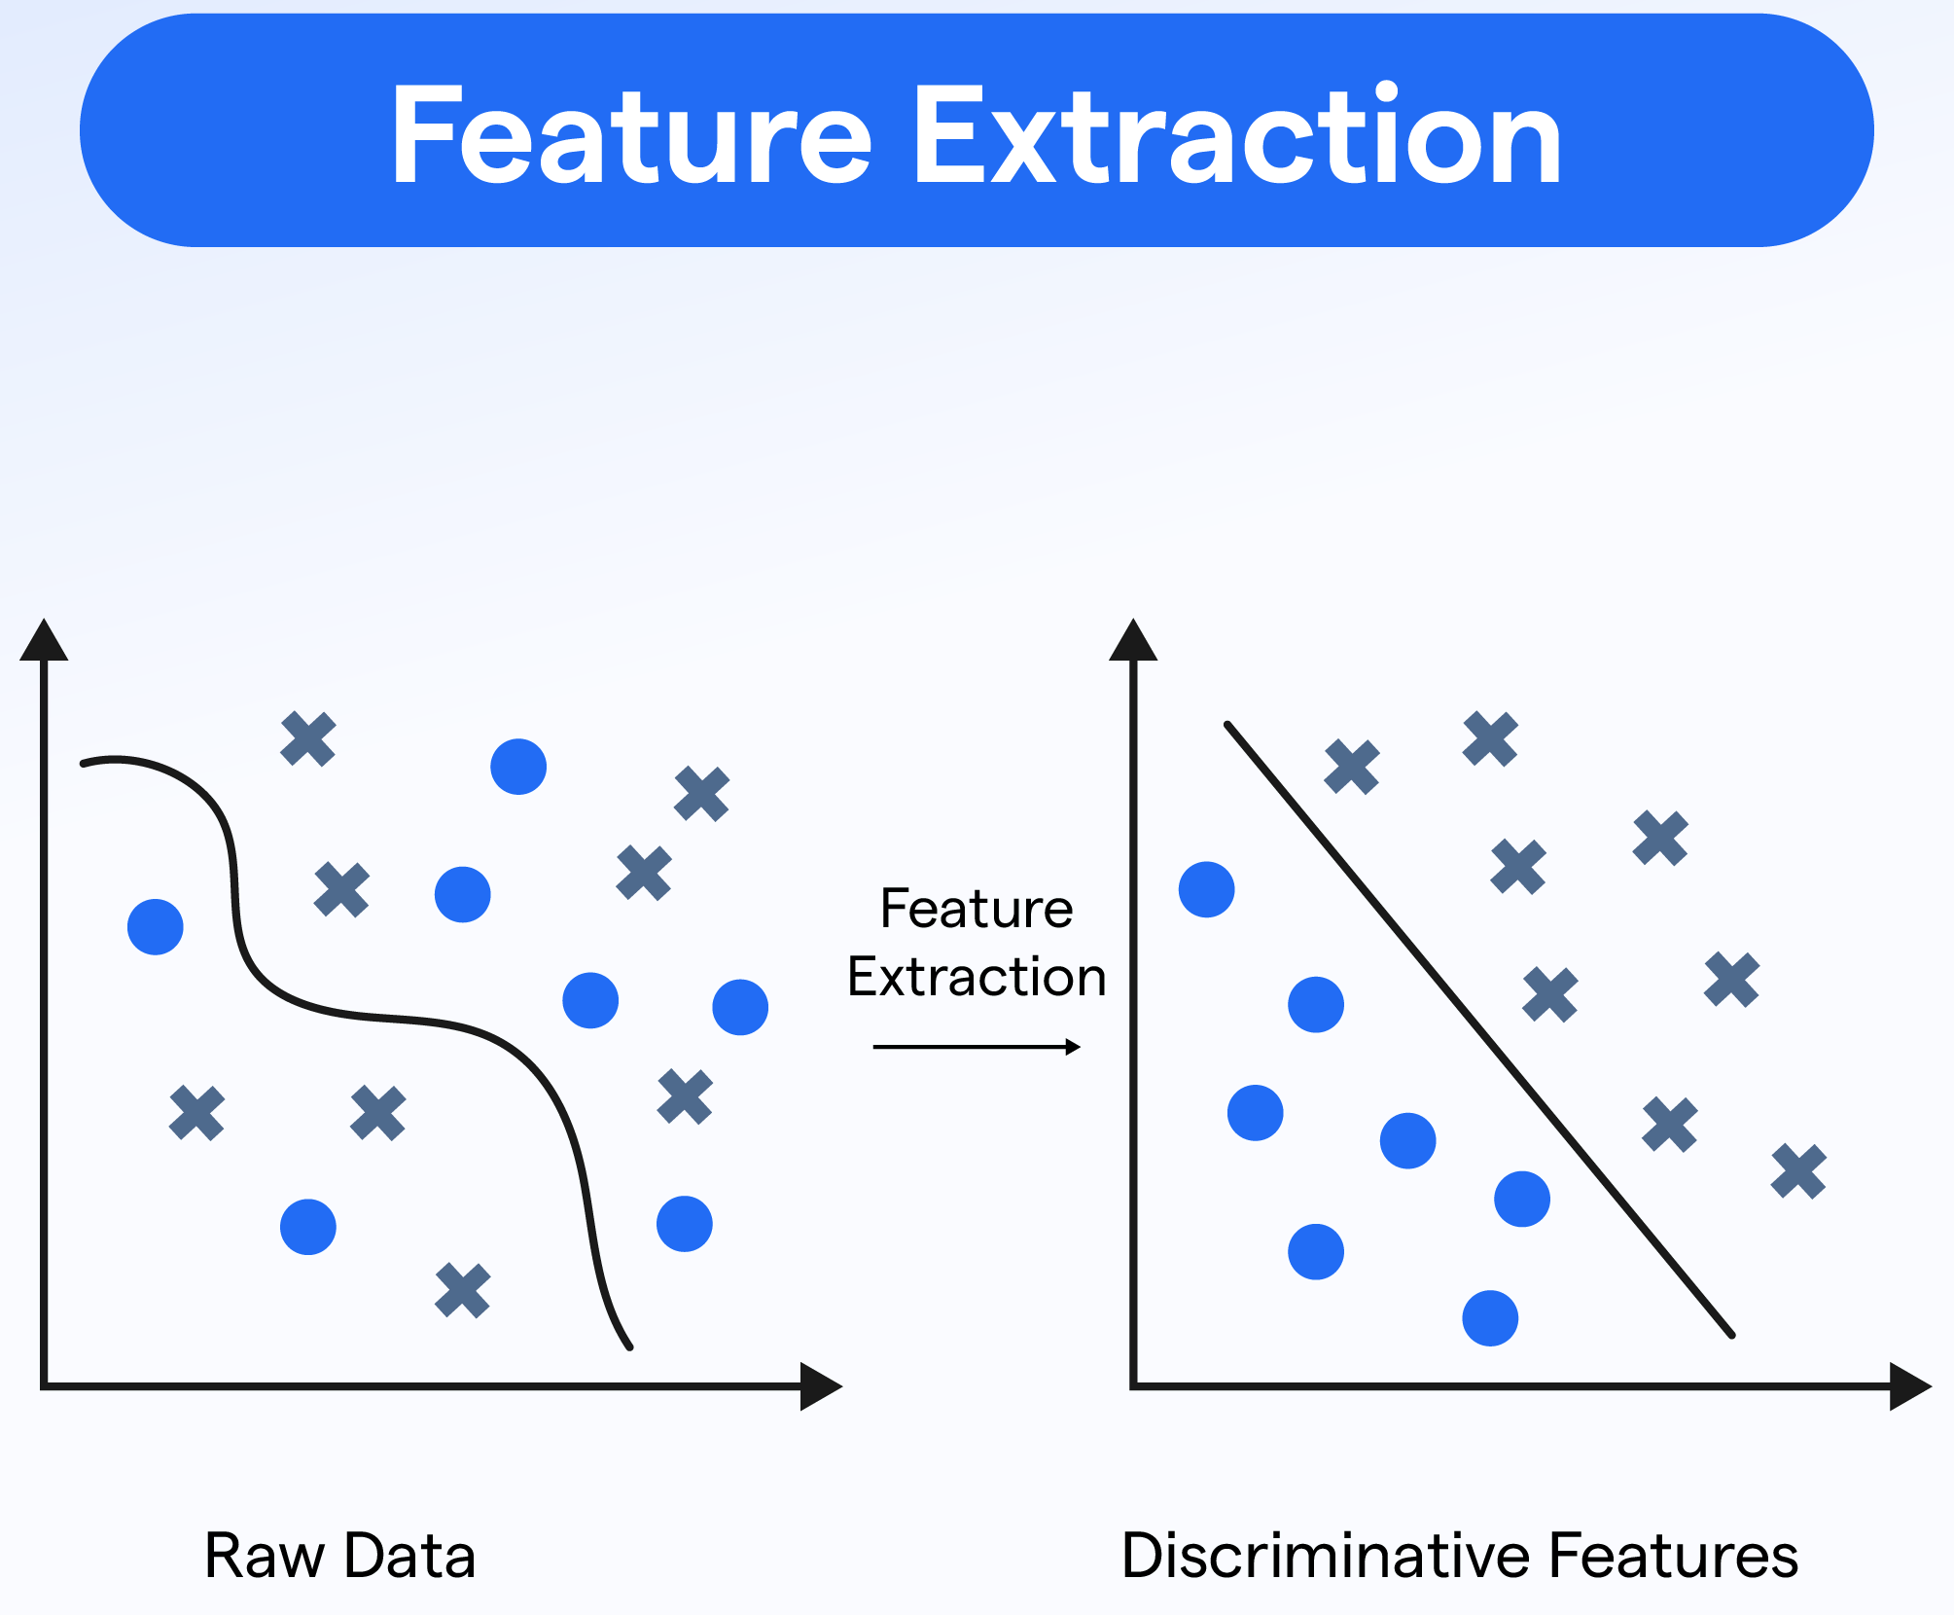
Machine Learning Workflow and Features
All condition indicators are features, but not all features are condition indicators.

Slide 3
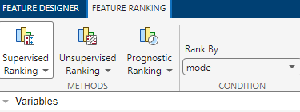
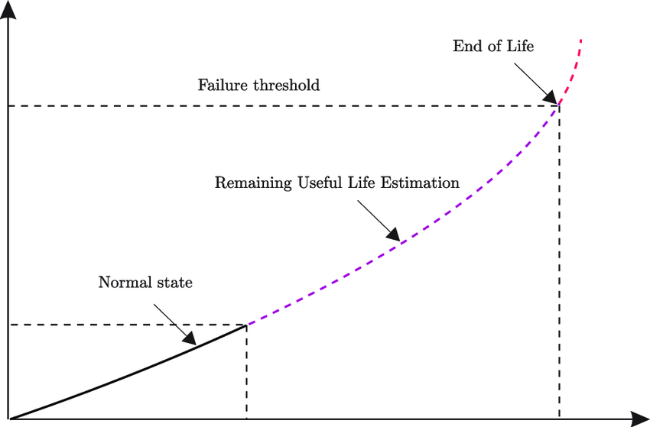
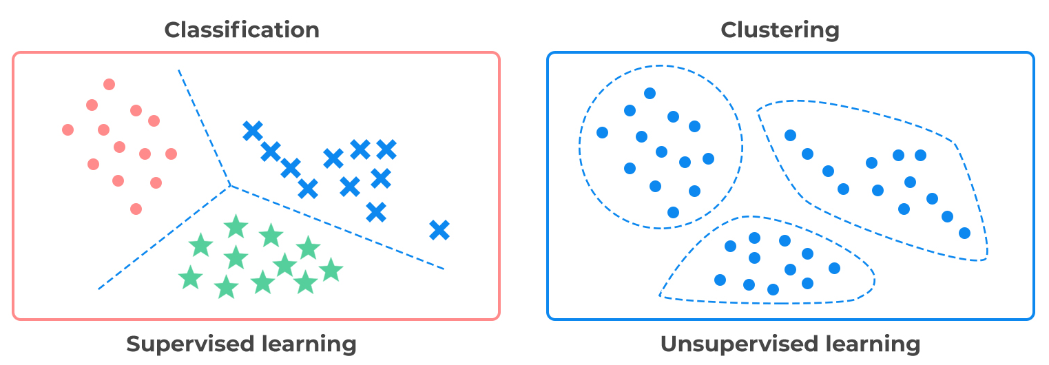
Feature Ranking Methods
Supervised Ranking: (Labeled Data)
Unsupervised Ranking: (Unlabeled Data)
Prognostic (Predictive) Ranking: (RUL)

Slide 4
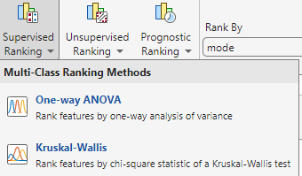
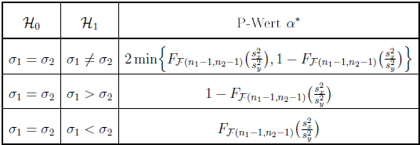
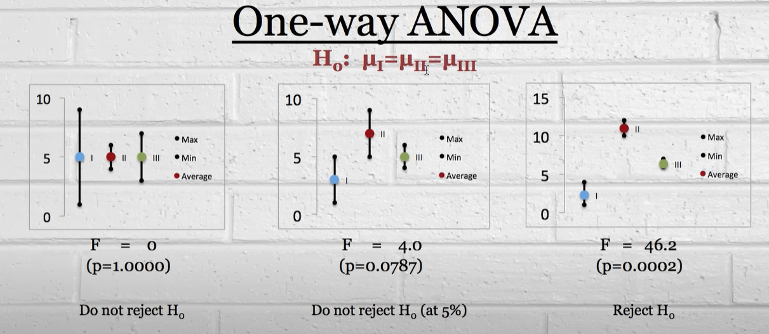
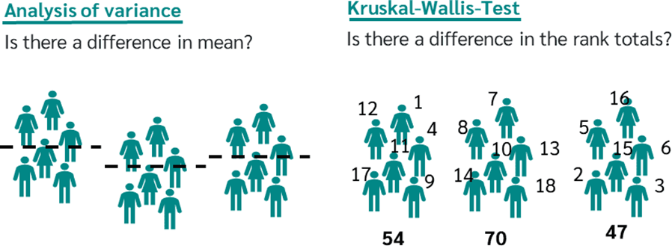
Feature Ranking Methods (Supervised)
One-way ANOVA (ANalysis Of VAriance) :
Compares feature means across modes
Fisher's F-Test
Small p-value (< 0.05): Reject H₀→ feature mean differs across modes
Kruskal-Wallis:
non-parametric alternative to ANOVA
useful when data is not normally distributed.
compares ranks instead of mean.
Feature 1
Feature 2
Feature 3
Mode 2
Mode 3
Mode 1

Slide 5
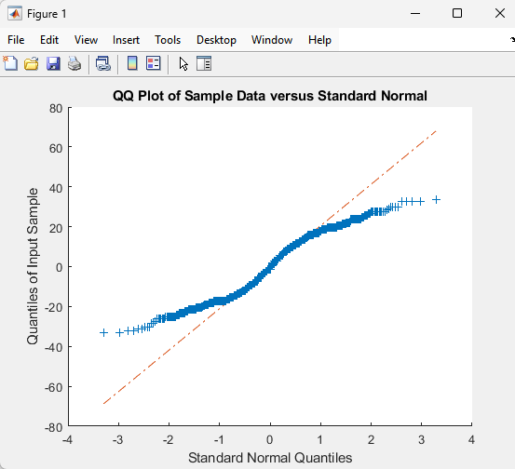
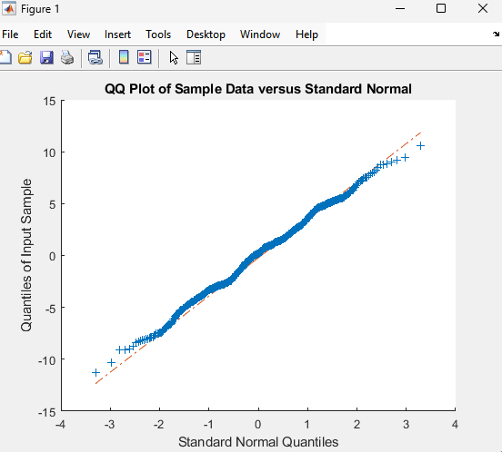
Normality Test of the Raw Data
Not Normally Distributed
Normally Distributed

Slide 6
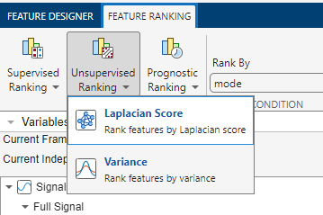
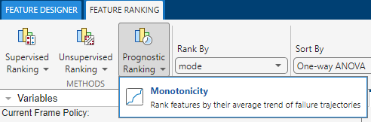
Feature Ranking Methods (Unsupervised & Prognostic)
Laplacian Score:
Ranks features by how well they maintain local structure (good for clustering). (Lower score→ higher rank)
Variance:
Ranks features based on how much they vary (more vary → higher rank) (good for identifying features with much spread in the data).
Monotonicity
Measures if the feature has a steady trend as the machine condition worsens.
Higher monotonicity → better prediction for machine failure
Use for predictive maintenance and RUL

Slide 7
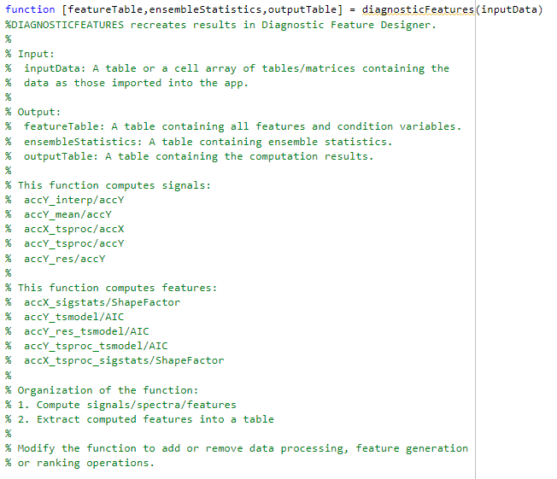

Feature Extraction Function Exported From Matlab
Code behind the feature engineering and ranking:
Preprocessing (time series/time domain)
Extracting features

Slide 8
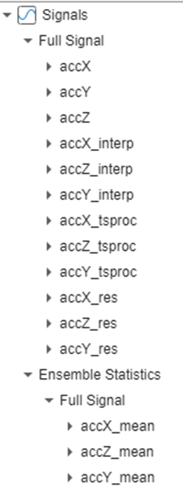
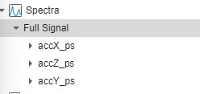
Feature Extraction → Intermediary Signals (time domain & frequency domain)
Time Domain Processed Signals:
accY_interp: (Interpolation) Interpolated Y-axis signal (resampled to a regular time grid).
accY_mean: (Mean) Mean of the Y-axis raw signal
accY_tsproc: (Time Series Processed data) Detrended Y-axis signal (linear trend removed).
accY_res: Residual Y-axis signal (difference between interpolated signal and its mean).
Frequency Domain Processed Signals:
accY_ps: Power spectrum of the accelerometer signal along each axis

Slide 9
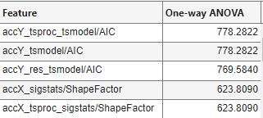
Feature Extraction → Top 5 Ranked Features
accY_tsproc_tsmodel/AIC: AIC value calculated from a time-series model applied to the processed Y-axis signal.
accY_tsmodel/AIC: AIC calculated from a time-series model applied to the raw Y-axis signal.
accY_res_tsmodel/AIC: AIC calculated from a time-series model applied to the residual Y-axis signal (difference between raw signal and its mean).
accX_sigstats/ShapeFactor: ShapeFactor (RMS/Mean Absolute) calculated from the raw X-axis signal.
accX_tsproc_sigstats/ShapeFactor: ShapeFactor calculated from the processed X-axis signal.
tsmodel:
Time Series Models such as AR model
sigstat:
Signal Statistics such as Shape Factor
AR (Autoregressive model): Describes how the current value of the signal depends on its past values.
AIC (Akaike Information Criterion): Measures how well the time-series model (AR) fits the signal, with lower values indicating a better fit.
Shape Factor: Compares the signal’s peaks to its average level, showing how spiky or smooth the signal is.

Slide 10
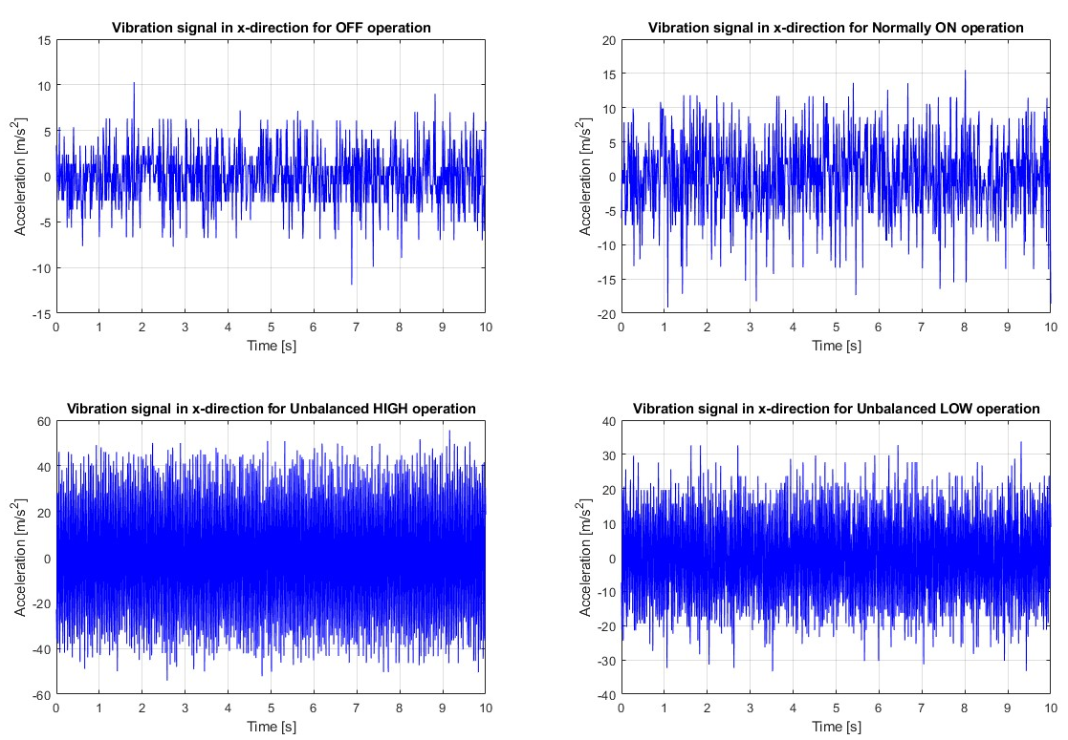
Analysis of raw data
Various Signal Processing techniques are performed on the vibration signals to see if any of the features can already be identified with the human eye
The signal processing is performed on detrended data to remove the DC offset. No filtering or smoothing is done.
The techniques performed:
Power spectrum analysis
Total Harmonic Distortion (THD)
Signal-to-noise ratio (SNR)
RMS
Peak-to-peak

Slide 11
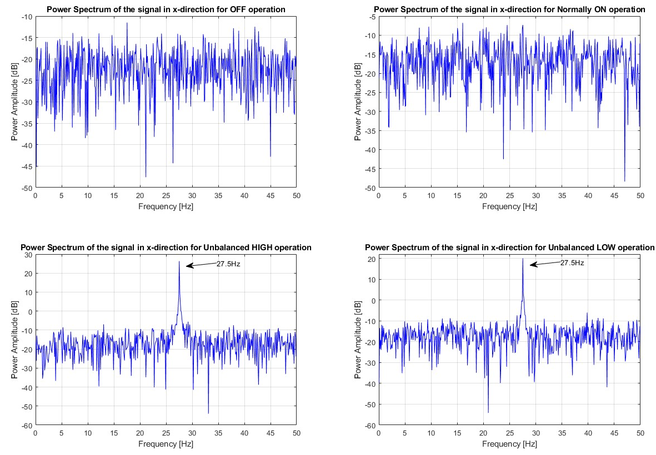
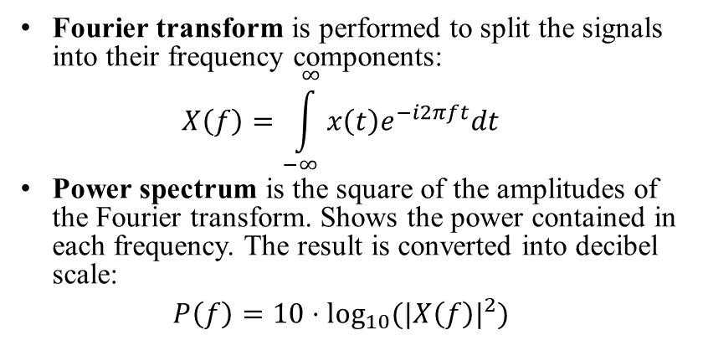
Power Spectrum Analysis
Fourier transform is performed to split the signals into their frequency components:
$$X\left(f\right)=\int_{−∞}^{∞}{x\left(t\right)e^{−i2πft}dt}$$
Power spectrum is the square of the amplitudes of the Fourier transform. Shows the power contained in each frequency. The result is converted into decibel scale:
$$P\left(f\right)=10⋅\log_{10}{({|X\left(f\right)|}^{2})}$$

Slide 12
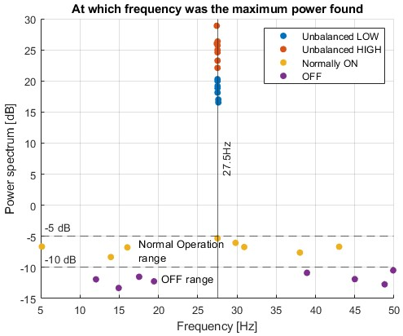
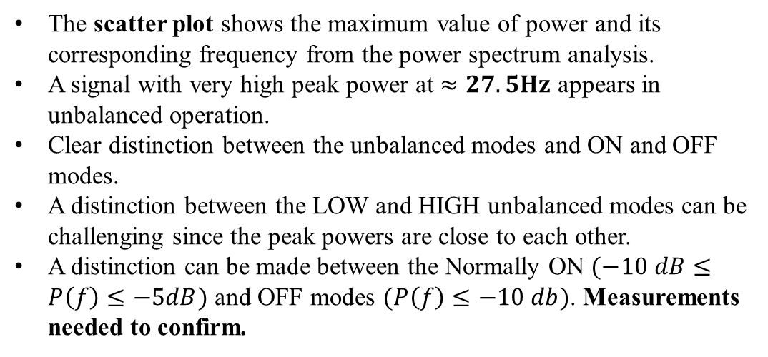
Power Spectrum Analysis
The scatter plot shows the maximum value of power and its corresponding frequency from the power spectrum analysis.
A signal with very high peak power at $≈27.5Hz$ appears in unbalanced operation.
Clear distinction between the unbalanced modes and ON and OFF modes.
A distinction between the LOW and HIGH unbalanced modes can be challenging since the peak powers are close to each other.
A distinction can be made between the Normally ON $(−10 dB≤P\left(f\right)≤−5dB)$ and OFF modes $(P\left(f\right)≤−10 db)$. Measurements needed to confirm.

Slide 13
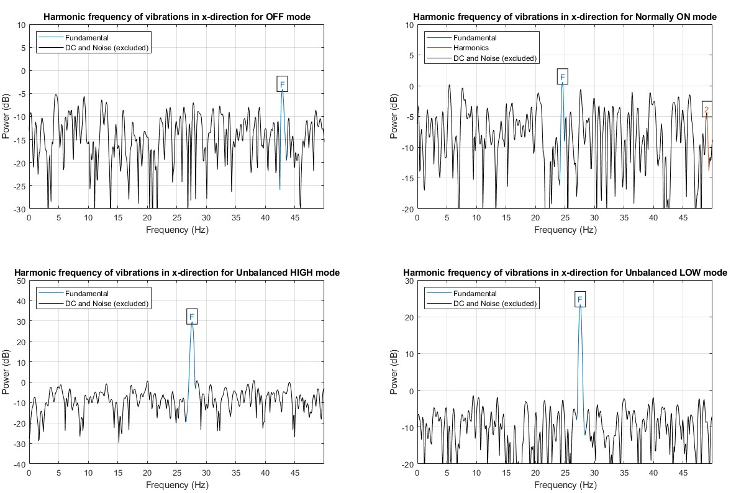
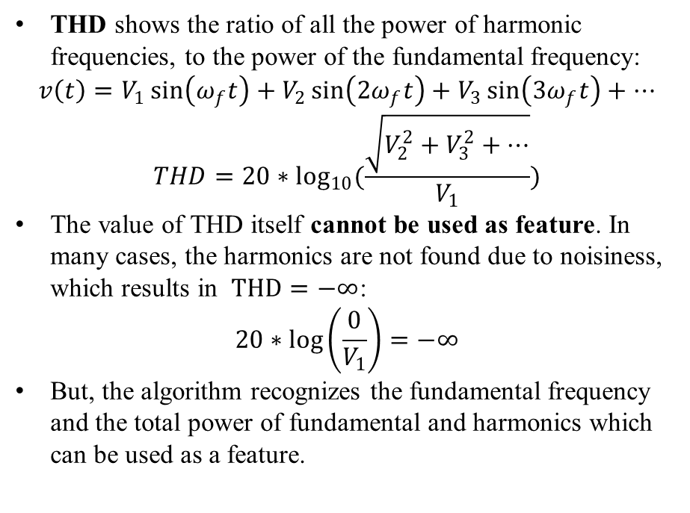
Total Harmonic Distortion
THD shows the ratio of all the power of harmonic frequencies, to the power of the fundamental frequency:
$$v\left(t\right)=V_{1}\sin\left(ω_{f}t\right)+V_{2}\sin\left(2ω_{f}t\right)+V_{3}\sin\left(3ω_{f}t\right)+…$$
$$THD=20∗\log_{10}{(\frac{\sqrt{V_{2}^{2}+V_{3}^{2}+…}}{V_{1}})}$$
The value of THD itself cannot be used as feature. In many cases, the harmonics are not found due to noisiness, which results in $THD=−∞$:
$$20∗\log\left(\frac{0}{V_{1}}\right)=−∞$$
But, the algorithm recognizes the fundamental frequency and the total power of fundamental and harmonics which can be used as a feature.

Slide 14
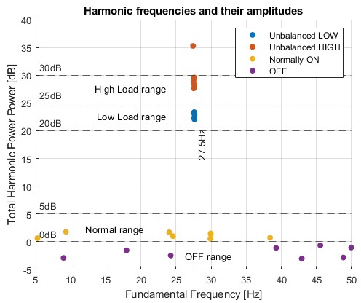
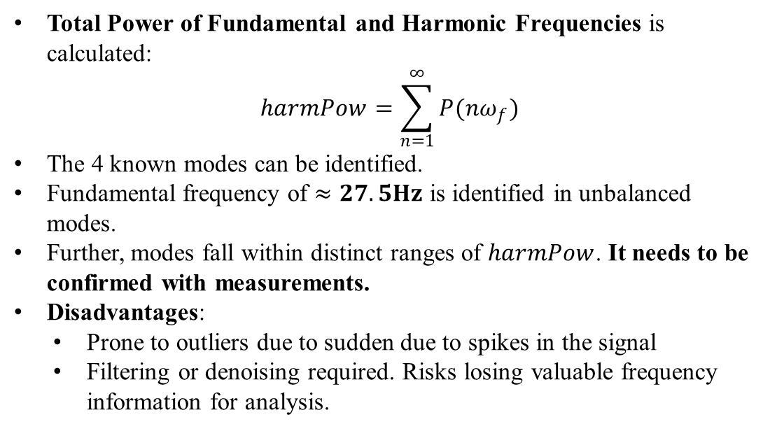
Total Harmonic Distortion
Total Power of Fundamental and Harmonic Frequencies is calculated:
$$harmPow=\sum_{n=1}^{∞}{P(nω_{f})}$$
The 4 known modes can be identified.
Fundamental frequency of $≈27.5Hz$ is identified in unbalanced modes.
Further, modes fall within distinct ranges of $harmPow$. It needs to be confirmed with measurements.
Disadvantages:
Prone to outliers due to sudden due to spikes in the signal
Filtering or denoising required. Risks losing valuable frequency information for analysis.

Slide 15
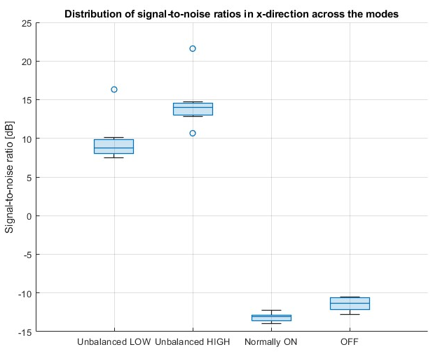
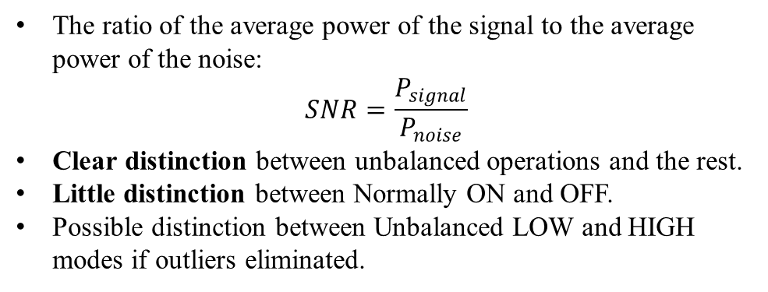
Signal-to-noise ratio
The ratio of the average power of the signal to the average power of the noise:
$$SNR=\frac{P_{signal}}{P_{noise}}$$
Clear distinction between unbalanced operations and the rest.
Little distinction between Normally ON and OFF.
Possible distinction between Unbalanced LOW and HIGH modes if outliers eliminated.

Slide 16
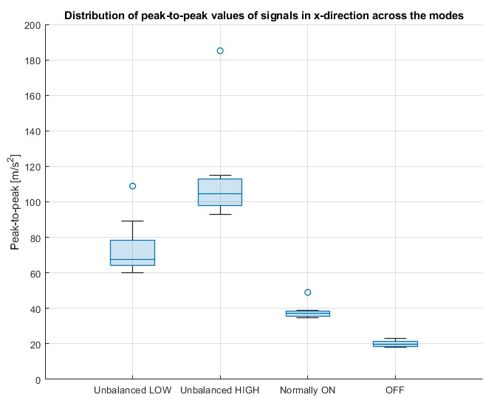
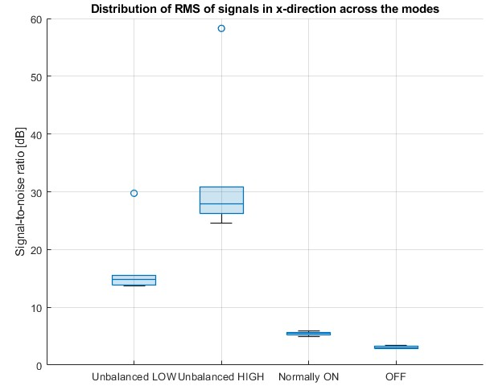
Peak-to-peak and RMS
Distinction possible between unbalanced, ON and OFF modes
Possible confusion between Unbalance LOW and HIGH
Distinction between the 4 modes possible.
Possible distinction between Unbalanced LOW and HIGH modes if outliers are eliminated.

Slide 17
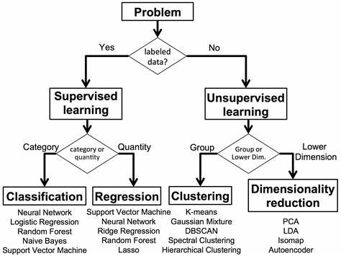
Classification Methods
K-Fold Cross Validation
K-NN
SVM
Tree
Linear Regression
Neural Network

Slide 18
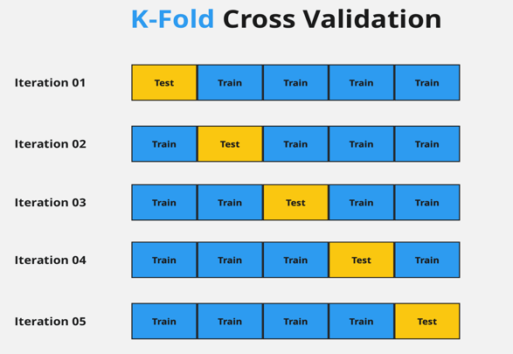
K-Fold Cross Validation
Technique for splitting the data
Model selection
Parameter optimization

Slide 19
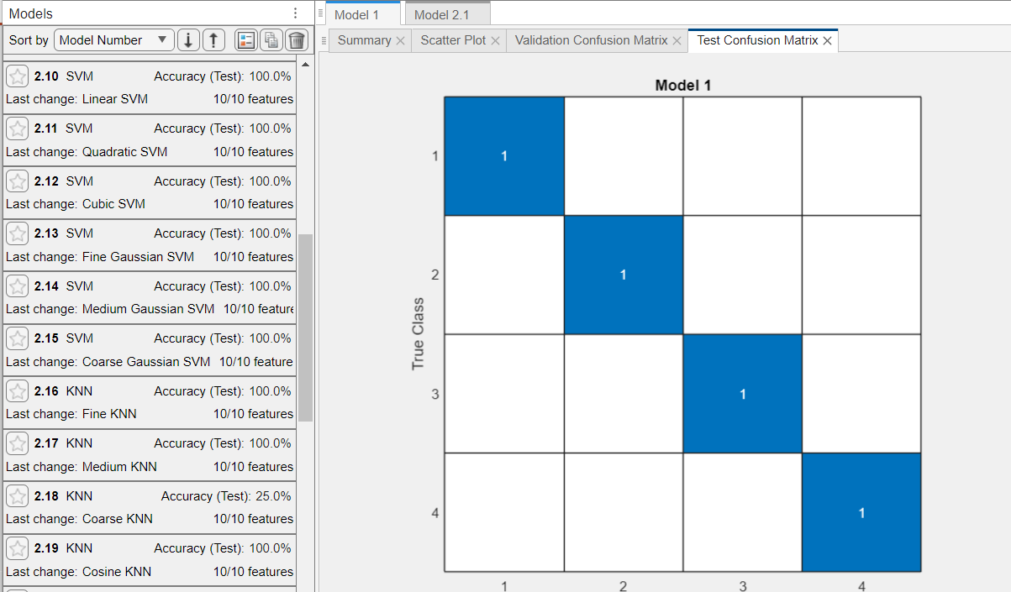
Classification Methods Comparison

Slide 20
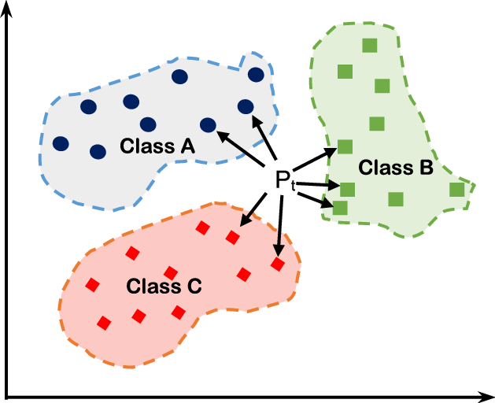
K-NN Classifier
Computes distance to each point
Majority vote for classification
K parameter optimization ->Cross Validation

Slide 21
Next Steps
Organisation of measurement
Extraction of features (Time & Frequency)
Training and comparison of models
Optimisation of the chosen model parameters
Extraction of the model to Simulink block
Test running measurement

