Slide 1

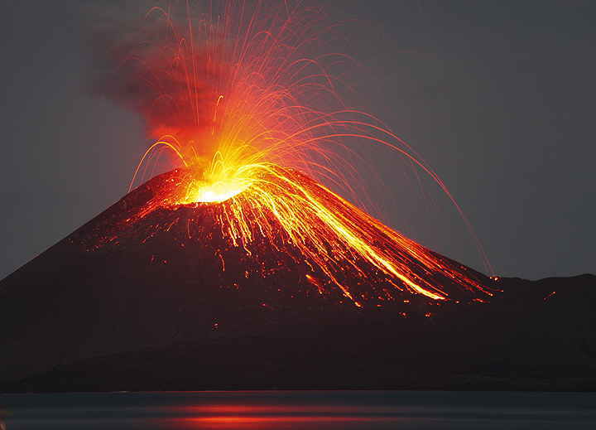
Deadly volcanos
One deadly night a, inderstructble volcano erupted at hawii’s deadliest land.
This Photo by Unknown Author is licensed under CC BY-SA-NC

