Slide 1
Banking system
Group: Cs-2006
Students:
Adilzhan Dusembay
Aybek Zhumabekov
Course instructor:
Aigerim Yessenbayeva
Astana IT University 2021

Slide 2

Agenda
The idea of the project.
ERD diagram.
Application creation.
Role assignment.
The methods of a particular role.
What difficulties were encountered during the development.
What can be done in the future?

Slide 3

Project idea
We were thinking of creation an application which will control banking system database. The idea of this project was given us, as a possible topic. We found this topic interesting, that’s why we chose it. We started searching, how the bank is set up. After long research We created our ERD diagram, to make our work easier.

Slide 4
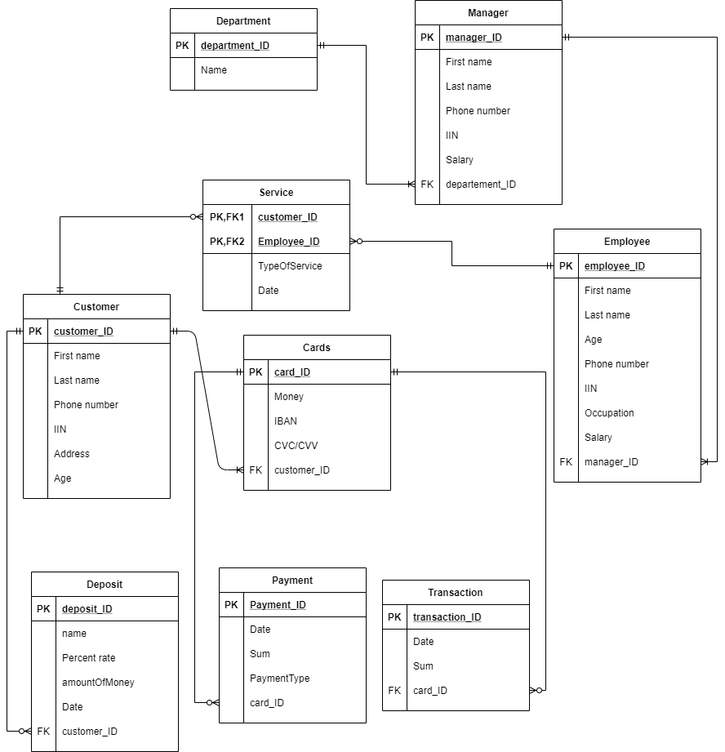
ERD diagram

Slide 5

Application creation
Since we have created ERD diagram, We were thinking what should be in database, what should be in java,moreover which classes,methods,interfaces will we need. After long and hard work our program finally was executed and it was like WOW. We were very glad. Obviously we had a lot of bugs and flaws. Then we started fixing our flaws.

Slide 6
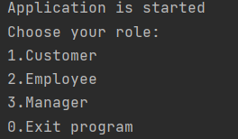
Role assignment
In our application there are 3 roles: customer,employee and manager. Different roles has different methods.When you run the program, program will ask you to choose your role, to know what to do next. You are able to choose any of them or even exit program. Depending on your choice, program will go to a specific piece of code.

Slide 7
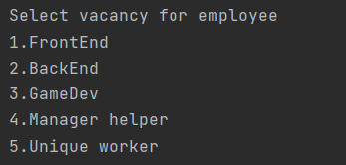
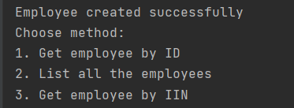
The methods of a particular role.
As it’s already mentioned depending on your choice, program will go to a specific part of code, you will be asked to create instance of your choice. After the creation, you will be able to choose methods that are related to your choice. For example: you chose to be an employee. You will be asked to fill the data about yourself, choose your vacancy. Then you will be able to choose any method, which you are allowed to use.

Slide 8
What difficulties were encountered during the development.
Dusembay Adilzhan’s thoughts: at the very beginning it was hard of course to make chemistry with groupmate also teamwork is also hard to learn. I mean when 2 people start coding together it can be unclear sometimes, however after making ERD diagram everything was OK. I had problems with programming part, for example how to know if string has digits or not, for this tasks I used stackoverflow website which really helped to me.
Zhumabekov Aybek’s thoughts: From the beginning I couldn’t realize what to do. We started quickly after making ERD diagram, there were too much work for 1 week. I met many problems with database. For example, I couldn’t connect database, pgAdmin sometimes didn’t work, following design pattern SOLID was some hardful. All of these problems and mistakes improved my programming skills.

Slide 9

What can be done in the future?
Banking system is really useful for banks. But our application far from what's in the bank. We can implement more methods, add manager transfer from 1 department to another department, add graphical interface such as website or phone application. Also we can add more roles, so that application will be more similar to real banking system.

Slide 10
