Slide 1
Asymptotic Notations
Iterative Algorithms and their analysis
Asymptotic Notations
  Big O, Θ, Ω Notations
Review of Discrete Math
  Summations
  Logarithms

Slide 2
Example I:
Finding the sum of an array of numbers
How many steps does this algorithm take to finish?
  We define a step to be a unit of work that can be executed in constant amount of time in a machine.
int Sum(int A[], int N) {
int sum = 0;
for (i=0; i < N; i++){
sum += A[i];
} //end-for
return sum;
} //end-Sum

Slide 3
Example I:
Finding the sum of an array of numbers
Times Executed
1
N
N
1
--------
int Sum(int A[], int N) {
int sum = 0;
for (i=0; i < N; i++){
sum += A[i];
} //end-for
return sum;
} //end-Sum
Total: 1 + N + N + 1 = 2N + 2
Running Time: T(N) = 2N+2
  N is the input size (number of ints) to add

Slide 4
Searching
One of the most important problems in computer science
Problem: Given an array of “N” numbers, search to find if a given “key” exists or not
  Linear Search
  Binary Search
  Recall Search Trees

Slide 5
Linear Search
int LinearSearch(int A[N], int N,
int key) {
int i= 0;
while (i < N){
if (A[i] == key) return i;
i++;
} //end-while
return -1;
} //end-LinearSearch
Times Executed
1
N
N
N
1
---------
Total: 1+3*N+1 = 3N+2

Slide 6
Example V: Binary Search
Problem: You are given a sorted array of integers, and you are searching for a key
  Linear Search – T(n) = 3n+2 (Worst case)
  Can we do better?
  E.g. Search for 55 in the sorted array below
0
1
2
3
4
5
6
7
8
9
10
11
12
13
14
15
3
8
10
11
20
50
55
60
65
70
72
90
91
94
96
99

Slide 7
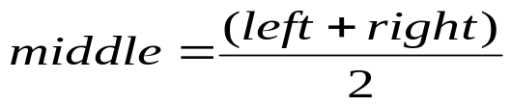
Example V: Binary Search
Since the array is sorted, we can reduce our search space in half by comparing the target key with the key contained in the middle of the array and continue this way
Example: Let’s search for 55
0
1
2
3
4
7
8
11
15
3
8
10
11
20
50
55
60
91
94
96
99
60
65
70
72
90
left
right
0
1
2
3
4
6
7
8
11
15
3
8
10
11
91
94
96
99
11
20
50
55
60
65
70
72
90
left
middle
right
Eliminated

Slide 8
Binary Search (continued)
0
1
2
3
4
5
6
7
8
11
15
3
8
10
11
20
50
91
94
96
99
50
55
60
65
70
72
90
Eliminated
left
middle
right
0
1
2
3
4
5
6
7
8
11
15
3
8
10
11
20
50
55
60
91
94
96
99
55
65
70
72
90
left
right
Eliminated
middle
Now we found 55→ Successful search
Had we searched for 57, we would have terminated at the next step unsuccessfully

Slide 9
Binary Search - Algorithm
// Return the index of the array containing the key or –1 if key not found
int BinarySearch(int A[], int N, int key){
left = 0;
right = N-1;
while (left <= right){
int middle = (left+right)/2; // Index of the key to test against
if (A[middle] == key) return middle; // Key found. Return the index
else if (key < A[middle]) right = middle – 1; // Eliminate the right side
else left = middle+1; // Eliminate the left side
} //end-while
return –1; // Key not found
} //end-BinarySearch
Worst case running time: T(n) = 3 + 5*log2N. Why?

Slide 10
Asymptotic Notations
  Summation – T(N) = 2N + 2
  Linear Search – T(N) = 3N + 2
Binary Search – T(N) = 3 + 5*log2N
In general, what really matters is the “asymptotic” performance as N → ∞, regardless of what happens for small input sizes N.
3 asymptotic notations
  Big-O --- Asymptotic upper bound
  Omega --- Asymptotic lower bound
  Theta --- Asymptotic tight bound

Slide 11
Big-Oh Notation: Asymptotic Upper Bound
T(n) = O(f(n)) [T(n) is big-Oh of f(n) or order of f(n)]
  If there are positive constants c & n0 such that
  T(n) <= c*f(n) for all n >= n0
c*f(n)
Running Time
T(n)
n0
Input size N
Example: T(n) = 50n is O(n). Why?
  Choose c=50, n0=1. Then 50n <= 50n for all n>=1
  many other choices work too!

Slide 12
Ω Notation: Asymptotic Lower Bound
T(n) = Ω(f(n))
  If there are positive constants c & n0 such that
  T(n) >= c*f(n) for all n >= n0
T(n)
c*f(n)
Running Time
n0
Input size N
Example: T(n) = 2n + 5 is Ω(n). Why?
  2n+5 >= 2n, for all n >= 1
T(n) = 5*n² - 3*n is Ω(n²). Why?
  5*n² - 3*n >= 4*n², for all n >= 4

Slide 13
Θ Notation: Asymptotic Tight Bound
T(n) = Θ(f(n))
  If there are positive constants c1, c2 & n0 such that
  c1*f(n) <= T(n) <= c2*f(n) for all n >= n0
c2*f(n)
T(n)
Running Time
c1*f(n)
n0
Input size N
Example: T(n) = 2n + 5 is Θ(n). Why?
  2n <= 2n+5 <= 3n, for all n >= 5
T(n) = 5*n² - 3*n is Θ(n²). Why?
  4*n² <= 5*n² - 3*n <= 5*n², for all n >= 4

Slide 14
Big-Oh, Theta, Omega
Tips to guide your intuition:
Think of O(f(N)) as “less than or equal to” f(N)
  Upper bound: “grows slower than or same rate as” f(N)
Think of Ω(f(N)) as “greater than or equal to” f(N)
  Lower bound: “grows faster than or same rate as” f(N)
Think of Θ(f(N)) as “equal to” f(N)
  “Tight” bound: same growth rate
(True for large N and ignoring constant factors)

Slide 15
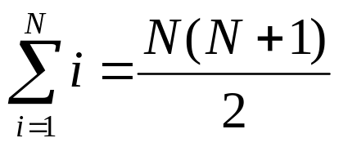
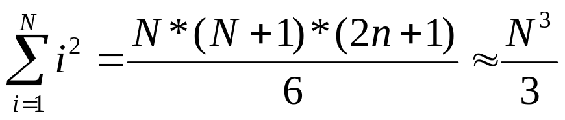
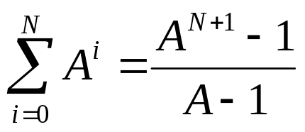
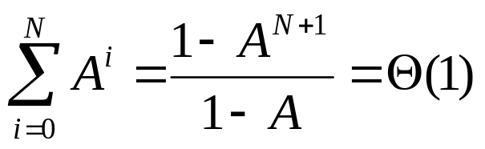
Some Math
S(N) = 1 + 2 + 3 + 4 + … N =
Sum of Squares:
Geometric Series: A > 1
A < 1

Slide 16
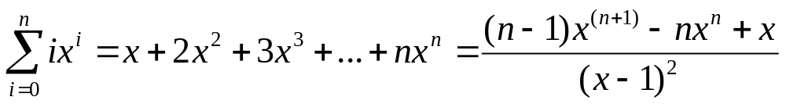
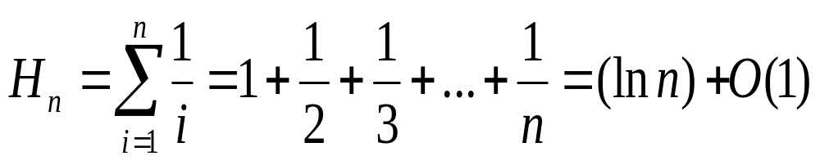
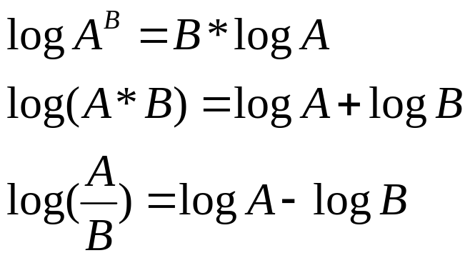
Some More Math
Linear Geometric
Series:
Harmonic Series:
Logs:

Slide 17
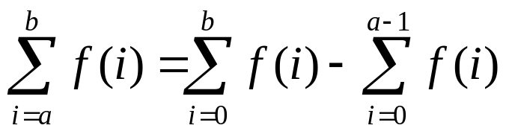
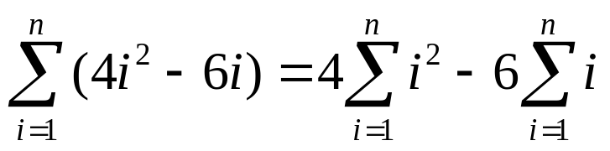
More on Summations
Summations with general bounds:
Linearity of Summations:

