Slide 1
Today’s Material
Sorting: Definitions
Basic Sorting Algorithms
  BubleSort
  SelectionSort
  InsertionSort
Divide & Conquer (Recursive) Sorting Algorithms
  MergeSort
Inversions Counting

Slide 2
Why Sort?
Sorting algorithms are among the most frequently used algorithms in computer science
  Crucial for efficient retrieval and processing of large volumes of data, e.g., Database systems
  Typically a first step in some more complex algorithm
    An initial stage in organizing data for faster retrieval
Allows binary search of an N-element array in O(log N) time
Allows O(1) time access to k^{th} largest element in the array for any k
Allows easy detection of any duplicates

Slide 3
Sorting – Things to consider
Space: Does the sorting algorithm require extra memory to sort the collection of items?
  Do you need to copy and temporarily store some subset of the keys/data records?
  An algorithm which requires O(1) extra space is known as an in place sorting algorithm
Stability: Does it rearrange the order of input data records which have the same key value (duplicates)?
  E.g. Given: Phone book sorted by name. Now sort by district – Is the list still sorted by name within each county?
  Extremely important property for databases – next slide
  A stable sorting algorithm is one which does not rearrange the order of duplicate keys

Slide 4
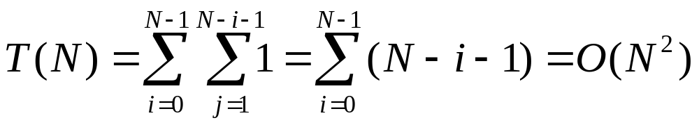
Bubble Sort
/* Bubble sort pseudocode for integers
* A is an array containing N integers */
BubleSort(int A[], int N){
for(int i=0; i<N; i++) {
/* From start to the end of unsorted part */
for(int j=1; j<(N-i); j++) {
/* If adjacent items out of order, swap */
if( A[j-1] > A[j] ) SWAP(&A[j-1], &A[j]);
} //end-for-inner
} //end-for-outer
} //end-BubbleSort

Slide 5
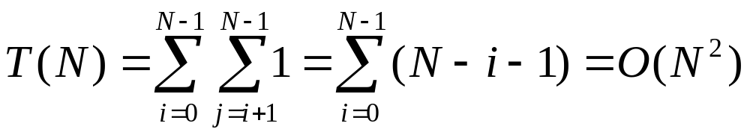
Selection Sort
SelectionSort(int A[], int N){
for(int i=0; i<N; i++) {
int maxIndex = i; // max index
for(int j=i+1; j<N; j++) {
if (A[j] > A[maxIndex]) maxIndex = j;
} //end-for-inner
if (i != maxIndex) SWAP(&A[i], &A[maxIndex]);
} //end-for-outer
} //end-SelectionSort

Slide 6
Insertion Sort
/* Insertion sort pseudocode for integers
A is an array containing N integers */
InsertionSort(int A[], int N){
int j, P, Tmp;
for(P = 1; P < N; P++ ) {
Tmp = A[ P ];
for(j = P; j > 0 && A[ j - 1 ] > Tmp; j-- ){
A[ j ] = A[ j - 1 ]; //Shift A[j-1] to right
} //end-for-inner
A[ j ] = Tmp; // Found a spot for A[P] (= Tmp)
} //end-for-outer
} //end-InsertionSort
In place (O(1) space for Tmp) and stable
Running time:
  Worst case is reverse order input = O(N²)
  Best case is input already sorted = O(N).

Slide 7
Summary of Simple Sorting Algos
Simple Sorting choices:
  Bubble Sort - O(N²)
  Selection Sort - O(N²)
  Insertion Sort - O(N²)
  Insertion sort gives the best practical performance for small input sizes (~20)

Slide 8
Recursive Sorting Algorithms
What about a divide & conquer strategy?
Merge Sort
  Divide the array into two halves
  Sort the left half
  Sort the right half
  Merge the sorted halves to obtain the final sorted array
Quick Sort
  Uses a different strategy to partition the array into two halves

Slide 9
MergeSort Example
0
1
2
3
4
5
6
7
8
2
9
4
5
3
1
6
Divide
Divide
8 2 9 4
5 3 1 6
8 2
9 4
5 3
1 6
Divide
1 element
8
2
9
4
5
3
1
6
Merge
2 8
4 9
3 5
1 6
Merge
2 4 8 9
1 3 5 6
Merge
Sorted Array
1 2 3 4 5 6 8 9

Slide 10
MergeSort
MergeSort – A[1..N]
Stopping rule:
    If N == 1 then done
Key Step
  Divide:
    Consider the smaller arrays A[1..N/2], A[N/2+1..N]
  Conquer:
    M1 = Sort (A[1..N/2])
    M2 = Sort (A[N/2+1..N]
  Merge:
    Merge(M1, M2) to produce the sorted array A

Slide 11
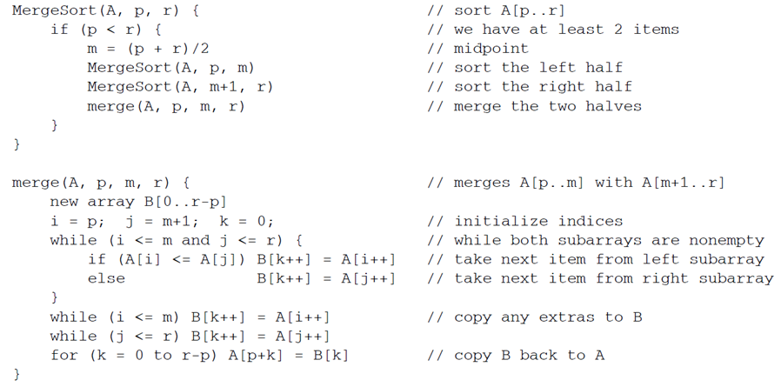
MergeSort PseudoCode

Slide 12
Recursive Calls of MergeSort
N
N/2
N/4
N/8
T(n) = 2*T(n/2) + N
Time to sort the 2 subarray
Time to merge the 2 sorted subarray

Slide 13
Inversion Counting
Let’s consider a variant on MergeSort
Although the problem description is not related, the solutions are closely related
Suppose a group of people rank a set of movies from the most popular to the least
After people rank the movies, you want to know which people tended to rank the movies in the same way

Slide 14
Ranking Example
Movie | Ali | Bulent | Cem
Movie1 | 1 | 4 | 6
Movie2 | 2 | 1 | 8
Movie3 | 3 | 3 | 4
Movie4 | 4 | 2 | 1
Movie5 | 5 | 5 | 7
Movie6 | 6 | 7 | 2
Movie7 | 7 | 8 | 5
Movie8 | 8 | 6 | 3
Given two such lists, we want to determine their degree of similarity
  One possible definition for similarity is to count the number of inversions

Slide 15
Inversion: Definition
Given two lists of preferences, L1 and L2, define an inversion to be a pair of movies “x” and “y” such that
  L1 has “x” before “y”, L2 has “y” before “x”
  Max (n 2) = n(n-1)/2 inversions
  If the two lists are the same, there are no inversions
Ali:
1
2
3
4
5
6
7
8
Ali:
1
2
3
4
5
6
7
8
Bulent:
4
1
3
2
5
7
8
6
Cem:
6
8
4
1
7
2
5
3
6 inversions
18 inversions

Slide 16
Inversion Counting
We can reduce the problem from one involving two lists to one involving just one list as follows
  Assume L1 consists of the sequence <1, 2, 3, 4, .., n>
  Let the other list L2 be denoted by <a1, a2, .., an>
  Then, an inversion is a pair of indices (i, j) such that i<j but ai > aj.
  Given a list of “n” distinct numbers, our objective is to count the number of inversions
List1:
1
2
3
4
5
6
7
8
List2:
4
1
3
2
5
7
8
6

Slide 17
Inversion Counting: Naïve Solution
We can easily solve this problem in O(n²) time
  For each ai, search all i+1<=j<=n, and increment a counter for every j such that ai > aj
  Let’s trace:
    For 4: Number of inversions: 3 (4 is bigger than 1, 2 and 3)
    For 1: Number of inversions: 0
    For 3: Number of inversions: 1 (3 is bigger than 2)
    For 2: Number of inversions: 0
    For 5: Number of inversions: 0
    For 7: Number of inversions: 1 (7 is bigger than 6)
    For 8: Number of inversions: 1 (8 is bigger than 6)
    Total: 6 inversions
4
1
3
2
5
7
8
6

Slide 18
Divide & Conquer Inversion Counting
We can design a more efficient divide & conquer solution as follows:
InversionCount(int A, int n){
    if (n== 1) return 0; // no inversion
    int left = InversionCount(A, n/2);
    int right = InversionCount(&A[n/2], n/2);
    int between = Count the number of inversions occurring between
    the two sequences;
    return left + right + between;
  } // end-InversionCount

Slide 19
Divide & Conquer Inversion Counting
The key to an efficient implementation of the algorithm is the step where we count the number of inversions between the two lists
  It will be much easier if we sort the list as we count the number of inversions
6
8
4
1
7
2
5
3
6
8
4
1
7
2
5
3
Sort & Count: 5 inversions
Sort & Count: 4 inversions
1
4
6
8
2
3
5
7
# of inversions between the lists: 9
6
8
4
1
7
2
5
3
Total: 5 + 4 + 9 = 18 inversions

Slide 20
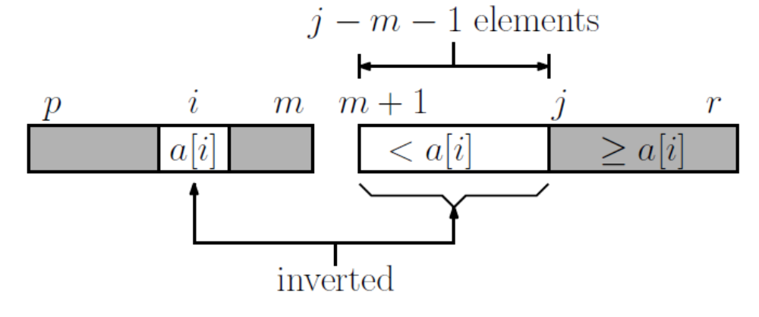
Divide & Conquer Inversion (1)
Assume the input is given as an array A[p..r]
We split into A[p..m], A[m+1..r], which are sorted during the merging step
During merging, maintain two indices “i” and “j”, indicating the current elements of the left & the right subarrays
Counting inversions when A[i] <= A[j]

Slide 21
Divide & Conquer Inversion (2)
When A[i] > A[j], advance j
When A[i] < A[j], then every element of the subarray A[m+1..j-1] is strictly smaller than A[i] and they all create inversions.
  (j-1)-(m+1)-1 = j-m-1 inversions
Counting inversions when A[i] <= A[j]

Slide 22
Divide & Conquer Inversion (3)
When we copy elements from the end of the left subarray to the final array, each element that is copied also generates an inversion with respect to ALL elements of the right subarray
  There are r-m such elements.
  Add this to the inversion counter
Counting inversions when A[i] <= A[j]

Slide 23
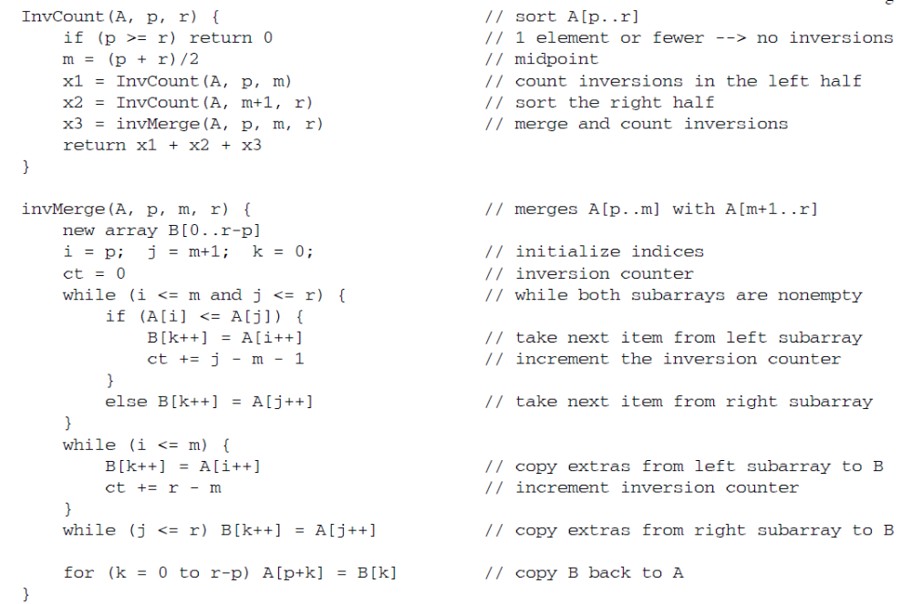
Divide & Conquer Inversion: Code

Slide 24
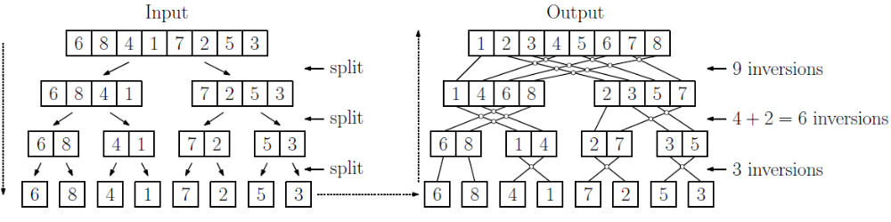
Divide & Conquer Inversion: Example
Divide & Conquer Inversion Counting

