Slide 1
Today’s Material
Medians & Order Statistics – Ch. 9

Slide 2
Selection: Problem Definition
Given a sequence of numbers a1, a2, a3, …aN and integer “i”, 1 <= i <= N, compute the i^{th} smallest element
Minimum is when k = 1, maximum is when k = N
Median is a special case where i = N/2
Selection looks like a very mundane problem
But it is such a basic question that it arises in many places in practice
  Give examples…

Slide 3
Brute Force Solution
There is an obvious brute-force solution
Just sort the numbers in ascending order and return the i^{th} element of the array
Takes O(nlogn)—Time to sort the numbers
Can we do better?
  There is a deterministic O(n) algorithm, but it is very complicated and not very practical
  However, there is a simple randomized algorithm, whose expected running time is O(n)
    We will only look at this randomized algorithm--next

Slide 4
Randomized Algorithms – An Intro
A randomized algorithm is one that incorporates a random number generator
Studies in recent years because many of the practical algorithms make use of randomization
There are 2 classes of randomized algorithms
  Monte Carlo Algorithms
    May make an error in its output, but presumably the probability of this happening is very small
  Las Vegas Algorithms
    Always produces the correct answer, but there is a small probability that the algorithm takes longer than it should
  With Monte Carlo algorithms randomization affects the result, with Las Vegas it affects the running time

Slide 5
A Simple Monte-Carlo Algorithm
Problem: Given a number N, is N prime?
  Important for cryptography
Randomized Monte-Carlo Algorithm based on a Result by Fermat:
  Guess a random number A, 0 < A < N
  If (A^{N-1} mod N) ≠ 1, then Output “N is not prime”
  Otherwise, Output “N is (probably) prime”
N is prime with high probability but not 100%
Can repeat steps 1-3 to make error probability close to 0

Slide 6
A Las Vegas Randomized Selection
As we mentioned, there is an O(n) expected-case randomized Las-Vegas algorithm for Selection
  Always produces the correct answer, but with low probability it might take longer than O(n)
Idea is based on a modification of QuickSort:
  Assume that the array A is indexed A[1..n]
  Consider the Partition() procedure in QuickSort
    Randomly choose a pivot x, and permute the elements of A into two nonempty sublists A[1..q] of elements < x and A[q+1..n] of elements >= x
      See page 154 of CLRS
    Assume Partition() returns the index “q”

Slide 7
Partition Algorithm
int Partition(int A[], int N){
if (N<=1) return 0;
int pivot = A[0]; // Pivot is the first element
int i=1, j=N-1;
while (1){
while (A[j]>pivot) j--; // Move j
while (A[i]<pivot && i<j) i++; // Move i
if (i>=j) break;
Swap(&A[i], &A[j]);
i++; j--;
} //end-while
Swap(&A[j], &A[0]); // Restore the pivot
return j; // return the index of the pivot
} //end-Partition

Slide 8
A Las Vegas Randomized Selection
Observe that there are “q” elements <= pivot, and hence the rank of the pivot is q
If i==q then return A[q];
If i < q then we select the i^{th} smallest element from the left sublist, A[1..q]
If i > q then we recurse on the right sublist.
  Because q elements have already been eliminated, we select the (i-q)^{th} smallest element from the right sublist

Slide 9
Randomized Selection: Pseudocode
// Assumes 1<= i <=N
Select(A[1..N], i){
if (N==1) return A[1];
int q = Partition(A[1..N], N);
if (i == q) return A[q];
if (i < q) return Select(A[1..q], i);
else return Select(A[q+1..N], i-q);
} //end-Select

Slide 10
Randomized Selection: C Code
// Assumes 1<= i <=N
int Select(int A[], int i, int N){
if (N==1) return A[0];
int q = Partition(A, N);
if (i == q+1) return A[q];
else if (i <= q) return Select(A, i, q);
// We have eliminated q+1 elements
else return Select(&A[q+1], i-(q+1), N-(q+1));
} //end-Select

Slide 11
Running Time - 1
Because the algorithm is randomized, we analyze its “expected” time complexity
  Where the expectation is taken over all possible choices of the random pivot element
Let T(n) denote the expected case running time of the algorithm on a list of size “n”
  Our analysis is with respect to the worst-case in “i”
  That is, since we do not know what “i” is, we make the worst case assumption that whenever we partition the list, the i^{th} smallest element occurs on the side having greater number of elements
  Partitioning procedure takes O(n) – See CLRS

Slide 12
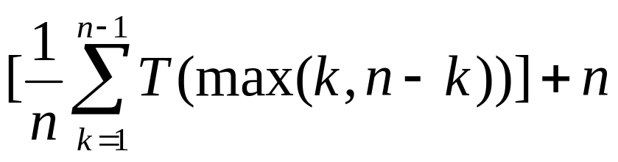
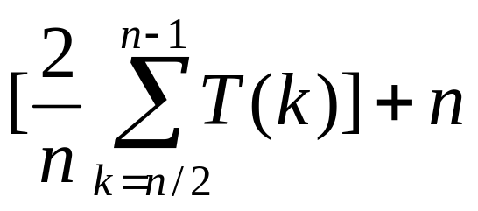
Running Time - 2
There are “n” possible choices for the pivot
Each is equally likely with probability 1/n
If “x” is the k^{th} smallest element of the list, then we create two sublists of size “k” and “n-k”
If we assume that we recurse on the larger side of the two sublists, then we get
  T(n) <=
  Basically, the recurrence can be simplified to:
  T(n) <=

Slide 13
Running Time - 3
Then an induction argument is used to show that T(n) <= c*n for some appropriately chosen constant c
After working through the induction proof (see page 189 in CLRS), we arrive at the condition
  c*(3n/4 – ½) + n < c*n
  This is satisfied for any c >= 4
  This technique of setting up an induction with an unknown parameter, and then determining the conditions on the parameter is known as “constructive proof”

Slide 14
Deterministic Selection
Once we find the median of the medians, partition the array using the medians of the medians
Then run the algorithm on the partitioned array recursively
Basically, we want to make partitioning deterministic by finding the median of the medians so that the array is partitioned into almost 2 equal halves

Slide 15
Deterministic Selection
(1) Divide the elements into roughly n/5 groups, each of size 5
(2) Compute the median of each group (by any method you like)
(3) Compute the median of these n/5 group medians
How do you implement step (3)?
  You call deterministic selection recursively
  Since the list is of smaller size, it will eventually terminate
  Why groups of 5?
    You need an odd number for median computation
    3 does not work. The smallest odd number greater than 3 is 5. But any other bigger odd number (7, 9, ..) would do too.

