Slide 1
0-1 Knapsack Problem
A burglar with a knapsack capacity of W breaks into a museum and finds “n” items
  Items={1, 2, .., n}
  Let vi denote the value of i^{th} item
  let wi denote the weight of the i^{th} item
Problem: Fill up the knapsack so as to maximize the total value of the items taken subject to the weight constraint
  Want to steal diamonds before gold

Slide 2
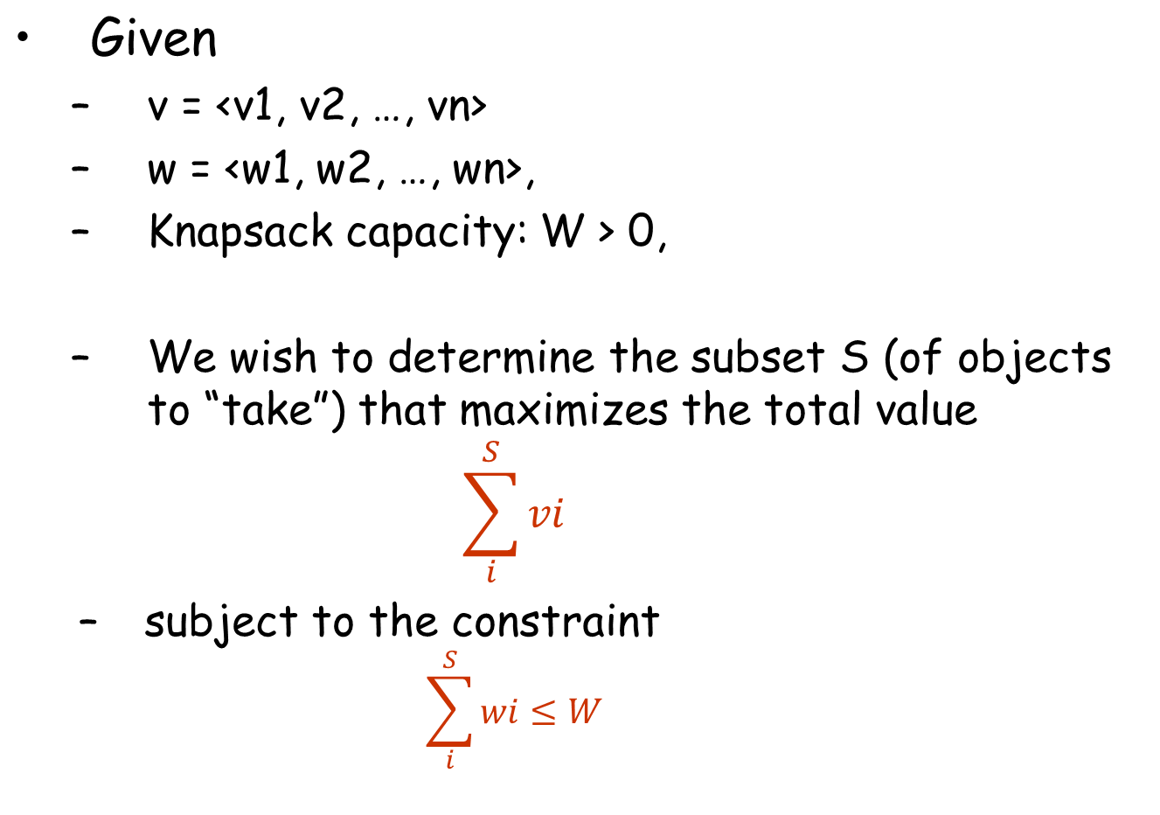
0-1 Knapsack: Formal Definition

Slide 3
0-1 Knapsack vs. Fractional Knapsack
The knapsack problem has two versions:
  0-1 Knapsack: The burglar cannot take a fraction of an object
  S/he can either take the entire object (1) or leave it behind (0)
  Fractional Knapsack: The burglar can take a fraction of an object for a fraction of its value and weight
    This version of the problem has a simple greedy solution

Slide 4
0-1 Knapsack: Example
I = {i1, i2, i3, i4, i5} // Items
v = {30, 20, 100, 90, 160} // value
w = {5, 10, 20, 30, 40} // weight
W = 60 // Knapsack capacity
S1 = {i2, i3, i4}.
  Total Weight: 10+20+30 = 60 <= W
  Total Value: 20+100+90 = 210
S2 = {i1, i3, i4}.
  Total Weight: 5+20+30 = 55 <= W
  Total Value: 30+100+90 = 220

Slide 5
0-1 Knapsack: Example (cont.)
n = 5 items
I = {i1, i2, i3, i4, i5} // Items
v = {30, 20, 100, 90, 160} // Value
w = {5, 10, 20, 30, 40} // Weight
W = 60 // Knapsack capacity
S3 = {i3, i5}.
  Total Weight: 20+40 = 60 <= W
  Total Value: 100 + 160= 260
This is in fact the optimal solution

Slide 6
0-1 Knapsack: Greedy Algorithm
How about a greedy algorithm?
The greedy thing to do will be:
  compute the gain per unit of weight (vi/wi) for each item “i”
  fill in the knapsack starting with the item having the highest gain
  continue this way until the knapsack is filled

Slide 7
0-1 Knapsack: Greedy Algorithm
60
60
60
35
--
40
60
40
40
30
$140
$160
$90
30
20
20
20
$100
20
$100
$100
10
5
5
$30
5
$30
$20
$100
$90
$160
-----
-----
-----
Knapsack
$30
$270
$220
$260
Gain
6.0 2.0 5.0 3.0 4.0
Greedy solution to
Fractional problem
Greedy solution to
0-1 problem
Optimal solution to
0-1 problem

Slide 8
Recursive Formulation of the Problem
How about a divide & conquer strategy?
Items= {1, 2, 3, …, n-1, n}, S={}, W
Take the last item “n”
Leave the last item “n”
Items= {1, 2, 3, …, n-1},
S={v[n]}, W- w[n]
Items= {1, 2, 3, …, n-1},
S={}, W

Slide 9
0-1 Knapsack: Divide&Conquer Algorithm
Knapsack(v[1..n], w[1..n], n, W){
if (n <= 0) return 0;
if (W <= 0) return 0;
// Consider leaving object “n”
leave_val = Knapsack(v, w, n-1, W);
// Consider taking object “n”
take_val = -INFINITY;
if (w[n] <= W) take_val = v[n] + Knapsack(v, w, n-1, W-w[n]);
return max(leave_val, take_val);
} //end-Knapsack
Running Time? O(2^{n}) in the worst case
  Notice that the function makes 2 calls to itself.
  At each call, n is decremented by 1. So the height of the function call tree is potentially “n”, giving rise to potentially 2^{n} function invocations

Slide 10
0-1 Knapsack: DP Solution
With Dynamic Programming (DP), the idea is:
  Store the solutions to sub-problems in a SolTable
  The next time we need to solve the same sub-problem, we retrieve the solutions from the solution table
  This way each sub-problem is solved just once, giving rise to efficient algorithms

Slide 11
0-1 Knapsack: DP Solution
How to store solutions to subproblems?
  Construct an array SolTable[0..n][0..W]
  For 1 <= i <= n, 0 <= j <= W, SolTable[i][j] will store:
    the maximum value of any subset of objects {1, 2, .., i} that can fit into a knapsack of capacity “j”
  Finally, SolTable[n][W] will contain the overall solution
  How many different sub-problems do we have?
    nxW

Slide 12
0-1 Knapsack: TopDownDP Solution
Simply augment the recursive algorithm with the SolTable
  Before we make a recursive call for a sub-problem, we check whether we already have the solution in the SolTable. If we do, we simply retrieve the solution from the table, and thus avoid the recursive call
  If we do not have the solution yet, we make the recursive call and save the result in the SolTable

Slide 13
0-1 Knapsack: BottomUp Formulation
{0 if i=0 and 0<=j<=W
T[i][j] ={T[i-1][j] if wi > j
{max{T[i-1][j], vi+T[i-1][j-wi]} if wi<=j
When there are no items, the total value is 0
When i^{th} item does not fit into the knapsack, then the total value is T[i-1][j]
When i^{th} item fits into the knapsack, we take the maximum value of when we leave the i^{th} item or take it

Slide 14
0-1 Knapsack: BottomUp DP Algorithm
Knapsack_BottomUpDP(v[1..n], w[1..n], n, W){
Allocate T[0..n][0..W];
For j=0 to W do T[0][j] = 0; // Initialization
For i=1 to n do {
For j=0 to W do {
leave_val = T[i-1][j]; // Total val. If we leave i
if (j >= w[i]) // Enough capacity to take i?
take_val = v[i] + T[i-1][j-w[i]]; // Tot. value if
else // we take i
take_val = -INFINITY; // cannot take i
T[i][j] = max{leave_val, take_val}; // final value
} //end-for
} //end-for
return V[n][W];
} //end-Knapsack
Running Time: O(nxW)

Slide 15
0-1 Knapsack: BottomUp DP Ex.
Values of the objects are <10, 40, 30, 50>
Weights of the objects are <5, 4, 6, 3>
The capacity of the knapsack, W = 10
Capacity→
J = 0
1
2
3
4
5
6
7
8
9
10
Item
Value
Weight
0
0
0
0
0
0
0
0
0
0
0
1
10
5
0
0
0
0
0
10
10
10
10
10
10
2
40
4
0
0
0
0
40
40
40
40
40
50
50
3
30
6
0
0
0
0
40
40
40
40
40
50
70
4
50
3
0
0
0
50
50
50
50
90
90
90
90
Final result is SolTable[4][10] = 90 (for taking items 2 and 4)

Slide 16
Finding the Selected Items
Values of the objects are <10, 40, 30, 50>
Weights of the objects are <5, 4, 6, 3>
The capacity of the knapsack, W = 10
Capacity→
J = 0
1
2
3
4
5
6
7
8
9
10
Item
Value
Weight
-
-
-
-
-
-
-
-
-
-
-
1
10
5
-
-
-
-
-
T
T
T
T
T
T
2
40
4
-
-
-
-
T
T
T
T
T
T
T
3
30
6
-
-
-
-
-
-
-
-
-
-
T
4
50
3
-
-
-
T
T
T
T
T
T
T
T
Take Items 4 and 2

Slide 17
Final Exam Question 4
Coin Exchange Problem:
  You are given a set of coins: {1, 3, 20, 25}, and an amount. Design a dynamic programing algorithm that returns the minimum number of coins necessary to represent this amount.
  Example: Assume you have the coins given above, and the amount is 68.
  Then the minimum number of coins necessary to make up for this amount is:
    1x25 + 2x20 + 1x3 = 25+40+3 = 68 ➔ 4 coins
  Notice that the greedy algorithm would return:
    2x25 + 6x3 = 50 + 18 = 68 ➔ 8 coins

Slide 18
Recursive Formulation of the Problem
How about a divide & conquer strategy?
Coins= {1, 2, 3, …, n-1, n}, A
Take the last coin “n”
Leave the last coin “n”
Coins= {1, 2, 3, …, n}, A - v[n]
Coins= {1, 2, 3, …, n-1}, A

