Slide 1
Hafta 6

Slide 2
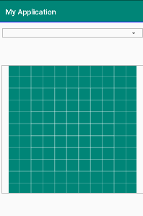
UYGULAMA

Slide 3
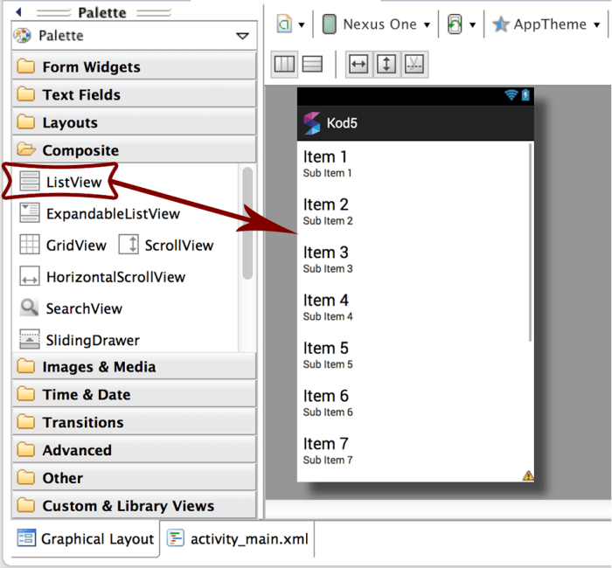
Listview

Slide 4
String[] listItem = {"Android","IPhone","WindowsMobile","Blackberry", "WebOS","Ubuntu","Windows7","Max OS X"}; listView=(ListView)findViewById(R.id.listview); final ArrayAdapter<String> adapter = new ArrayAdapter<String>(this, android.R.layout.simple_list_item_1, listItem); listView.setAdapter(adapter); listView.setOnItemClickListener(new AdapterView.OnItemClickListener() { @Override public void onItemClick(AdapterView<?> adapterView, View view, int i, long l) { String value=adapter.getItem(i); Toast.makeText(getApplicationContext(),value,Toast.LENGTH_SHORT).show(); } });

Slide 5
ArrayList listem ;
listem = new ArrayList(); listem.add("ugur"); listem.add("Tuna");
listView=(ListView)findViewById(R.id.listview); listem = new ArrayList(); listem.add("ugur"); listem.add("dasdas");
final ArrayAdapter<String> adapter = new ArrayAdapter<String>(this, android.R.layout.simple_list_item_1, listem); listView.setAdapter(adapter);

Slide 6
listem.add("Degisken");
adapter.notifyDataSetChanged();

Slide 7
Uygulama
Dinamik Ekleme

Slide 8
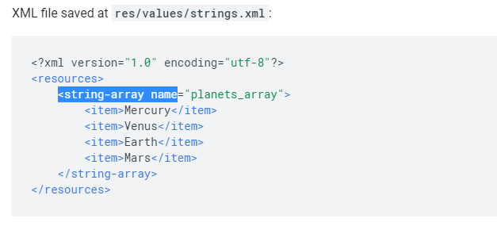

Slide 9
String[] listItem;
listItem = getResources().getStringArray(R.array.planets_array); final ArrayAdapter<String> adapter = new ArrayAdapter<String>(this, android.R.layout.simple_list_item_1, listItem); listView.setAdapter(adapter);

Slide 10
Uygulama

