Slide 1
The Activity lifecycle

Slide 2
An activity can be thought of as being in one of several states:
– starting: In process of loading up, but not fully loaded.
– running: Done loading and now visible on the screen.
– paused: Partially obscured or out of focus, but not shut down.
– stopped: No longer active, but still in the device's active memory.
– destroyed: Shut down and no longer currently loaded in memory.

Slide 3
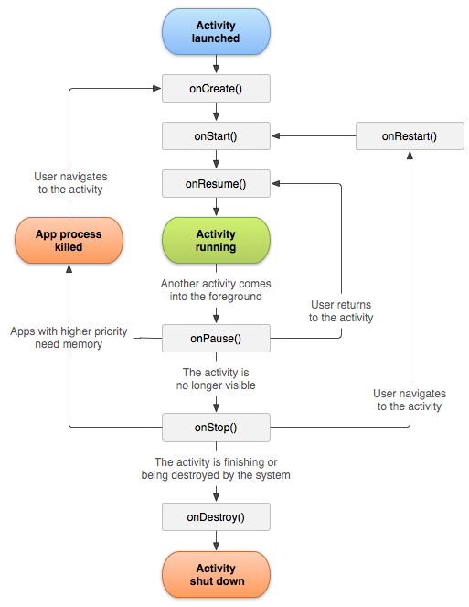

Slide 4
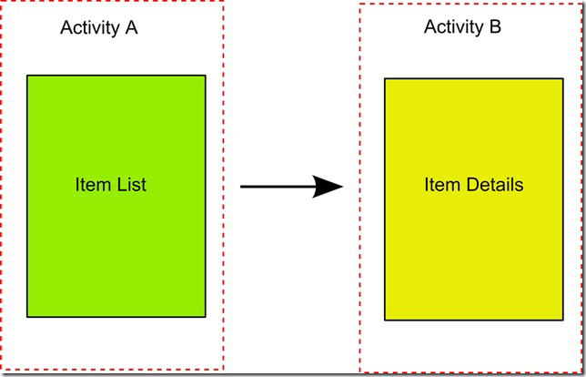
Multiple Activities
Many apps have multiple activities.
– Example: In an address book app, the main activity is a list of contacts, and clicking on a contact goes to another activity for viewing details.
– An activity A can launch another activity B in response to an event.
– The activity A can pass data to B.
– The second activity B can send data back to A when it is done.

Slide 5
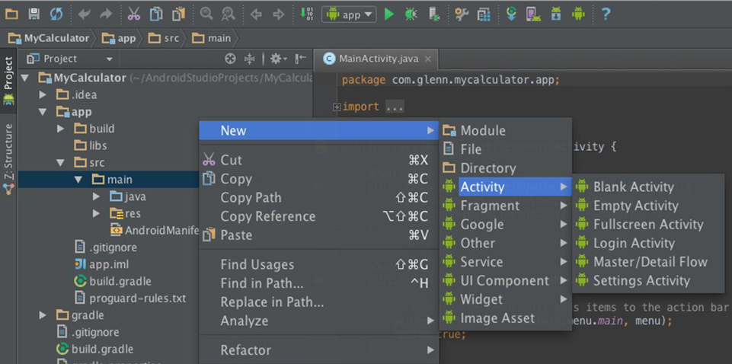
Adding an Activity

Slide 6
intent: a bridge between activities; a way for one activity to invoke another the activity can be in the same app or in a different app can store extra data to pass as "parameters" to that activity second activity can "return" information back to the caller if needed

Slide 7
Creating an Intent
Intent intent = new Intent(this, ActivityName.class);
intent.putExtra("name", value);
intent.putExtra("name", value);
startActivity(intent);
public class SecondActivity extends Activity {
public void onCreate(Bundle savedState) {
super.onCreate(savedState);
setContentView(R.layout.activity_second);
Intent intent = getIntent();
String extra = intent.getExtra("name"); } }

Slide 8
Waiting for a result
public void acsayfa(View view) { Intent intent=new Intent(MainActivity.this,SecondActivity.class); startActivityForResult(intent, 2);// Activity is started with requestCode 2 }
@Override protected void onActivityResult(int requestCode, int resultCode, @Nullable Intent data) { super.onActivityResult(requestCode, resultCode, data); if(requestCode==2) { String message=data.getStringExtra("MESSAGE"); Toast.makeText(this, "ewqee", Toast.LENGTH_SHORT).show(); } }
String message="deneme"; Intent intent=new Intent(); intent.putExtra("MESSAGE",message); setResult(2,intent); finish();//finishing activity

Slide 9
Preferences
SharedPreferences object can store permanent settings and data for your app.
– stores key/value pairs similar to a Bundle or Intent
– pairs added to SharedPreferences persist after shutdown/reboot

Slide 10
Saving preferences for the activity (in onPause, onStop):
SharedPreferences preferences = getSharedPreferences("Settings", MODE_PRIVATE); SharedPreferences.Editor editor = preferences.edit(); editor.putString("Key1","Deger 1"); editor.putString("Key2","Deger 2"); editor.apply();

Slide 11
Loading preferences later (e.g. in onCreate):
SharedPreferences preferences = getSharedPreferences("Settings", MODE_PRIVATE); String s = preferences.getString("Key1",""); Toast.makeText(this, s, Toast.LENGTH_SHORT).show();

Slide 12
Referans
Marty Stepp and Stanford Computer Science.
https://developer.android.com/

