Slide 1




PROJECT - I
DERE
CME1252 PROJECT BASED LEARNING – II
By
Ayberk Kılıçaslan 2017510053
Oktay Türkdağlı 2017510101
Efe Kaan Kabakaş 2017510042
15 March 2019

Slide 2
OUTLINE
INTRODUCTION
PROGRESS SUMMARY
Task Sharing And Scheduling
Changes In Requirements
Completed Task
Incomplete Task
ADDITIONAL IMPROVEMENTS
PROBLEMS ENCOUNTERED
SCREENSHOTS
ALGORITHMS AND SOLUTION STRATEGIES
CONCLUSION
REFERENCES

Slide 3
INTRODUCTION
The subject of the project is to develop a real estate management software for the Dokuz Eylul Real Estate company.
The software has to include some entities to handle the records of agencies, real estates, customers, employees, contracts etc.

Slide 4
PROGRESS SUMMARY
Task Sharing And Scheduling
WEEK | PROGRESS
WEEK I | Discussed the problem, designed the solutions Created necessary variables/structures
WEEK II | Taken datas from files Parsing commands Designed classes and created the necessary data structures
WEEK III | Executed add, delete and display commands Created phone, date and address classes Completed search operation, statistics, and remaining parts of the project.
WEEK IV | Taken datas from console Made some additional improvements Slides, Report, Poster

Slide 5
PROGRESS SUMMARY
Task Sharing And Scheduling
Firstly, to understand the game better, all of us drew simple flowcharts individually and we came together at school to consist the best flowchart.
Generally, when we tried to solve the problems in our individual tasks when we come together we made progress by combining our ideas.
After we finished the coding of the program, we did task sharing for the presentation.

Slide 6

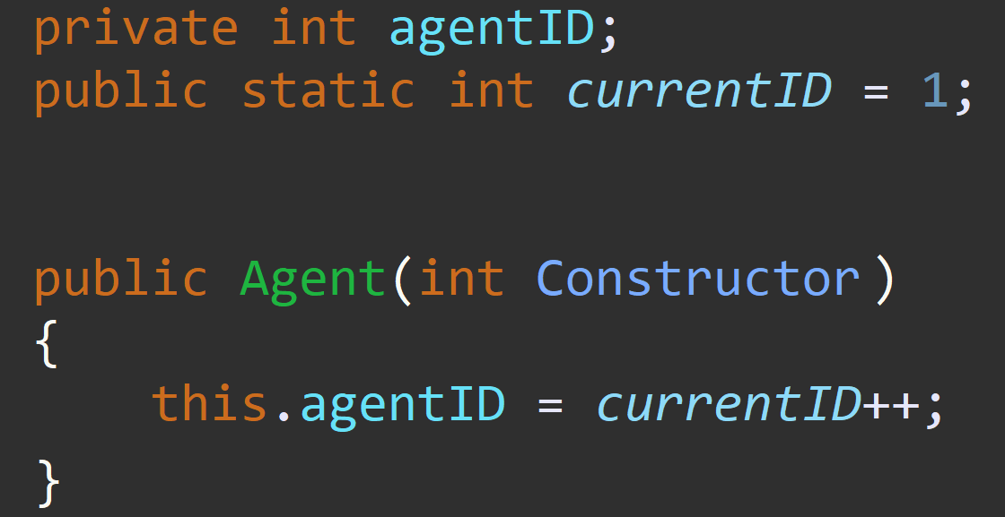
PROGRESS SUMMARY
Changes In Requirements
Each class member has «0» id unless you use static id.
We tried to count the id in main but it did not work either.

Slide 7
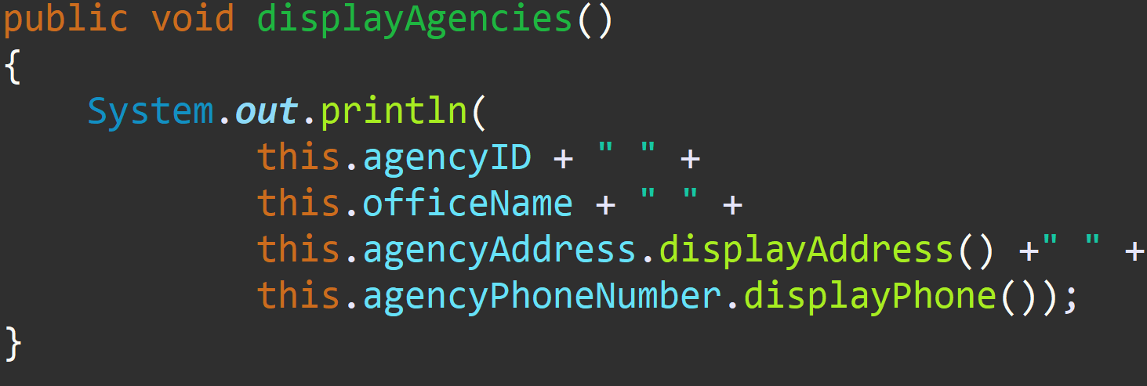
PROGRESS SUMMARY
Changes In Requirements
We created display methods in classes.
By this way, we just call the display method of the class when we need.

Slide 8
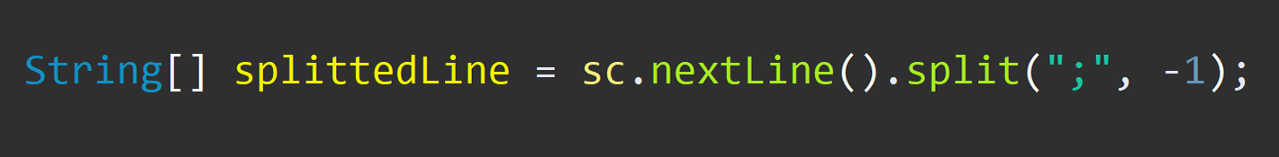
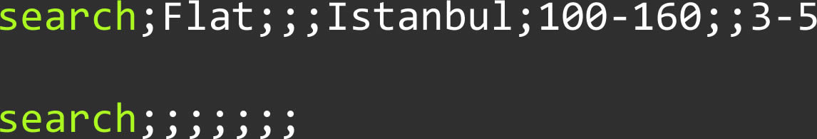
PROGRESS SUMMARY
Changes In Requirements
We added –1 value to split method when seperating the lines for easy use.

Slide 9
PROGRESS SUMMARY
Completed Task
01
STRATEGY
02
FIRST STEP
03
NECCESSARIES
Discussing the problem.
Making flowchart.
Reading txt file and
parsing commands.
Creating variables, methods and classes.
04
FUNCTIONS
05
FINAL
06
EXTRA
Search operation and calculating salaries.
Adding the user's manual input option.
Adding some new features for user.

Slide 10
PROGRESS SUMMARY
Incompleted Task
There is no incompleted task.

Slide 11




ADDITIONAL IMPROVEMENTS
WOMEN IS WOMEN, FLOWER IS YOUR FATHER
Our program respects women, That's why it transforms the word lady as a woman, this feature has been added to Turkish users.
WE MADE COLORING, THIS IS VERY DIFFICULT
All creatures on earth like colors and with our developer team we love colors. Finally we don't live in the '80s. Just like our slide, we made a colorful program.
DO YOU WANT HELP, I AM SUPERMAN
Our program likes to help. if you are uncertain about which command to write, offers a few suggestions for you.

Slide 12
PROBLEMS ENCOUNTERED
We calculated manually to find out the accuracy of the printouts
Enigma was experiencing overflow when receiving input and output
The methods were not working in main if it is not defined as static
Everything that needs to be defined as static

Slide 13
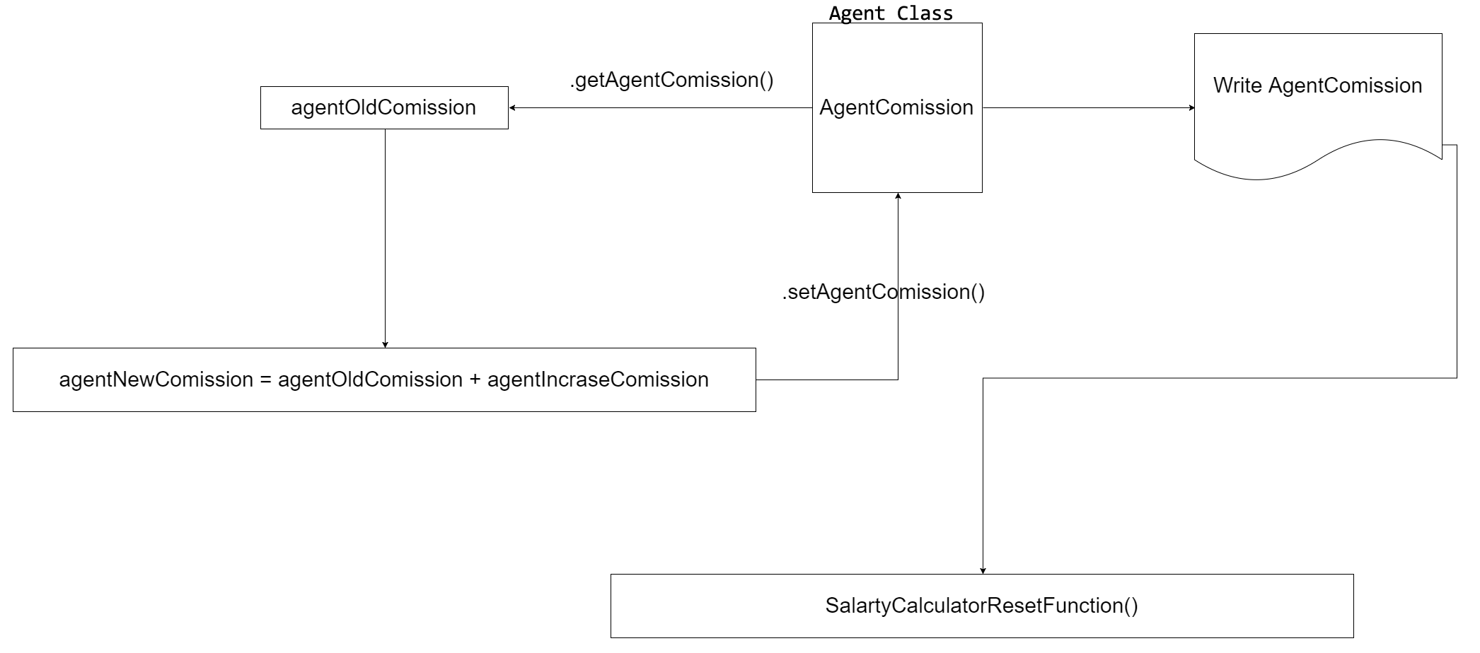
ALGORITHMS AND SOLUTION STRATEGIES
1
4
2
3
5

Slide 14
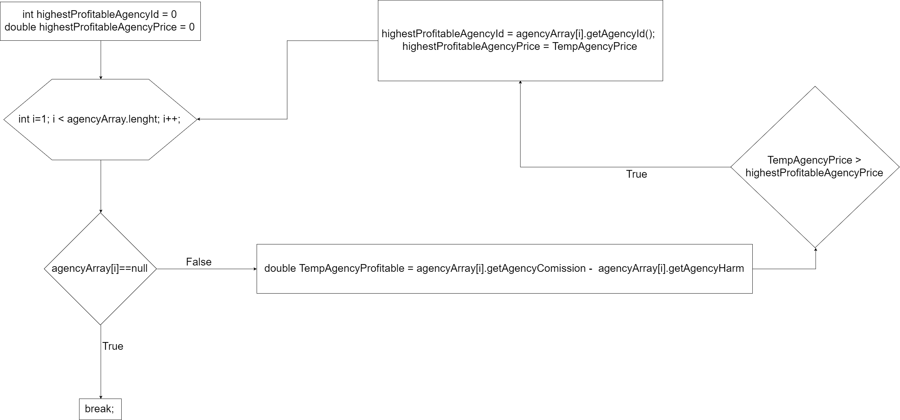
ALGORITHMS AND SOLUTION STRATEGIES
6
1
5
2
3
4
3

Slide 15
SCREENSHOTS
Hi Commander! Today is a wonderful day, please make us a favor and enter a command!
Do you want to exit from the program, enter "exit" command...
Do you want to get some help, enter "help" command...
load;input.txt
-----displayAgencies-----
Center Office;21 Sokak No:50;Buca;Izmir;02324449988
Istanbul Office;34 Sokak No:109;Sariyer;Istanbul;02123296600

Slide 16
SCREENSHOTS
addRealEstate;Flat;For Rent;Menderes Caddesi No:20;Buca;Izmir;120;1400;4
Real Estate is Added!
search;Flat;For Rent;Buca;Izmir;100-200;1000-1600;3-5
deleteAgent;11
Agent 11 is deleted!
deleteCustomer;2
Agent 11 is deleted!
Okay Commander!
1 result found…
1 Flat For Rent Menderes Cad. No:20 Buca İzmir 120 1400.0 4

Slide 17
CONCLUSION
The project is finished perfectly
The project has clean coding, object oriented structure and effective algorithms
It has a enigma interface and some special functions
Also it is respectful, helpful and colorful

Slide 18
REFERENCES
https://www.javatpoint.com/static-keyword-in-java
https://www.geeksforgeeks.org/classes-objects-java/
https://www.geeksforgeeks.org/system-exit-in-java/
https://www.w3schools.com/java/java_constructors.asp
http://javadevnotes.com/java-string-split-tutorial-and-examples

Slide 19
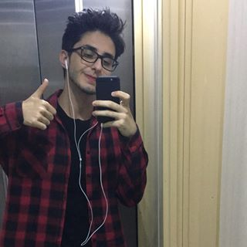
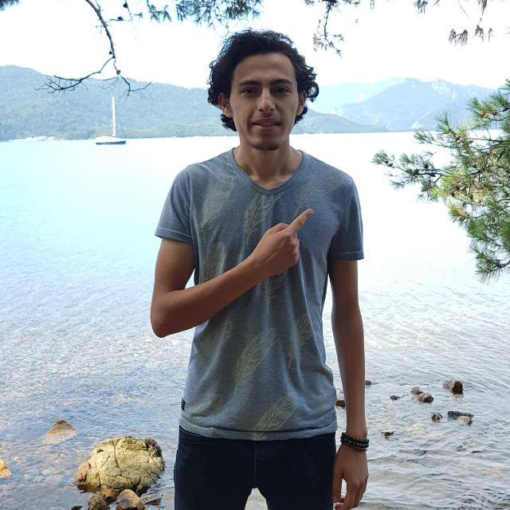
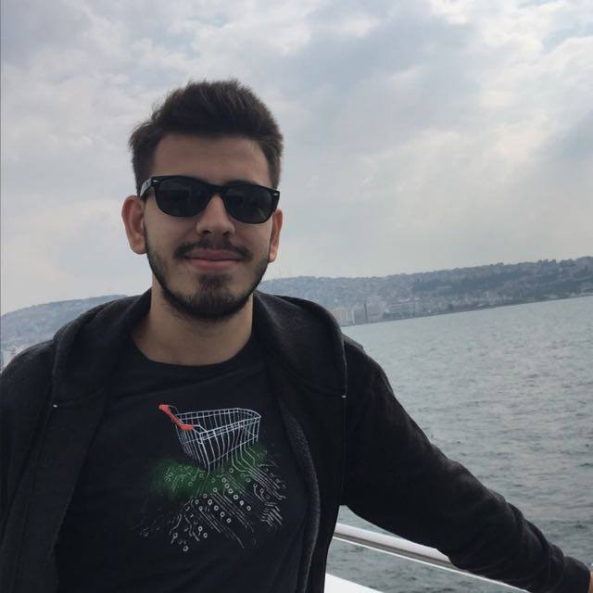
ANY QUESTION?
If you’re not having fun with what
you’re doing then you’re doing it wrong.
AYBERK KILIÇASLAN
OKTAY TÜRKDAĞLI
EFE KAAN KABAKAŞ
Designer
Project Manager
Programmer
Our designer, he got himself a new smart phone after design the program. What is this! now he can shoot his selfie with 5 MP.
Our project manager resigned after the end of the program. Now, he is selling lemons.
Our programmer became blind after writing the code.

