Slide 1



SMART INSULIN PUMP
DEPARTMENT OF BIOMEDICAL ENGINEERING
FACULTY OF ENGINEERING
UNIVERSITY OF LAGOS
BY:
ONYEJIAKA MADUABUCHI 170410008
AND
LAWAL AYOBAMI 170410023
SUPERVISOR : DR. O.A ADELEYE
DEPARTMENT OF BIOMEDICAL ENGINEERING
FACULTY OF ENGINEERING
UNIVERSITY OF LAGOS

Slide 2
OUTLINE
INTRODUCTION
LITERATURE REVIEW
METHODOLOGY
REFERENCES

Slide 3
INTRODUCTION
Background to the study
Statement of the problem
Aim and Objectives
Significance of the study

Slide 4
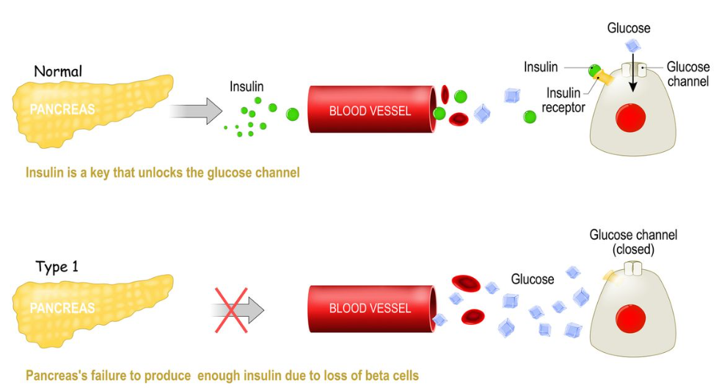
Background Of The Study
Diabetes mellitus, a chronic condition characterized by impaired insulin production or function, affects millions worldwide.

Slide 5

Background Of The Study
Diabetes cases have increased exponentially, especially Type 1 in youth (World Health Organization [WHO], 2021).
Insulin pumps help with compliance but lack real-time glucose data and automation (Murphy et al., 2022).
Smart closed-loop systems can revolutionize self-management.

Slide 6
Statement Of The Study
This project aims to design and prototype a smart insulin pump integrating continuous glucose monitoring, automation algorithms and connectivity for improved diabetic care.

Slide 7
Aim And Objectives
To Add connectivity and app for remote monitoring/alerts
Aim:
To develop a cost-effective, smart insulin pump for automated blood glucose control and management.
Objectives:
To Incorporate real-time continuous glucose monitor
To Develop control algorithms to automate insulin delivery
To Test and validate the automated insulin pump system

Slide 8
Literature Review
A number of study has been done on smart insulin pump with continuous glucose monitoring. Below are a few of them :
Closed-Loop Systems Advancements
Agrawal et al., 2020. Engineering insulin delivery devices for improved glucose control.
Combining continuous glucose monitoring with automated insulin delivery

Slide 9
Literature Review
Sun et al., 2022. Personalized model predictive control for automated insulin delivery: In silico evaluation of single- and dual-hormonal control.
Model Predictive Control emerging as optimal algorithm

Slide 10
Literature Review
Key Technology Enablers
Miao et al., 2022. Accuracy of real-time continuous glucose monitoring sensors in outpatients with Type 2 Diabetes Mellitus.
Accurate and low-cost CGM sensors like Dexcom G6
Bode et al., 2022. Clinic-to-home transition and clinical biomarkers of glycemic control using a mobile app-driven insulin guidance system
ESP32 microcontroller for control algorithms & connectivity

Slide 11
Literature Review
Kumaresan et al., 2022. DIABITS: A closed-loop insulin delivery system with Bluetooth remote monitoring.
Bluetooth for app connectivity and remote monitoring
Wu et al., 2022. Effects of the WeChat-based telemedicine educational program on glycemic variability and diabetes management in Chinese patients with type 2 diabetes
Android apps aid in glucose management when tailored to patient

Slide 12
Literature Review
Sabanayagam & Sandarua, 2022. Closed-loop insulin delivery systems for diabetes management: Current perspectives and future directions.
In summary, integrating reliable CGM, intelligent algorithms, and connectivity provides an optimized automated system

Slide 13

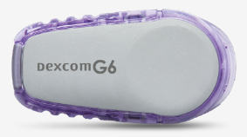

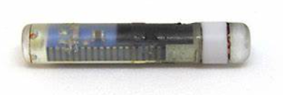
METHODOLOGY
The key methods and technologies used to develop the smart insulin pump are:
Sensor Selection
Evaluate accurate CGM sensors like Dexcom G6, Eversense for performance metrics and cost
Finalize sensor based on accuracy, reliability, affordability constraints
Fig.1 DexcomG6 sensor
Fig.2 Eversense sensor

Slide 14
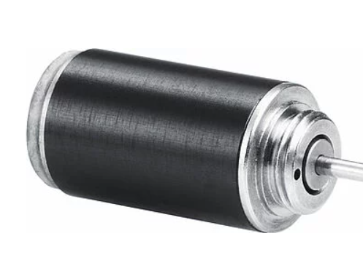
METHODOLOGY
Delivery Mechanism
Design pumping mechanism with stepper motor for precision
Incorporate durable insulin reservoir and cannula setup
Stepper Motor

Slide 15
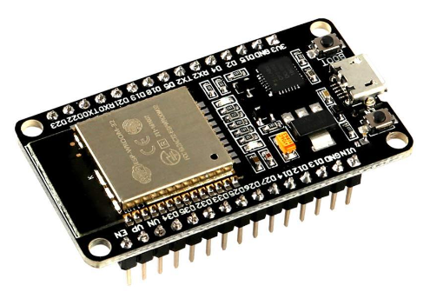
METHODOLOGY
Control Algorithm Development
Explore and adapt model predictive control algorithms from literature
Tune algorithm based on clinical glucose data for personalized delivery
Electronics and Firmware
Select ESP32 as the main microcontroller for this system
Program insulin delivery logic and connectivity firmware with Arduino IDE
ESP32 Microcontroller

Slide 16
METHODOLOGY
App Development
Build Android app with connectivity to device using Bluetooth protocols
Enable remote monitoring, logging and alerts for users
Testing and Validation
Rigorously test sub-systems first followed by integrated system
Validate key metrics - accuracy, reliability, automation performance in trials

Slide 17
REFERENCE
World Health Organization [WHO]. (2021). Diabetes factsheet. https://www.who.int/news-room/fact-sheets/detail/diabetes
Murphy, H. R., Rayman, G., & Skinner, T. C. (2022). Psycho-educational interventions for children and young people with Type 1 diabetes. Diabetic Medicine, 39(1), 40-51.
Agrawal, P., Welsh, J. B., & Kannard, B. (2020). Engineering insulin delivery devices for improved glucose control. Annual Review of Biomedical Engineering.
Bode, B., Choudhary, P., Gilmore, L. A., Sutton, D., Blake, K., Brazg, R. L., ... Grosman, B. (2022). Clinic-to-home transition and clinical biomarkers of glycemic control using a mobile app-driven insulin guidance system: BIoLA. Diabetes Technology & Therapeutics, 24(1), 40-47.
Kumaresan, K., Alhattab, D., & Elkhader, I. A. (2022). DIABITS: A closed-loop insulin delivery system with Bluetooth remote monitoring. Biomedical Signal Processing and Control, 73, 103288.

Slide 18
REFERENCE
Miao, M., Pan, Y., Wang, Y., Wang, Z., Zhang, H., Wu, X., Mi, B., Zhou, X., Wang, Q., & Yin, B. (2022). Accuracy of real-time continuous glucose monitoring sensors in outpatients with Type 2 Diabetes Mellitus. Medical Devices & Sensors, 7(1).
Sabanayagam, C., & Sandarua, S. (2022). Closed-loop insulin delivery systems for diabetes management: Current perspectives and future directions. Applied Sciences, 12(2), 799.
Sun, Q., Dassau, E., Gondhalekar, R., Gao, J., Doyle Iii, F. J., Zisser, H., & Jiang, P. (2022). Personalized model predictive control for automated insulin delivery: In silico evaluation of single- and dual-hormonal control. Journal of Diabetes Science and Technology, 16(3), 592-601.
Wu, Y., Zhou, H., Wang, Q., Zhang, S., Wu, X., Ji, L., Wang, W., & Ji, Q. (2022). Effects of the WeChat-based telemedicine educational program on glycemic variability and diabetes management in Chinese patients with type 2 diabetes: Randomized controlled trial. JMIR mHealth and uHealth, 10(1), e26818.

