Slide 1

In-depth Analysis of Movie Productions
Ayda Woldegerima
This Photo by Unknown Author is licensed under CC BY-SA-NC

Slide 2
OBJECTIVE
Analyze and Understand the movie production industry
Investigate 5 questions to address business problem
Provide beneficial suggestions to to help Microsoft in deciding what movies to produce to join the film production market

Slide 3
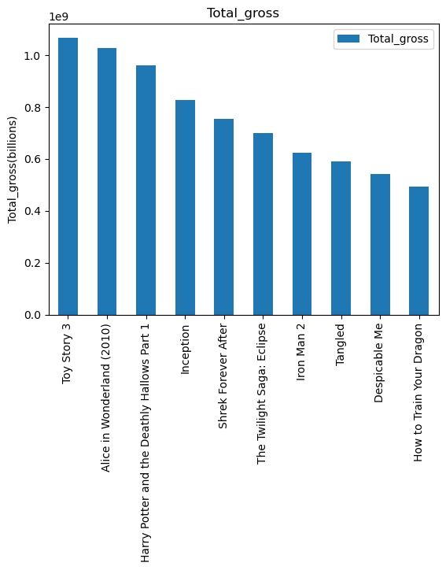
Question 1: What is the highest gross profit obtained for movies?
The highest profit is around 1.5 billion
This shows what the profit expectation is in order to set the budget

Slide 4
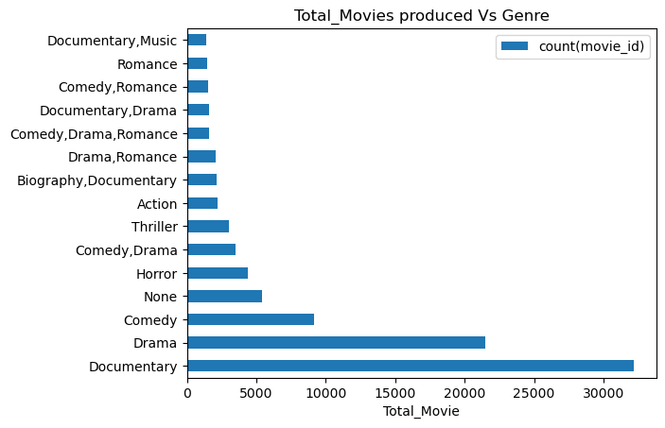
Question 2: Which Genres has the most movies produced?
The genre with a lot of movies produced is Documentary followed with Drama
This opens up the question to see why most movies are being produced in certain Genre

Slide 5
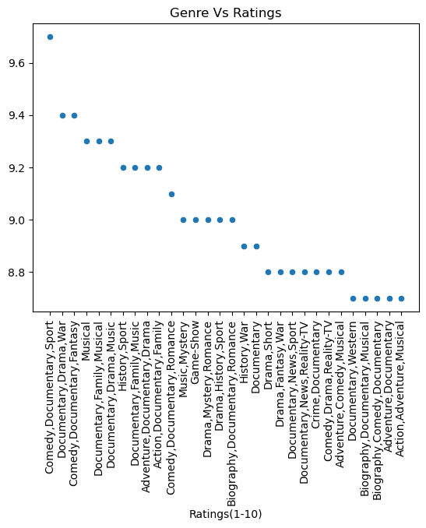
Question 3: Does movie genres and movie rating have correlation?
As per the data genre with most movie and rating is showing some correlation
The highest rated movies are somewhere in Documentary and Drama

Slide 6
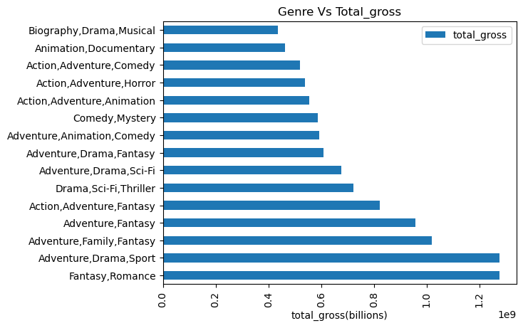
Question 4: Does Genres and gross of profit have any correlation?
Amount of movies in genre does not correlate to gross profit
The genre with the most profit is Fantasy/Romance , Adventure/Drama

Slide 7
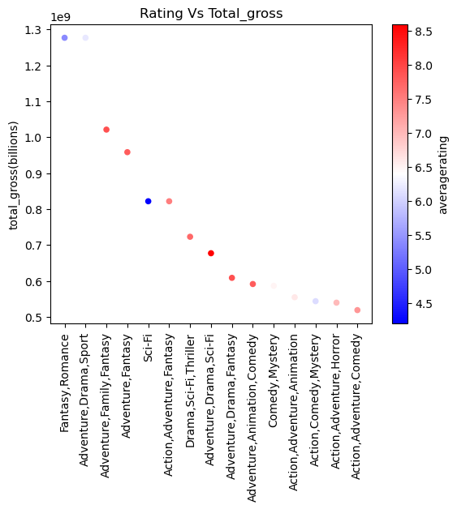
Question 5: What is the rating of each Genres with high gross profit?
Data is indicating that average rating does not have an impact on the gross profit of the movie produced
The highest profited movie genre has a rating close to 6

Slide 8
Conclusion and Further Suggestions
From all the observations made, I suggest that Microsoft's new movie studio focuses on genre that is making the most profit.
The current analysis serves as a steppingstone in the process for new studio to produce movie.
We still need to keep in mind other factors for the movie's success, such as Producers, time of production, actors etc.

