Slide 1
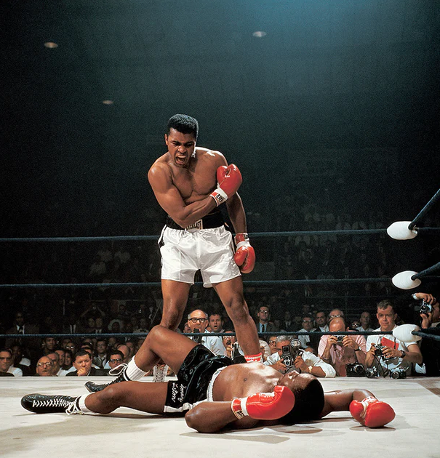
The
Phantom
Punch
Neil Leifer
May 25, 1965

Slide 2
Historical context
Second fight between Cassius Clay (Muhammad Ali) and Sonny Liston
Took place on May 25, 1965
Clay knocked out Liston on the first round with a single punch
Due to this, many claimed the fight was fixed

Slide 3
Why is it iconic ?
Symbolizes Ali’s power and confidence
Visually powerful, well framed and shows the importance of the event for the sport
Recalls a controversial event of sports history

Slide 4
Modern perspectives
To this day, the fight remains a topic of debate
This photograph is still considered one if not the greatest of sports history
Strong meaning for the pop culture and black civil rights

