Slide 1











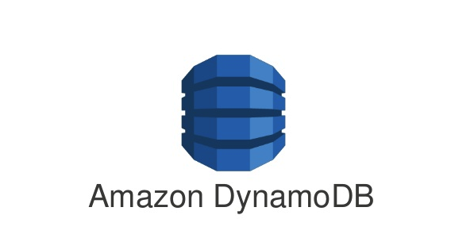

AWS Overall View Cloud System Design
Virtual Private Cloud
Authentication
Avail Zone 1
Public Gateway
Private
Image
Upload
AWS VPC Nat Gateway
Web
Portal
Web
App/Page
AWS Cognito
Avail Zone 2
Private Gateway
Amazon
MSK
Kafka Stream
Transformation
AWS VPC Nat Gateway
Web
Portal
Web
App/Page
Company
AWS
Lambda w Code on Kafka
Data Silo
BI/Analytics
S3 Bucket
S3 Bucket
S3 Bucket
Amazon
Quicksight
S3 Bucket
S3 Bucket
S3 Bucket

Slide 2
S3 System Design
User
DNS
Cluster Manager
Resource Tracking for data storage
Hold policies
Manage data storage clusters
Partition Manager
Entry point to data storage
Load Balancer
DB
Authentication
API Server(s)
Partition Map Table
Contains map of all the data and where they are stored
Partition Server
Partition Server
Partition Server
Partition Server
US
Stream Manager
Redundancy Planning w Synchronized writing
Europe
File Server
File Server
File Server
File Server
Manage health of storage clusters
Manage storage space to scale
Asia
File Server
File Server
File Server
File Server
AU
File Server
File Server
File Server
File Server

