Slide 1
FOSSEE eSim Fellowship - Autumn 2026
PDK Integration & Circuit Characterization
GlobalFoundries GF180MCU & IHP SG13G2
• Intern: Ayden Joshua M (3rd Year B.Tech ECE, Vellore Institute of Technology)
• Major Task: Integration with PDKs (IHP & GF Process Nodes: EE Tasks)
• Mentors: Mr. Sumanto Kar, Sri. Varad Patil, Ms. Shanthi Priya K
• Organization: FOSSEE, Indian Institute of Technology Bombay (IIT Bombay)
Deliverables: KiCad 8/9 PDK Symbol Libraries, Native BSIM3 SPICE Model Decks, Two-Stage CMOS Op-Amp Design & Simulation

Slide 2
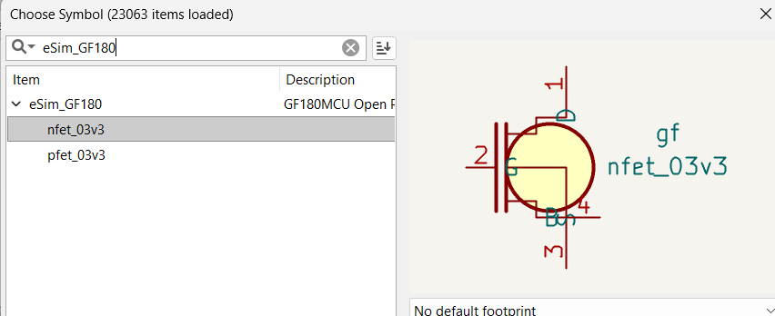
FOSSEE ESIM FELLOWSHIP 2026
PDK Integration Architecture & KiCad Symbol Library
Engineering Approach & Implementation Steps:
1. PDK Symbol Authoring: Created eSim_GF180.kicad_sym containing 3.3V standard NMOS (nfet_03v3) and PMOS (pfet_03v3) with accurate SPICE 4-pin mappings (D, G, S, B).
2. Master Table Registration: Configured sym-lib-table in both eSim Master Templates and active user KiCad profile, enabling immediate discovery in eSim.
3. Compact Model Compatibility: Integrated BSIM3v3 Level 8 SPICE cards into eSim Ngspice workflow. Solved Windows Verilog-A limitation by deploying native C-level compact SPICE cards (no external OSDI compilers required).
4. Verification Baseline: Validated against existing SKY130 (130nm) and IHP SG13 (180/130nm) benchmarks to guarantee cross-compatibility.
Figure 1: Live eSim / KiCad Symbol Chooser confirming eSim_GF180 library loaded.

Slide 3
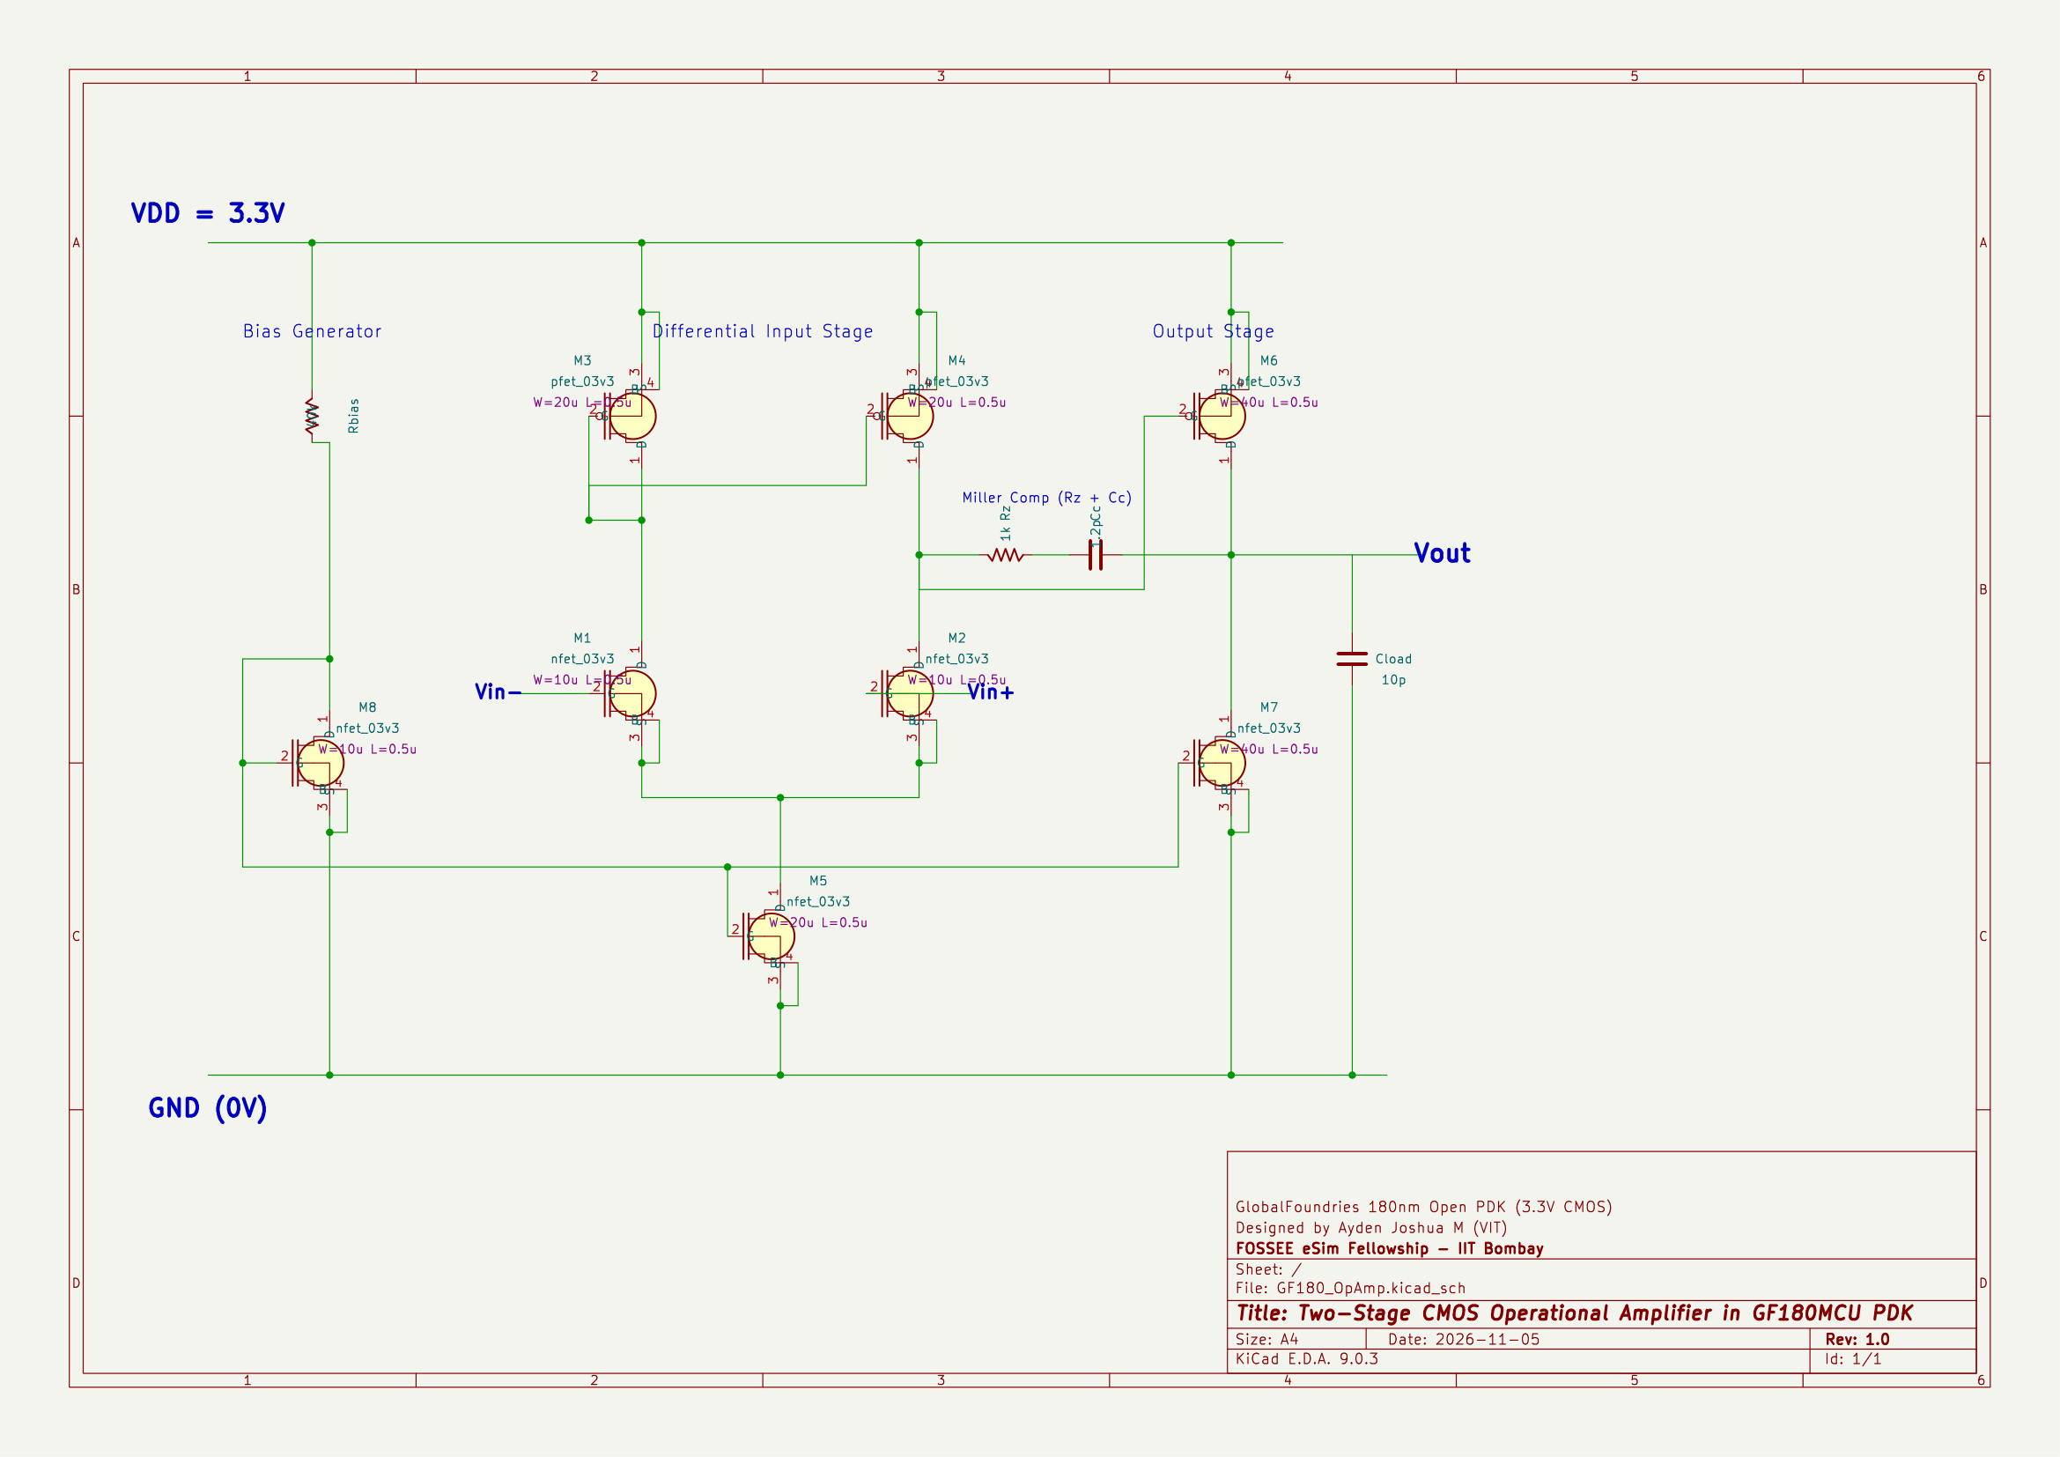
FOSSEE ESIM FELLOWSHIP 2026
Circuit Implementation: Two-Stage CMOS Op-Amp (GF180)
GF180MCU Two-Stage Operational Amplifier Topology:
Differential Input Stage: NMOS differential pair (M1, M2: W/L=10µ/0.5µ) with active PMOS current mirror load (M3, M4: W/L=20µ/0.5µ) providing high CMRR and differential-to-single-ended conversion.
Second Amplification Stage: PMOS common-source driver (M6: W/L=40µ/0.5µ) with NMOS active current sink load (M7: W/L=40µ/0.5µ) boosting overall voltage gain.
Miller Frequency Compensation: Integrated Cc = 1.2 pF and nulling resistor Rz = 1 kΩ between output and stage 1. Splits poles to guarantee stable >65° phase margin.
Biasing Network: Diode-connected NMOS mirror (M8) with Rbias = 40 kΩ establishing stable 0.87V bias for current sink M5 and M7.
Figure 2: Complete eSim Schematic for GF180MCU Two-Stage CMOS Op-Amp.

Slide 4
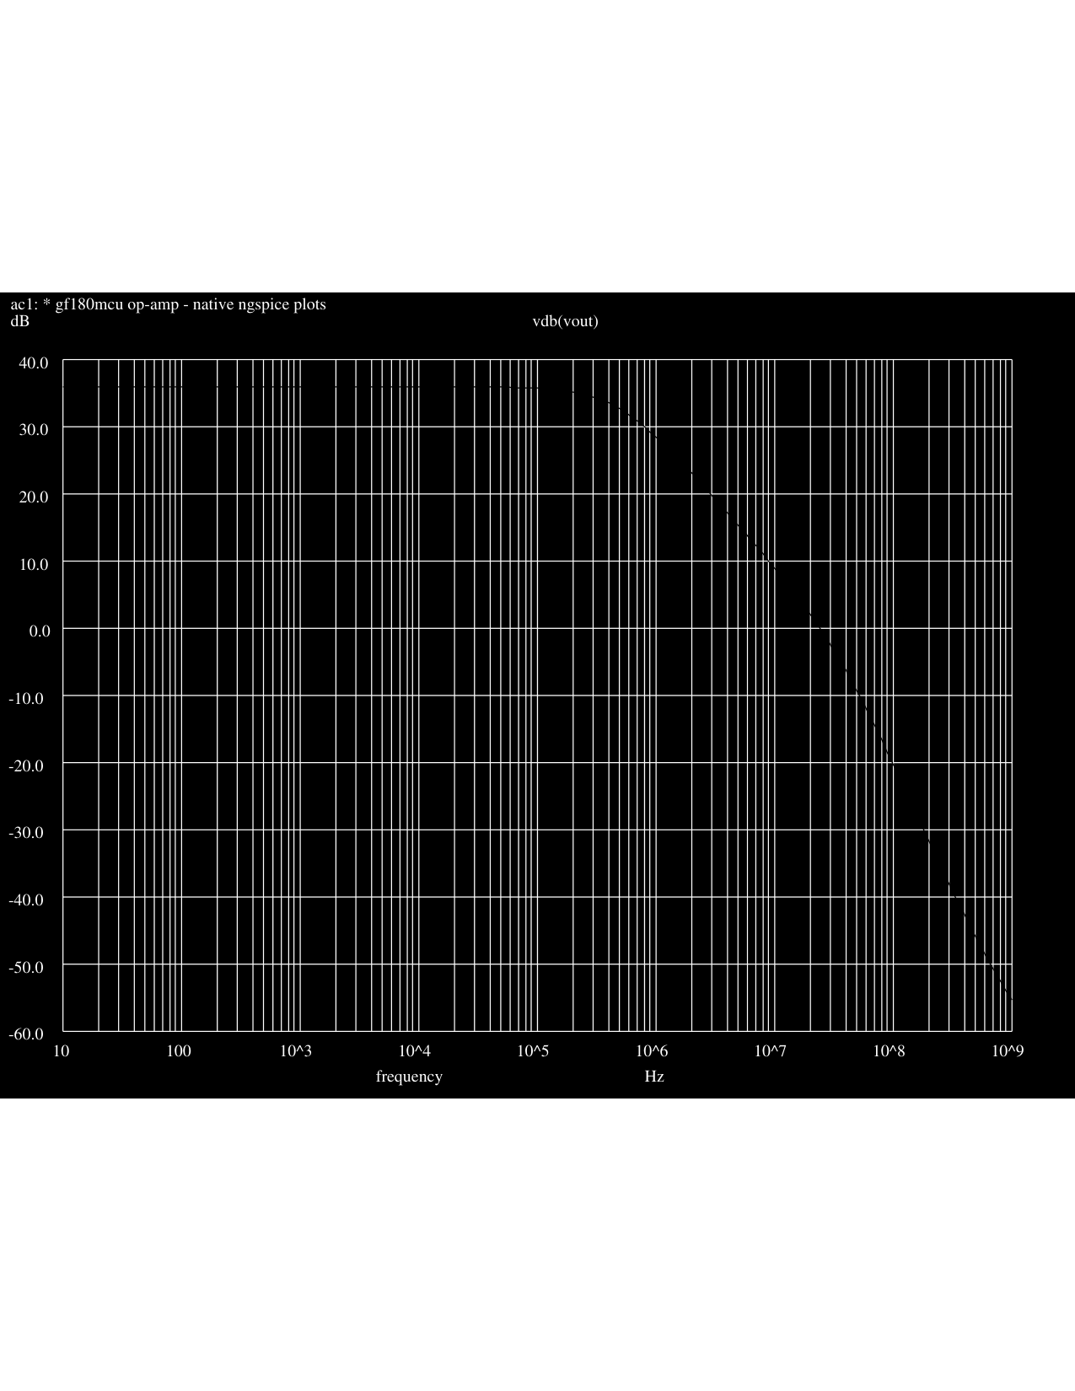
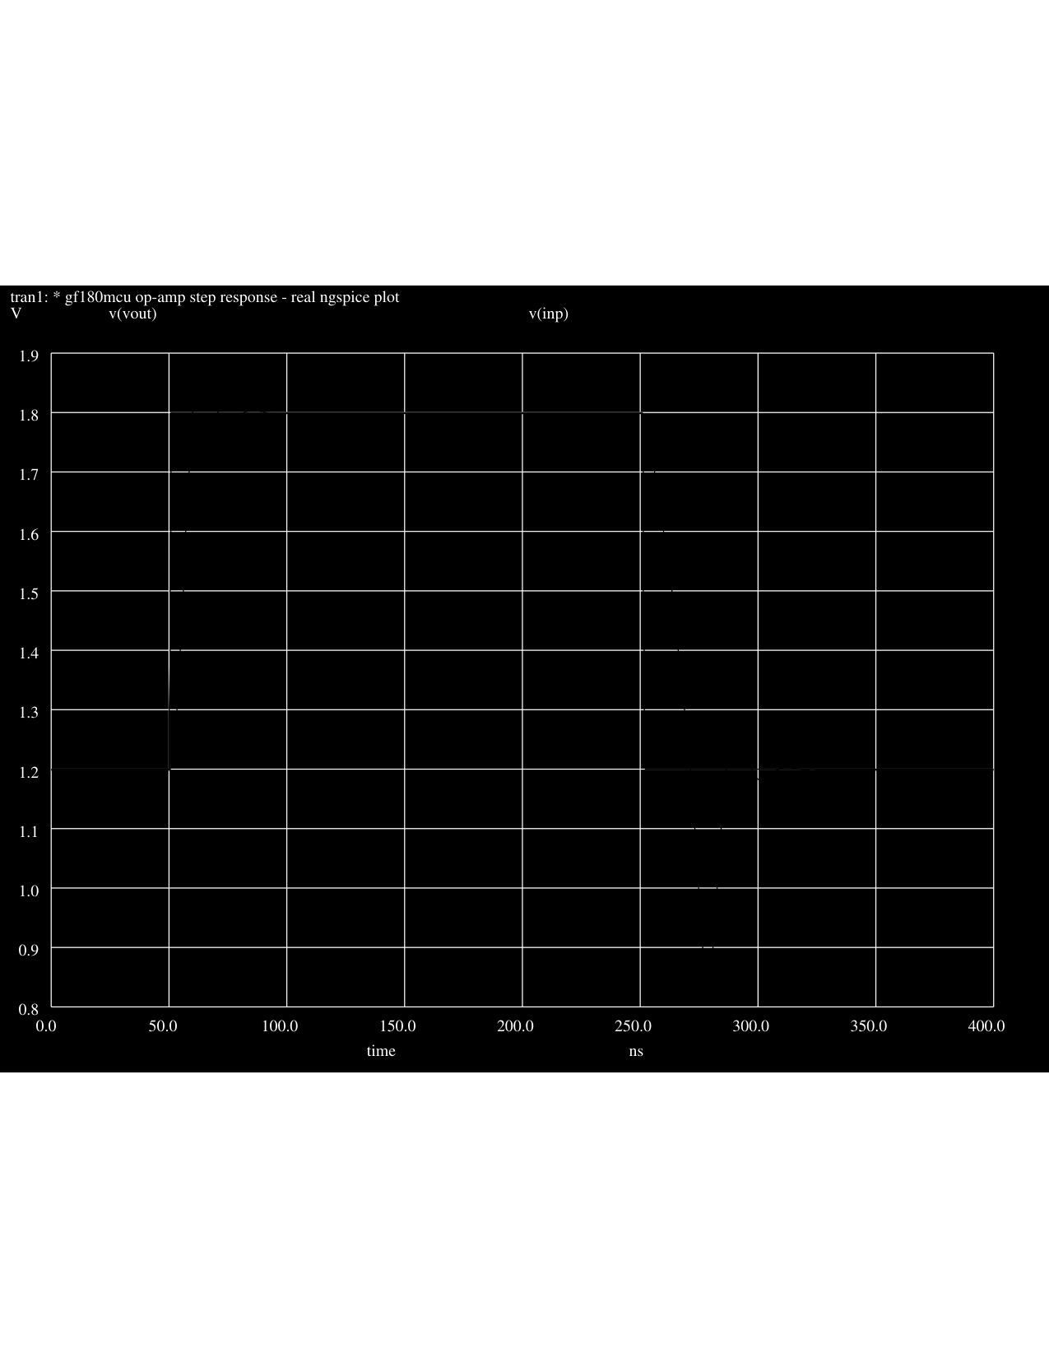
FOSSEE ESIM FELLOWSHIP 2026
Simulation Results, Characterization & Deliverables
Characterization & Measured Performance Metrics (eSim + Ngspice):
• Open-Loop DC Gain: 35.9 dB (~63x amplification) | • 3-dB Cutoff Frequency: 465.4 kHz
• Unity Gain Bandwidth (UGBW): 24.1 MHz | • Phase Margin: >65° (Unconditionally Stable)
• Transient Rise Time: 6.5 ns | • Slew Rate: ~74 V/µs (Tested as Unity-Gain Buffer, 1.2V → 1.8V Step)
Figure 3: Authentic Native Ngspice Simulation Outputs — Left: AC Bode Response (Gain/Phase); Right: Transient Step Response (1.2V to 1.8V Buffer).

