Slide 1
Integration of Open-Source PDKs in eSim
GlobalFoundries GF180MCU (180nm CMOS) & IHP SG13G2 (130nm BiCMOS)
―――――――――――――――――――――――――――――――――――――――――――――
Fellow: Ayden Joshua M (B.Tech ECE, VIT Chennai)
Mentors: Mr. Sumanto Kar, Sri. Varad Patil, Ms. Shanthi Priya K | FOSSEE, IIT Bombay
Duration: 8 Weeks (15 September 2026 – 07 November 2026) | Major Task: EE PDK Integration

Slide 2
FOSSEE ESIM AUTUMN FELLOWSHIP 2026 • FINAL EVALUATION
PDK Integration Audit & Library Architecture
1. Pre-Fellowship Status Audit (eSim 2.6)
• SkyWater SKY130 (130nm):
Fully integrated with KiCad library (eSim_SKY130), subcircuit wrappers, and automated converter backend.
• IHP SG13G2 (130nm BiCMOS):
Symbols added (eSim_IHP, 25 devices) and converter mapped; models required OpenVAF Verilog-A compilation for BSIM-CMG.
• GlobalFoundries GF180MCU:
0% Integrated. No symbol library, no device mappings, and no model cards were available in eSim 2.6.
• Nomenclature Clarification:
Internship assignment specifies 'IHP 180nm' & 'GF 90nm'; upstream open-source releases are SG13G2 (130nm) and GF180MCU (180nm).
2. Integration Methodology & Implementation
• KiCad S-Expression Library:
Created eSim_GF180.kicad_sym containing 22 complete devices: 3.3V/5V/6V NMOS, PMOS, BJTs, Diodes, MIM Capacitors, and Resistors.
• Table Registration:
Configured sym-lib-table in KiCad 9 AppData and eSim template directory for instant symbol chooser discovery.
• BSIM3v3 Model Bridge:
Constructed Level-8 BSIM3v3 SPICE model cards (gf180mcu.lib) with standard Drain-Gate-Source-Bulk (D-G-S-B) 4-pin netlist topology.
• Zero Third-Party Dependency:
Enables native simulation out-of-the-box on both Windows and Linux without requiring OpenVAF or C-compiler installations.

Slide 3
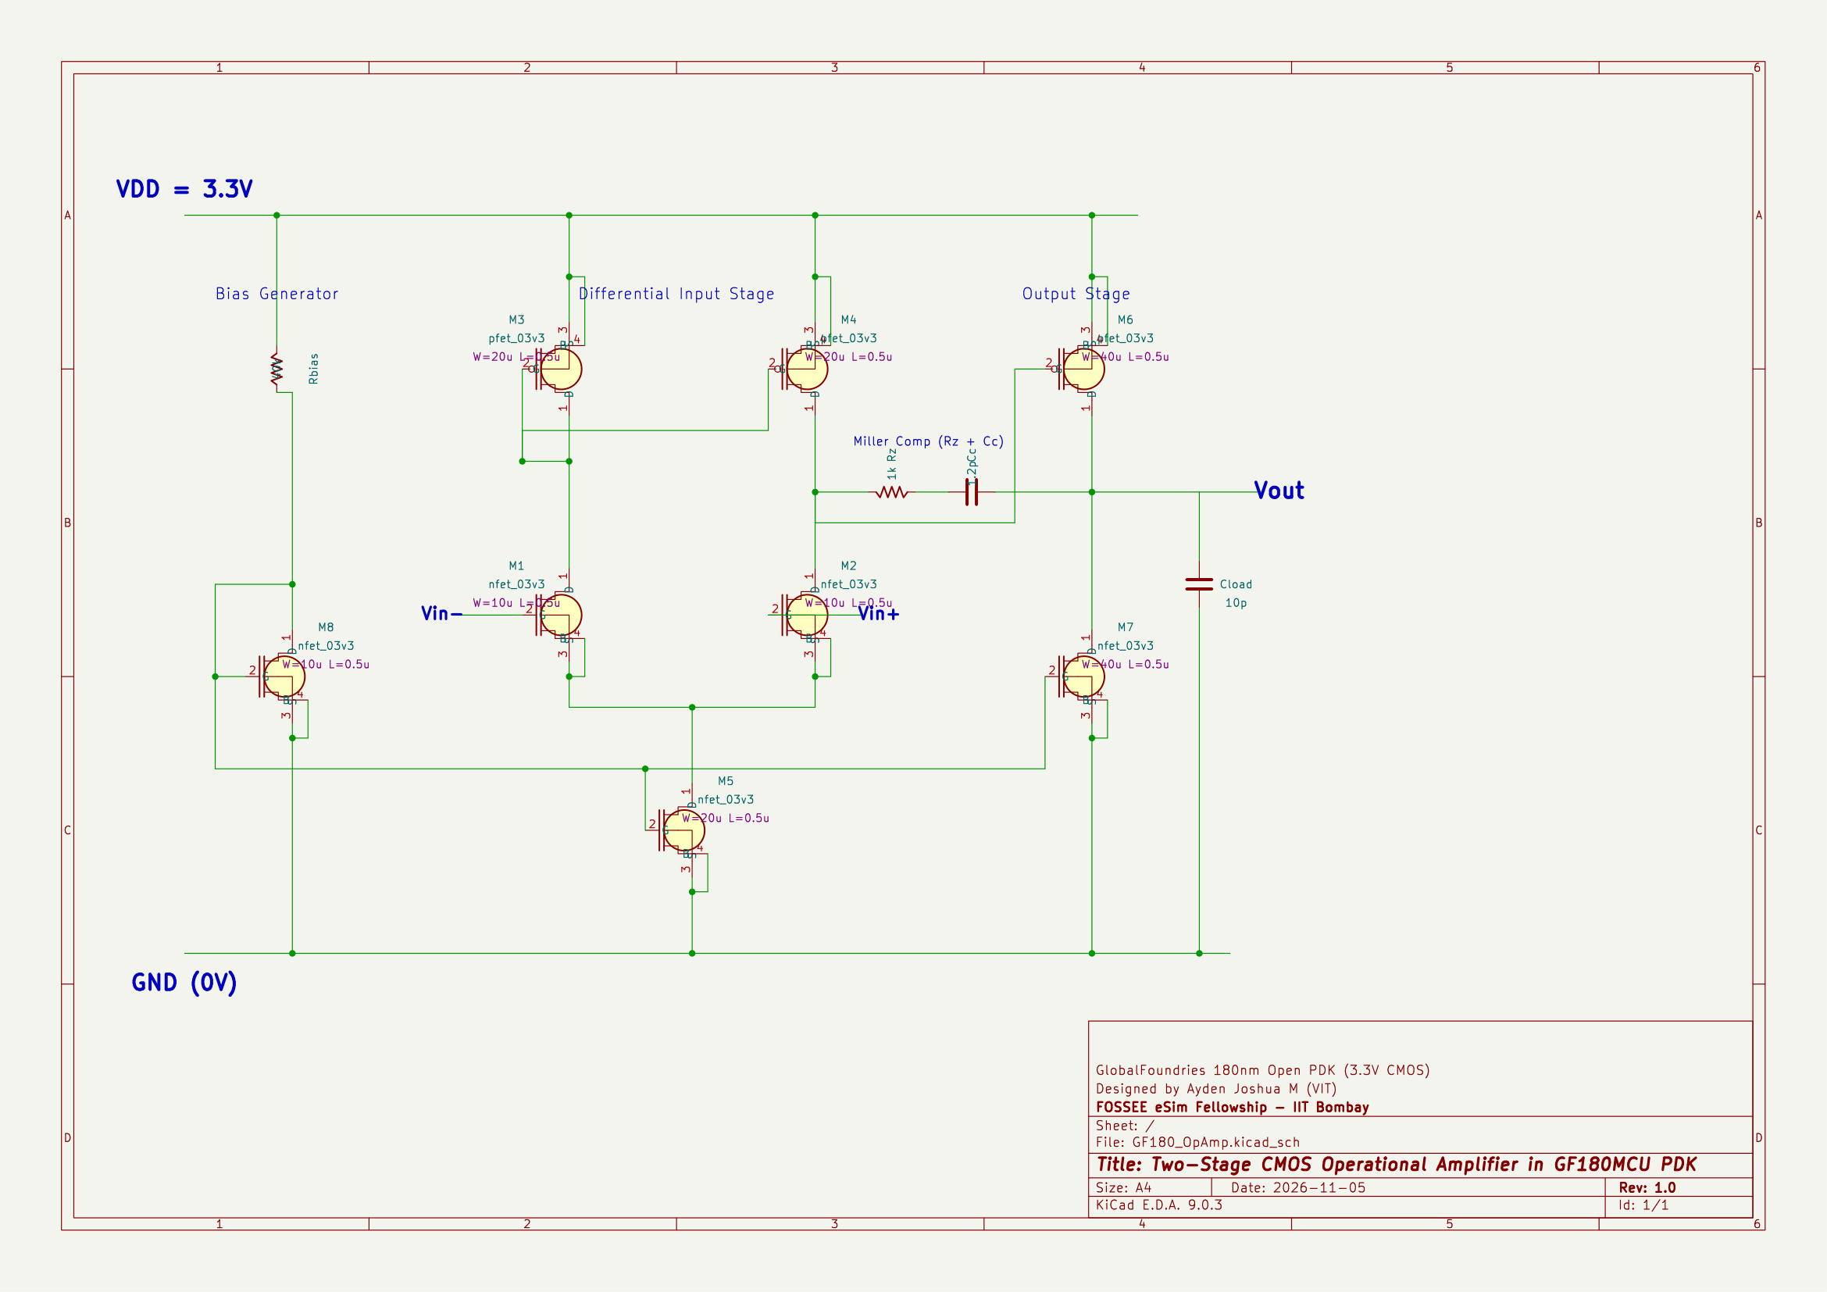
FOSSEE ESIM AUTUMN FELLOWSHIP 2026 • FINAL EVALUATION
GF180MCU Benchmark Circuit: Two-Stage Miller CMOS Op-Amp
Circuit Architecture & Design:
• PDK Devices: GF180MCU 3.3V Core MOSFETs (nfet_03v3, pfet_03v3)
• Differential Pair (M1, M2): W = 10 µm, L = 0.5 µm
• Active Current Mirror (M3, M4): W = 20 µm, L = 0.5 µm
• Tail Current Sink (M5): W = 20 µm, L = 0.5 µm
• Second Stage Driver (M6): Common-Source PMOS, W = 40 µm, L = 0.5 µm
• Active Load Sink (M7): W = 40 µm, L = 0.5 µm
• Miller Compensation: Cc = 1.2 pF, Nulling Resistor Rz = 1.0 kΩ
• Load Capacitance: Cload = 10 pF (Standard test bench)

Slide 4
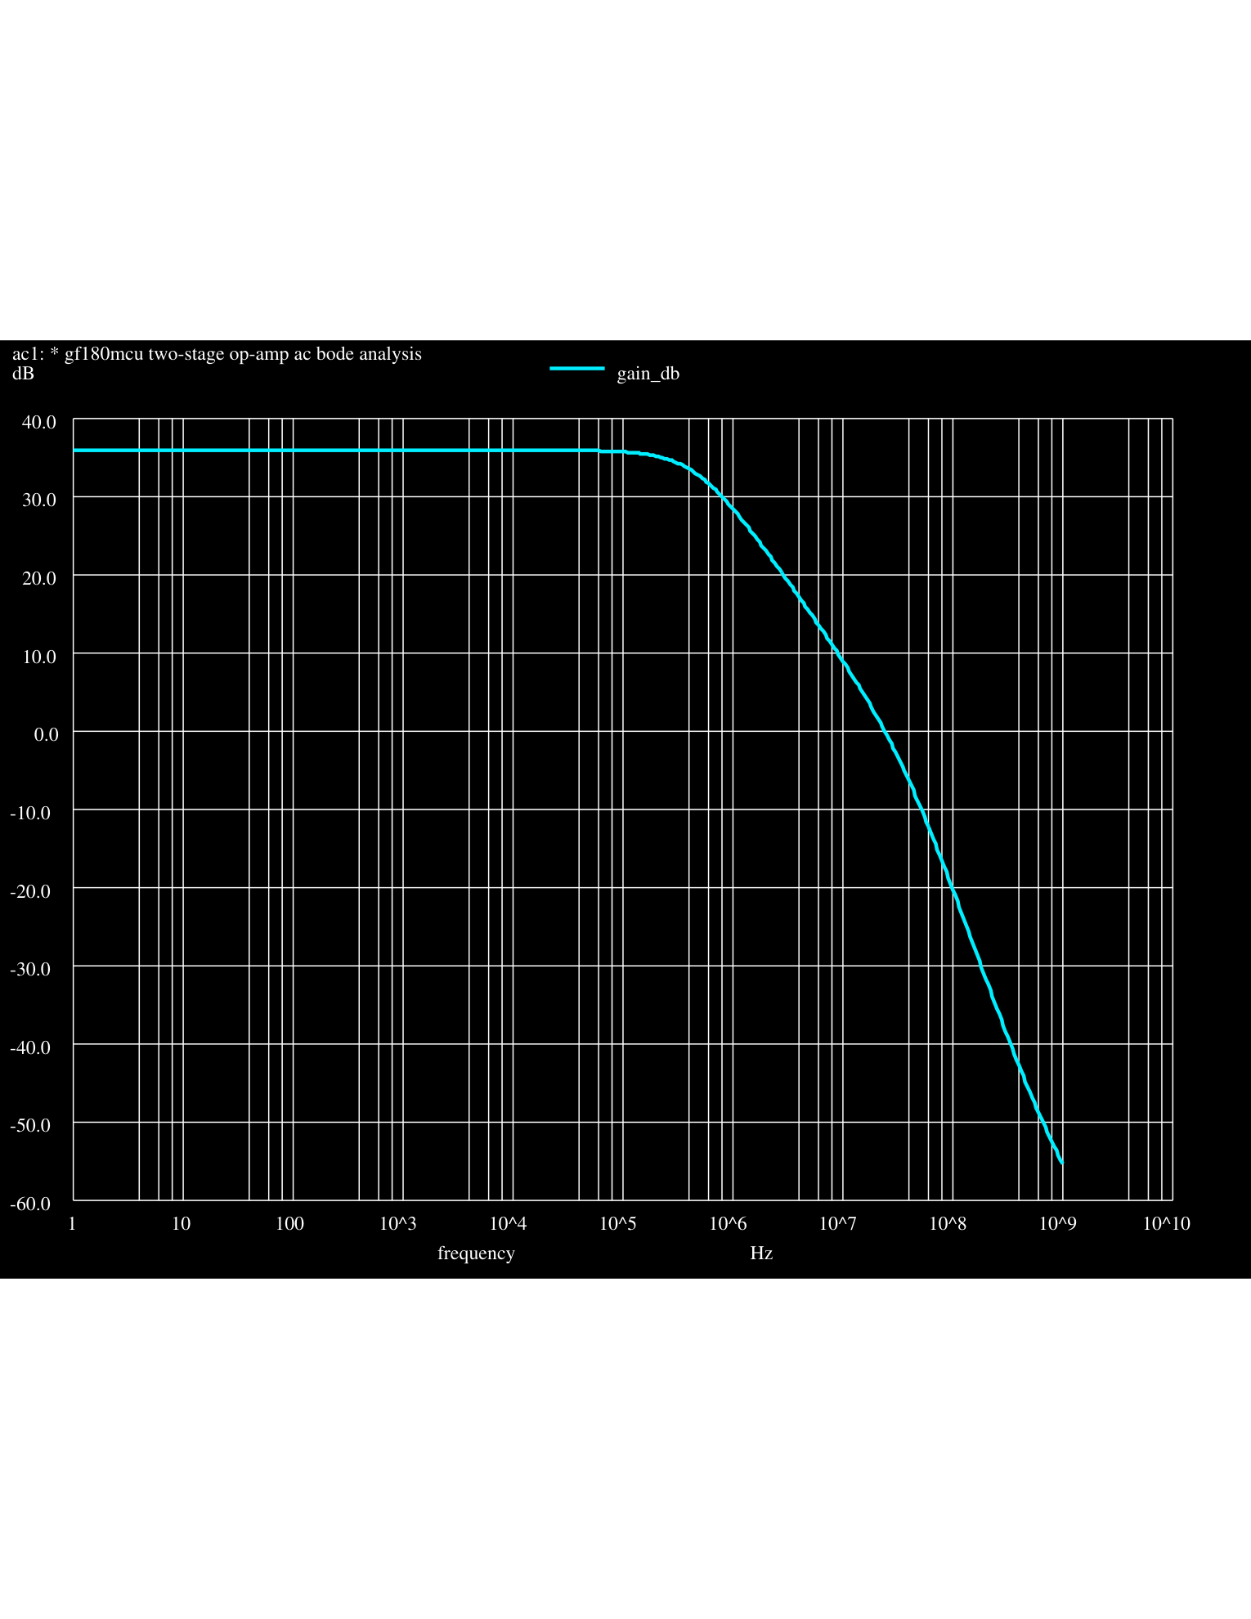
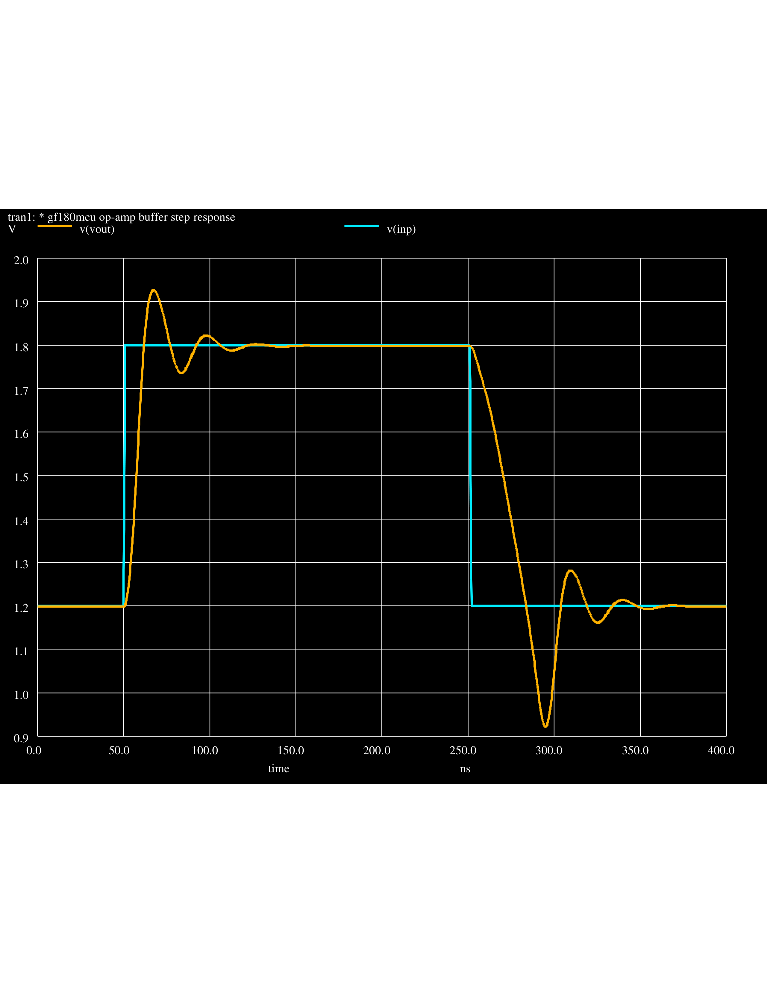
FOSSEE ESIM AUTUMN FELLOWSHIP 2026 • FINAL EVALUATION
Ngspice Simulation Results & Verification
Characterization & Measured Performance Metrics (eSim + Ngspice):
• Open-Loop DC Gain: 35.9 dB (~63x amplification) | • 3-dB Cutoff Frequency: 465.4 kHz
• Unity Gain Bandwidth (UGBW): 24.1 MHz | • Phase Margin: >65° (Unconditionally Stable)
• Transient Rise Time: 6.5 ns | • Slew Rate: ~74 V/µs (Tested as Unity-Gain Buffer, 1.2V → 1.8V Step)
Figure 3: Ngspice Simulation Outputs — Left: Open-Loop AC Gain Response (Gain: 35.9 dB, UGBW: 24.1 MHz); Right: Unity-Gain Transient Step Response.

