Slide 1
Obstacle Remover Sumo Robot
Aydoğan Arslantaş , Deni Utsiev

Slide 2
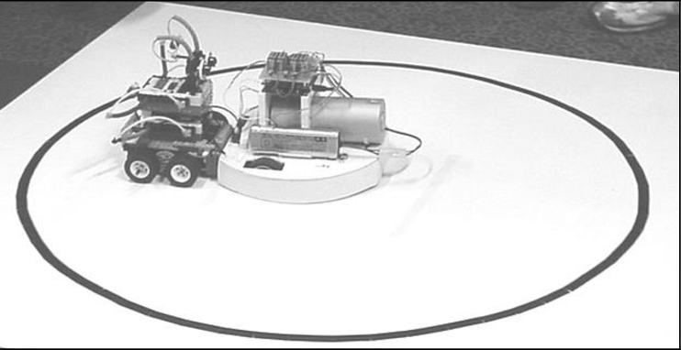
Sumo Robot Competition
The task of the mini sumo robot is to get your opponent out of the ring, following all the rules of politeness and competition. The challenge is open to all, regardless of technical level and age.
Sumo robot competitions have been prevalent in Japan, with the first competition being held in 1989 with only 33 robots, and its popularity has only been growing exponentially since its inception.

Slide 3
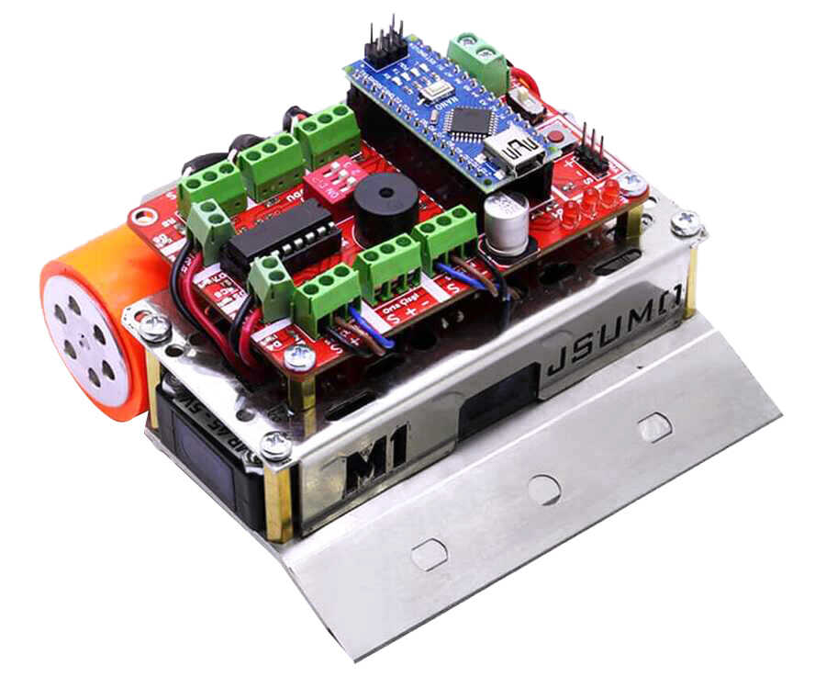
Our Set
We will use Genesis Mini Sumo Robot Kit for our project.
​
1x 7.4 V 2S Battery - 450mAh 25C​
1 x Arduino Nano Clone - with USB Cable - (USB Chip CH340)​
1 x Genesis Arduino Mini Sumo Card​
2 x 6V 400 Rpm Dc Motor​
2 x Plastic Micro Metal Motor Holder - White - PL-1086​
3 x MR45 Object Sensor​
2 x QTR1A Contrast Sensor​
1 x M1 Metal laser cutting body and standoffs​
1 x Plastic clamp and cables​
2 x SLT20 Silicone Wheel

Slide 4
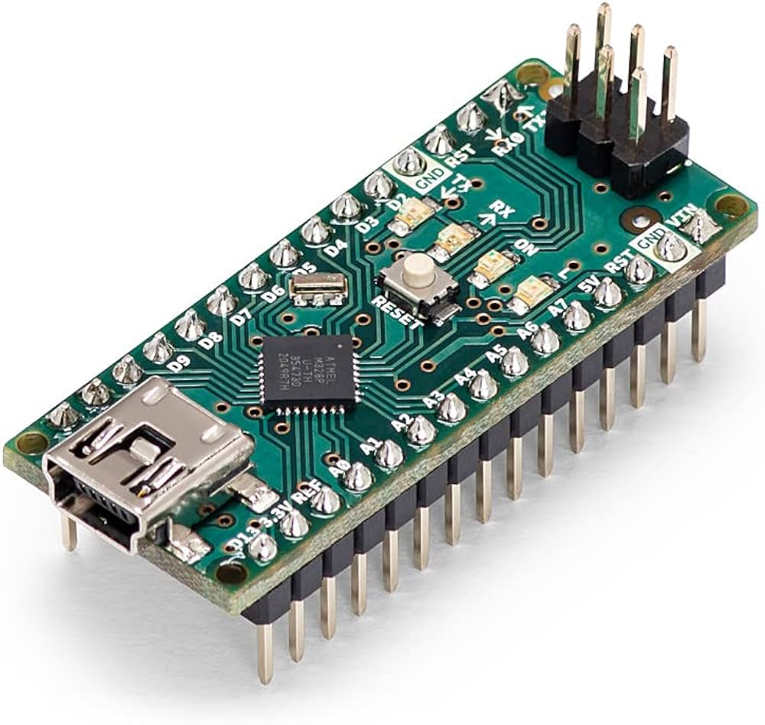
Let's Learn Our Components – I Arduino Nano
The Arduino Nano is an open-source breadboard-friendly microcontroller board based on the Microchip ATmega328P microcontroller (MCU).
It's a great Arduino board if you need to have something small yet useful.

Slide 5
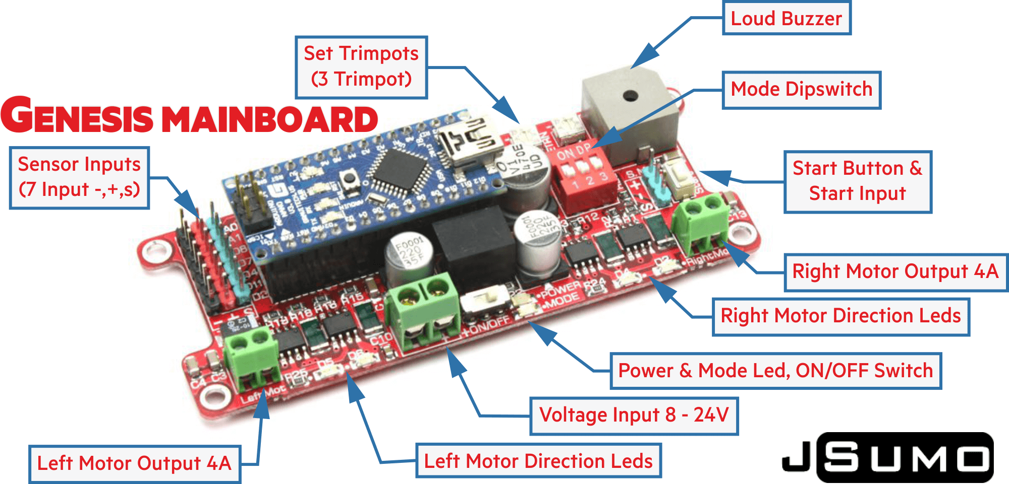
Let's Learn Our Components – II Genesis Arduino Mini Sumo Card
The Genesis Arduino Mini Sumo Card is a specialized microcontroller board designed for Mini Sumo robot competitions.
Built-in motor drivers to control the movement of the robot.
Easy to use and practical.

Slide 6
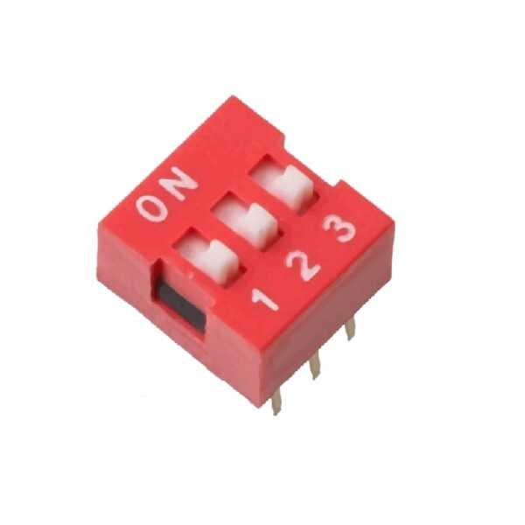
Let's Learn Our Components-III Dipswitch
It's a small mechanical component commonly used in electronics for setting various operational modes or configurations of a device.
Our Board has 3 modes. We use each mode for motor modes like going forward etc.
Total Combinations = 2^3 = 8.

Slide 7
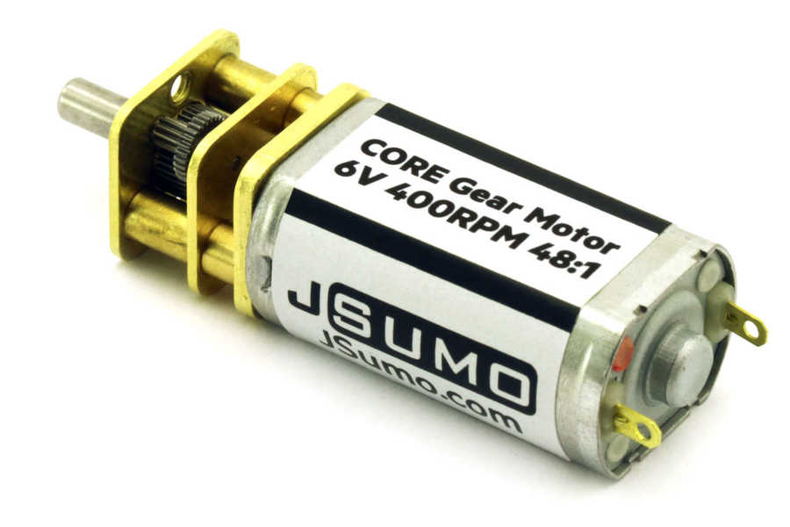
Let's Learn Our Components-IV DC Motor
A DC (Direct Current) motor is an electromechanical device that converts electrical energy into mechanical energy through the interaction of magnetic fields.
6V , 400 RPM (revolutions per minute)
We use 2 of those. (Left and Right)

Slide 8
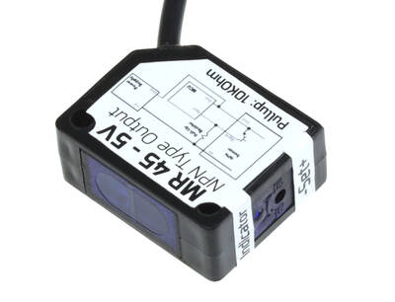
Let's Learn Our Components-V MR45 Object Sensor
The MR45 object sensor is a type of proximity sensor designed to detect the presence or absence of objects within its sensing range.
It emits infrared (IR) light towards the target object and then detects the reflected light.
The presence or absence of the reflected light is used to determine the presence or absence of an object.
We use 3 of these. (Left, Middle and Right)

Slide 9
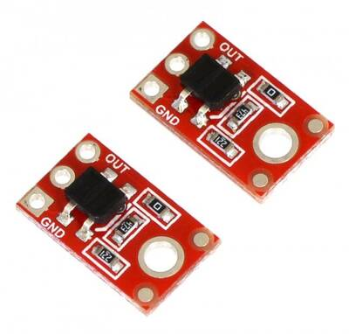
Let's Learn Our Components-VI QTR-1A Contrast Sensor
The QTR-1A is a contrast sensor module developed by Pololu, designed specifically for detecting changes in reflectance, primarily for line-following and edge-detection applications in robotics.
The QTR-1A module consists of an infrared (IR) emitter and a phototransistor detector positioned close to each other on the module.
We use 2 of these to detect if we are still in the area.

Slide 10
NOW LETS LOOK AT OUR CODE
For this I'll open up Notepadqq.

